Slide 1

Adam Gillfillan
Cal Supik
Randy Murdock

Slide 2
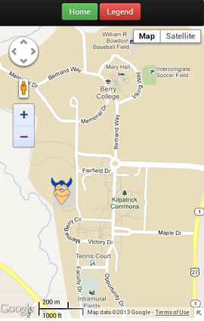
About
Berry Bus is an interactive bus tracking app that makes real-time campus bus information available online for Berry students. Berry buses are displayed on a detailed map, using the power of GPS and Google Maps.

Slide 3
Demo
https://webby.cs.berry.edu/berrybus

Slide 4
Implementation
Brainstorming
Why?
Software Requirements
What?
Software Design
How?
Development
Making it work
Making it pretty

Slide 5
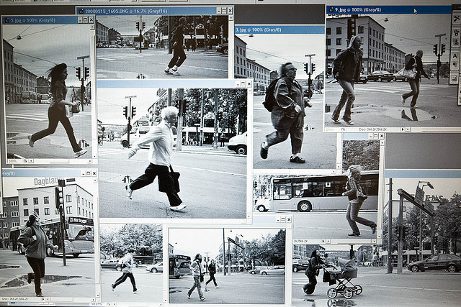
Brainstorming
Why Berry Bus?

Slide 6
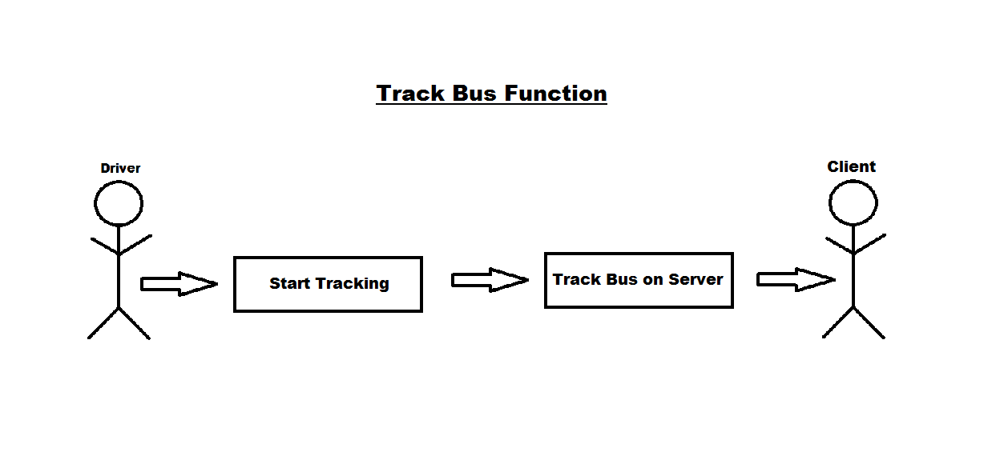
Software Requirements
What features do we want?
What features do we actually think we can complete on time?

Slide 7

Software Design
How are we actually going to make this work?

Slide 8






Making it work
A process of discovery…

Slide 9
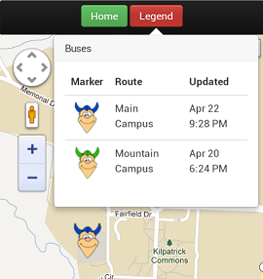

Making it pretty

Slide 10
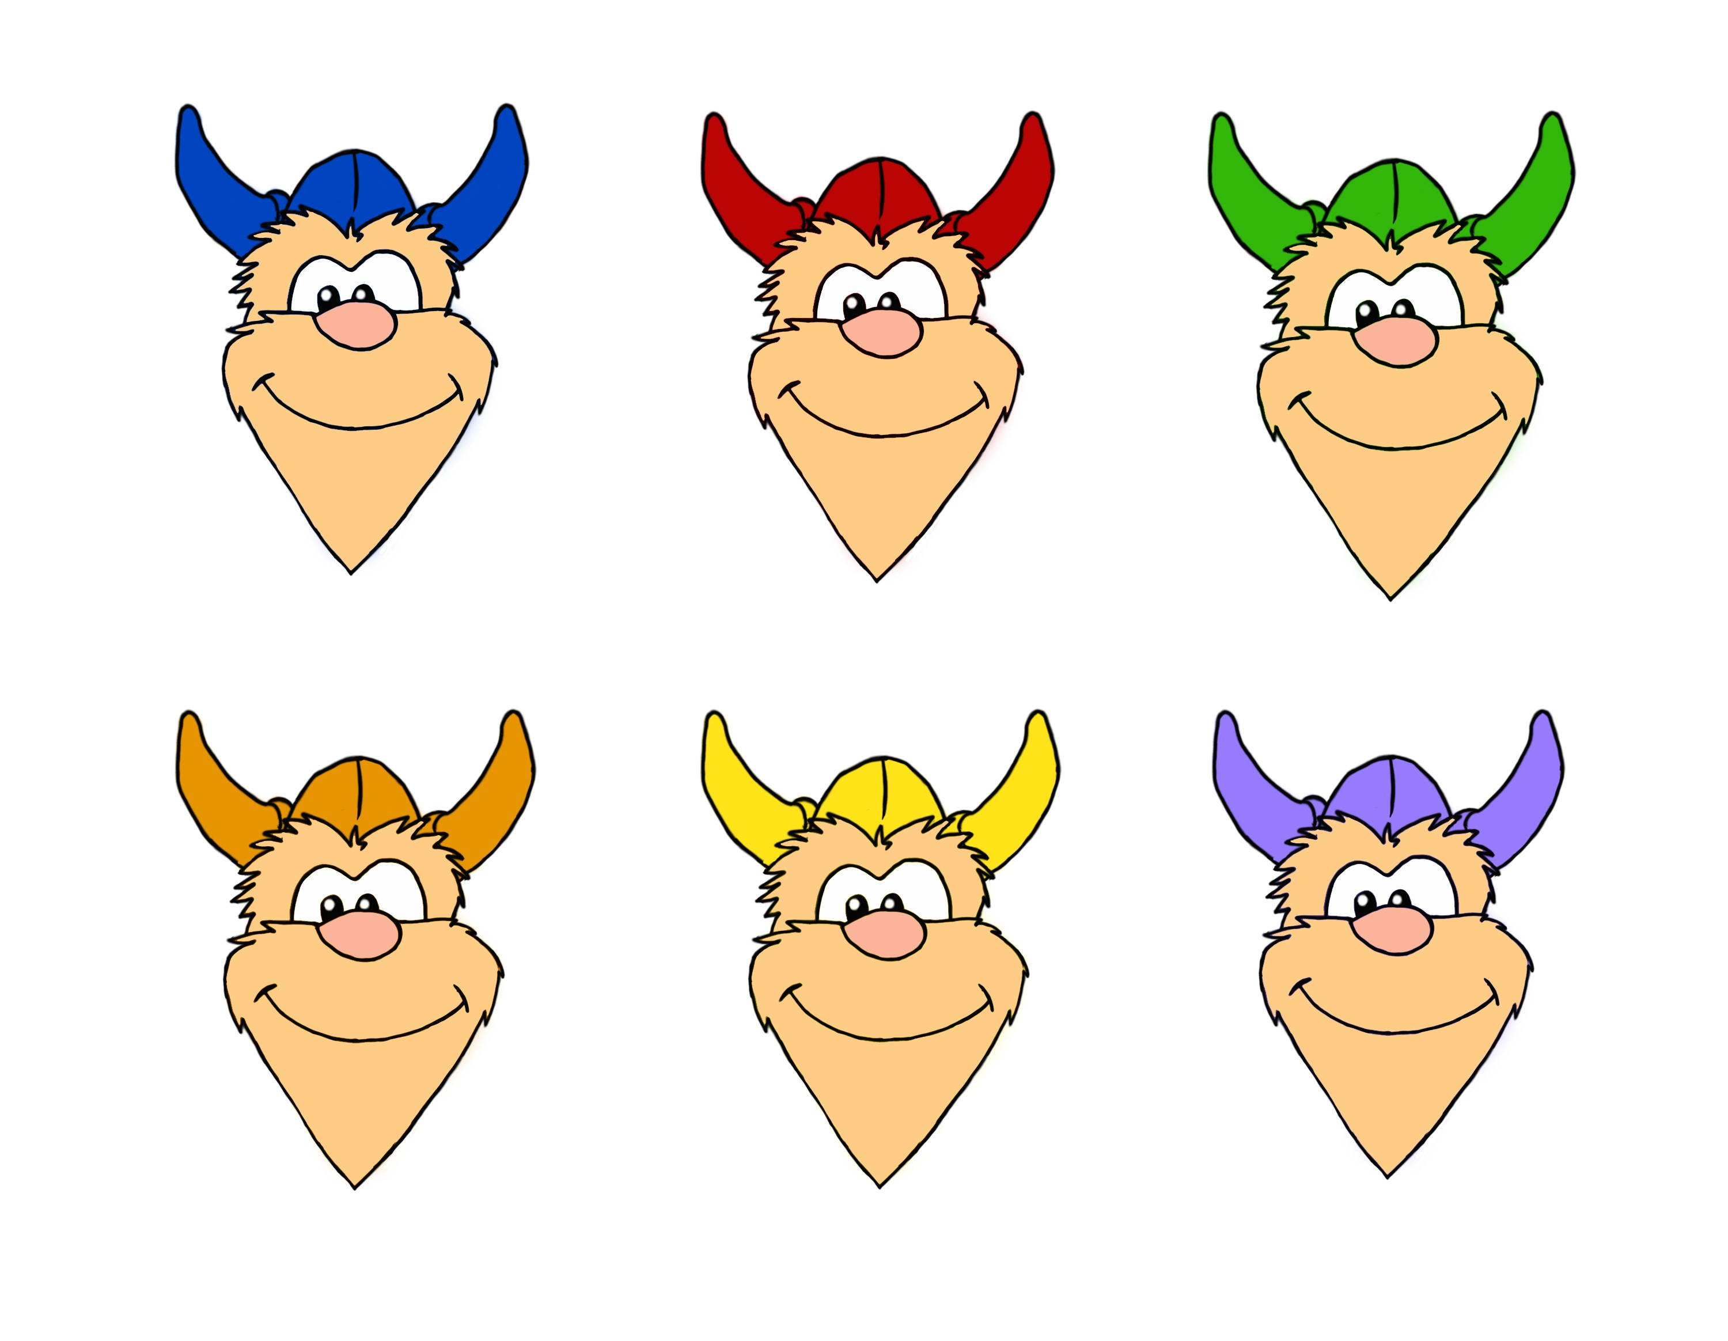
Making it pretty

Slide 11
Reflections
Shortcomings
“Pick Me Up!” Feature
Native App vs. Web App
Browser Issues
GPS Precision on Android
The Future of Berry Bus
Berry Bus at Berry College
Final Thoughts

Slide 12
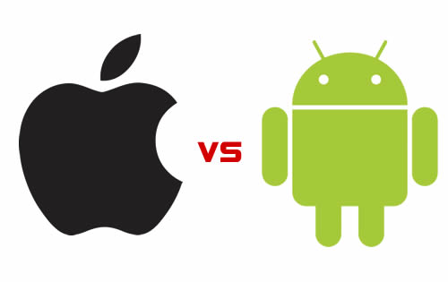
Shortcomings
“Pick Me Up!” Feature
Native App vs. Web App
Browser Issues
GPS precision on Android devices

Slide 13

The Future of Berry Bus
Berry Bus at Berry College

Slide 14
Final Thoughts
“Without reflection, we go blindly on our way, creating more unintended consequences, and failing to achieve anything useful.” –Margaret J. Wheatley

