Slide 1
Defend Math Land!
Adam Gillfillan

Slide 2
Purpose
Defend Math Land! takes place on an alien land under attack from enemies that can only be defeated by the player solving addition problems. 2nd graders achieve simple addition mastery by entering the solution to the addition problem attached to each enemy.

Slide 3
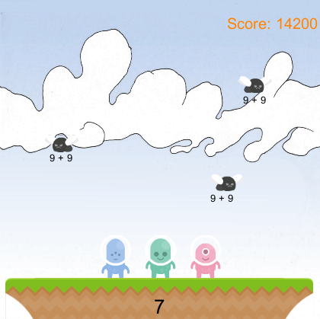

Slide 4
Release 1.0
Enemies
Display math problems (ex: 4 + 9)
Math Answer Entry
Ex: upon entering “13” + spacebar, enemy blows up
Scoring
+100 correct answer
+100 every 10 seconds
-100 incorrect answer
Student Model
Name
High Scores

Slide 5
Scenes
Menu Scene
Play
User authentication
“My Profile”
Show top 5 high scores
Play Scene
Summary Scene
Show summary of #correct, #incorrect, time elapsed
Show score

Slide 6
Release 2.0
Level Based System
Track completed levels in the student model
Add intelligent feedback in summary scene
Display the problems the player got incorrect
Quiz them
Show speedy addition tips

Slide 7
Difficulty Progression
Survival-based playing
Make enemies fall more quickly
Produce more enemies
Add length to math problems (ex: 4 + 8 + 12)
Make problems harder (32 + 79)
Use Student Model to select problems

