Slide 1
Infrared Spectroscopy
(and the Cassini Composite Infrared spectrometer)
  Adam Ginsburg
  September 25, 2007

Slide 2
Outline
  Infrared Spectroscopy:
  What is it, what science?
  Difficulties with observing in the IR
  Detectors
  Spectrometers
  Conceptual Question
  Cassini instrument comparison

Slide 3
Infrared: What wavelengths?
Notes:
Starts at ~1um, goes up to about 1mm
Split into near, mid, and far-ir regimes
VIMS near, CIRS far

Slide 4
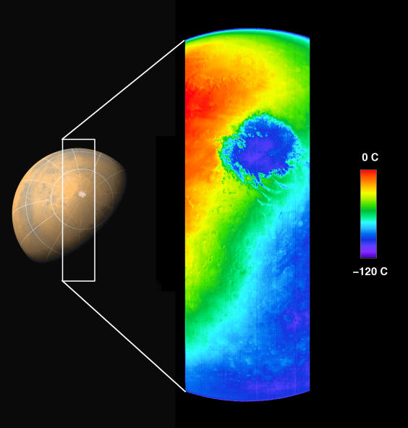
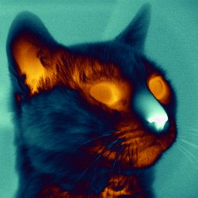
What can you see?
Thermal Infrared
Notes:
All infrared wavelengths see thermal infrared
300K blackbody peaks at about 10um
Planets reflect starlight in the visual, emit in thermal infrared
Mid- and Far-IR ideal for seeing cool planets' thermal emission

Slide 5
Near, Mid, Far
Blackbody emission throughout spectrum
Near-IR dominated by reflection and absorption
Notes:
Near-IR will show mostly absorption of solar radiation
Mid- and Far- will show cool blackbody emission
What might this look like for other planets?

Slide 6
Seeing deeper at longer wavelengths
Notes:
Visual wavelengths from surfaces
Near-IR also from surfaces, mostly (some windows)
Mid, far see through clouds
Can see chemical species, map out chemical distributions
-by altitude
-on a surface
This gives only gas planets – what might far-infrared and visual/near IR see on solid planets?

Slide 7
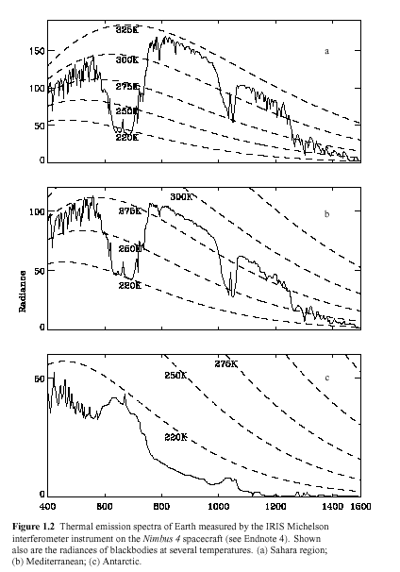
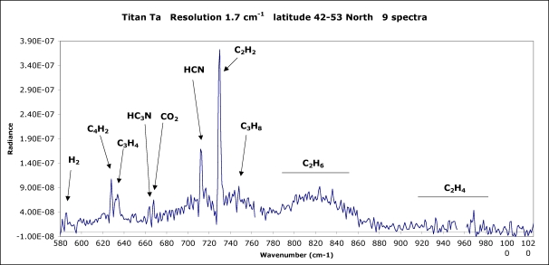
Infrared Spectra
Emission and absorption lines and bands
Notes:
A lot of molecular bands emit in the infrared
Low wavenumber = long wavelength, water is far in the infrared (39.5 microns)
Many hydrocarbons observed in Titan's atmosphere in mid-IR
(next slide - how)

Slide 8
Infrared Mechanisms
Annoying animations give an idea of the types of molecular transitions that can occur
Notes:
stretching (symm, asymm)
“scissoring”
“rocking”
“wagging”
“twisting”
+ rotational
Different bonds occur in diff parts of spectrum
What difference b/w molecular and atomic? What sort of molecular emission in UV, IR?

Slide 9
Science in the Infrared
Mid-High resolution spectra show emission and absorption features, i.e. atmospheric chemical content
Low-resolution spectral energy distributions give temperature measurements
Near-IR observations can penetrate reflective atmospheres for mapping

Slide 10
Dealing with Infrared
Longer wavelengths
Atmospheric emission and absorption
Instrument emission

Slide 11
Dealing with Infrared
Longer wavelengths
  Lower resolution for a given aperture
Atmospheric emission and absorption
Instrument emission

Slide 12
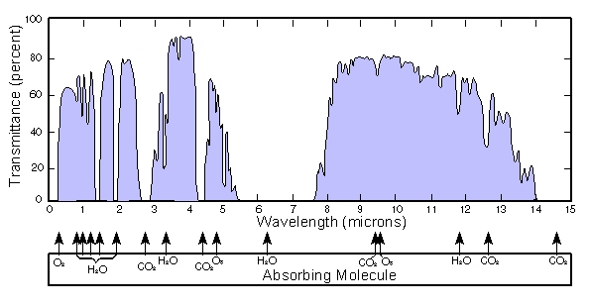
Dealing with Infrared
Longer wavelengths
  Lower resolution for a given aperture
Atmospheric emission and absorption
  Difficult or impossible from Earth
Instrument emission
Notes:
Where else might an absorption/transmittance spectrum like this be useful? VIMS observation of Titan's surface has to see though atmosphere

Slide 13
Dealing with Infrared
Longer wavelengths
  Lower resolution for a given aperture
Atmospheric emission
  Difficult or impossible from Earth
Instrument emission
  Must cool the whole box

Slide 14
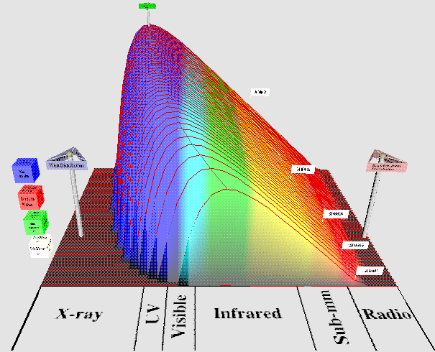
Dealing with Infrared
Instrument emission
  Must cool the whole box
Notes:
Cooler objects move peak to longer wavelengths
for a given object, if it's warmer, it emits more at all wavelengths

Slide 15
IR Detectors
Will discuss 2 types:
  Solid State
  Thermopile
There are others, don't worry about them:
  Bolometer
  Heterodyne

Slide 16
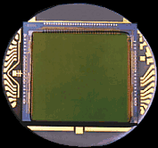
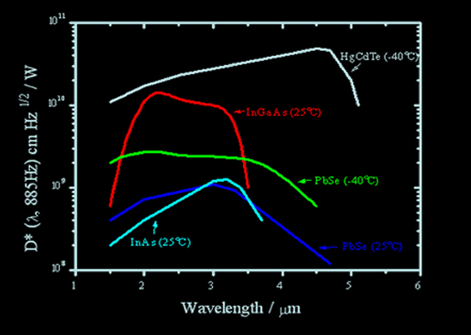
Solid State Infrared Detectors
Notes:
Near-IR uses solid state: CCDs or similar
HgCdTe on CIRS
Indium Antimonide InSb on VIMS

Slide 17
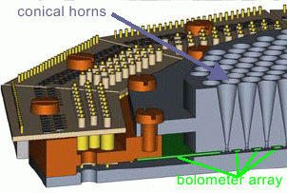
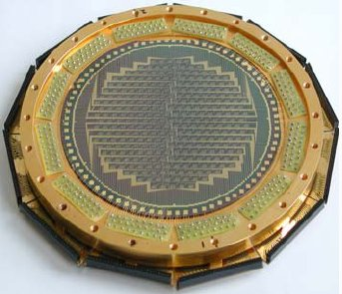
Bolometers
Absorb photons, thermometers measure temperature
Broadband sensitivity
Notes:
broadband sensitivity
~most sensitive at far-IR
relatively new technology, first and second generation ground instruments still delivering brand new results

Slide 18
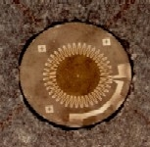
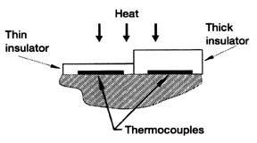
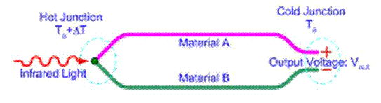
Thermopiles
Collection of thermocouples sensitive to temperature change
Consistent response with wavelength
Notes:
good response out to long wl
different materials with diff thermal conductivity => current
absorbed photons heat up material
well-tested: used on Voyager IRIS

Slide 19
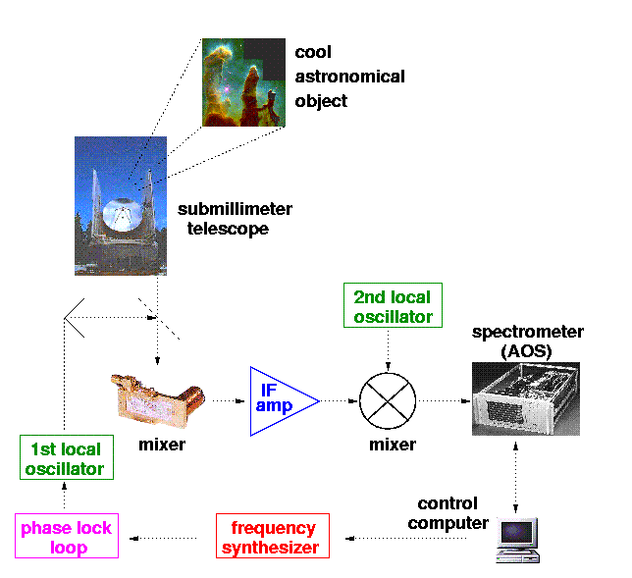
Heterodyne Detectors

Slide 20
Types of Spectrographs
Grating spectrographs (Ben covered these)
Fourier Transform spectrographs
  Michelson Interferometer
    wavelength changes over time
  Fabry-Perot Interferometer / Etalon
    Multiple internal reflections -> very sharp fringes
Heterodyne Detectors
  Highest resolution
  Difficult to make local oscillators in IR

Slide 21
Types of Spectrographs
Grating spectrographs (Ben covered these)
Fourier Transform spectrographs
  Michelson Interferometer
Fabry-Perot Interferometer / Etalon
Heterodyne Detectors
Notes:
Grating spectrographs disperse reflected light
-at far-ir, must be large b/c separation b/w wls is large
-difficult to get broad range of wls
FT like Michelson change wls with time
-move the mirror
-reference interferometer to find fringes, measure wl
FP very high res, useful for atmospheric sounding but not good exploratory instrument
Heterodyne mostly reserve for ground-based, i.e. radio

Slide 22
Diffraction Grating

Slide 23

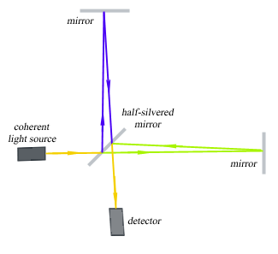
Michelson Interferometer
Broad spectral range with range of resolutions
Notes:
No intrinsic limit to spectral range
Measure constructive interference
can choose variety of resolutions
use reference interferometer to tune, calibrate
easier to build with broad wl range than FP?

Slide 24
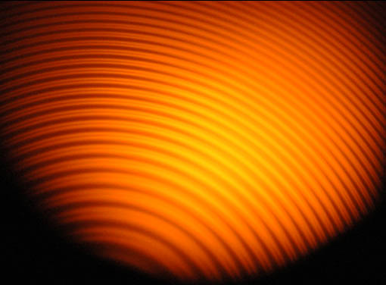
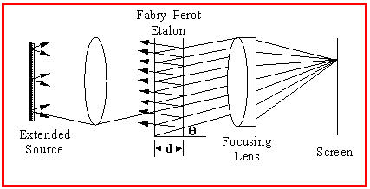
Fabry-Perot Etalon
Very high resolving power ~30000
Most useful for
narrow-band
spectroscopy

Slide 25
Conceptual Challenge
What instrument would you use to determine atmospheric compositions of Earth? Venus? Mercury?
Mapping?
Things to consider:
  Atmosphere type
  Temperature of planet
  What else?

Slide 26
Conceptual Challenge
2 thermopile detectors for long wavelengths
2 solid-state HgCdTe detectors for short wavelengths
Budget cuts mean you have to lose one

Slide 27
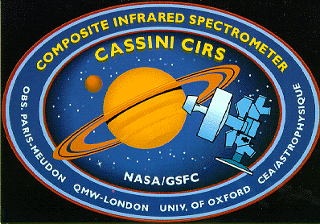
Cassini CIRS
Notes:
CIRS flew on Cassini!
Previous diagram was of CIRS, and FP 2, the second long-wavelength focal plane, was cut

Slide 28
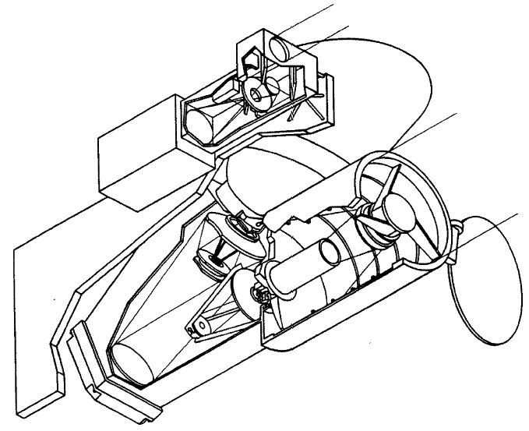
The Instruments
CIRS: Beamsplitter
Two interferometers
1 point-like FP
2 linear array FPs
VIMS: Two-telescope (f/3.2, 23cm f/3.5)
Two Grating Spectrometers
Visual CCD
256 elements linear array IR

Slide 29
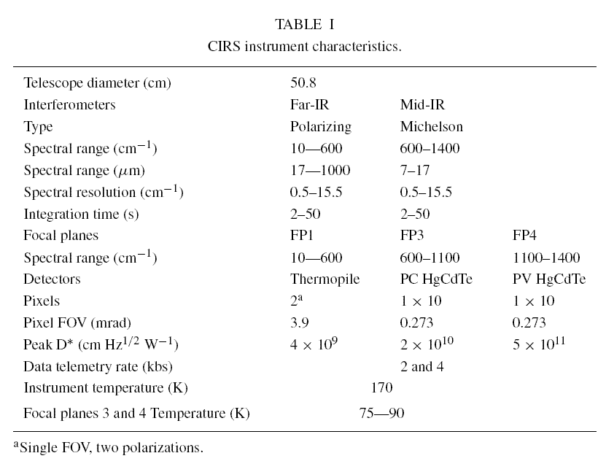
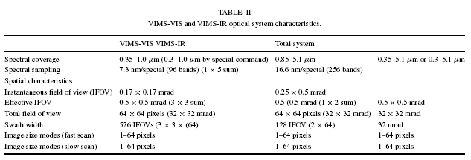
CIRS and VIMS Specs
Notes:
Polarization modulation?
low res at short wl is .42um, at long is 600um
hires at short wl is .014um, long 48um
FOV long ~13 arcminutes
FOV short ~1 arcmin

Slide 30
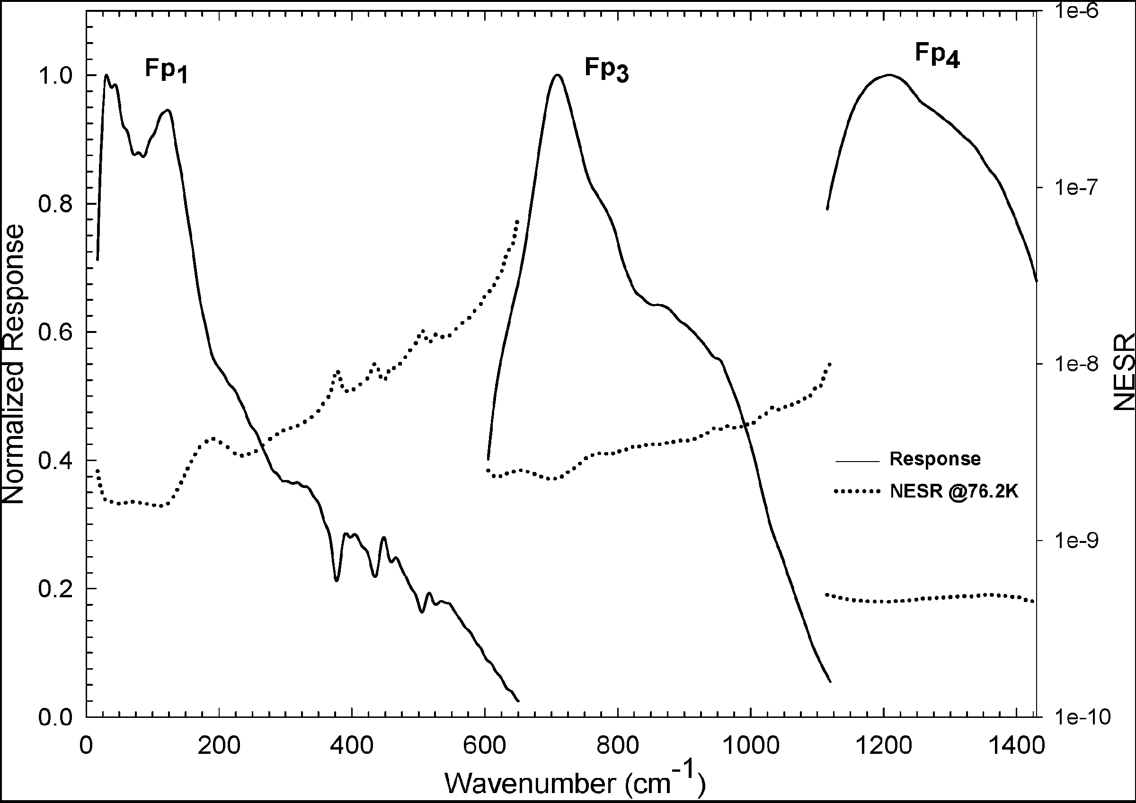
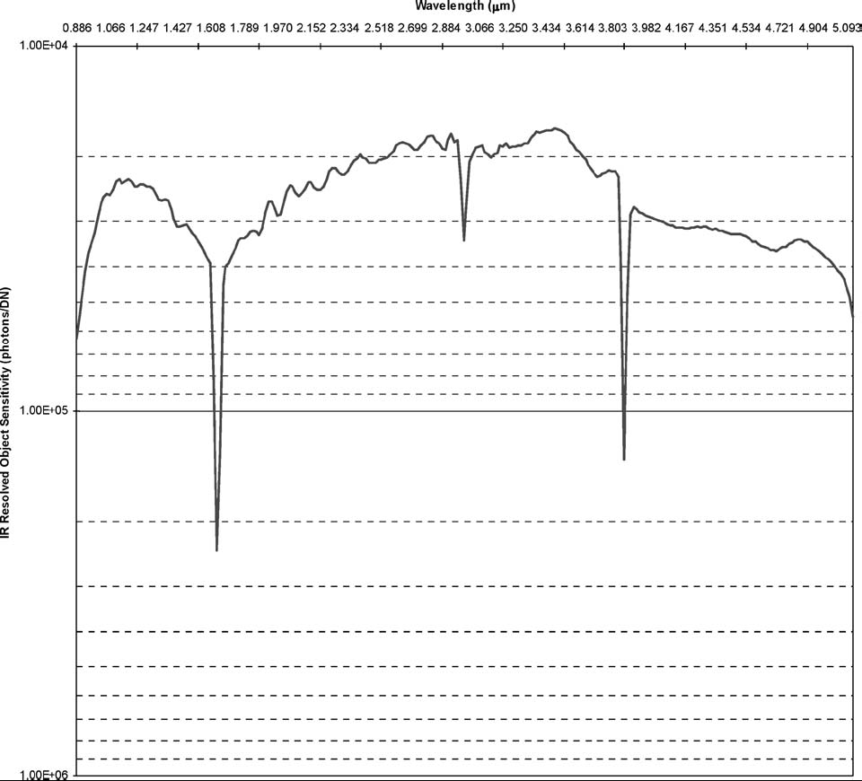
Spectral Response Comparison
CIRS:
FP1: Thermopile
FP3: Photovoltaic HgCdTe
FP4: Photoconductive HgCdTe
VIMS:
InSb array
Notes:
dotted lines are noise level
FP2 would have been nice to fill in sensitivity gap
FP1 important: fills in 10-180 cm^-1 range not covered by IRIS on Voyager (56um-1mm)
-deeper atmos measurements
-thermal measurements of icy objects

Slide 31
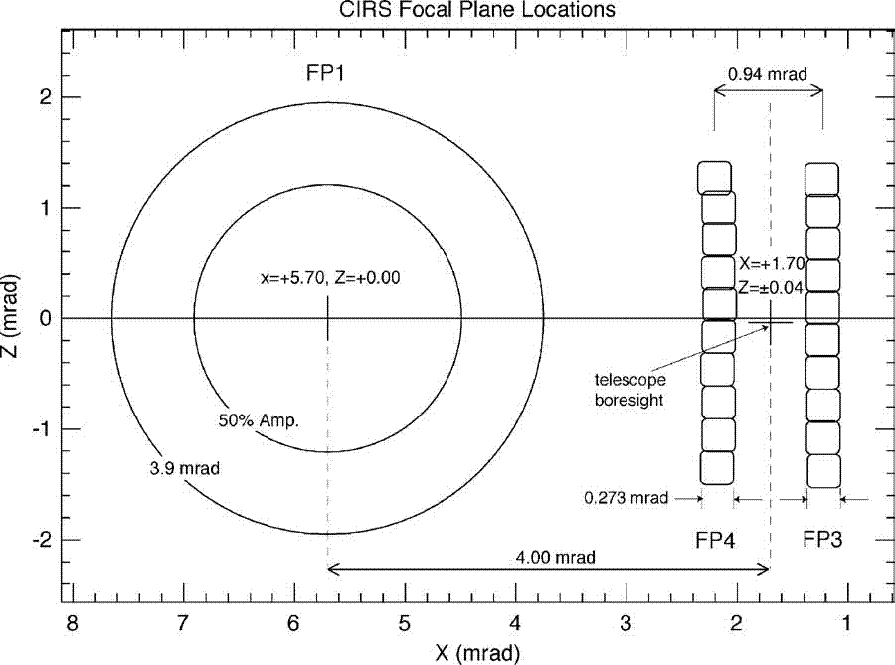
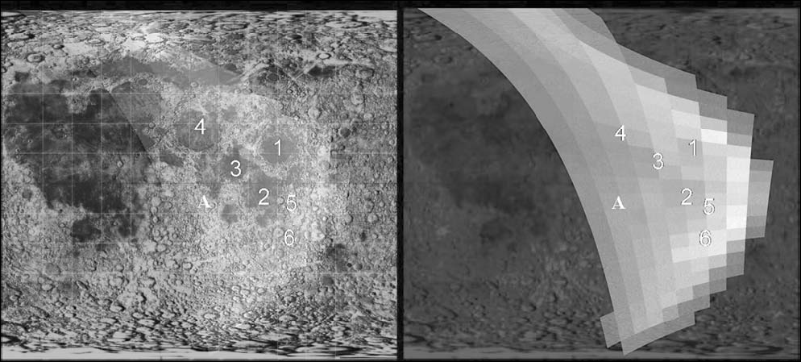
Fields of View
Notes:
single pixel field in fir
fp3 and 4 can only use 5 of 10 elements at once
resolution is better than one scale height for titan and saturn

Slide 32
CIRS pointing, VIMS mapping
CIRS: Atmospheric Composition
Temperature Distribution
VIMS: Surface composition
Surface features
Notes:
nadir hi-res: gas composition, isotopic ratios
nadir lo-res: temperature map, aerosols
limb hi-res: distinguish vapor, condensed. Vertical profile of trace constituents
limb lo-res: vertical temp profile, aerosols, abundant species
nadir stare: composition
nadir lo-res stare: whole disk temperature, thermal inertia
lo-res icy satellite: thermal probing with FIR, hi-res surface temp mapping, eclipse heating/cooling to measure thermal inertia
ring scans determine composition, radial profile, temperature, opacity

Slide 33
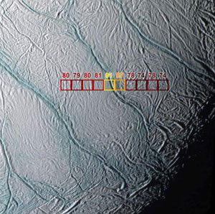
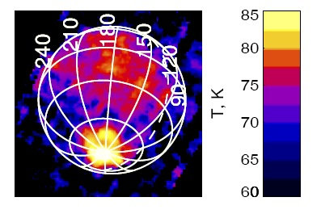
Science Results: Enceladus
Warm emissions around ice cracks
http://cdsads.u-strasbg.fr/abs/2005AGUFM.P32A..04S
Notes:
Average temperature 73k -> ~40um BB peak
Very cold, but FP3 & 4 can still be used for temperature mapping
Poles warmer (85K) than sunlit equatorial (75-80K)
some small areas as hot as 125K
http://cdsads.u-strasbg.fr/abs/2005AGUFM.P32A..04S

Slide 34
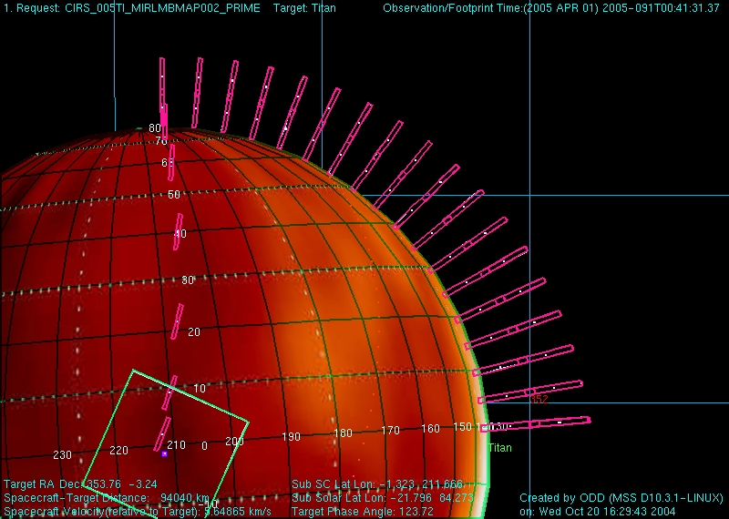
Science Results: Titan
Notes:
rotational and vibrational-rotational lines
monodeuterated methane detected
image shows pointing / FOV of CIRS

Slide 35
Why CIRS?
Notes:
nearly all significant species in mid-IR

Slide 36
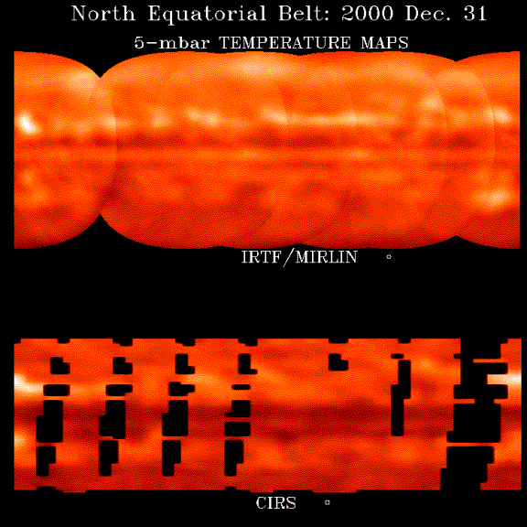
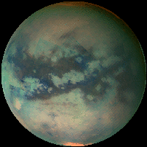
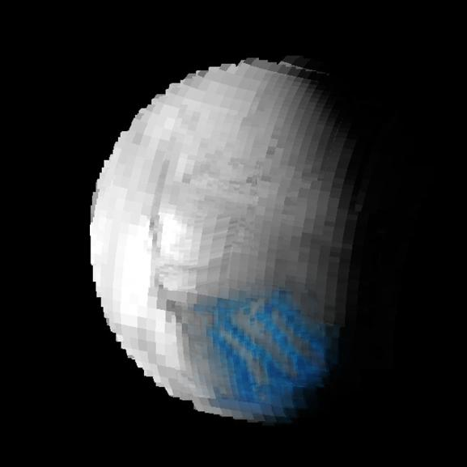
CIRS vs VIMS mapping
Notes:
VIMS images of Enceladus and Titan
higher resolution
good for false-color
less information about chemical species

Slide 37
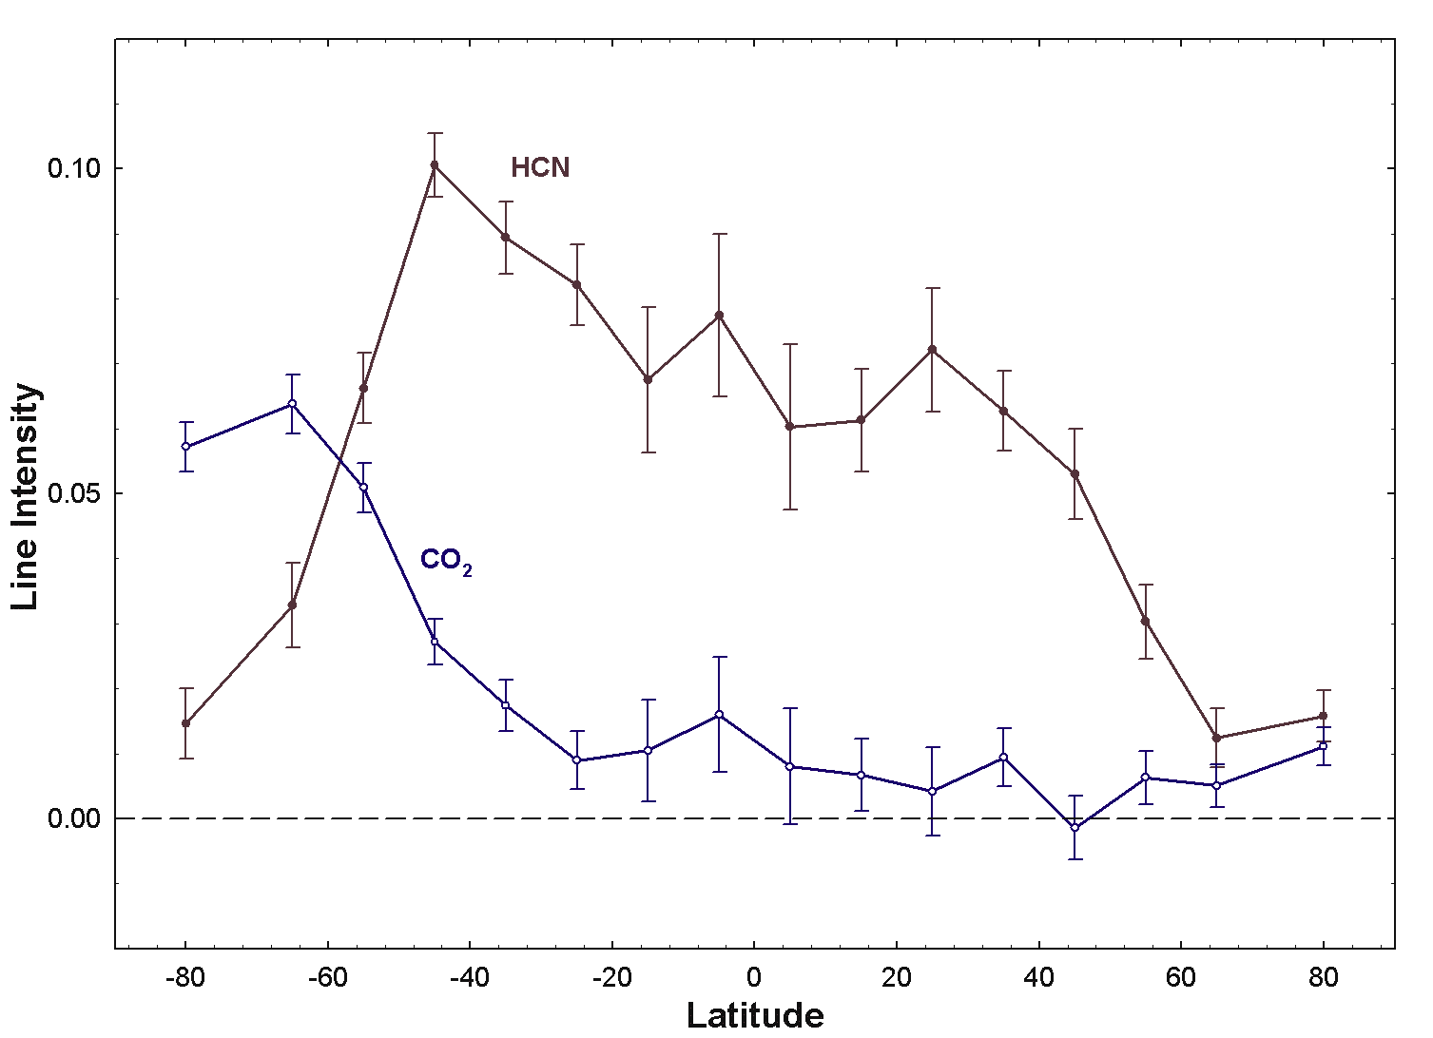
Science Results: Jupiter
Notes:
temperature map of jupiter

Slide 38
References
http://cirs.gsfc.nasa.gov/
http://saturn.jpl.nasa.gov/spacecraft/inst-cassini-cirs-details.cfm
http://www.iop.org/EJ/abstract/0143-0807/27/5/010 - Fabry Perot interferometers described
http://cdsads.u-strasbg.fr/cgi-bin/nph-iarticle_query?1995ESASP.374..385M&amp;data_type=PDF_HIGH&amp;whole_paper=YES&amp;type=PRINTER&amp;filetype=.pdf
http://cdsads.u-strasbg.fr/abs/1995ESASP.374..385M
http://www.boulder.swri.edu/recent/enceladus_geological_activity/
http://irtfweb.ifa.hawaii.edu/research/science/03.Orton.Cassini_CIRS.html (Cassini Jupiter Temperature Mapping)
http://www.obspm.fr/actual/nouvelle/sep04/jupiter.en.shtml (Jupiter CO/HCN vs latitude)
http://cassini-huygens.jpl.nasa.gov/cgibin/gs2.cgi?path=../multimedia/images/jupiter-flyby/images/cirs010123b.jpg&type=image (field of view for Jupiter flyby)
http://cassini-huygens.jpl.nasa.gov/cgibin/gs2.cgi?path=../multimedia/images/jupiter-flyby/images/cirs010123a.jpg&type=image (spectrum from jupiter flyby)
http://www.astro.umd.edu/~nixon/research.html (Titan spectrum)
http://www.astro.umd.edu/~nixon/mission.html (Titan pointings, Cassini must be pointed as a whole)
http://www.californiasciencecenter.org/Exhibits/AirAndSpace/MissionToThePlanets/Cassini/CassiniUpdates/Archive/Cscience.php (saturn temperature mapping)
http://adsabs.harvard.edu/abs/2004SSRv..115..169F
http://en.wikipedia.org/wiki/Michelson_interferometer
http://cdsads.u-strasbg.fr/abs/2005AGUFM.P32A..04S

