Slide 1
A closer look into NY parking violations
Cody Hegwer, Jeff LaPrade, Adam Grabowski

Slide 2
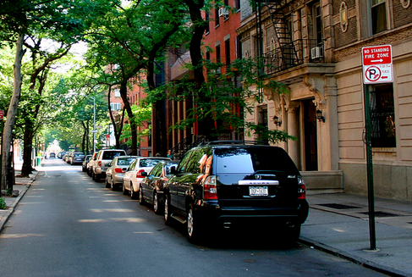
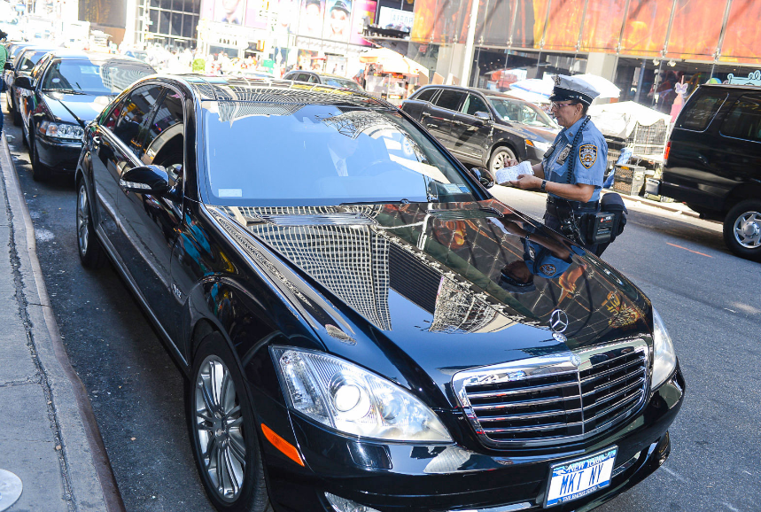
Description
For our semester project, we intend to analyze data regarding parking violations in New York City. Along the way we may discover other interesting questions we wish to answer, but our initial interest will be in questions such as: “If I wish to traverse the city of New York and never pay for parking, can I identify a route to take that minimizes my chance of receiving a ticket?” or “Is there a profile we can establish from the data to predict what cars will receive tickets?”.

Slide 3
Prior Work
After choosing our data set, we identified several examples of other students performing similar data mining projects concerning both NY parking violations, and parking violations in other cities. It actually was a more popular research topic than we anticipated, but the other student projects were asking different questions that what will be exploring.
An example of a professional inquiry done by a college professor: http://iquantny.tumblr.com/post/83696310037/meet-the-fire-hydrant-that-unfairly-nets-nyc
Another example of a professional inquiry done by a data analyst: https://www.linkedin.com/pulse/toronto-parking-ticket-data-analysis-angela-ju/

Slide 4
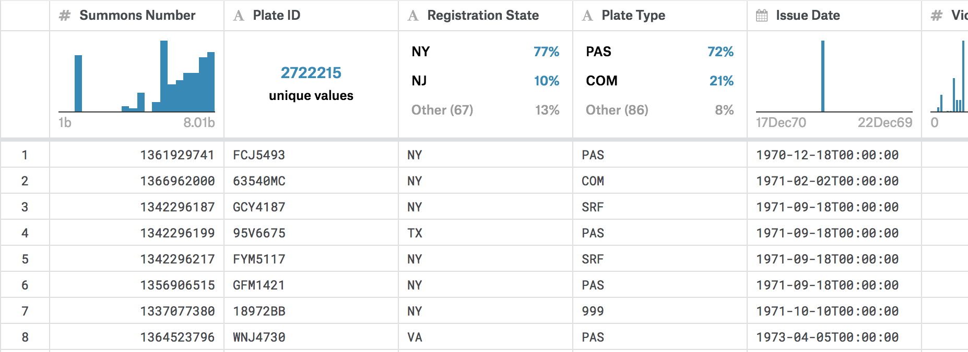
Datasets
Currently held on Adam’s desktop computer.
Source: https://www.kaggle.com/new-york-city/ny-parking-violations-issued
43 attribute types
9.10 million objects
Contains data ranging from years 1970 all the way to 2014.

Slide 5
Proposed Work
Items to be Cleaned:
The data appears fairly clean so far. The only cleaning we have currently identified that will be necessary is dealing with missing values. Since there is only a very small number of missing values, we currently plan to simply exclude those rows as it will hardly reduce the number of available entries.
Data Preprocessing:
Most of the data is already complete and in an ideal format. However, some attributes are irregular formats and will need to be transformed. The only attributes we have identified as of now that require transformation are the various Date and/or Time attributes.

Slide 6
Tools
Tableau
Python
Pandas
Matplotlib

Slide 7
Evaluation
In our evaluation of the data, we will be primarily concerned with the metrics: accuracy, error rate, and precision.
Due to the nature of our questions, the main events we wish to predict are future events that, for the sake of this study, we would not have access to. Therefore, the precision of our classification will be more readily evaluated since we may predominantly be testing on data already in our dataset as opposed to new, more recent data.

