Slide 1
Social Network effects In online platforms The case of Steam® Chat

Slide 2
framework
1 Introduction
2 Motivation
3 Setting
4 Descriptive Evidence
5 Model

Slide 3
1 Introduction Network effects

Slide 4
Definition: A product is said to exhibit network effects if each user’s utility is increasing in the number of other users of that product or products compatible with it.
Direct network effects: other people when other people in the network allow the consumer to communicate with them.
Indirect network effect: more consumers of a good mean there will be more support and applications for consumers on that platform.
Platforms can use network effects to reduce competition
Increasing barriers to entry & Vertical integration.

Slide 5
What is Steam?

Slide 6
What is steam?
Royalty fee of 30% of game price
Digital store for games and downloadable content only.
Launched in 2003, by 2013 controlled 75% of PC games market, and with 4.3bn US$ revenue in 2017.
On 12/2018 Epic Games launches, with a royalty fee of only 12% of game price.
Notes:
Reference for Epic CEO declarations: https://www.pcgamesn.com/steam-revenue-cut-tim-sweeney

Slide 7
Steam chat launches on 07/2018
More integrated social features:
Group chat, group voice chat
Support for videos, pictures and tweets in conversations
Friendlier user interface for streaming and managing friends
On top of other existing social features as: friends, broadcast, workshop.
Features are identical as those offered by other PC programs (e.g., Discord).

Slide 8
2 motivation

Slide 9
Motivation
Steam’s Market Power
Consumer Welfare
We try to analyze how the introduction of steam chat (direct network effect) in 2018 influenced steam’s market power and if it pre-vented harsh competition when Epic Games entered the market.
We also want to study if the direct network effects on consumer welfare offset the effects on market po-wer held by Steam.

Slide 10
2 setting

Slide 11
How does the platform work?
Business Model
Before buying a game, user can see:
100% digital goods (no deliveries).
A la carte sales model
Buy a game
Library of games
Download
Before buying a game, user can see:
Steam friends who own or want to have it.
Features: e.g., multiplayer, genre, pictures, trailers, system requirements.
Access social features while in game using steam overlay: chats, game invitations, streaming management.

Slide 12
3 descriptive evidence

Slide 13
Descriptive evidence
Tudon (2022)
Summary Statistics in 2013
A 1% increase in friends’ demands increases demand by 0.13%.
He models social interaction as in Becker (1991).
45% of active users have no friends but have games.
Active users have on average 7 friends and 13 games.
Distribution has a long right tail.
24% of the games have a multiplayer mode.
Users lean toward pricier and higher-rated games.

Slide 14
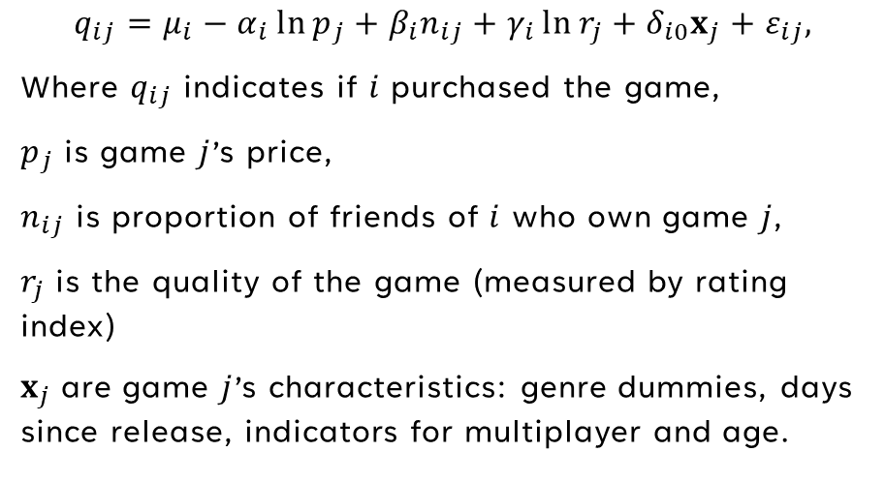
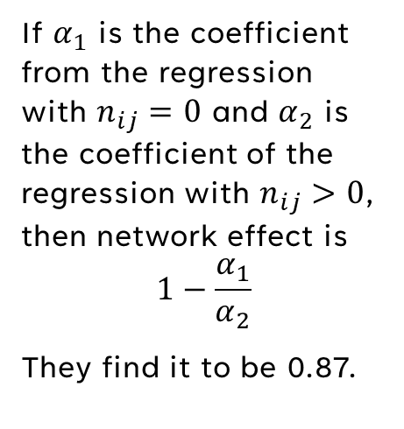
Reduced form evidence Model of social interaction as in Becker (1991)
Tudon (2022) fits linear regression
Network Effect:
$$q_{ij}=μ_{i}−α_{i}\ln{p_{j}}+β_{i}n_{ij}+γ_{i}\ln{r_{j}}+δ_{i0}x_{j}+ε_{ij},$$
Where $q_{ij}$ indicates if $i$ purchased the game,
$p_{j}$ is game $j$’s price,
$n_{ij}$ is proportion of friends of $i$ who own game $j$,
$r_{j}$ is the quality of the game (measured by rating index)
$x_{j}$ are game $j$’s characteristics: genre dummies, days since release, indicators for multiplayer and age.
If $α_{1}$ is the coefficient from the regression with $n_{ij}=0$ and $α_{2}$ is the coefficient of the regression with $n_{ij}>0$, then network effect is
$$1−\frac{α_{1}}{α_{2}}$$
They find it to be 0.87.

Slide 15
4 Model Lu and LaRiviere (2024)
Two-step decision process:
What game to buy.
How many hours to play each game in library.

Slide 16
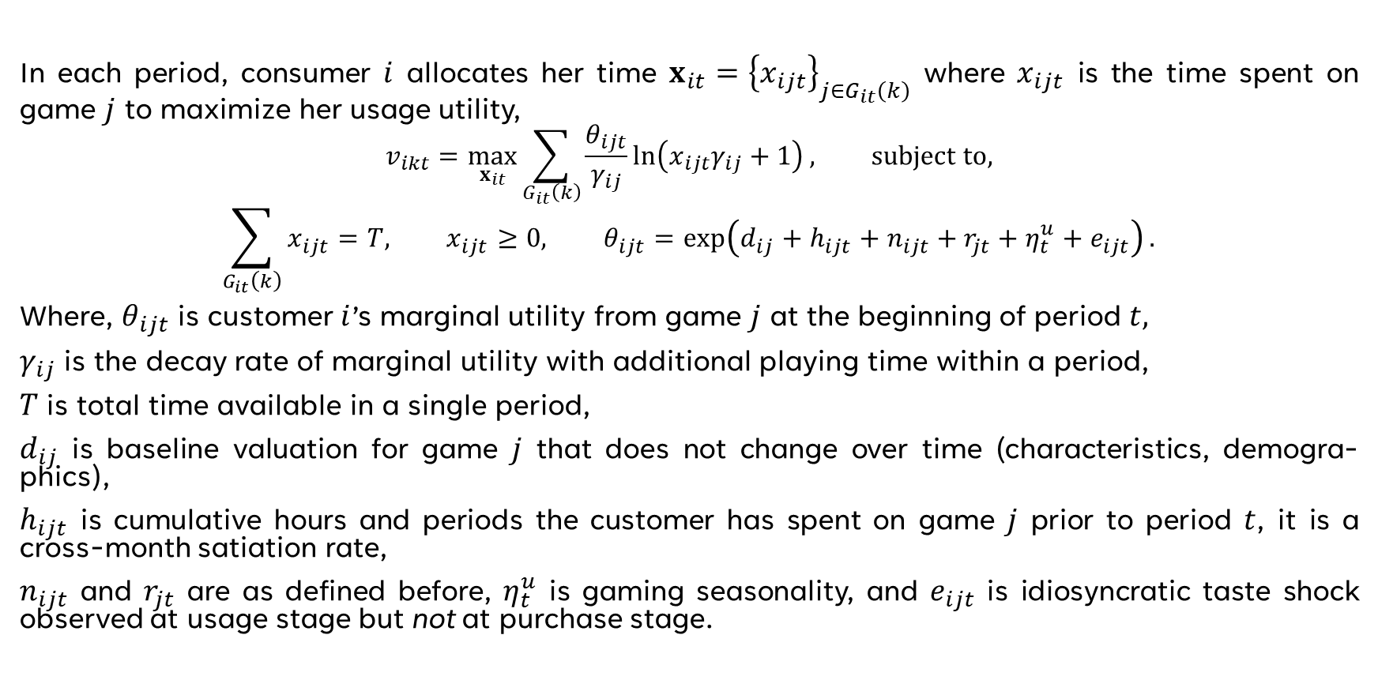
Second stage Intensity Use Model (Crawford et al.(2018))
In each period, consumer $i$ allocates her time $x_{it}={\left\{x_{ijt}\right\}}_{j∈G_{it}\left(k\right)}$ where $x_{ijt}$ is the time spent on game $j$ to maximize her usage utility,
$$v_{ikt}=\max_{x_{it}}{\sum_{G_{it}\left(k\right)}{\frac{θ_{ijt}}{γ_{ij}}\ln\left(x_{ijt}γ_{ij}+1\right)}}, subject to,$$
$$\sum_{G_{it}\left(k\right)}{x_{ijt}}=T, x_{ijt}≥0, θ_{ijt}=\exp\left(d_{ij}+h_{ijt}+n_{ijt}+r_{jt}+η_{t}^{u}+e_{ijt}\right).$$
Where, $θ_{ijt}$ is customer $i$’s marginal utility from game $j$ at the beginning of period $t,$
$γ_{ij}$ is the decay rate of marginal utility with additional playing time within a period,
$T$ is total time available in a single period,
$d_{ij}$ is baseline valuation for game $j$ that does not change over time (characteristics, demogra-phics),
$h_{ijt}$ is cumulative hours and periods the customer has spent on game $j$ prior to period $t$, it is a cross-month satiation rate,
$n_{ijt}$ and $r_{jt}$ are as defined before, $η_{t}^{u}$ is gaming seasonality, and $e_{ijt}$ is idiosyncratic taste shock observed at usage stage but not at purchase stage.

Slide 17
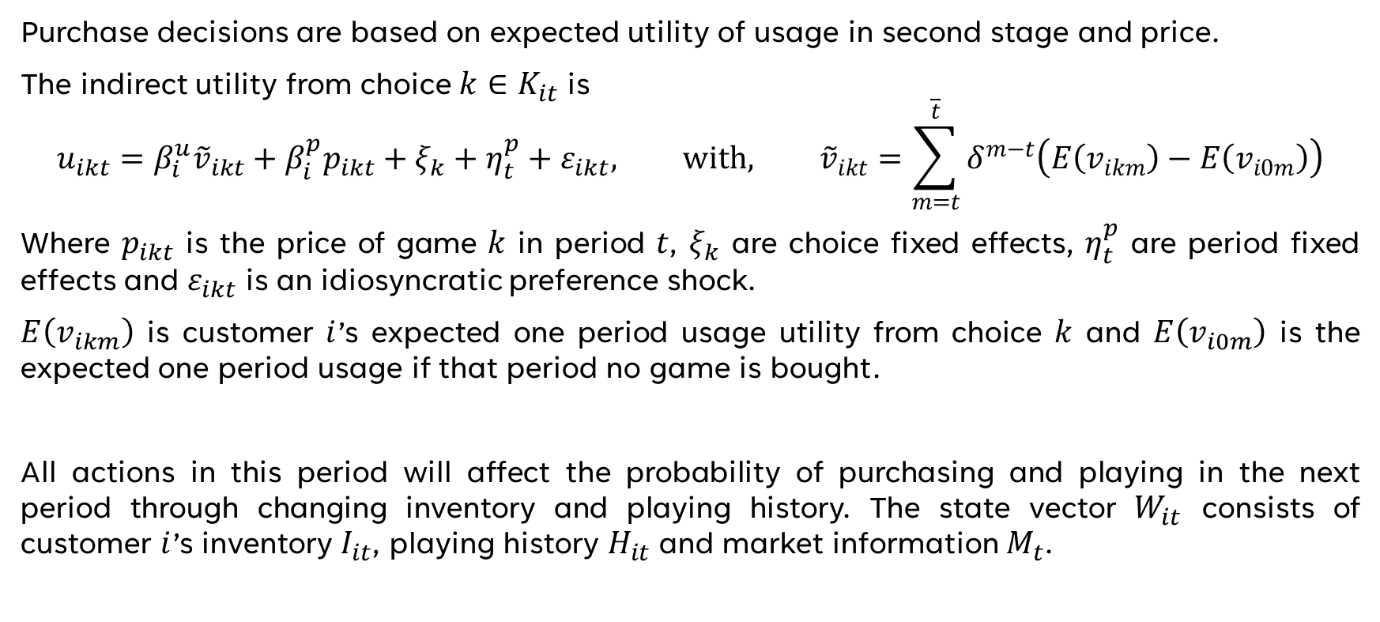
First stage Purchase Decision
Purchase decisions are based on expected utility of usage in second stage and price.
The indirect utility from choice $k∈K_{it}$ is
$$u_{ikt}=β_{i}^{u}{\tilde{v}}_{ikt}+β_{i}^{p}p_{ikt}+ξ_{k}+η_{t}^{p}+ε_{ikt}, with, {\tilde{v}}_{ikt}=\sum_{m=t}^{\overline{t}}{δ^{m−t}\left(E\left(v_{ikm}\right)−E\left(v_{i0m}\right)\right)}$$
Where $p_{ikt}$ is the price of game $k$ in period $t$, $ξ_{k}$ are choice fixed effects, $η_{t}^{p}$ are period fixed effects and $ε_{ikt}$ is an idiosyncratic preference shock.
$E\left(v_{ikm}\right)$ is customer $i$’s expected one period usage utility from choice $k$ and $E\left(v_{i0m}\right)$ is the expected one period usage if that period no game is bought.
All actions in this period will affect the probability of purchasing and playing in the next period through changing inventory and playing history. The state vector $W_{it}$ consists of customer $i$’s inventory $I_{it}$, playing history $H_{it}$ and market information $M_{t}$.

Slide 18
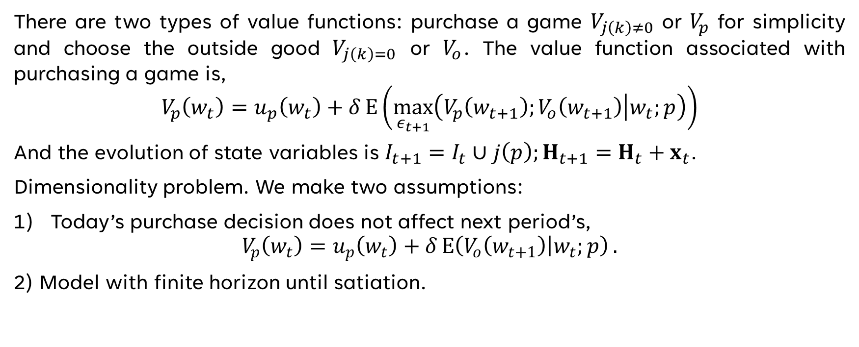
First stage Purchase Decision
There are two types of value functions: purchase a game $V_{j\left(k\right)≠0}$ or $V_{p}$ for simplicity and choose the outside good $V_{j\left(k\right)=0}$ or $V_{o}$. The value function associated with purchasing a game is,
$$V_{p}\left(w_{t}\right)=u_{p}\left(w_{t}\right)+δE\left(\max_{ε_{t+1}}\left(V_{p}\left(w_{t+1}\right);V_{o}\left(w_{t+1}\right) | w_{t};p\right)\right)$$
And the evolution of state variables is $I_{t+1}=I_{t}∪j\left(p\right);H_{t+1}=H_{t}+x_{t}$.
Dimensionality problem. We make two assumptions:
Today’s purchase decision does not affect next period’s,
$$V_{p}\left(w_{t}\right)=u_{p}\left(w_{t}\right)+δE\left(V_{o}\left(w_{t+1}\right) | w_{t};p\right).$$
2) Model with finite horizon until satiation.

Slide 19
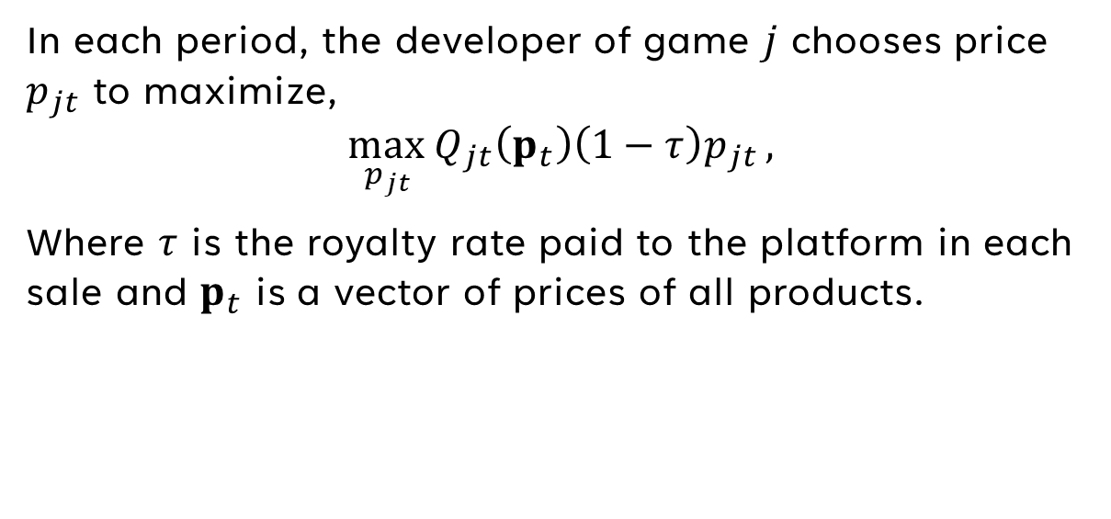
Supply
In each period, the developer of game $j$ chooses price $p_{jt}$ to maximize,
$$\max_{p_{jt}}{Q_{jt}\left(p_{t}\right)\left(1−τ\right)p_{jt}},$$
Where $τ$ is the royalty rate paid to the platform in each sale and $p_{t}$ is a vector of prices of all products.

Slide 20
5 Counterfactuals

Slide 21
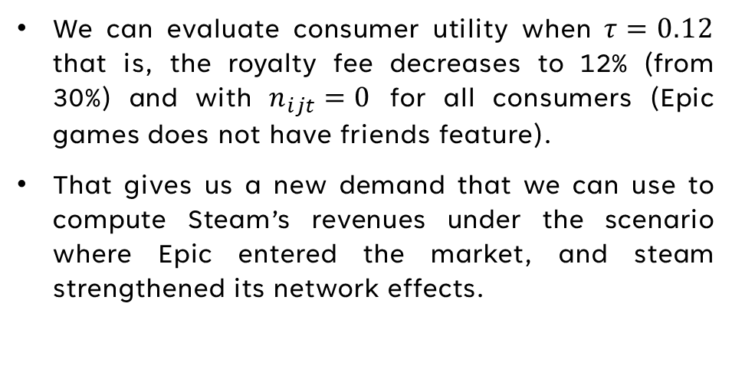
counterfactuals
Steam market power and consumer welfare
We can evaluate consumer utility when $τ=0.12$ that is, the royalty fee decreases to 12% (from 30%) and with $n_{ijt}=0$ for all consumers (Epic games does not have friends feature).
That gives us a new demand that we can use to compute Steam’s revenues under the scenario where Epic entered the market, and steam strengthened its network effects.

Slide 22
references
Becker, G. S. (1991). A note on restaurant pricing and other examples of social influences on price. Journal of Political Economy, 1109-1116.
Crawford, G. S., Lee, R. S., Whinston, M. D., & Yurukoglu, A. (2018). The welfare effects of vertical integration in multicfhannel television markets. Econometrica, 891-954.
Lu, C. H., & LaRiviere, J. (2022). Welfare Impacts of Subscriptions for Digital Goods: The Case of Videogames. International Industrial Organization Conference, 1-90.
Tudon, J. (2022). Distilling network effects from Steam. Quantitative Marketing and Economics, 293-312.

Slide 23
THANK YOU

