Slide 1
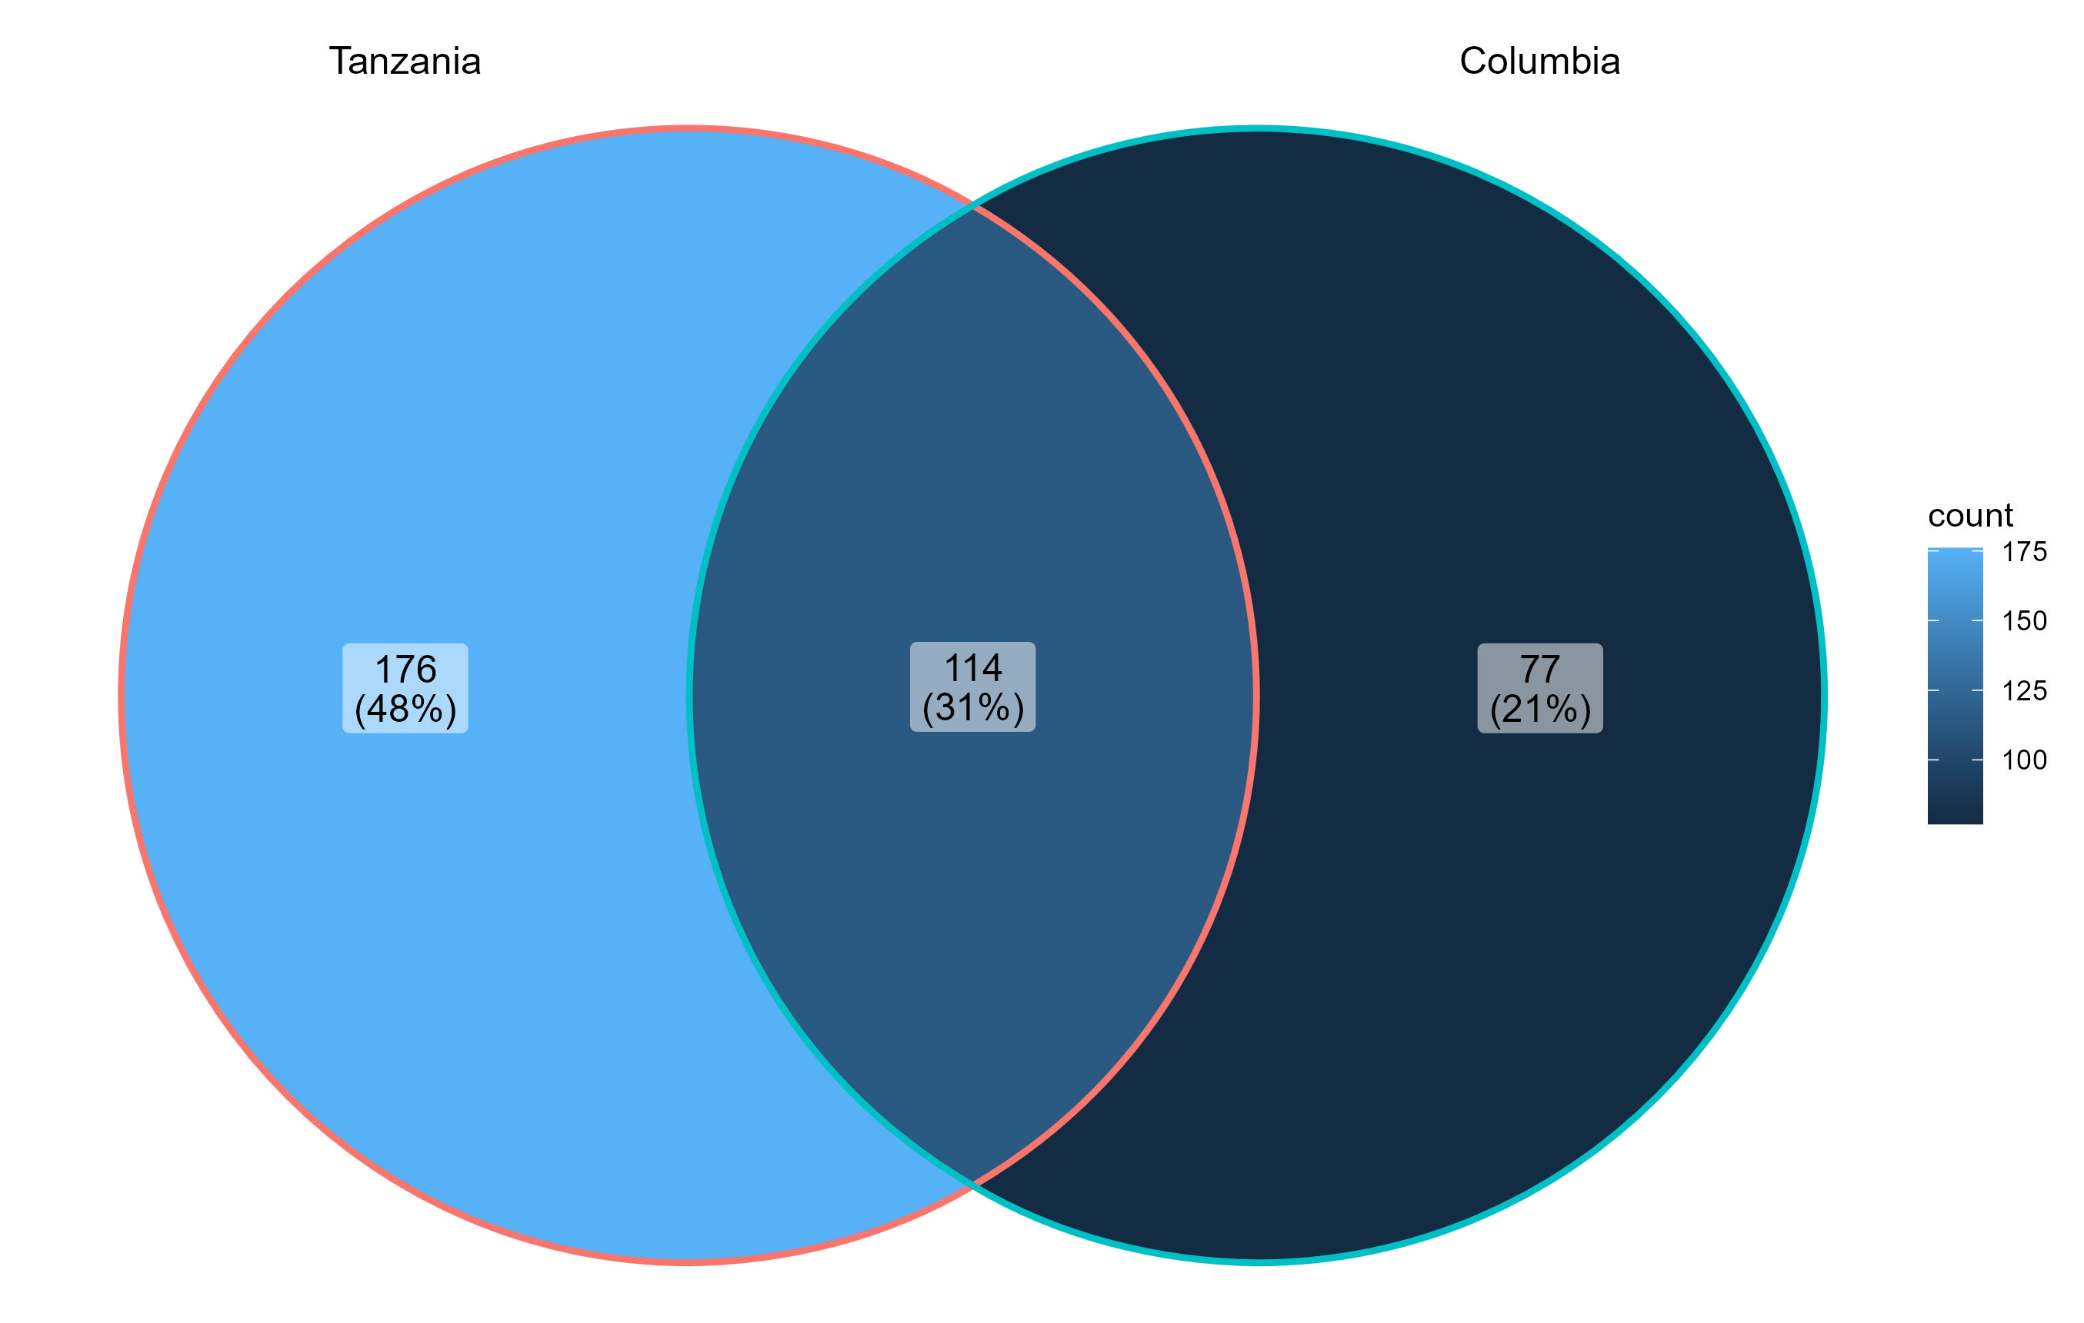
Figure 2 – Core Microbiome Significantly Different Between Tanzania and Columbia Datasets: Core microbiome analysis was carried out upon the fecal samples from the Tanzania (n= 249) and Columbia (n= 381) datasets. An abundance threshold of 0.001 and a prevalence of 0.10 were used. Taxa of interest are detailed within Table 1 and 2

