Slide 1
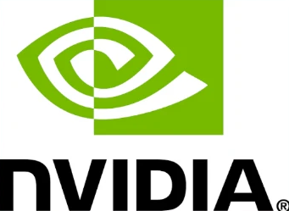
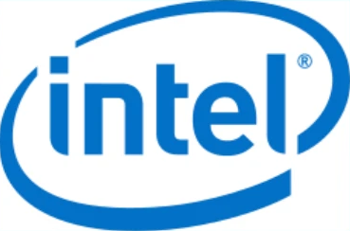
Two Questions
$500,000
five-year project
Q1 · Risk & Return
Q1 · Forecast & Hedge
Q2 · Investment Project
Beta and CAPM
against the Nasdaq
Over- or undervalued on the
Security Market Line?
Does holding both diversify?
Intel's closing price
six months ahead
Hedging the downside:
futures or options?
$200,000 revenue and
$100,000 costs a year
NPV and IRR in the base case
Monte Carlo:
10,000 simulated futures
Notes:
Hello, my name is Adam Heier, and this is my student ID. Today I'm answering two questions. First, for our portfolio manager: what risk and return should we expect from NVIDIA and Intel, does holding both diversify, where is Intel heading, and how could we protect that position? Second, for management: should the firm invest half a million dollars in a five-year project? Everything comes from one R script, which I'll run section by section.

Slide 2
Key Findings
$500,000
five-year project
Beta 1.93: almost twice
the Nasdaq's moves
Above the SML,
alpha significant (p = 0.013)
The market explains
61% of its moves
Beta 1.84, but the market
explains only 27%
Above the SML,
but not significant (p = 0.61)
Flat forecast at $116,
80% range $66–$204
NPV −$120,921 at 10%
IRR 0%: only returns its cost
Value created in only 1.2%
of 10,000 simulations
Break-even outlay: $379,079
Hold NVIDIA and Intel as a satellite position, not the core: a correlation of 0.23 lowers company risk, but a portfolio beta of 1.88 keeps market risk high, so protect Intel with puts. Reject the project on current terms.
Notes:
Let me bring the findings together. For the portfolio manager: both stocks roughly double the market's moves. Both plot above the SML, but only NVIDIA's outperformance is statistically reliable. Holding both lowers total risk, not market risk, and Intel's price isn't forecastable six months out. My recommendation: hold them as a satellite position, not the core, with more NVIDIA and a smaller Intel position protected with puts after its rally, and size it knowing that a ten percent market fall means about nineteen percent for these two. For management: reject the project on current terms. It only returns its cost and destroys value in almost ninety-nine percent of simulated futures. Revisit it only if the investment falls below 380 thousand dollars or the project carries an option to expand or abandon. The main caveat: five years that included an AI boom and an extreme rally drive all of this; a different window would give different betas. Thank you.

