Slide 1
E-Commerce Fraudulent Activity Detection
Zilong li

Slide 2

Business Rationale
The flourishing e-commerce business is accompanied with aggravating online transaction fraudulent activities such as credit card fraud, affiliate fraud, money laundering, etc.
The fraudulent activities can seriously hurt e-commerce profits, wreck the reputation, and alienate the customers.
Robust statistical machine learning models excels at identifying such fraudulent activities and help protect the benefits of the e-commerce.

Slide 3

Project Targets
Apply advanced machine learning algo to predict whether a certain online transaction is fraudulent
Keep model flexibility to accommodate different aggressiveness level on fraud detection
Propose practical business solutions based on the statistical findings

Slide 4
Project Roadmap
Data Preprocessing
Data Cleansing
Exploratory Data Analysis
Correlation analysis
Model Fitting
Apply random forest algo
Qualitative Approach
Business Solutions
Feature Engineering
Preliminary data visualization
Assess model performance
Quantitative Approach

Slide 5
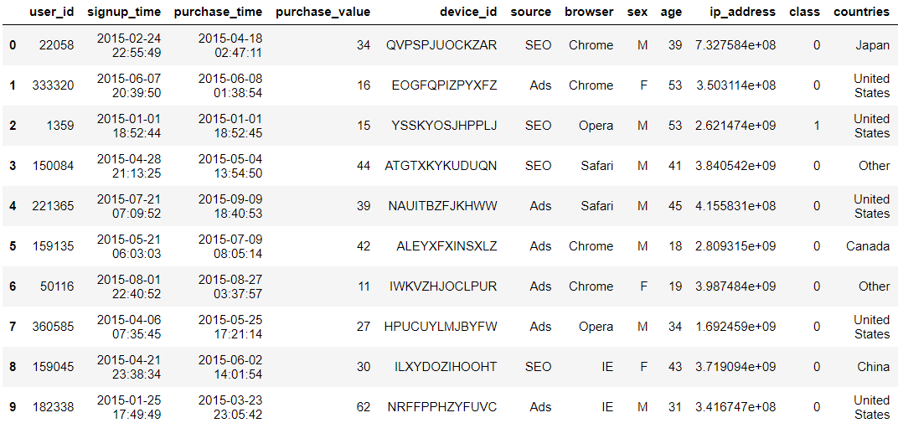
Data Structure
Size: 150k observations
Features: 10 Raw Features
Transaction Related: signup time, purchase source, purchase device, purchase value, etc.
Demographic Related: gender, age, country, etc.
Target
Fraudulent Transactions: 14k
Non-Fraudulent Transactions: 136k

Slide 6
Data Preprocessing
Sign Up Time/ Purchase Time
Time Diff
Data Cleansing
Result: No missing values nor significant outliers
Feature Engineering
Explanation: manipulate raw features to better fit the model and reflect the business hypothesis
Example:
Raw Features: Sign Up Timestamp, Purchase Timestamp
Business Hypothesis: The shorter of the time range between sign up time and purchase time, the higher probability of fraudulent activity
New Feature: Time Difference
Results: 10 standardized features as model inputs
Device ID
#Users/
Device ID
IP Address
#Users/
IP

Slide 7
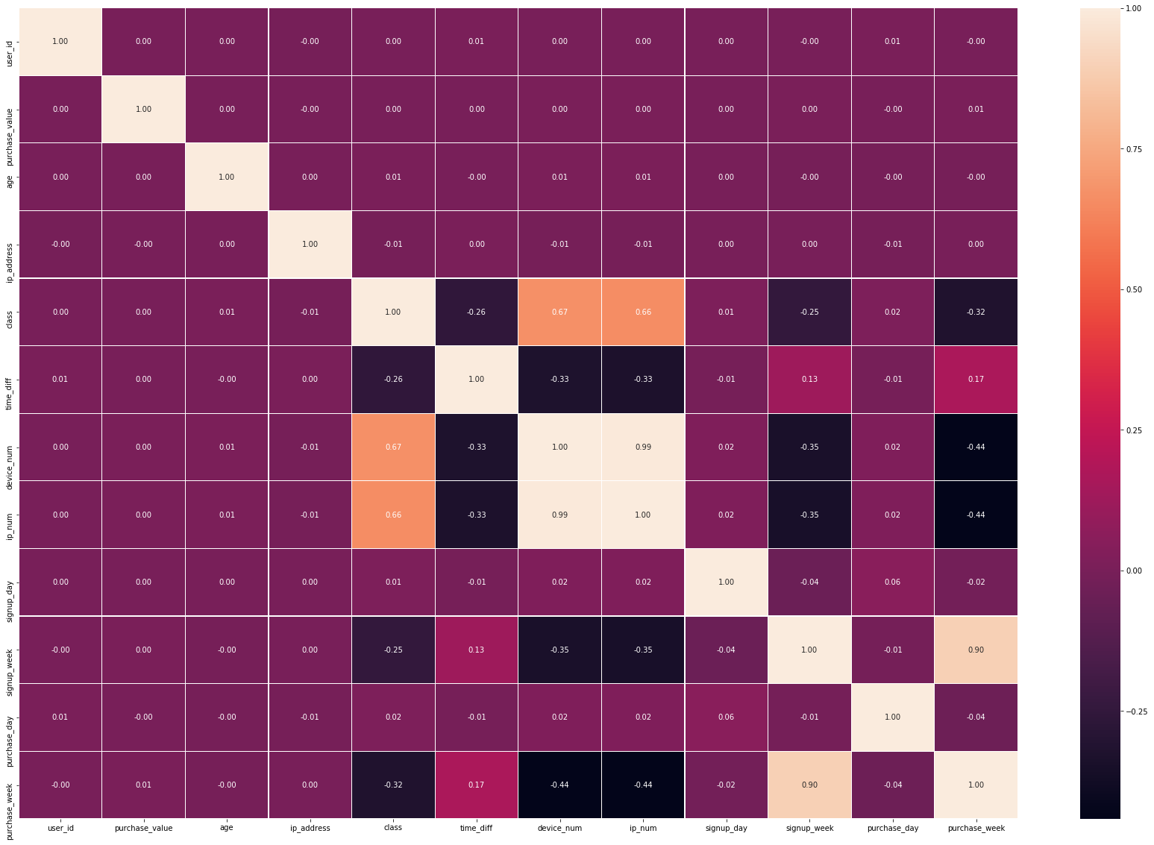
Exploratory Data Analysis: Correlation Analysis
Purpose: Detect pairwise correlation between feature and target, and among features
Findings: Several features show significant correlation among themselves.
Device Number VS IP Number
Sign up week VS Purchase week
Implication: We should pick a model robust to multi-collinearity

Slide 8
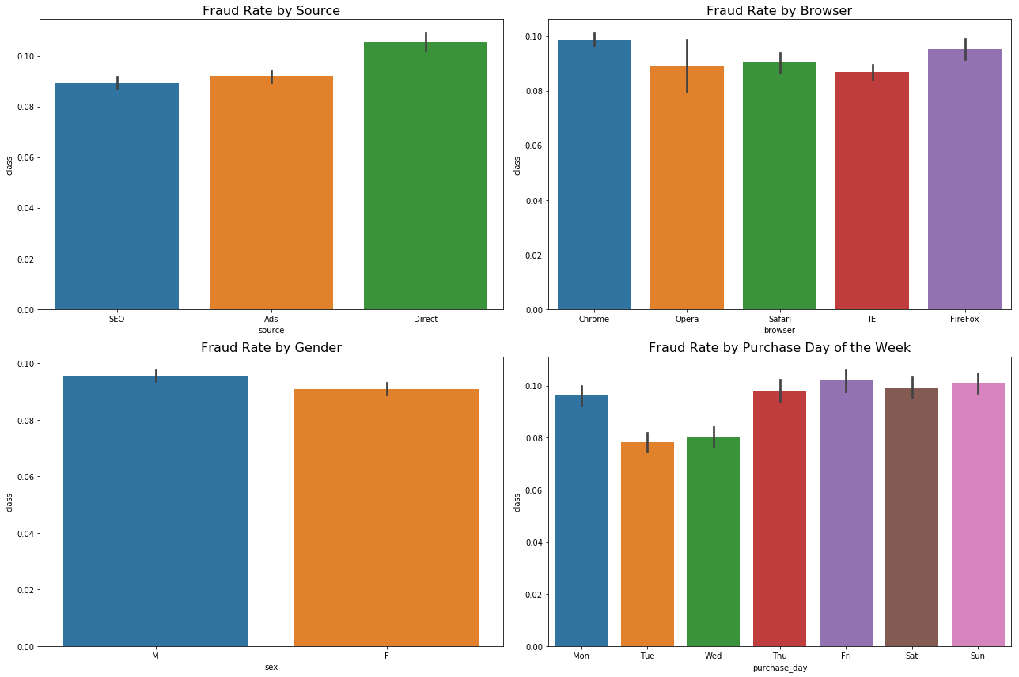
Exploratory Data Analysis: Categorical Features
Purpose: Apply bar plot to visualize the fraud rate versus categorical features to detect preliminary findings
Example Findings:
Fraud rate of transactions using Chrome or Firefox is higher than other browsers
Fraud rate between male and female shoppers are roughly the same

Slide 9
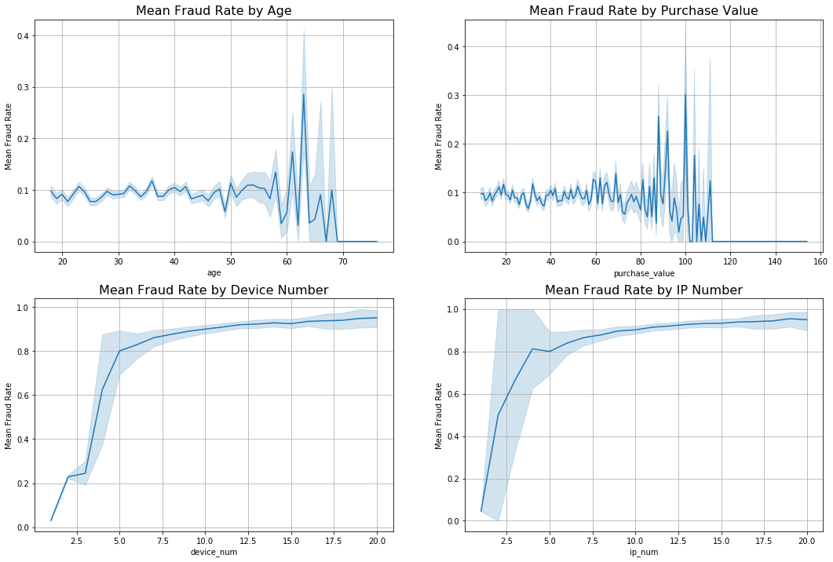
Exploratory Data Analysis: Continuous Features
Purpose: Use line plot to depict the preliminary relationship between fraud rate and continuous variables
Example Findings:
The mean fraud rate is constant across different age groups and purchase values
Fraud rate is increasing with increased number of users per device or IP address

Slide 10
Model Fitting: Random Forest
Model Logic:
A popular ensemble machine learning algo based on tree model
For each iteration (tree), part of the features and observations are randomly selected to fit the tree model
Final decision is based on the majority vote of the total iterations
Advantages:
Prevent overfitting
Robust to multi-collinearity

Slide 11
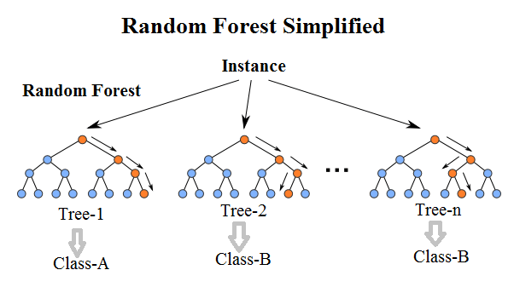
Model Fitting: Model Processing
Training Data: 70% of the total observations assigned, specifically used for training the model
Testing Data: 30% of the total observations, used for checking the model performance
In general, 41 trees have been generated. Fraud is predicted based on majority rule of the trees

Slide 12
Model Performance: Key Results
Out of the 30% (45k) of total observations used for testing, 4,253 are labeled fraudulent
43,258 (96%) of the testing samples are predicted correctly with their true labels
2,250 out of 4253 (53%) fraud-labeled samples are successfully identified
No false positives predictions. However, 2,003 false negatives might require further model adjustment
 |  | Predicted class
 |  | Fraud | Non-Fraud
Actual class | Fraud | TP: True positive (2,250) | FN: False negative (2,003)
 | Non-Fraud | FP: False positive (0) | TN: True negative (41,008)

Slide 13
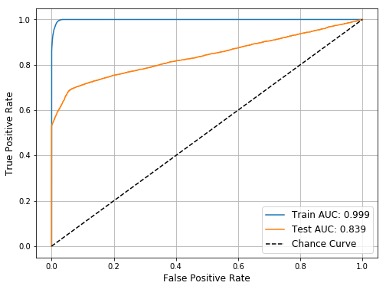
Model Performance: AUC-ROC Curve
Purpose: Visualize the True Positive and False Positive trade off under different classification thresholds
Rule of Thumb: the larger of the area under testing AUC curve, the better of the model prediction power
Results: our random forest model returns a decent 0.839 (83.9%) area under testing AUC curve, proving that our model is robust

Slide 14
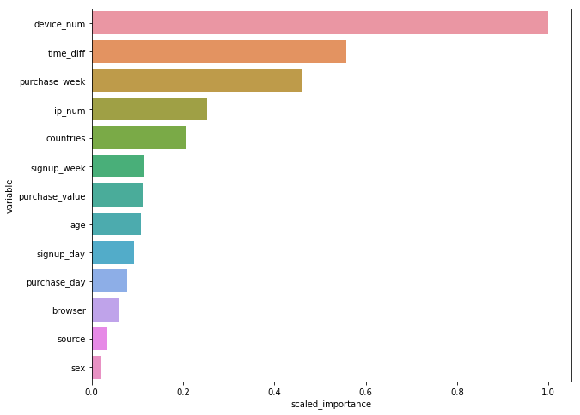
Model Performance: Feature Importance
Purpose: List the features in descending order based on their importance in making predictions
Findings: The most important five features are
#Users per device
Time difference between sign up and purchase
Week of the year to make purchase
#Users per IP address
IP address location of the transaction

Slide 15
Business Recommendation
Qualitative Approach
Quantitative Approach
Extra vigilance should be executed based on the important features. Flag the transaction if:
Multiple transactions share same device
Multiple transactions share same IP address
Time difference between sign up and purchase is very short
Purchase are transacted in certain week of the year
Purchase are transacted in certain countries such as USA, China, Japan
Categorize the transactions based on their predicted probability of fraud:
< 20%: No fraud => green light
20% ~ 40%:Slightly fraudulent => double check
40% ~ 75%: Intermediate fraudulent => block the transaction
> 75%: Highly fraudulent => block the transaction and the account

