Slide 1
Exploratory Plots

Slide 2
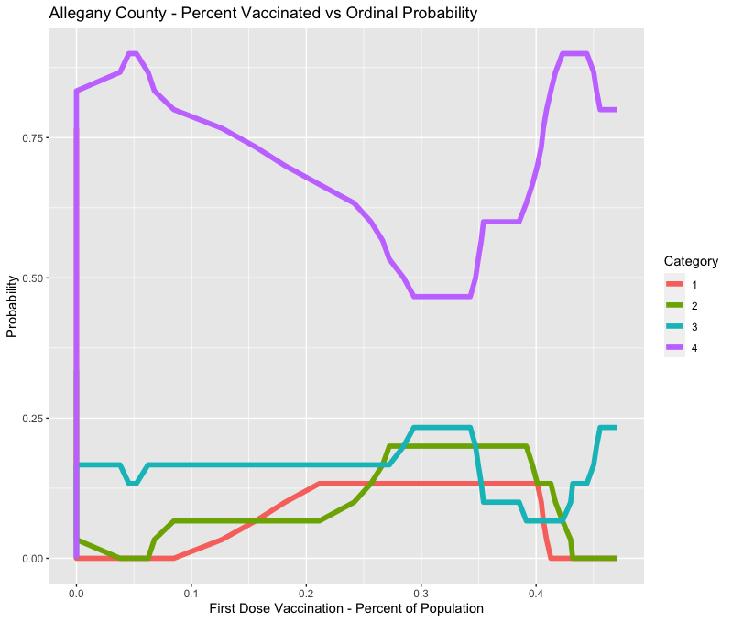
Window Plot (30 week interval) – Allegany County (Rural)

Slide 3
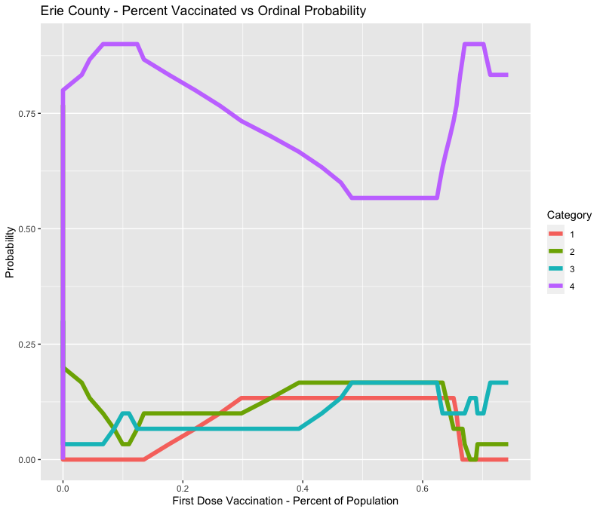
Window Plot (30 week interval) – Erie County (Urban – City of Buffalo)

Slide 4
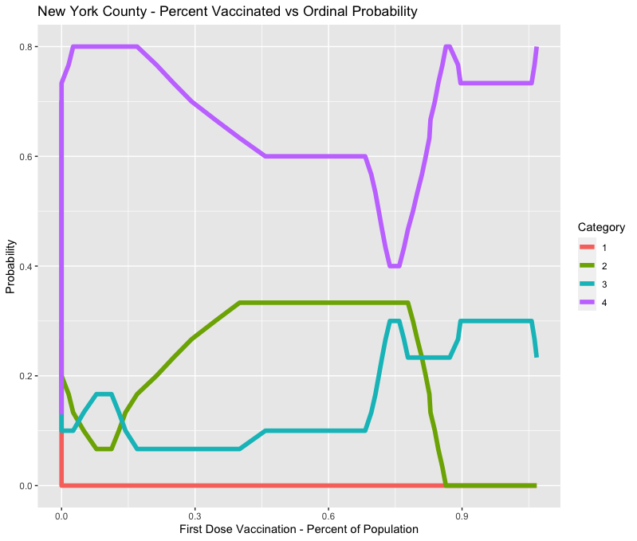
Window Plot (30 week interval) – New York County (Urban - Manhattan)

Slide 5
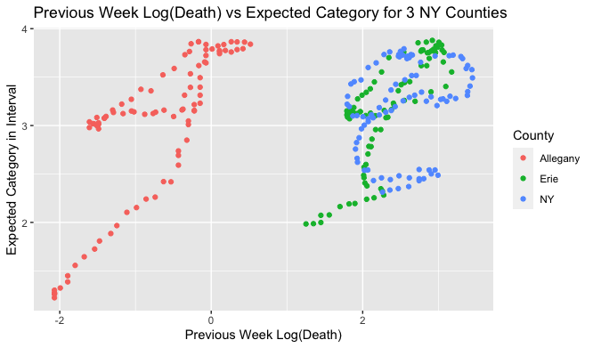
Expected Category within 30 week interval for all 3 counties – Plotted against “Prev_new_log_death”

