Slide 1
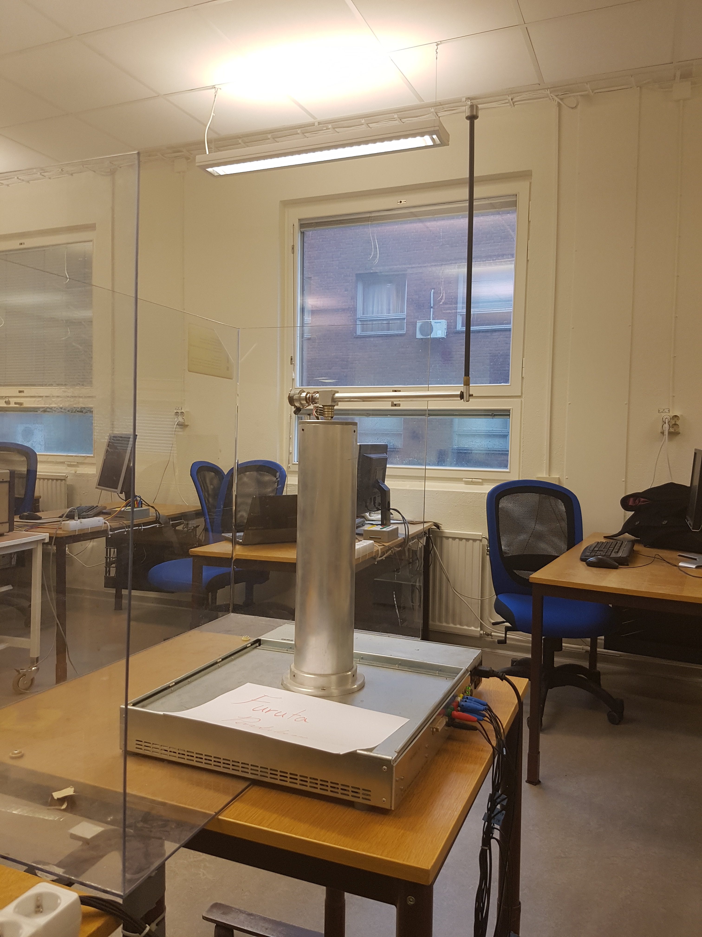
Adaptive friction compensation of inverted pedulum.
Notes:
Process
Swing up - lyaponov
Top controller – LQR
Yields limit cycles due to friction
Estimate friction in controlled test in bottom position or in real time in top position.
Estimation using recursive least squares.
Using a lab in non linear control as a basis

Slide 2
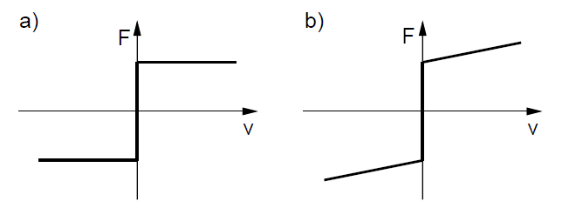
Friction models
a) Coulomb friction model
b) Coulomb + viscosity friction model
Notes:
Different friction models to consider. Focus on simple models due to low speeds and noisy measurements.

Slide 3
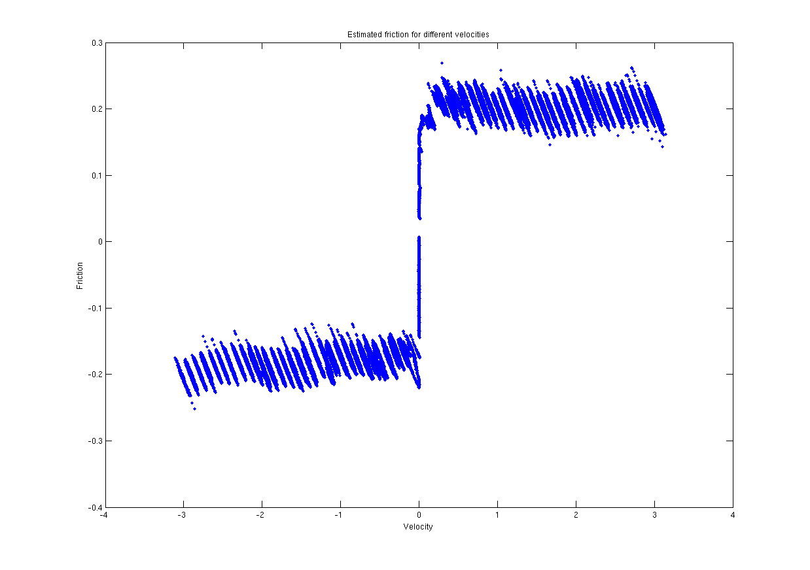
Estimated friction for different velocities
Notes:
Offline friction estimation in the lower position.
Both friction models might be viable.
As one can see it seems that the friction varies with the arm position.

Slide 4
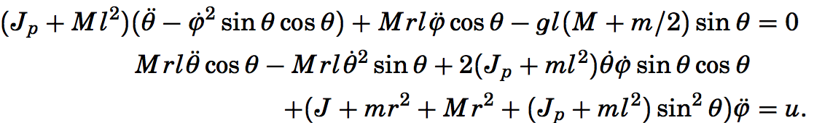
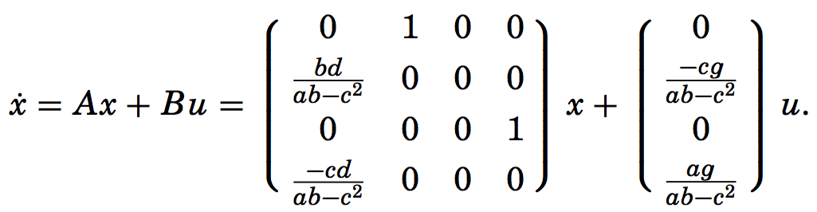
Simplified dynamics
Linearized model
Notes:
Since the pendulum dynamics are quite complicated these simplified dynamics where given in the non linear control lab. The dynamics where simplified using some lagrangian theory.
The model was then linearized around the top since this is where we want to estimate the friction.

Slide 5
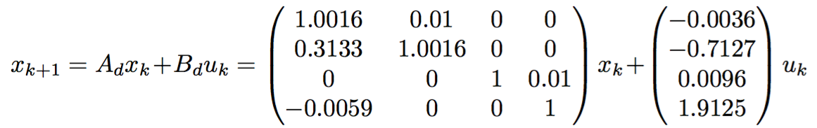
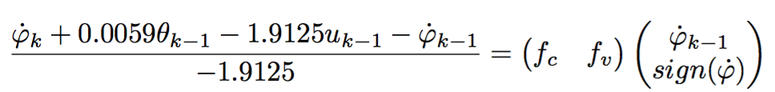
Discretized model
Model with friction
Recursive least squares equation
Notes:
This model was discretized using the c2d command in matlab which uses zero order hold.
Then we added friction to our model, we consider the friction as a torque and thus we remove it from the given control signal.
With the coloumb + viscouse friction model as a basis we arrive at this equation for the recursive least squares estimation using the fourth state.
The fourth state is chosen since we get both the dynamics of the arm and pendulum in that equation.

Slide 6

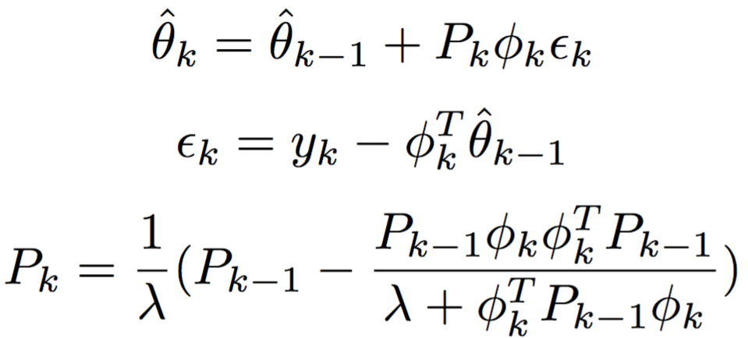
RLS ALGORITHM

Slide 7
Limit Cycles with and without friction compensation

Slide 8
Friction models

Slide 9
VL mot UF

Slide 10
RLS convergence With step, with compensation on no step compensation off

Slide 11
Step response???

Slide 12
Video??

