Slide 1
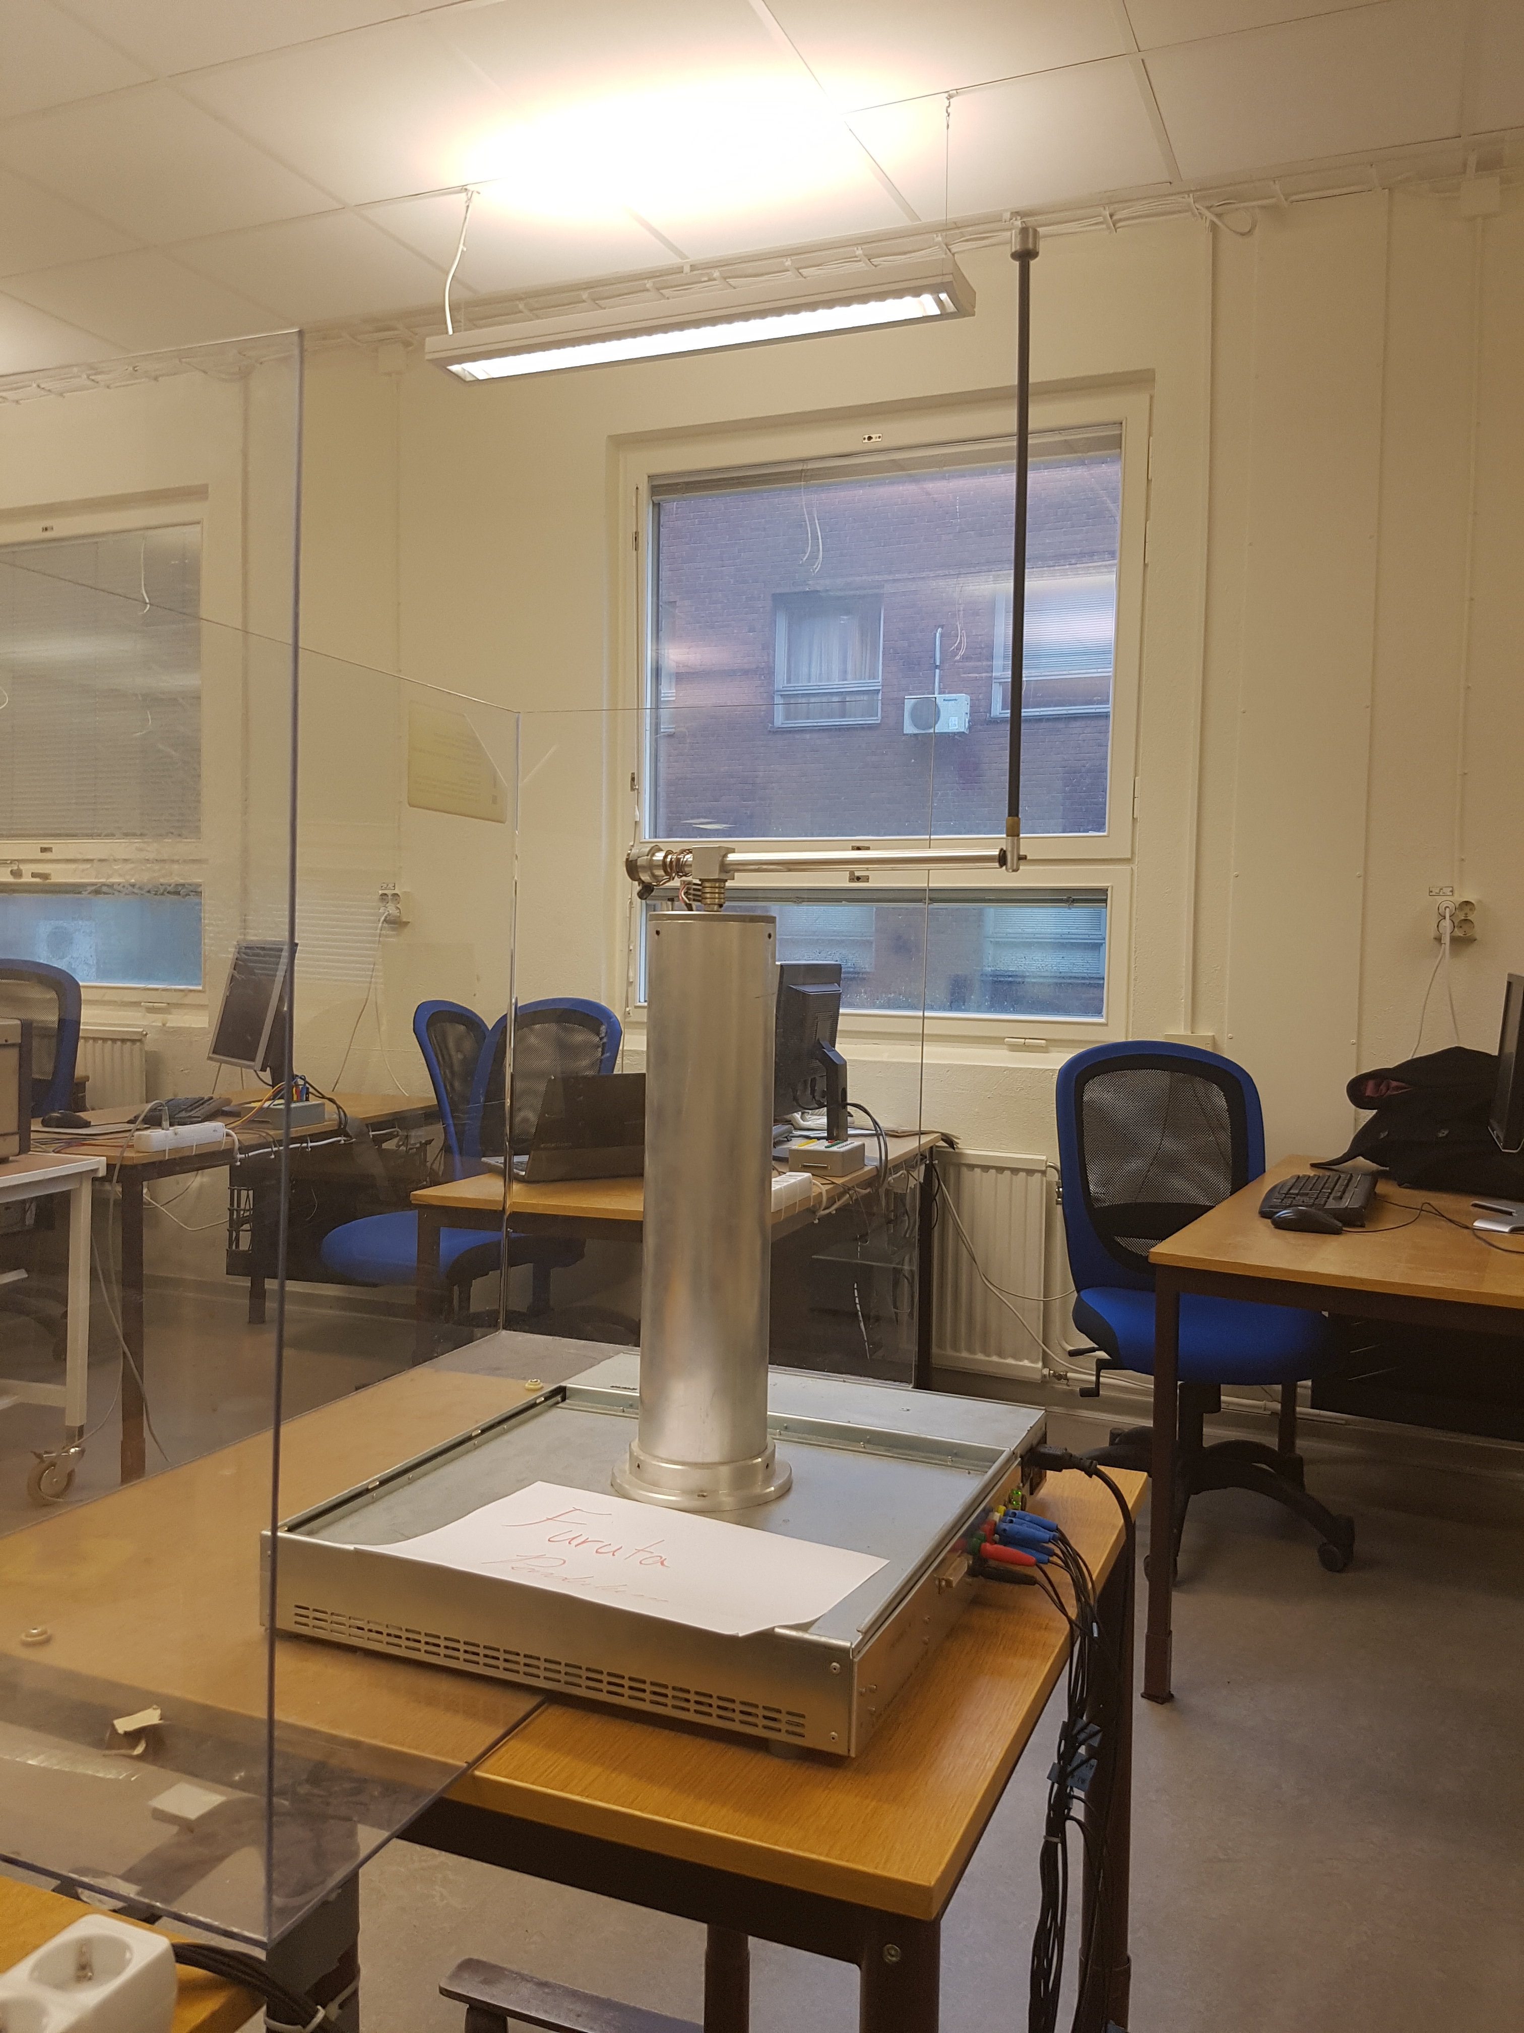
Adaptive friction compensation of inverted pedulum.

Slide 2





Slide 3
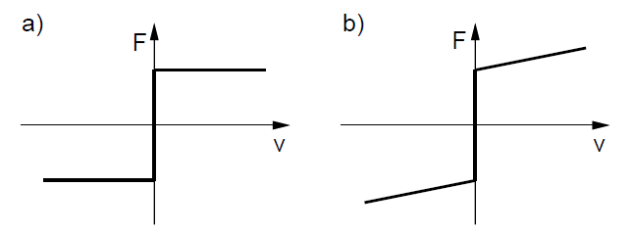
Friction models
a) Coulomb friction model
b) Coulomb + viscosity friction model

Slide 4
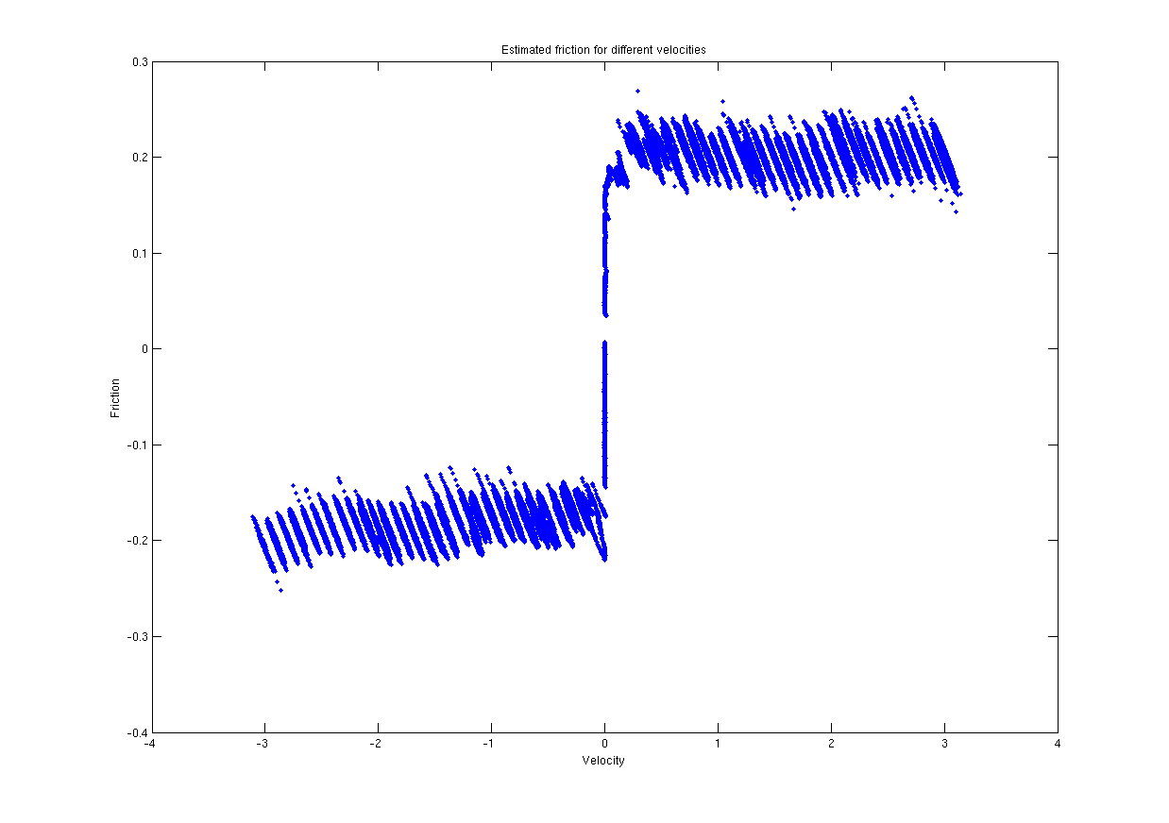
Estimated friction for different velocities

