Slide 1



Gurdon scRNA-seq data analysis workshop – day 2
Adam Reid
Head of Bioinformatics
Gurdon Institute
22nd March 2023

Slide 2
Outline
Recap
Identifying cell types
Differentially expressed genes
Your own data

Slide 3
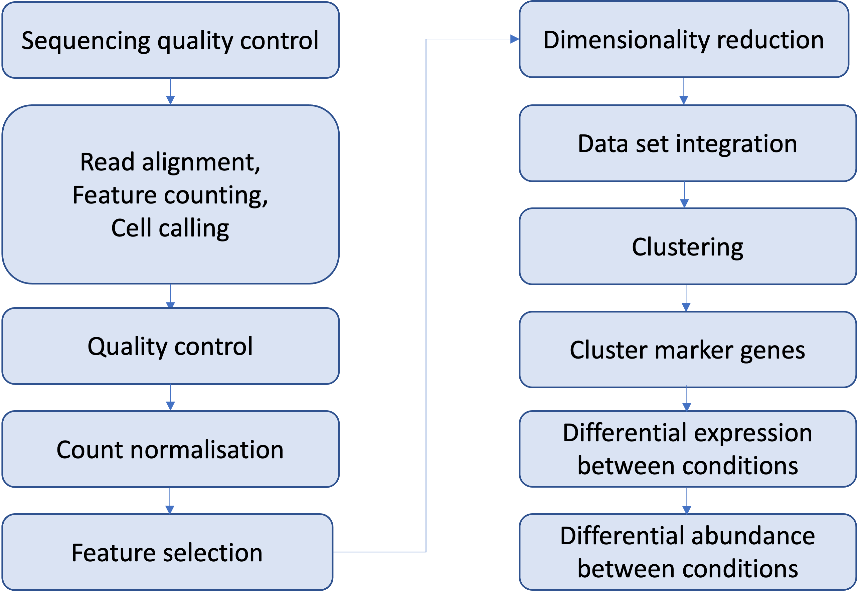
Analysis workflow
Day 2

Slide 4
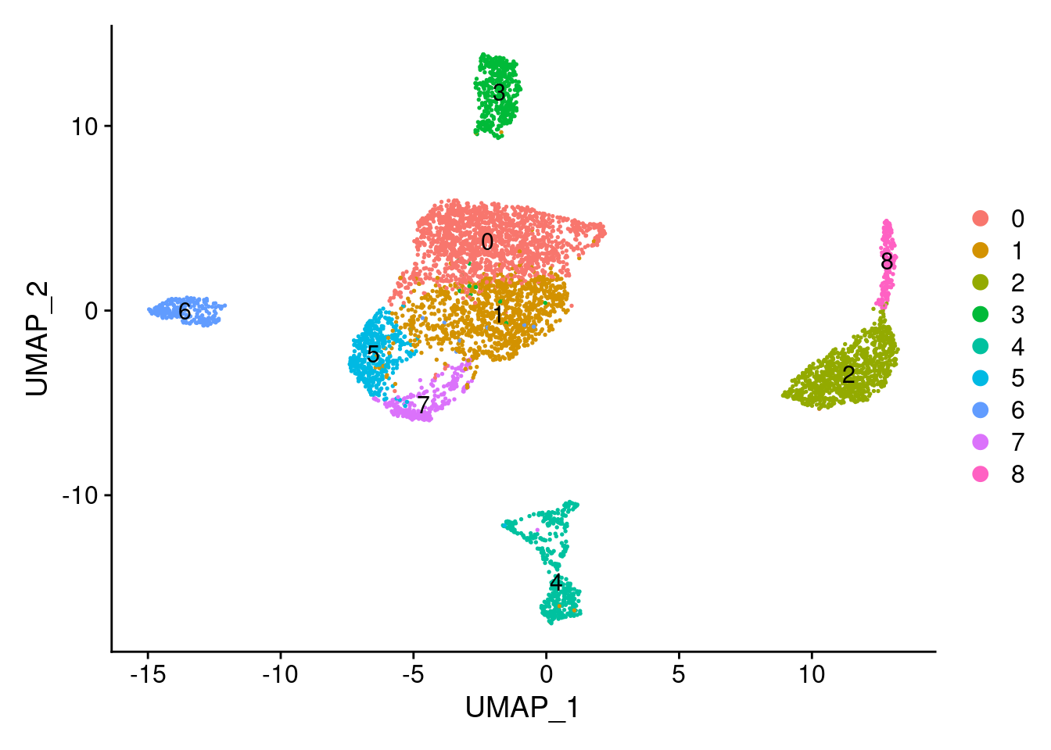
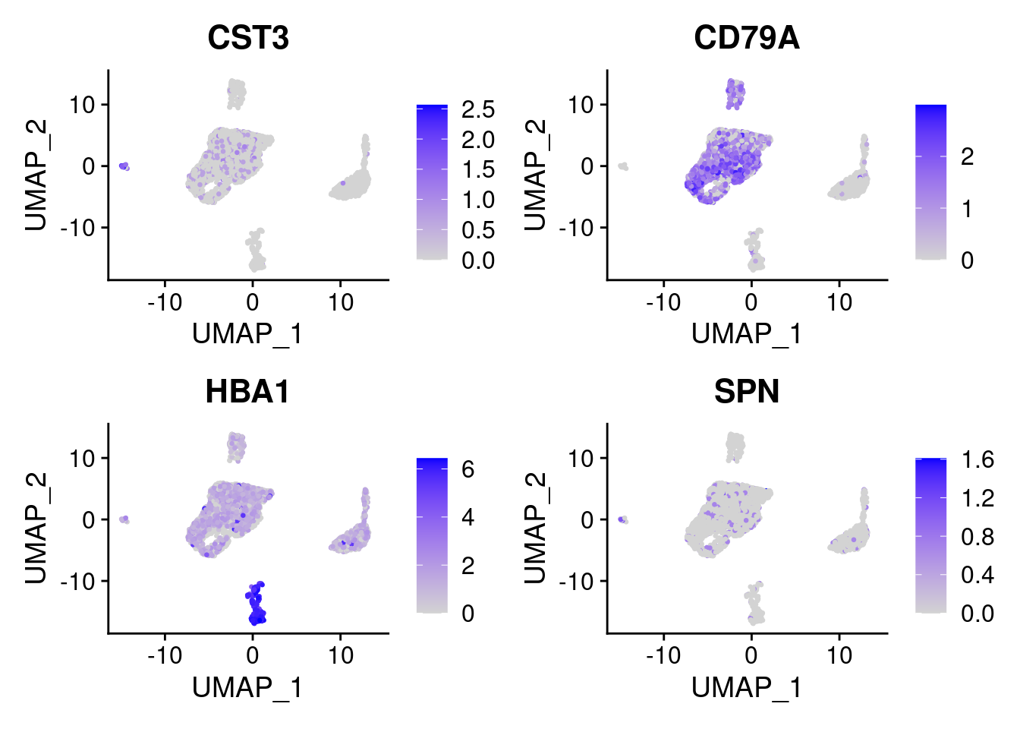
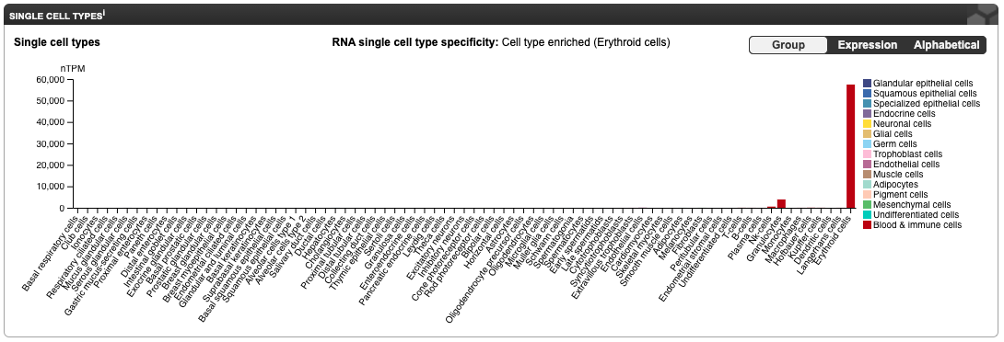

Identifying cell types
Identifying markers de novo
Identify genes which are more highly expressed in one cell cluster than in others
In Seurat use ‘FindMarkers’
Using known markers for cell types you expect
p_val avg_log2FC pct.1 pct.2 p_val_adj
GNLY 0 2.648152 0.476 0.009 0
CTSW 0 1.112248 0.601 0.022 0
KLRD1 0 1.084170 0.519 0.008 0
CCL5 0 2.858279 0.841 0.020 0
NKG7 0 2.532095 0.841 0.042 0
CST7 0 1.298939 0.692 0.008 0
Look for where the marker genes are known to be expressed e.g. using Human Protein Atlas in
Automated typing tools are available, e.g.

Slide 5
Differentially expressed genes
Clusters and/or cell types have been identified, we now want to compare sample groups:
Differential expression – E.g. differences in gene expression between sample groups within a particular cell type.
Differential abundance - Differences in cell numbers between sample groups for a particular cell type.

Slide 6
Differential expression
There are a variety of different approaches. These were assessed for accuracy in Squair et al (2021)
The best methods, account properly for variability between replicates and in essence work just as for bulk RNA-seq
Replicates should be samples, not cells:
it is important to treat each sample and not each cell as the experimental unit of interest.
cells from one sample are likely more similar to each other than cells taken from different samples.
ignoring variability in gene expression with a condition, and treating cells (as opposed to samples) as independent biological replicates can lead to false discoveries (Squair et al. 2021, Zimmerman et al. 2021).
Pseudo-bulk:
gene expression levels for each cluster in each sample are obtained by summing across cells

Slide 7
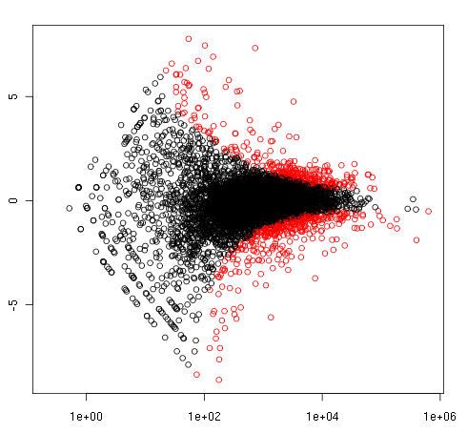
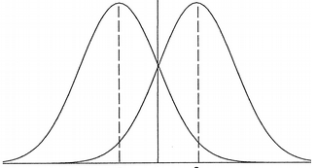
Determining differential expression
We normally don’t have enough replicates to do traditional tests of significance for RNA-seq data
Instead most methods look for outliers in the relationship between average abundance and fold change, assuming most genes are not differentially expressed
gene A, condition 1
gene A, condition 2
Log fold change
M
Normalised read counts
Single-cell RNA-seq data is even more noisy than bulk methods!
Average abundance

Slide 8
A big caveat
We are going to use a simple but poorly performing approach (Wilcoxon Rank Sum test)
It will not give you the best results, because it doesn’t treat replicates properly and does not account for some of the properties of scRNA-seq data
The current best practice approach is to use pseudobulking and DESeq2, but this is currently relatively code-heavy in Seurat (although quite nicely implemented in scran).

