Slide 1
CSC 271 Final Project
Adam Jean-Laurent And Michael Jackson

Slide 2
User Stories
As a student, I want to see bubble sort implemented in my favorite programming language because it’s the one I’m most comfortable with.
As a visual learner, I want to see bubble sort visually in action because I don’t learn well from textbooks.

Slide 3
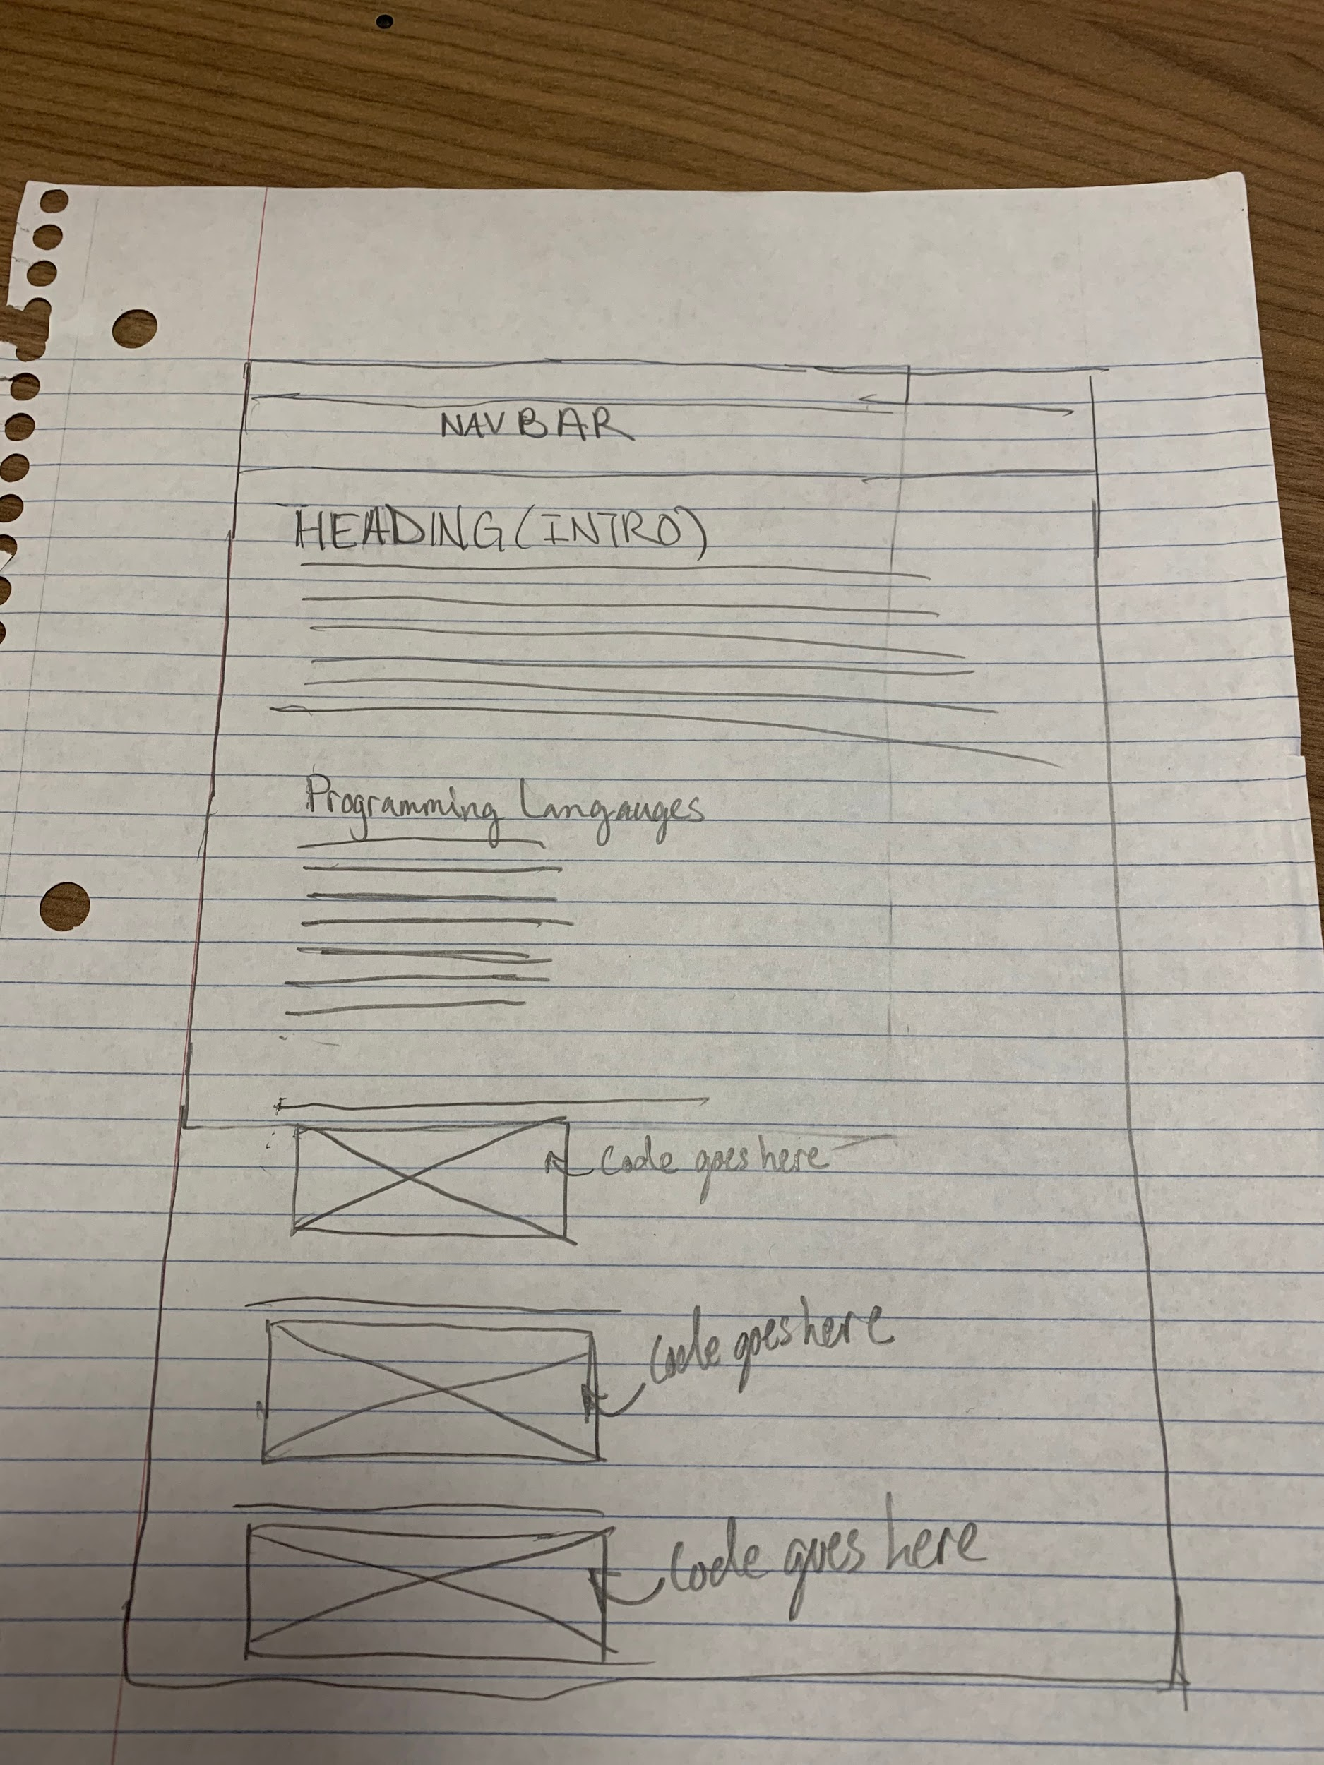
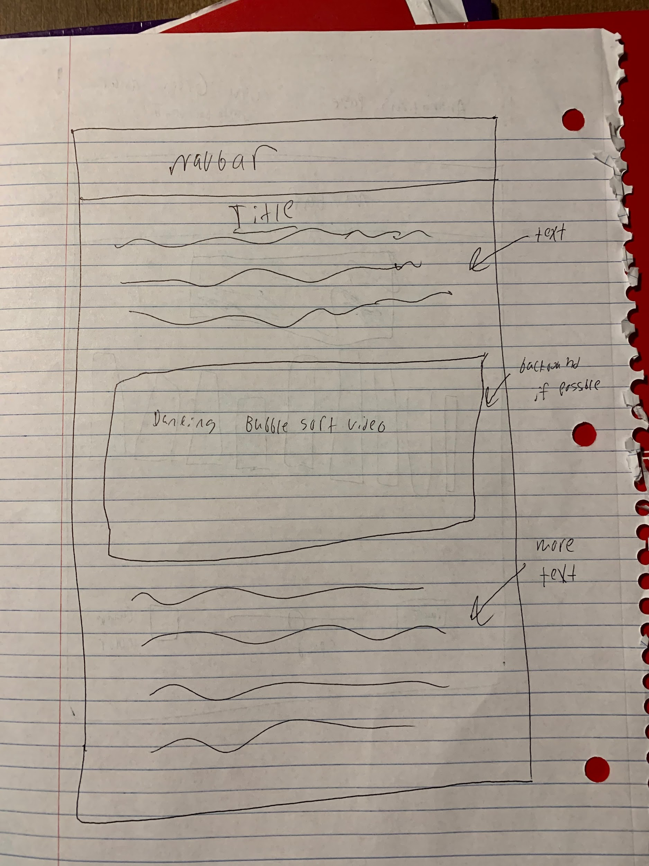
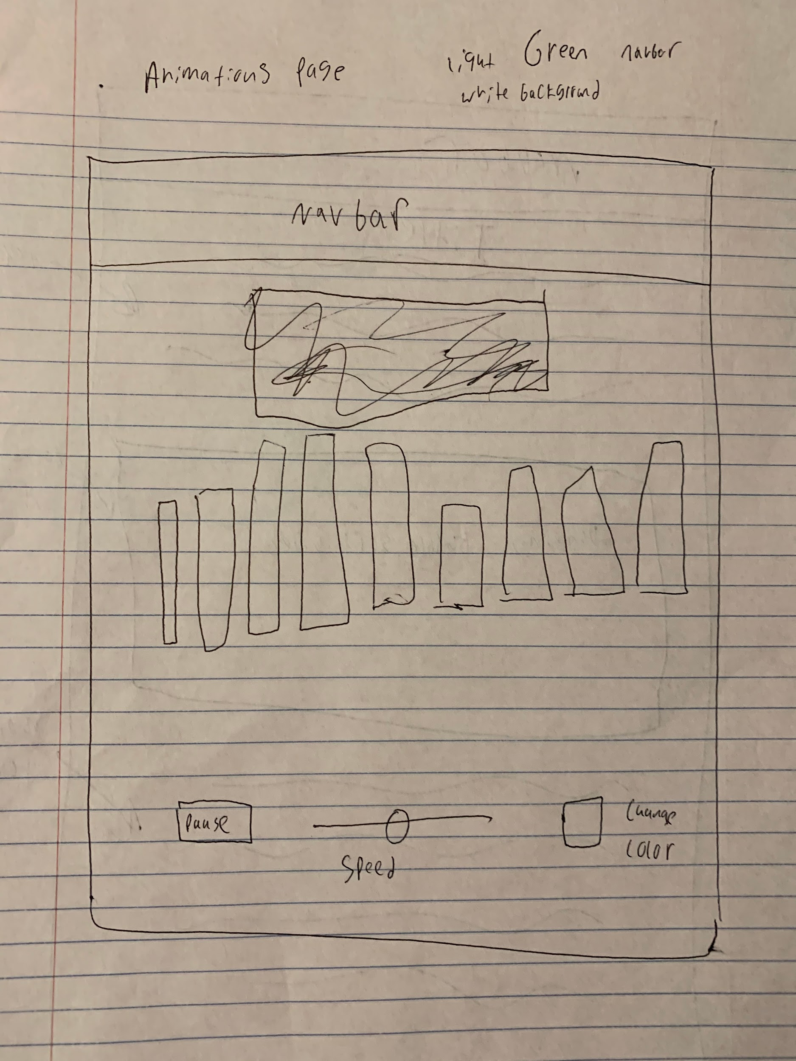
Wire Frames

Slide 4
Live Demo Time!
Do Live Demo Here

Slide 5
Contribution Table
Adam:
Animation Page:
Wrote HTML CSS, and JavaScript for animation player, and rest of the page.
Home Page:
Wrote all HTML and CSS for the home page.
Created Footer
Michael:
Code Page:
Wrote all HTML and CSS for the code page.
Home Page:
Wrote JavaScript for form validation
Created navbar

Slide 6
Answering Some Questions
Who is your project for?
Our project is for any one who wants to learn bubble sort, we offer code implementations, animations, and explanation of the algorithm.
What is the purpose of your project?
To teach sorting algorithms to students of all learning styles.
Why does your project matter?
Our project matters because CSC 212 is has of the highest failing rates in the University. Something like this on a larger scale could help lower that number.

Slide 7
Major Challenges
Displaying bubble sort code for each programming language.
Creating the animation player.
Adjusting the speed of the animation player.
Randomizing all the bars.
Making the animation player more accessible.
Optimizing all the gifs on the site.

Slide 8
If We Had More Time
Expand the website to include other sorting algorithms.
Improve on the form validation.
The form should not allow anything other than letters and spaces.
The form should have a red border around boxes with errors.
The form should have an asterisk next to require fields.
Include code along with the animation player.
Trace the code as the animation happens.
Default code would be pseudocode.
Change the layout for the Code Page.

