Slide 1
Week 2, lab activity
Adam khay

Slide 2
Dataset: Placement Prediction Dataset
Description: the dataset includes data on students' academic performance and extracurricular activities with features like CGPA, number of internships, projects, workshops/certifications, aptitude test scores, soft skill ratings, participation in extracurricular activities, placement training, and scores on SSC and HSC exams. Whether or not the student was placed throughout the recruitment process is indicated by the goal variable, PlacementStatus. Based on these variables, the dataset seeks to forecast placement results. Dataset link: https://www.kaggle.com/datasets/ruchikakumbhar/placement-prediction-dataset

Slide 3
Data type
Field_name | description | Data_type
CGPA | the student's overall grades | Continuous
Internships | how many internships a student has completed | Discrete
Projects | Number of projects completed by the student | Discrete
Workshops/Certifications | Number of workshops/certifications the student took | Discrete
Aptitude Test Score | Score of the student's logical reasoning and quantitative reasoning | Discrete
Soft Skill Rating | Rating of the student’s soft skills (5.0 is the max rating) | Ordinal
Extracurricular Activities | Whether or not the student does extracurricular activities | Nominal
Placement Training | Whether or not the student took the placement training | Nominal
SSC Marks | The student’s Senior Secondary marks | Discrete
HSC Marks | The student’s Higher Secondary marks | Discrete
Placement Status | Whether the student is placed or not | Nominal

Slide 4
MLS well defined problem.
The problem we are trying to solve: Predicting Placement Status of Students using Academic and Extracurricular Factors
Relevance of the columns to the problem: These columns or features related to student's academic performance and extracurricular activities will help me reach my goal which is to predict whether a student will be placed or not placed during the placement process.

Slide 5
Machine Learning System Overview
Data Collection: Records of students' education, training, and placement
Data Preprocessing: treat missing values “if there are any”, encode categorical variables (Yes/No” , "Placed/Not Placed)
Feature Selection: identify important features (CGPA, Aptitude Score, Soft Skills…)
Train-Test Split: Split our Data: 80% Training and 20% Testing
Model Selection and Training: Selecting an algorithm: Random Forest, Decision Tree, or Logistic Regression. And use the training dataset to train the model.
Model Evaluation: Evaluate performance using F1-Score, Accuracy, Precision, and Recall
Tuning hyperparameters: Enhance the model's performance
Deployment: Making predictions in real time using the learned model

Slide 6
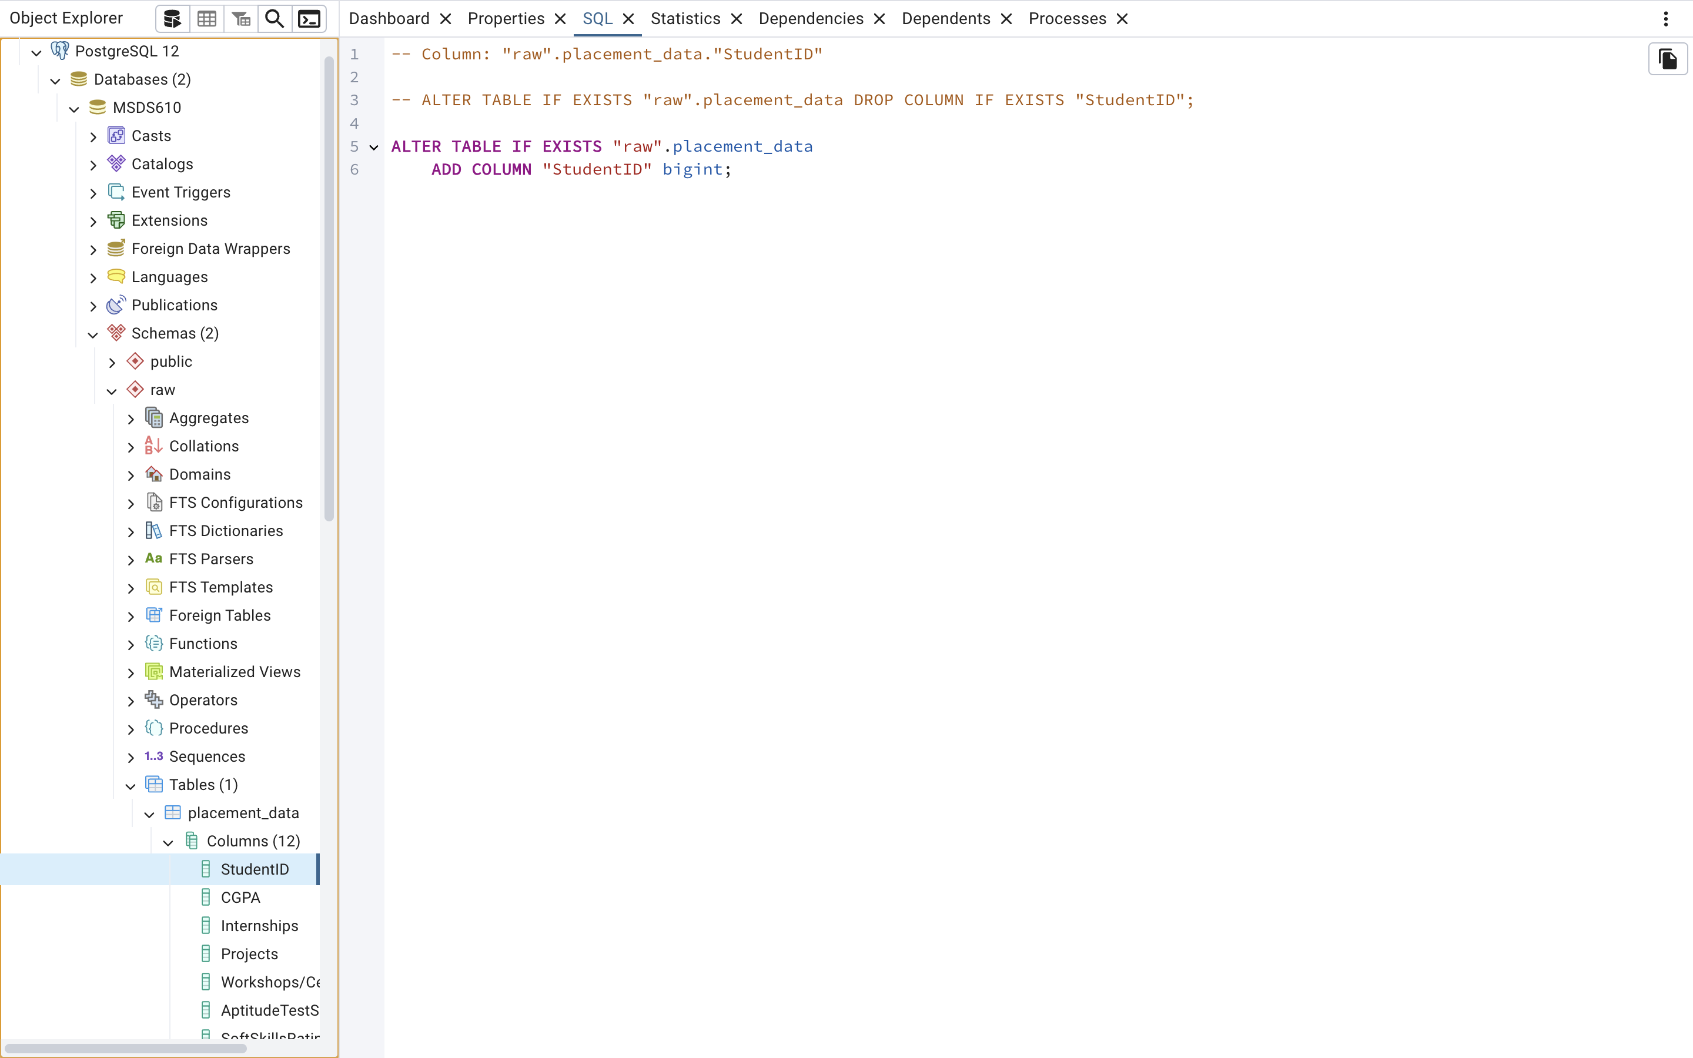
Screenshot of my loaded data from within pgAdmin

