Slide 1

ABC Supermarkets
Store Sales Analysis
Provided by
Data Science Institute

Slide 2
The Data Science Institute was asked to review certain data provided to us and present out findings We analyzed the data to determine patterns in sales and to provide executive summary feedback to management

Slide 3
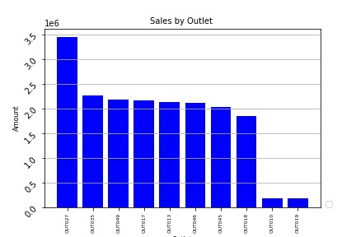
Sales by outlet & type
Outlet 27
19%
Supermarket Type 3
Outlet 18
10%
Supermarket Type 2
Outlets 13,17,35,45,46,49 – (69% or total)
11% each
Supermarket type 1
Outlets – 10, 19
1% each
Grocery

Slide 4
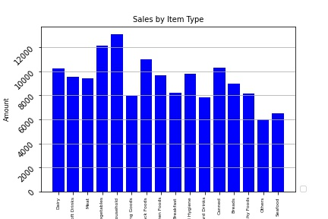
Sales by item type
Largest Categories – account for 51% of sales:
Fruits & Vegetables – 15%
Snacks 15%
Household 11%
Frozen Foods 10%

Slide 5
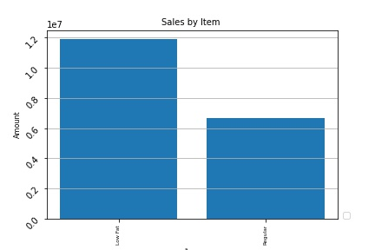
Sales – low fat vs regular
Low Fat 64%
Regular 36%
However, it was noticed that the categories of household and health & hygiene are included. In removing these categories.
Low Fat 57%
Regular 43%

Slide 6
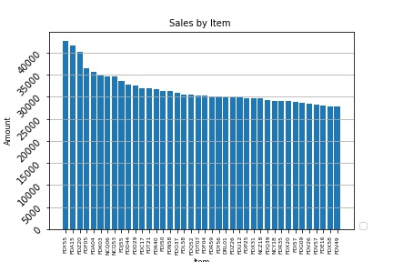
Sales by item- top 40
The top 5 selling items only account for 1% of total sales
Top 40 items

Slide 7
Recommendations
Multi year data should be provided so that trends can be identified in consumer purchasing patterns for year over year:
Outlet sales
Item sales
Trends in healthy product purchasing – Low Fat vs Regular
Item identifiers should be expanded to allow for post sales analysis
Item types should be expanded to allow for better analysis
Item Fat Content categories need to be reviewed.
Not all products fit into these categories. Inclusion makes the data analysis inaccurate

Slide 8
The Data Science Institute thanks you for this opportunity. A full report will be sent separately.

