Slide 1
DECODING STIMULATION INTENSITY FROM EEG
Time-domain & frequency-domain decoding of EMS haptic-shock intensity,
comparing a shrinkage-LDA pipeline against EEGNet.
30 subjects · 60 channels · 3-class & 4-class · LOSO + within-subject

Slide 2
DATA COLLECTION
How the EEG was recorded & prepared
60
1000 Hz
250 Hz
160
EEG channels
Acquisition rate
Analysis rate
Epochs / subject
10-20 montage, central/fronto-central focus for the somatosensory response
Notch-filtered at 50 Hz; band-pass up to 100 Hz on the raw recording
Anti-aliased decimation by 4 (FIR low-pass) before feature extraction
Stimulus-locked trials, balanced across intensity conditions
Preprocessing & epoching pipeline
Raw EEG
›
Downsample ÷4
›
Epoch
›
Crop window
›
Label scheme
1000 Hz · notch 50 · BP 100
→ 250 Hz, anti-aliased
stimulus-locked
−0.2 → +1.5 s
3-class / 4-class
**Note: 31 subjects were recorded, but subjects 10 and 24 have been removed from training sets.

Slide 3
Part 1: EEGNet
A compact convolutional network learning its own filters from raw EEG

Slide 4
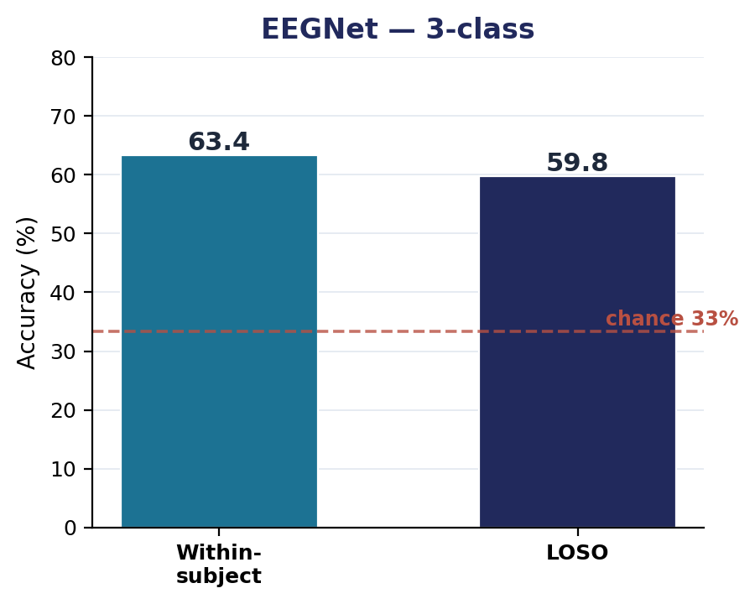
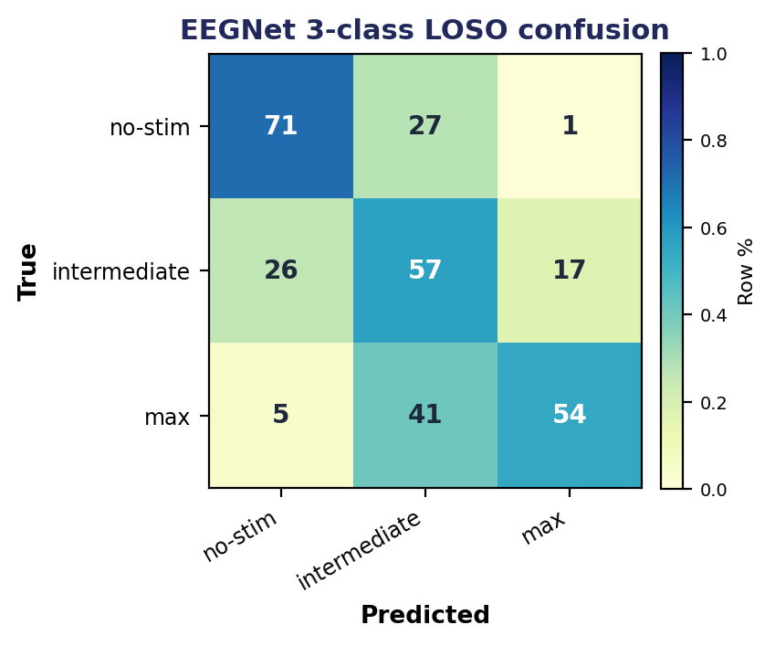
EEGNET · 3-CLASS
Network, setup, and performance
Architecture (EEGNet-8,2)
Input
60 ch × T samples × 1
Temporal conv
F1 = 8 filters, kernel 500 ms
Depthwise conv
D = 2 (spatial, per-channel)
Separable conv
F2 = 16 filters
Pooling
avg-pool ×4 then ×8
Dropout
0.25 (cross) / 0.50 (within)
Head
dense → softmax
Results & reading
Training setup
63.4%
59.8%
1.79×
no-stim best separated (71% recall); the intermediate (min+medium merged) class is the hardest, bleeding into no-stim. LOSO ≈ within shows the model generalizes across subjects but plateaus at the same place the LDA does.
Optimizer
Adam, lr 1e-3, batch 32
Epochs
up to 500, early-stop pat. 50
within-subject
LOSO
vs chance (33%)
LR schedule
halve on plateau (pat. 20)
Class weights
balanced
Scaler / seed
per-channel z-score · 42

Slide 5
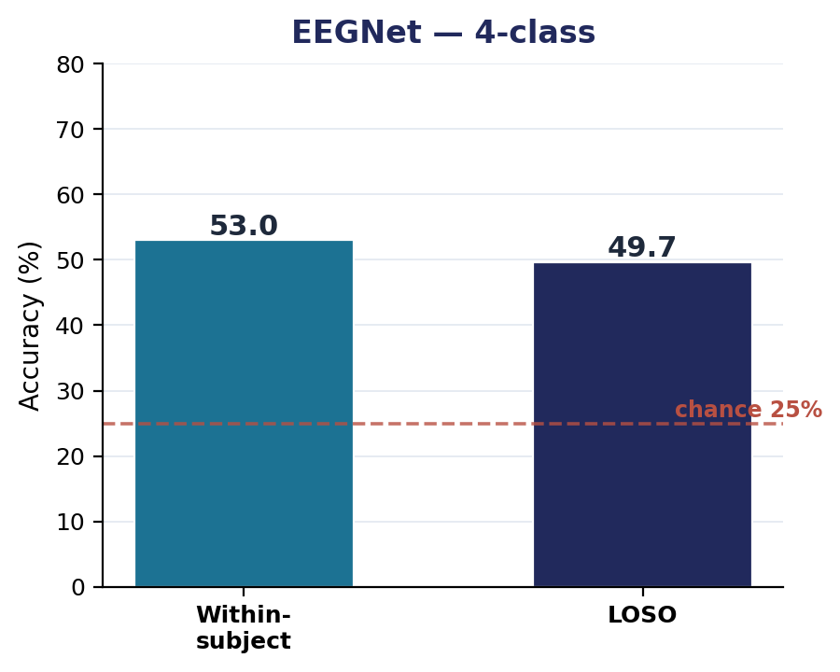
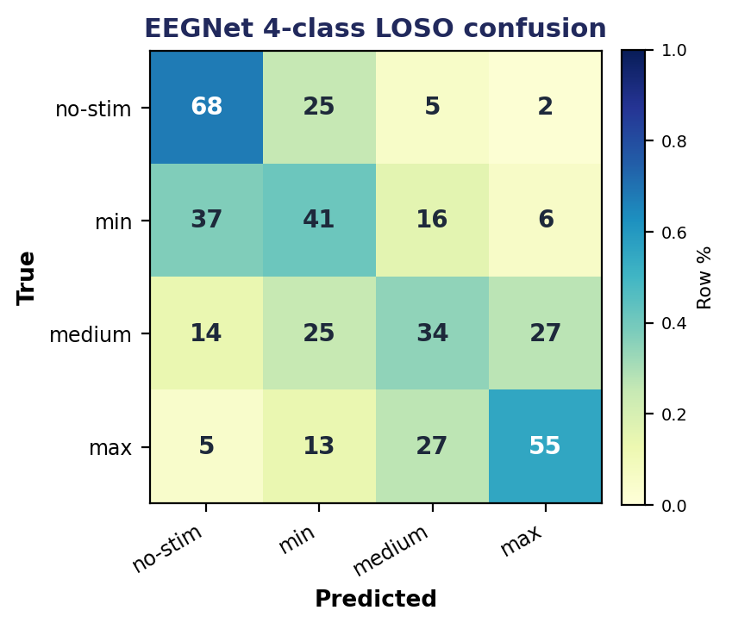
EEGNET · 4-CLASS
Network, setup, and performance
Architecture (EEGNet-8,2)
Input
60 ch × T samples × 1
Temporal conv
F1 = 8 filters, kernel 500 ms
Depthwise conv
D = 2 (spatial, per-channel)
Separable conv
F2 = 16 filters
Pooling
avg-pool ×4 then ×8
Dropout
0.25 (cross) / 0.50 (within)
Head
dense → softmax
Results & reading
Training setup
53.0%
49.7%
1.99×
min ↔ medium collapse. Recall is 41% (min) and 34% (medium) — the two adjacent low-intensity classes look alike in EEG. no-stim (68%) and max (55%) stay best separated.
Optimizer
Adam, lr 1e-3, batch 32
Epochs
up to 500, early-stop pat. 50
within-subject
LOSO
vs chance (25%)
LR schedule
halve on plateau (pat. 20)
Class weights
balanced
Scaler / seed
per-channel z-score · 42

Slide 6
Part 2: Shrinkage LDA
Hand-built ERP & band-power features → linear discriminant analysis

Slide 7
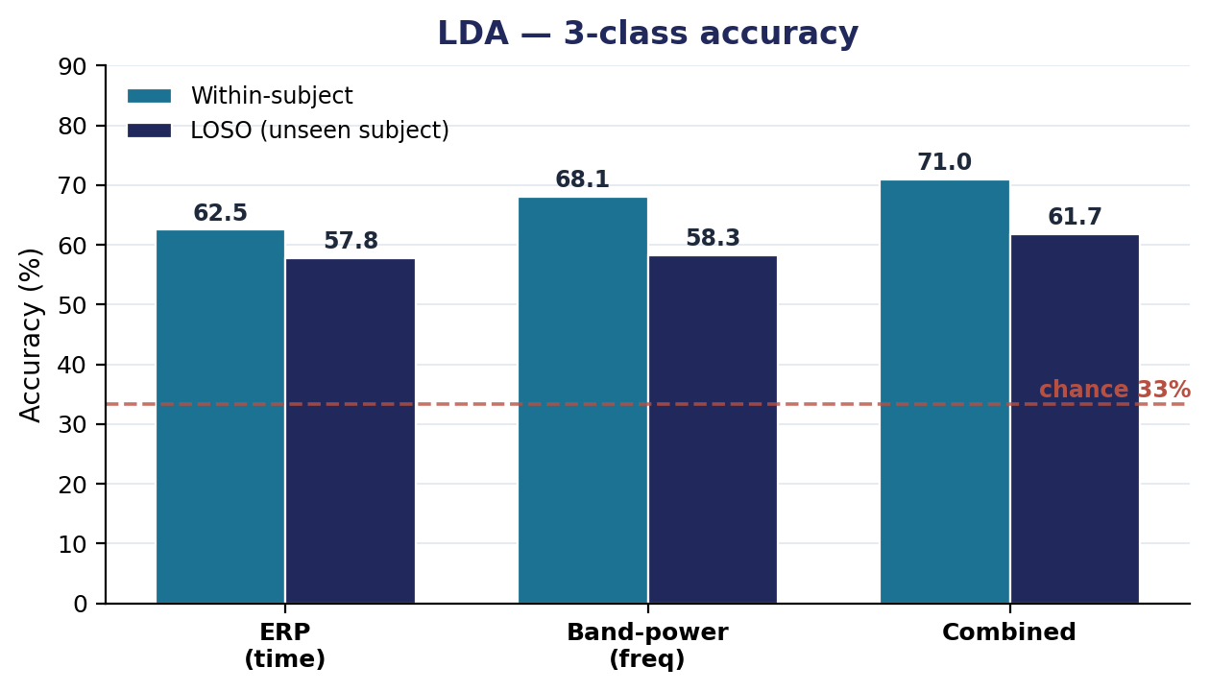
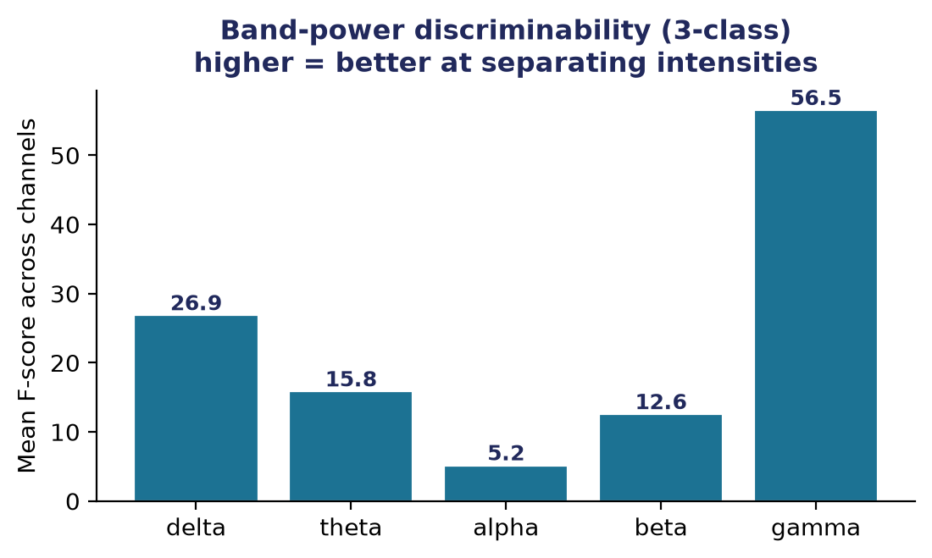
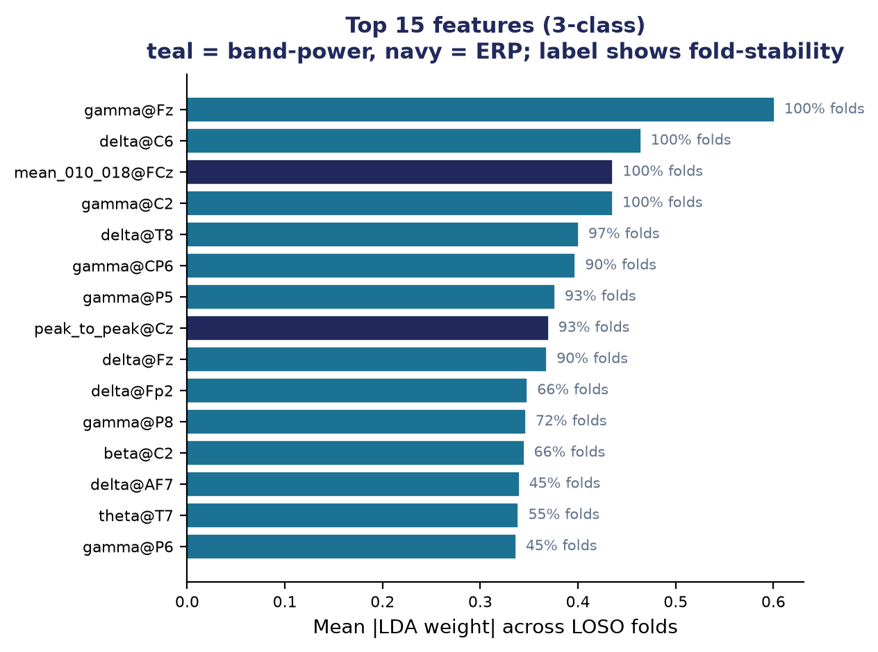
LDA · 3-CLASS
Features, pipeline, and per-model performance
Three feature pipelines
ERP (time)
Peak amplitude/latency & mean-window features on 8 central channels — the evoked SEP.
Band-power (freq)
log Welch PSD in delta/theta/alpha/beta/gamma across all 60 channels — the induced response.
Combined
ERP ⊕ band-power concatenated — distinct neural phenomena, non-redundant features.
Validation pipeline
features → StandardScaler → shrinkage-LDA
LOSO (cross-subject)
Within-subject
Combined wins both. Band-power alone edges ERP; fusing them adds ~3 pts. Best cross-subject result of any model here.
57.8 / 58.3 / 61.7
62.5 / 68.1 / 71.0
Leakage-safe: extractors use no labels; scaler & LDA fit inside each fold. LOSO adds per-subject z-scoring. Artifact filter drops high baseline-SD trials.
ERP / BP / Combined %
ERP / BP / Combined %

Slide 8
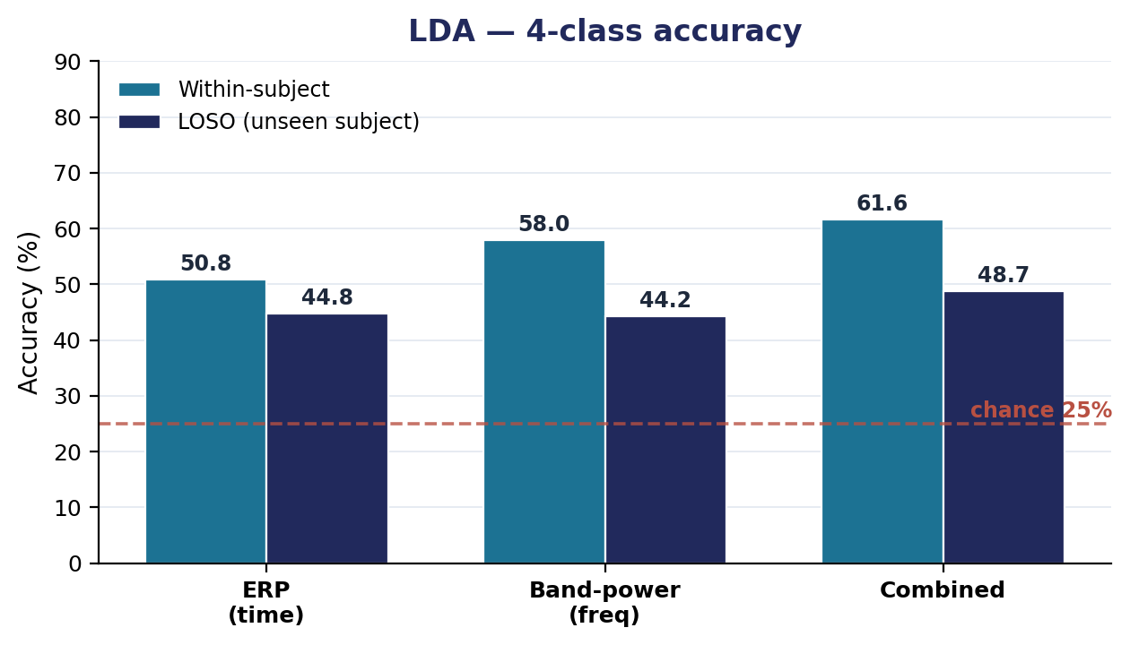
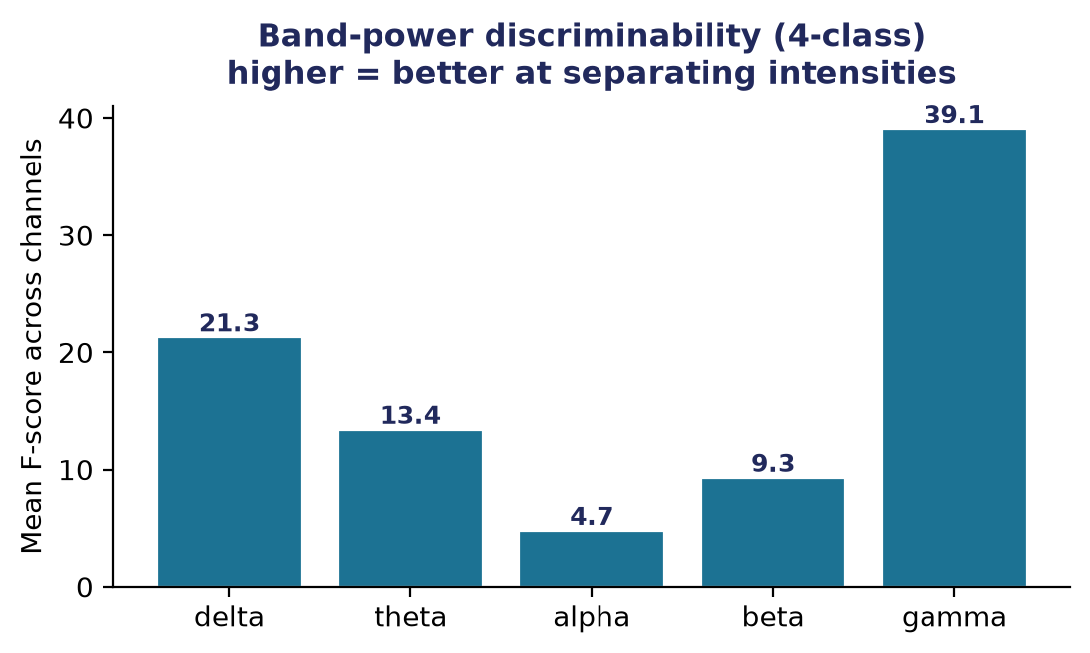
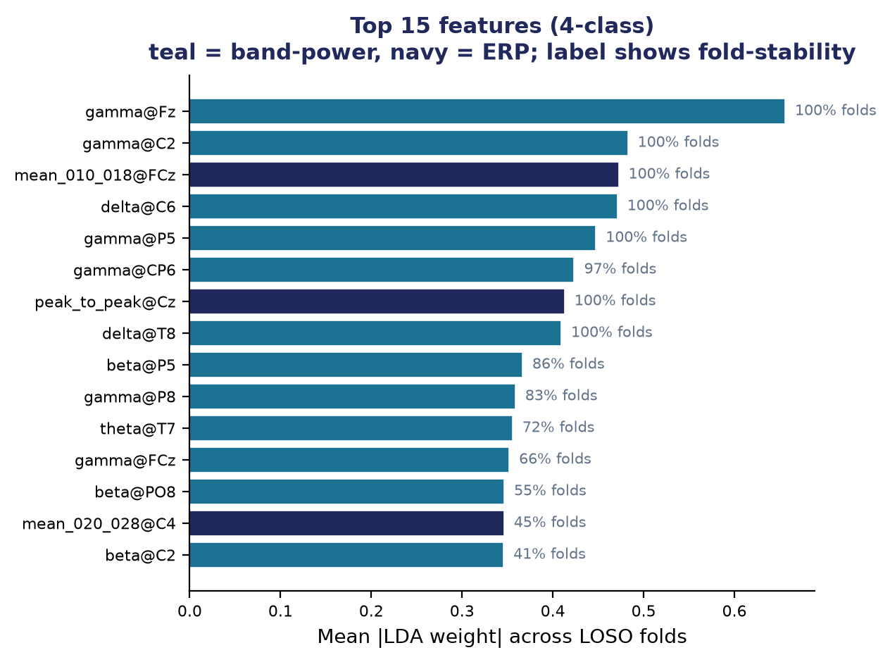
LDA · 4-CLASS
Features, pipeline, and per-model performance
Three feature pipelines
ERP (time)
Peak amplitude/latency & mean-window features on 8 central channels — the evoked SEP.
Band-power (freq)
log Welch PSD in delta/theta/alpha/beta/gamma across all 60 channels — the induced response.
Combined
ERP ⊕ band-power concatenated — distinct neural phenomena, non-redundant features.
Validation pipeline
features → StandardScaler → shrinkage-LDA
LOSO (cross-subject)
Within-subject
Combined still best. Cross-subject the extra class costs ~13 pts vs 3-class; the min↔medium overlap is the ceiling.
44.8 / 44.2 / 48.7
50.8 / 58.0 / 61.6
Same leakage-safe design. 4th class (min_intensity) is the only difference — it sits between no-stim and medium.
ERP / BP / Combined %
ERP / BP / Combined %

Slide 9
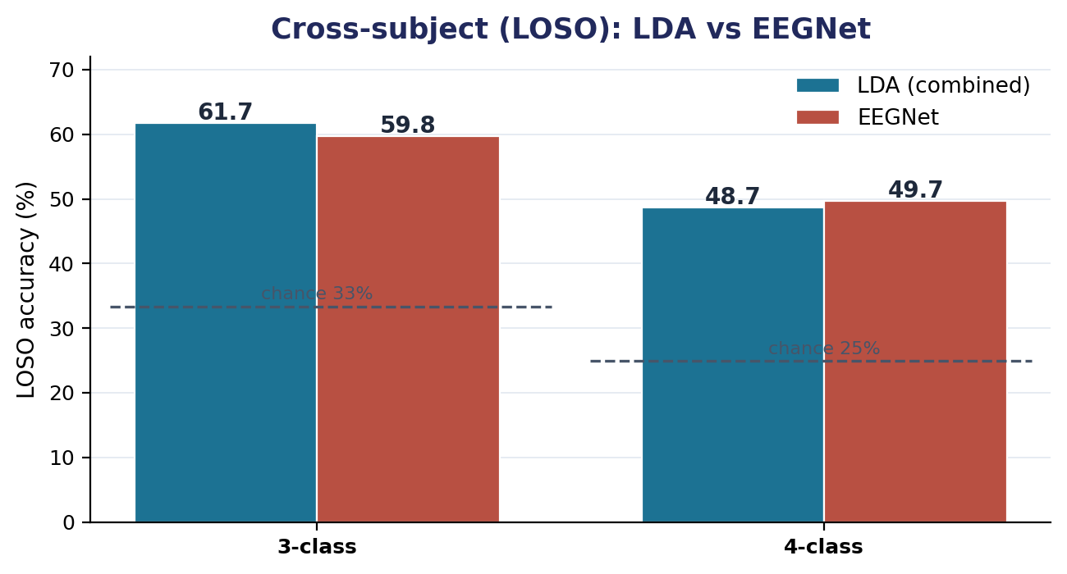
HEAD TO HEAD
Which model, and what it means
Near-tie cross-subject
On LOSO the combined-LDA (61.7% / 48.7%) and EEGNet (59.8% / 49.7%) are within ~2 pts at both class counts.
LDA is the better deal
It matches EEGNet with a closed-form fit in seconds, full interpretability, and no GPU, EEGNet needs 30 LOSO folds of training.
Shared ceiling
Both models fail the same way: adjacent low-intensity classes (min↔medium) overlap.
The combined ERP + band-power LDA is the keeper. We see equal cross-subject accuracy to EEGNet, a fraction of the cost, and it tells you why (gamma↑/alpha↓ activation, dose-dependent SEP). EEGNet is the validation that a learned model finds the same signal.

