Slide 1
DECODING STIMULATION INTENSITY FROM EEG
Time-domain & frequency-domain decoding of EMS haptic-shock intensity,
comparing shrinkage-LDA, EEGNet, and a 4-family stacking ensemble.
29 subjects · 60 channels · 3-class · 4-class · stacking · LOSO + within-subject

Slide 2
DATA COLLECTION
How the EEG was recorded & prepared
60
1000 Hz
250 Hz
160
EEG channels
Acquisition rate
Analysis rate
Epochs / subject
10-20 montage, central/fronto-central focus for the somatosensory response
Notch-filtered at 50 Hz; band-pass up to 100 Hz on the raw recording
Anti-aliased decimation by 4 (FIR low-pass) before feature extraction
Stimulus-locked trials, balanced across intensity conditions
Preprocessing & epoching pipeline
Raw EEG
›
Downsample ÷4
›
Epoch
›
Crop window
›
Label scheme
1000 Hz · notch 50 · BP 100
→ 250 Hz, anti-aliased
stimulus-locked
−0.2 → +1.5 s
3-class / 4-class
**Note: 31 subjects were recorded, but subjects 10 and 24 have been removed from training sets.

Slide 3
Part 1: EEGNet
A compact convolutional network learning its own filters from raw EEG

Slide 4
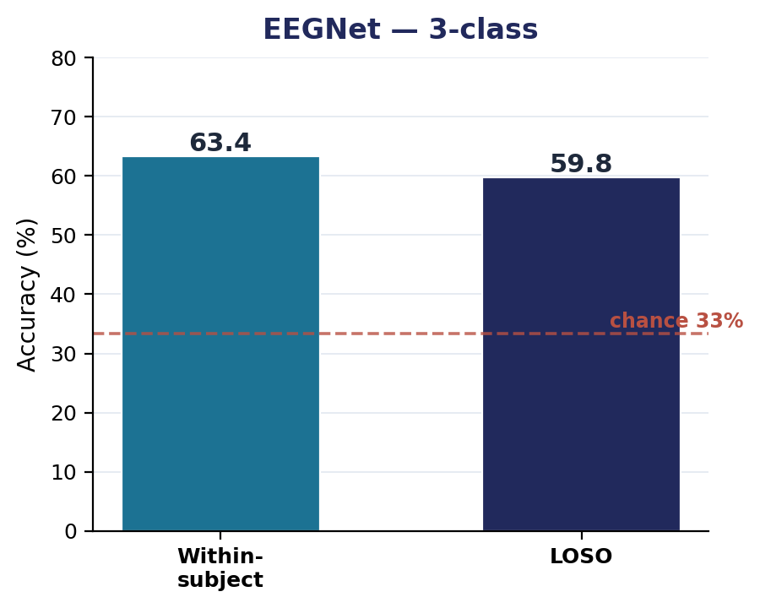
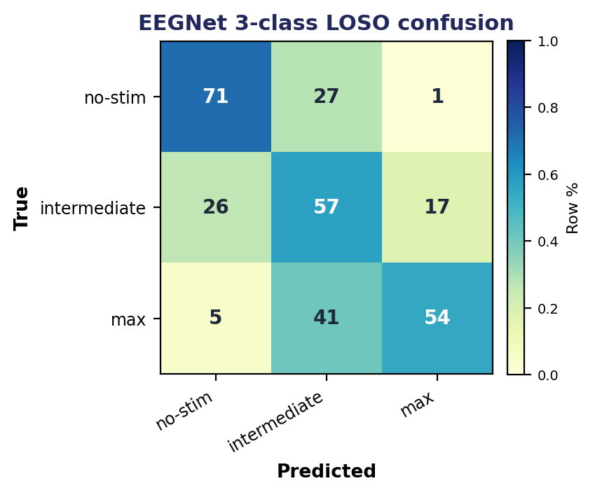
EEGNET · 3-CLASS
Network, setup, and performance
Architecture (EEGNet-8,2)
Input
60 ch × T samples × 1
Temporal conv
F1 = 8 filters, kernel 500 ms
Depthwise conv
D = 2 (spatial, per-channel)
Separable conv
F2 = 16 filters
Pooling
avg-pool ×4 then ×8
Dropout
0.25 (cross) / 0.50 (within)
Head
dense → softmax
Results & reading
Training setup
63.4%
59.8%
1.79×
no-stim best separated (71% recall); the intermediate (min+medium merged) class is the hardest, bleeding into no-stim. LOSO ≈ within shows the model generalizes across subjects but plateaus at the same place the LDA does.
Optimizer
Adam, lr 1e-3, batch 32
Epochs
up to 500, early-stop pat. 50
within-subject
LOSO
vs chance (33%)
LR schedule
halve on plateau (pat. 20)
Class weights
balanced
Scaler / seed
per-channel z-score · 42

Slide 5
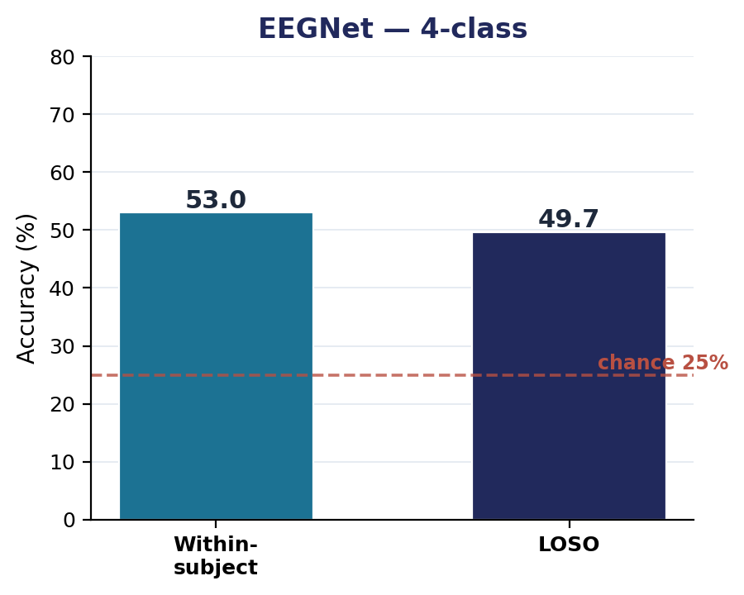
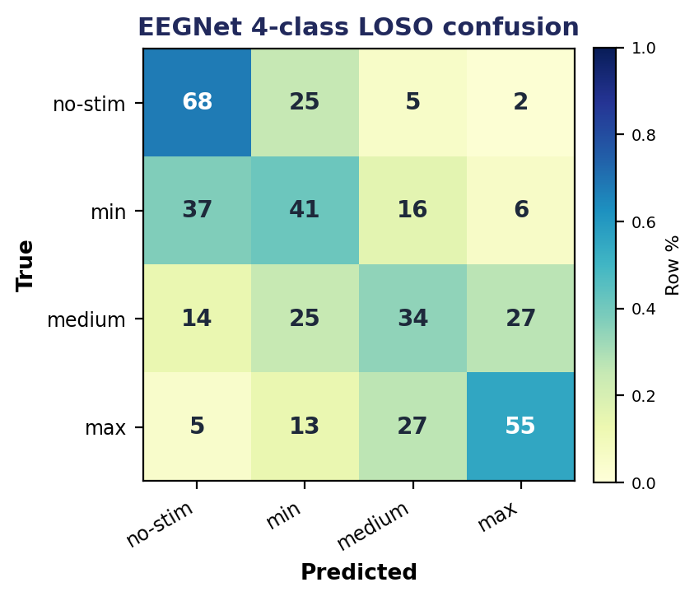
EEGNET · 4-CLASS
Network, setup, and performance
Architecture (EEGNet-8,2)
Input
60 ch × T samples × 1
Temporal conv
F1 = 8 filters, kernel 500 ms
Depthwise conv
D = 2 (spatial, per-channel)
Separable conv
F2 = 16 filters
Pooling
avg-pool ×4 then ×8
Dropout
0.25 (cross) / 0.50 (within)
Head
dense → softmax
Results & reading
Training setup
53.0%
49.7%
1.99×
min ↔ medium collapse. Recall is 41% (min) and 34% (medium) — the two adjacent low-intensity classes look alike in EEG. no-stim (68%) and max (55%) stay best separated.
Optimizer
Adam, lr 1e-3, batch 32
Epochs
up to 500, early-stop pat. 50
within-subject
LOSO
vs chance (25%)
LR schedule
halve on plateau (pat. 20)
Class weights
balanced
Scaler / seed
per-channel z-score · 42

Slide 6
Part 2: Shrinkage LDA
Hand-built ERP & band-power features → linear discriminant analysis

Slide 7
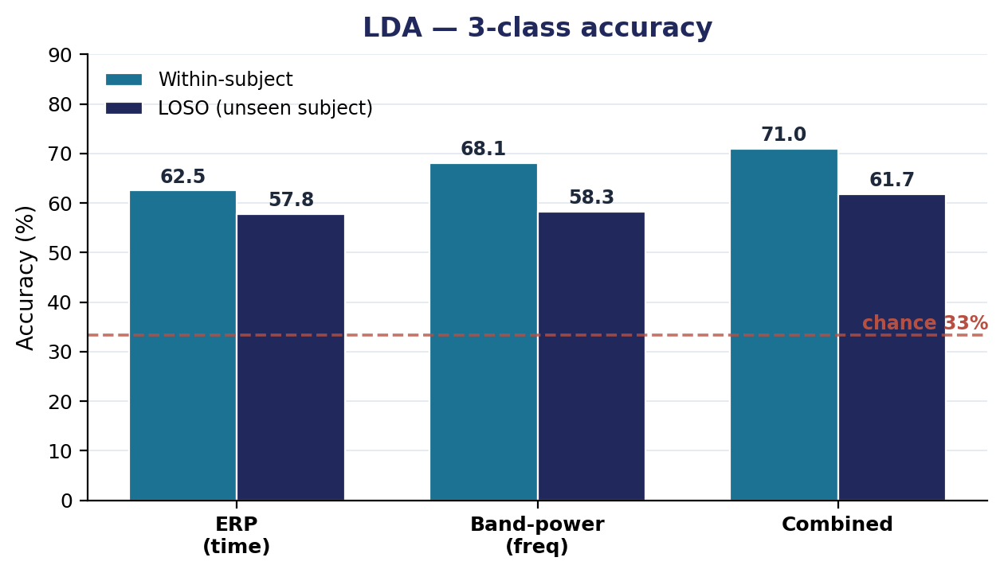
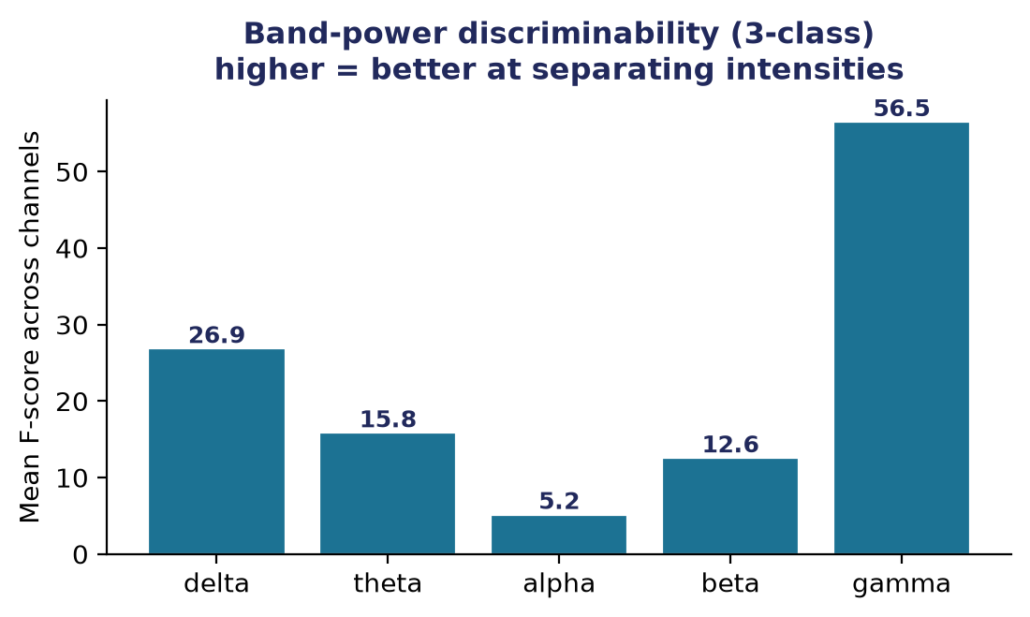
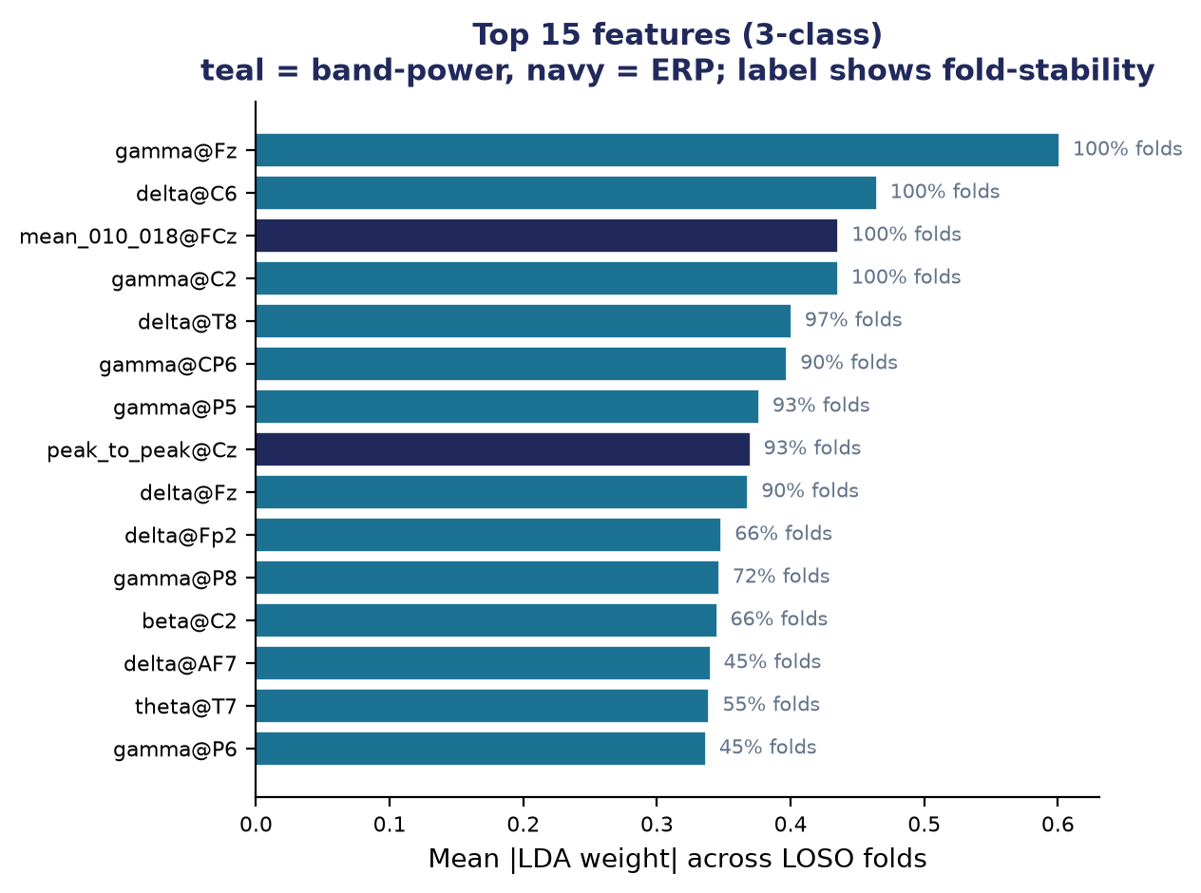
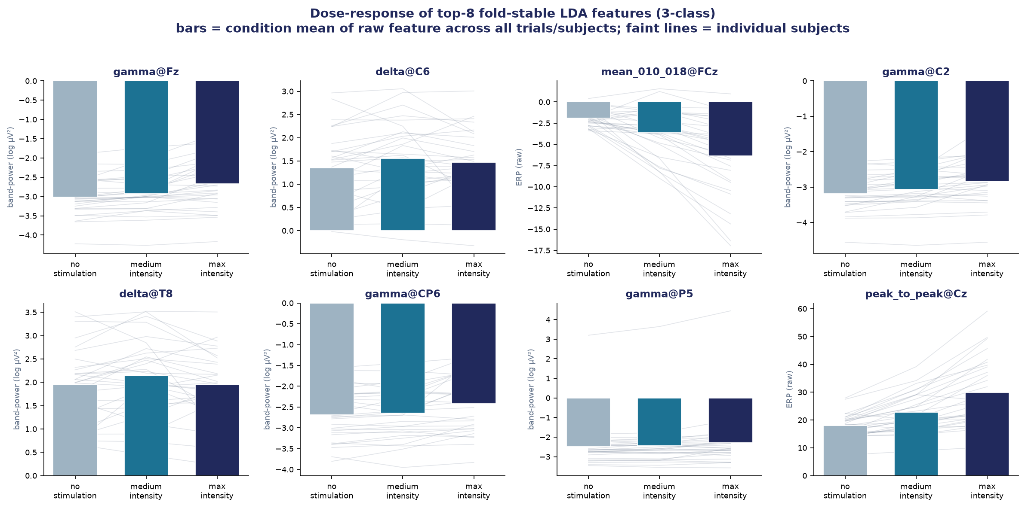
LDA · 3-CLASS
Features, pipeline, and per-model performance
Three feature pipelines
ERP (time)
Peak amplitude/latency & mean-window features on 8 central channels — the evoked SEP.
Band-power (freq)
log Welch PSD in delta/theta/alpha/beta/gamma across all 60 channels — the induced response.
Combined
ERP ⊕ band-power concatenated — distinct neural phenomena, non-redundant features.
Validation pipeline
features → StandardScaler → shrinkage-LDA
Within-subject
LOSO (cross-subject)
Combined wins both. Band-power alone edges ERP; fusing them adds ~3 pts. Best cross-subject result of any model here.
62.5 / 68.1 / 71.0
57.8 / 58.3 / 61.7
Leakage-safe: extractors use no labels; scaler & LDA fit inside each fold. LOSO adds per-subject z-scoring. Artifact filter drops high baseline-SD trials.
ERP / BP / Combined %
ERP / BP / Combined %

Slide 8
LDA · 3-CLASS · 7-CHANNEL DEVICE
Does a deployable montage hold up?
The 7-channel montage
60 channels vs 7 channels (LOSO)
Chosen from fold-stable feature importance: the fronto-central cluster where the somatosensory response concentrates.
61.7%
59.8%
FCz
Fz
FC2
FC4
Cz
Only 1.9 points lost dropping from 60 channels to 7. The intensity signal is concentrated, not spread, so the montage is cheap.
C2
C4
7ch is 1.79x chance (33%).
full 60ch
7ch device
LOSO (cross-subject)
Within-subject
61.7% → 59.8%
71.0% → 68.1%
Under 2 pts lost. 7 fronto-central channels retain ~97% of full-montage LOSO accuracy.
60ch → 7ch
60ch → 7ch

Slide 9
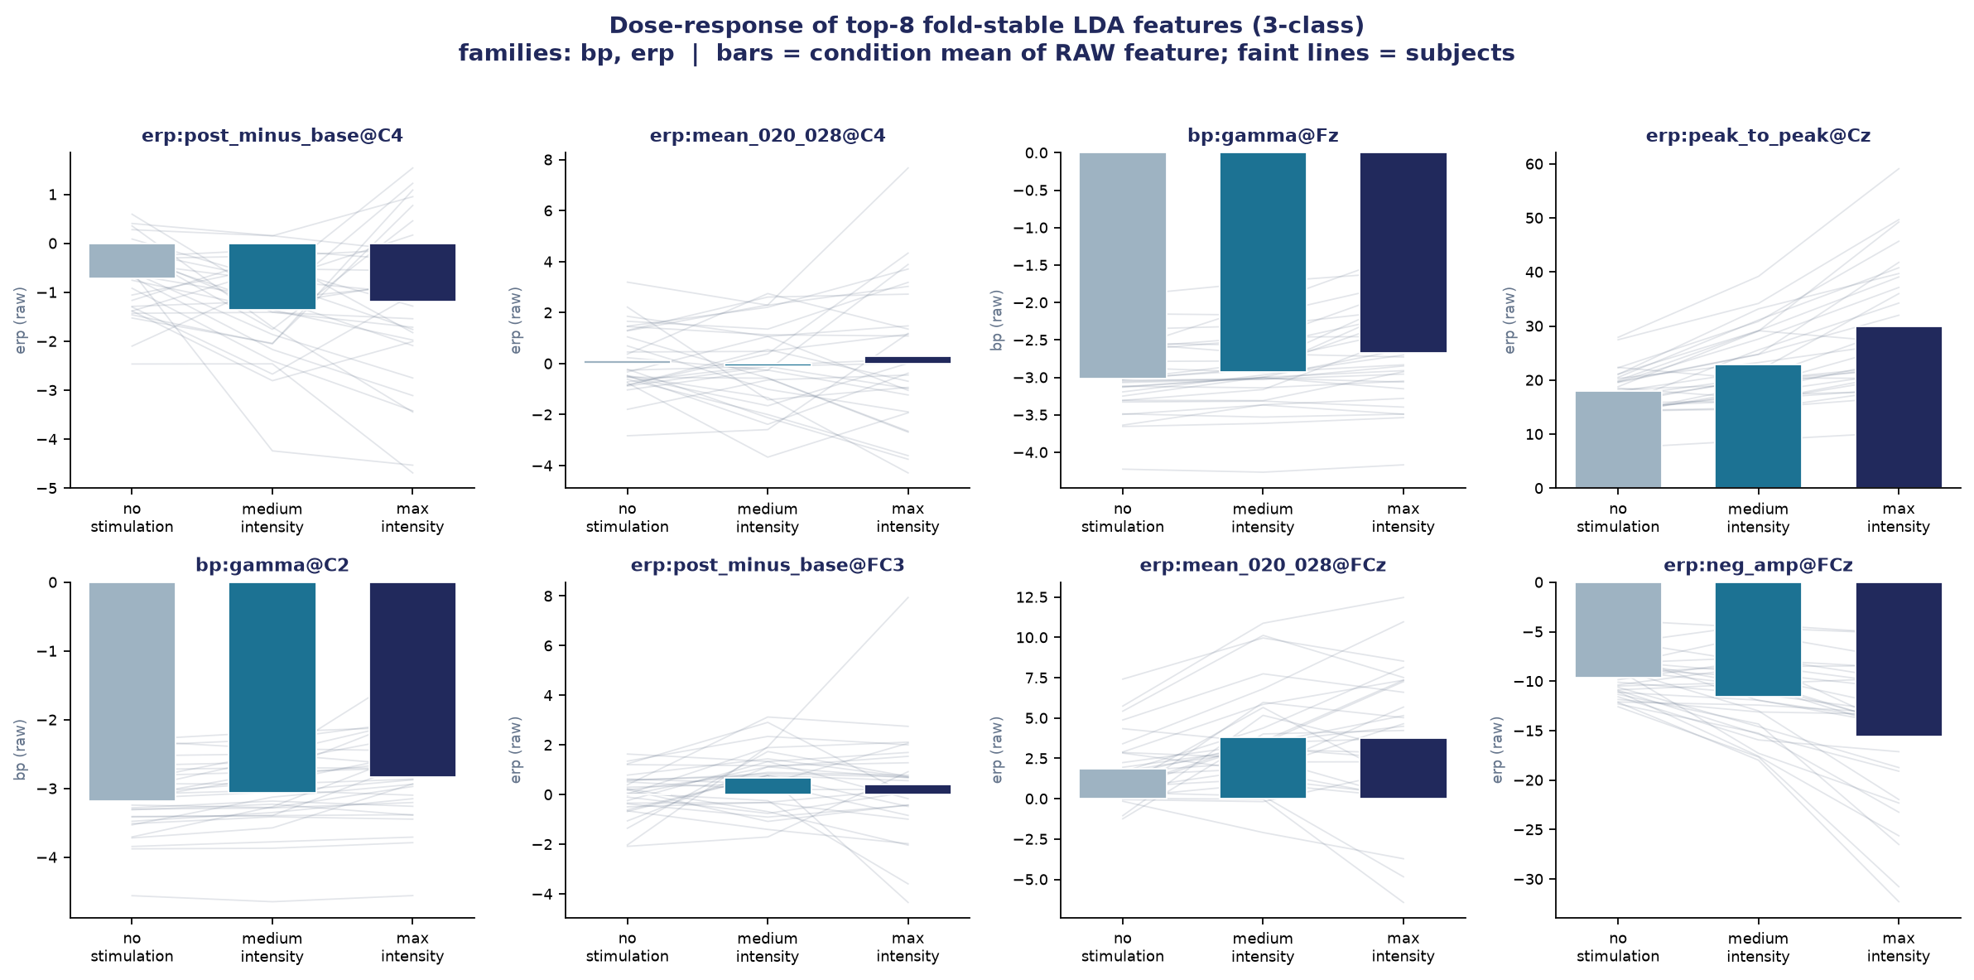
LDA · 3-CLASS · BALANCED (40/40/40)
Removing no-stimulation: the pure-intensity question
40 / 80 / 40 (with no-stim)
Includes an easy stim-vs-no-stim contrast; the "medium" class is min+medium merged. erp+bp: LOSO 62.8% / 59.9% balanced.
40 / 40 / 40 (balanced)
no_stimulation dropped; min vs medium vs max only. erp+bp: LOSO 58.0% / 58.1% balanced, within-subject 69.0%.
What it proves
Only a modest drop without the easy class — the decoder genuinely separates graded intensity, not just whether a pulse occurred.
Balancing to 40/40/40 isolates the real question — discriminating stimulation levels. Chance is a clean 33%, so accuracy is directly interpretable with no majority-class caveat.

Slide 10
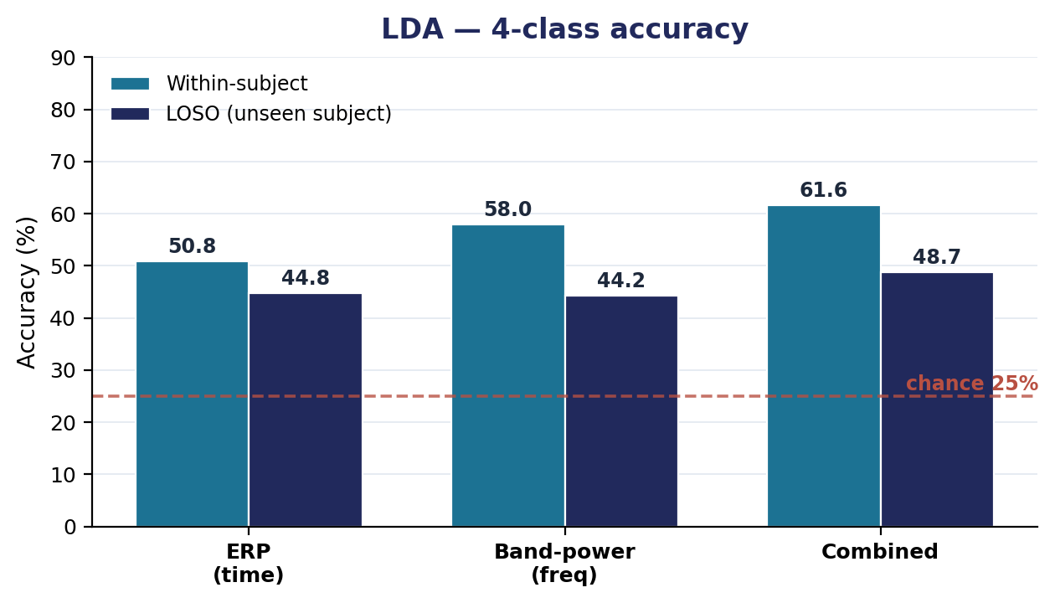
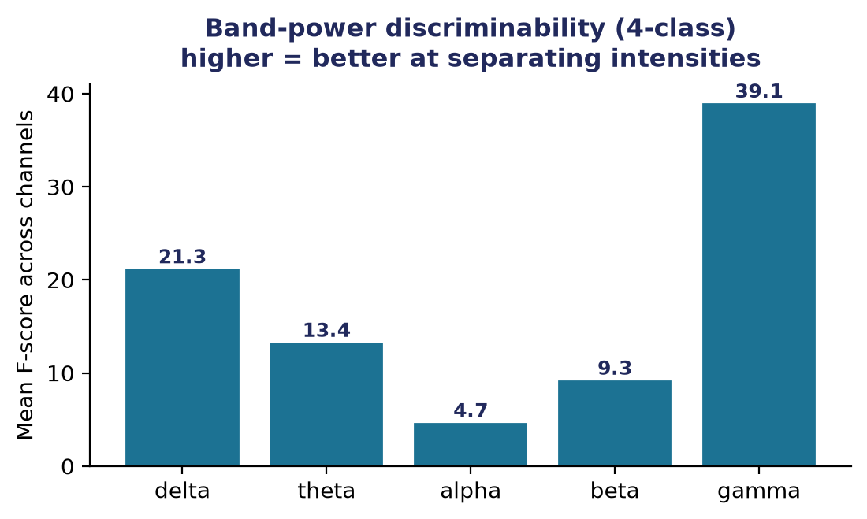
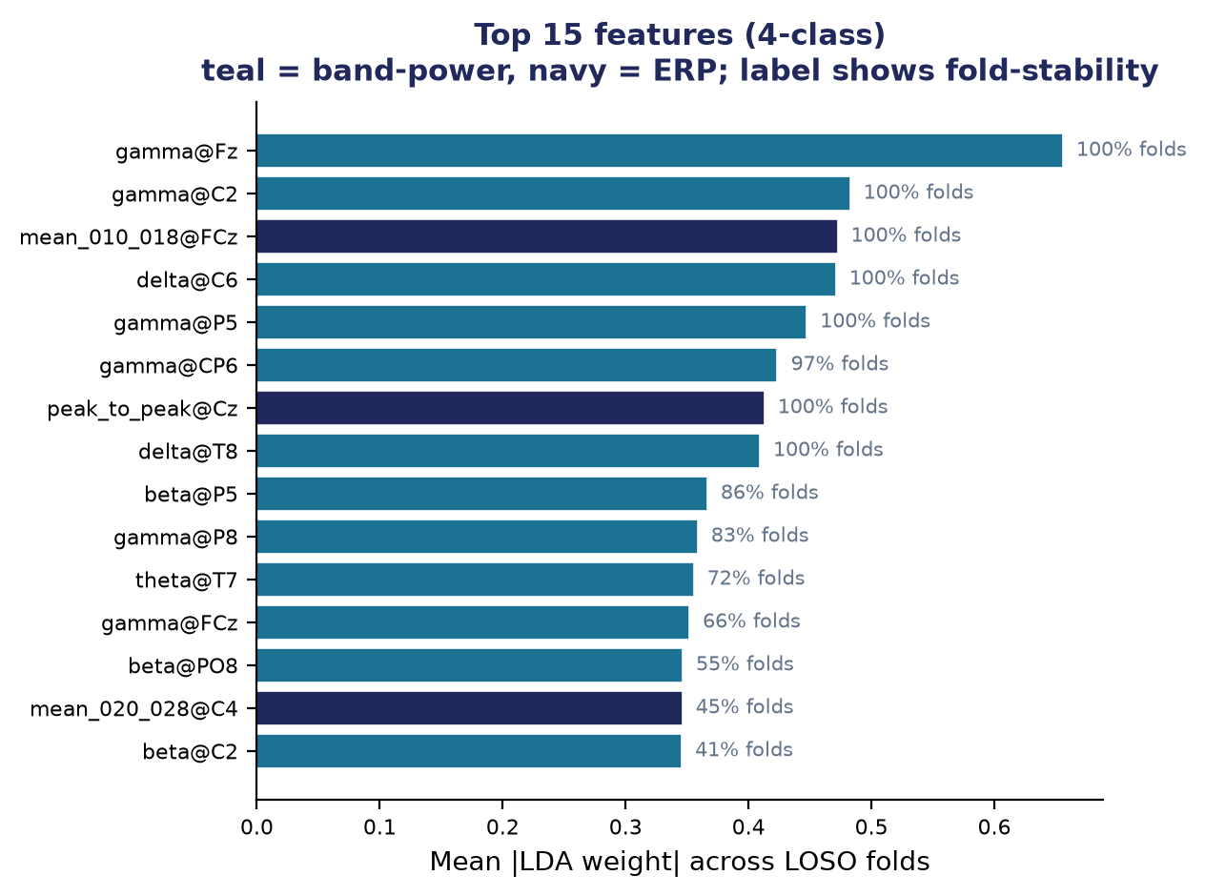
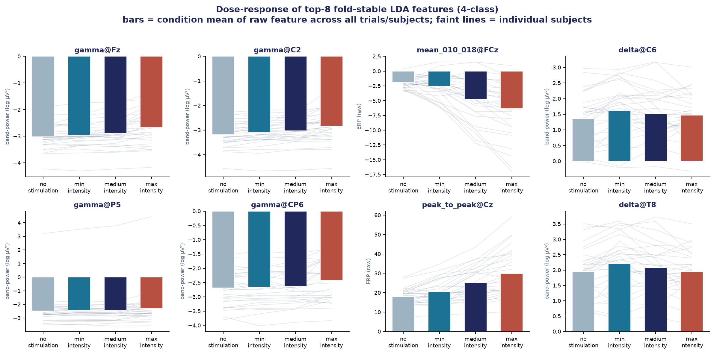
LDA · 4-CLASS
Features, pipeline, and per-model performance
Three feature pipelines
ERP (time)
Peak amplitude/latency & mean-window features on 8 central channels — the evoked SEP.
Band-power (freq)
log Welch PSD in delta/theta/alpha/beta/gamma across all 60 channels — the induced response.
Combined
ERP ⊕ band-power concatenated — distinct neural phenomena, non-redundant features.
Validation pipeline
features → StandardScaler → shrinkage-LDA
Within-subject
LOSO (cross-subject)
Combined still best. Cross-subject the extra class costs ~13 pts vs 3-class; the min↔medium overlap is the ceiling.
50.8 / 58.0 / 61.6
44.8 / 44.2 / 48.7
Same leakage-safe design. 4th class (min_intensity) is the only difference — it sits between no-stim and medium.
ERP / BP / Combined %
ERP / BP / Combined %

Slide 11
LDA · 4-CLASS · 7-CHANNEL DEVICE
Does a deployable montage hold up?
The 7-channel montage
60 channels vs 7 channels (LOSO)
Chosen from fold-stable feature importance: the fronto-central cluster where the somatosensory response concentrates.
48.7%
47.3%
FCz
Fz
FC2
FC4
Cz
Only 1.4 points lost dropping from 60 channels to 7. The intensity signal is concentrated, not spread, so the montage is cheap.
C2
C4
full 60ch
7ch device
7ch is 1.89x chance (25%).
LOSO (cross-subject)
Within-subject
48.7% → 47.3%
61.6% → 57.2%
Same story as 3-class. Dropping to 7 channels costs ~1.4 pts cross-subject. min↔medium overlap stays the ceiling.
60ch → 7ch
60ch → 7ch

Slide 12
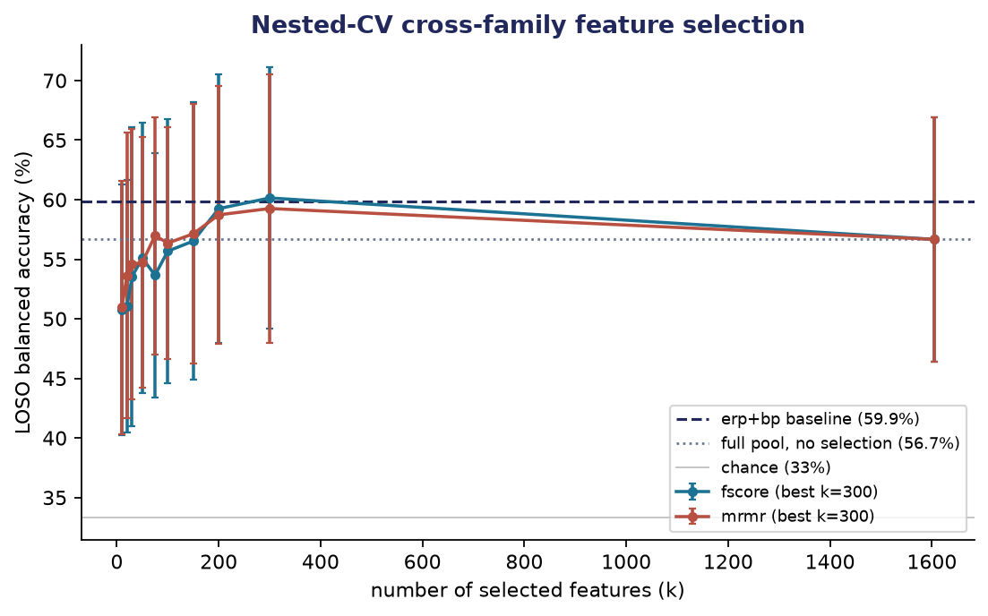
WHAT DIDN'T WORK
Approaches tested and rejected
Time-frequency (ERD/ERS)
erp+bp+tf -> LOSO 57.4% (vs 62.8%). The 1200 ERD/ERS features dilute the model; the time-frequency domain is less discriminative than time or frequency alone.
Riemannian covariance
riem alone LOSO 57.5%; concatenated with erp+bp 59.7% — both below the 62.8% baseline. As a single feature block it only dilutes.
Selection & montage
Nested-CV feature selection across erp+bp+tf never beat erp+bp (best 60.1% vs 59.9%). The XON frontal-parietal montage was far worse (46.9%).
The recurring failure mode is dilution: with ~120-160 trials/subject, piling features into one vector hurts cross-subject accuracy. erp+bp is the ceiling of single-vector linear feature engineering.

Slide 13
Part 3: Stacking ensemble
Fusing per-family LDAs at the decision level — the best model

Slide 14
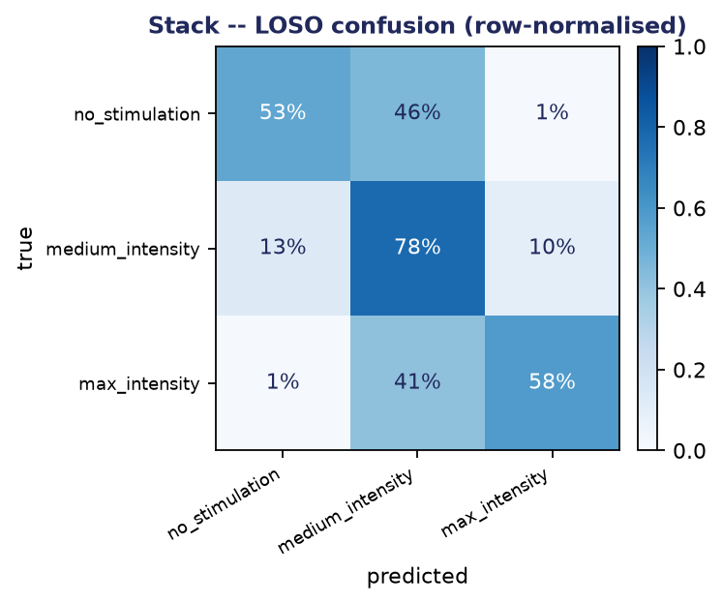
STACKING · 3-CLASS · BEST MODEL
Per-family LDAs fused by a meta-learner
Architecture
One shrinkage-LDA per family (ERP, band-power, ERD/ERS, Riemannian). A logistic meta-learner fuses their class probabilities based on correctness during learning.
Results
Within 73.0% / 70.2% bal, LOSO 66.7% / 63.0% bal. This is +3.9 / +3.1 over erp+bp, which is the only method that beats it.
Why it works
The weaker but complementary views help when they’re fused after decision, not concatenated pre inference, as their errors decorrelate from ERP/band-power. Meta-weights (LOSO): erp .37 / bp .32 / riem .20 / tf .11.
Decision-level fusion beats feature concatenation. Riemannian features here earn some real weight in the ensemble. The gain is concentrated in LOSO, the cross-subject metric that matters.

Slide 15
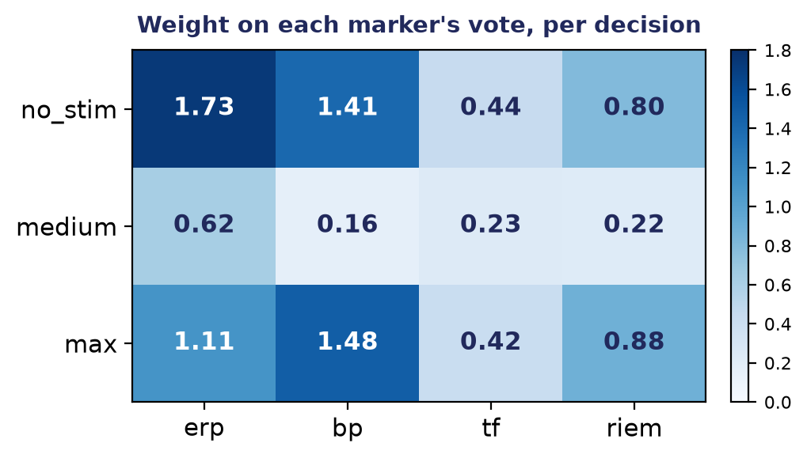
WHY THE META-LEARNER'S WEIGHTS ARE NEUROSCIENCE
Decision Weighting
Presence ← ERP + gamma BP
With no stim, there is no evoked potential and no induced gamma so the absence of both the is the cleanest evidence that no afferent volley reached cortex, so the two strong markers dominate.
Max intensity ← induced gamma
The strongest input drives the gamma response in sensorimotor cortex as per Wanjoo’s observations (gamma power scales with stimuli), so the spectral marker becomes the most diagnostic signal for high intensity.
Medium class is ambiguous
For the middle class, every weight is small (<=+0.62), as no marker is confident. The trace exposes the difficulty and matches where the confusion matrix concentrates.

Slide 16
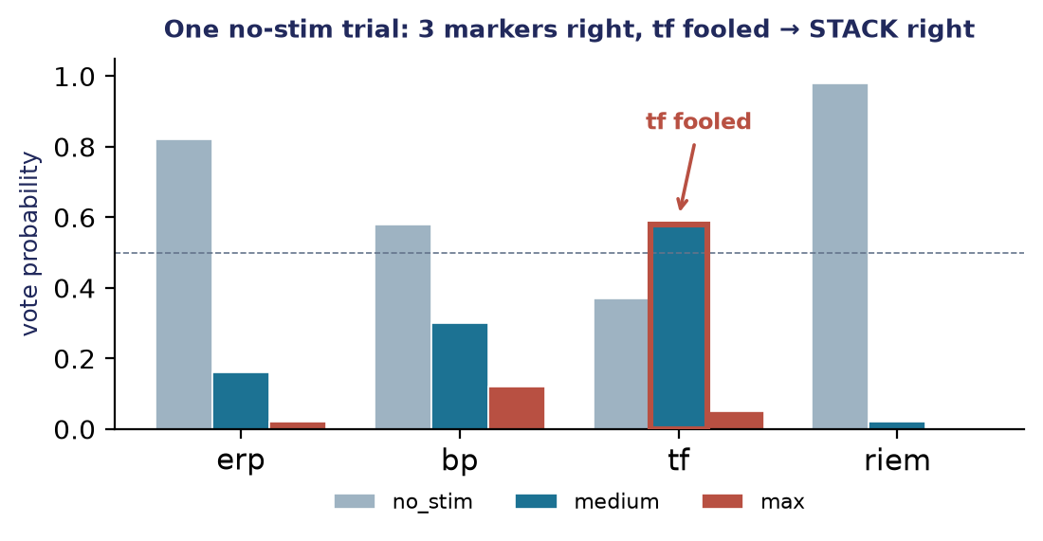
A BACKTRACK
Trace of a no-stim trial
End-to-end decision calculation
decision = SUM (meta-weight x family vote)
family vote = SUM (LDA coef x feature)
feature = a named amplitude/band at a named electrode & latency
One trial (true: no-stim)
erp 0.82 (no SEP) · bp 0.58 (no induced gamma) · riem 0.98 (no network engagement) but tf votes 0.58 medium (incorrectly), fooled by baseline-rhythm fluctuation, a known weakness of single-trial ERD.
Principled override
The three independent, reliable markers carry more weight and agree; the meta-learner's low tf weight (.11) reflects its unreliability in this area.
tf is fooled because ERD is defined relative to baseline, and sensorimotor rhythms dip spontaneously, so it read a random baseline wobble as a stimulus response. For this reason, the ensemble model’s multi-decisional architecture is capable of providing weight to different features for different class-trials, enhancing explainability by improving the model’s decisions in all regions by electing the most trusting candidate.

Slide 17
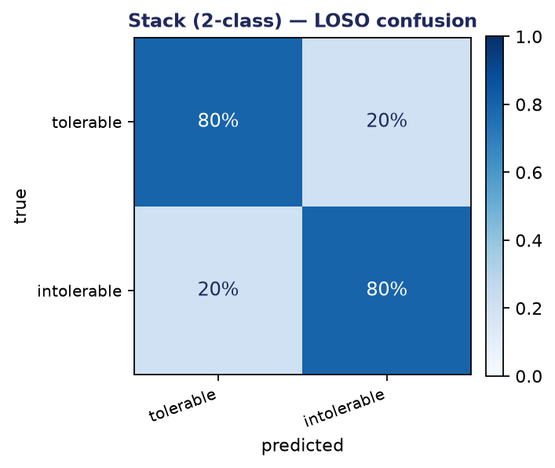
STACKING · 2-CLASS · TOLERABLE vs INTOLERABLE
Detecting high-intensity (intolerable) stimulation
The reframing
Bottom three intensities merged into 'tolerable' (120) vs 'intolerable' (40). The 75/25 imbalance is handled with uniform LDA priors + a class-balanced meta-learner (Options 1 & 2).
Results
LOSO 79.9% balanced · within 87.3%. ROC-AUC 0.88 / 0.94. Intolerable recall 0.80 (LOSO). The minority class is genuinely detected, not ignored (majority baseline 75%).
What marks intolerable
Elevated fronto-central gamma-band power and a larger central evoked-potential (SEP) amplitude (both known to scale with stimulus intensity) are the top discriminators.
Collapsing to tolerable vs intolerable cleanly separates high-intensity EMS (cross-subject ROC-AUC 0.88) and surfaces its neural signature — the basis for a discomfort-aware stop trigger.

Slide 18
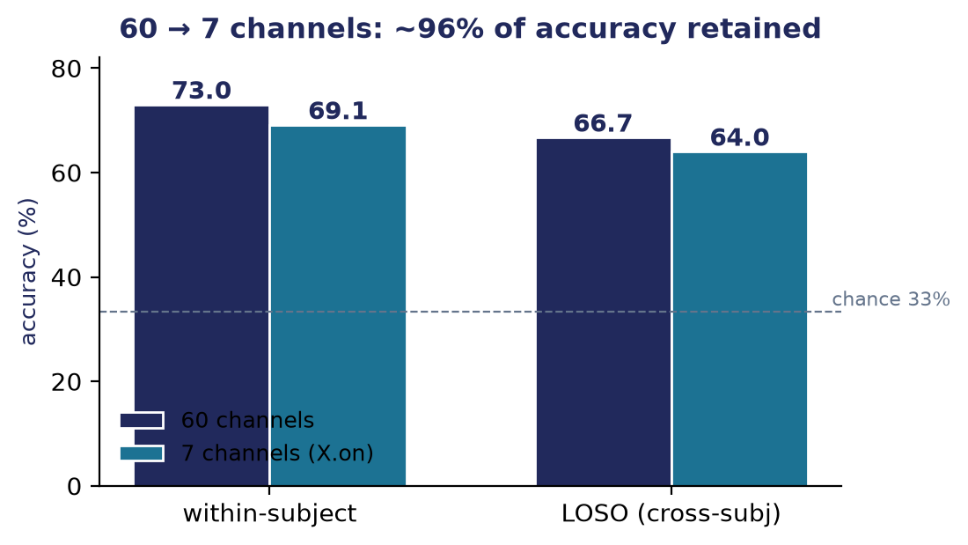
X.ON DEVICE · 7-CHANNEL REDUCTION
7 electrodes: deployable without losing fidelity
The reduction
60 -> 7 channels (F3, F4, C3, Cz, C4, P3, P4). Feature count 3434 -> 294 (12x smaller): erp 91, bp 35, tf 140, riem 28. Identical 4-family stack, every family restricted to the 7 electrodes.
Impact on performance
LOSO accuracy 64.0% (balanced 59.8%) vs the full 60-channel stack's 66.7% (balanced 63.0%). Within-subject 69.1% vs 73.0%. Only ~2-3 pts lost.
Still practical & robust
The meta-learner re-balances for 7 channels. Riem rises to 0.26 as its 28-feature covariance is now clean and low-dimensional. Same adjacent-intensity confusion; the within-subject sweep runs in ~20s.
A wearable headset needs few electrodes. The X.on 7-channel montage keeps the decoding fidelity of the full cap while being far cheaper and faster to acquire.

Slide 19
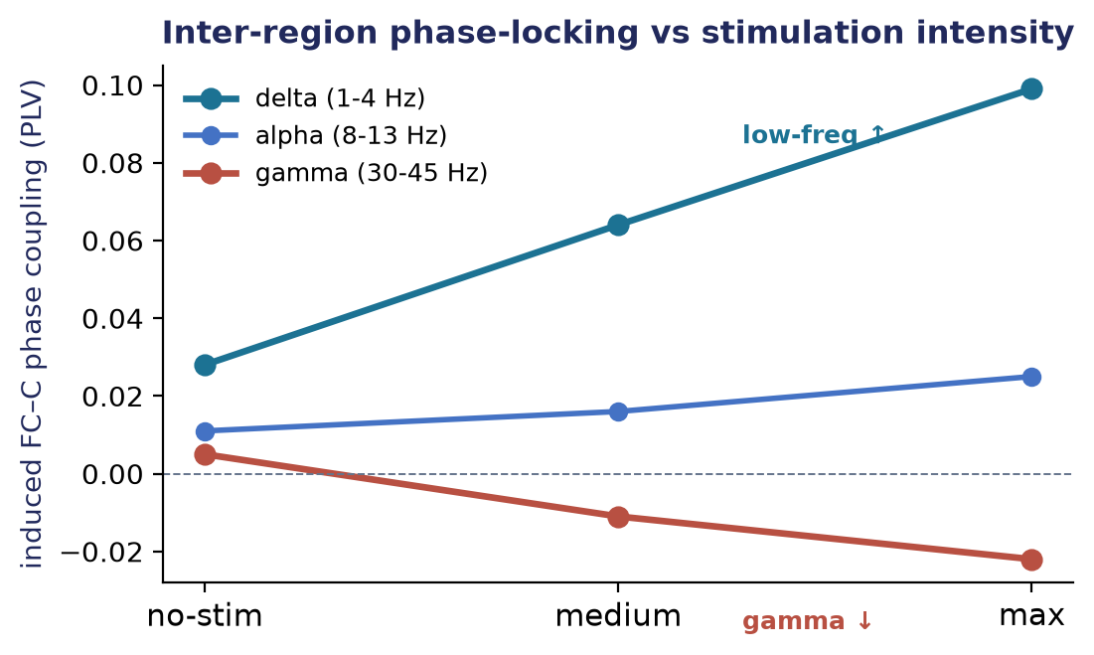
FUNCTIONAL CONNECTIVITY · PHASE COUPLING
Do FC/C/P regions phase-lock differently with intensity?
The method
Phase-locking (PLV) and volume-conduction-robust iPLV between FC / C / P regions, per band, per intensity — filter-Hilbert phase across trials, baseline-corrected, Friedman-tested over 29 subjects.
The finding
Low-frequency (delta/theta/alpha) inter-region coupling RISES dose-dependently with intensity (delta FC-C: +0.028 -> +0.064 -> +0.099); gamma coupling FALLS. Significant at p~0, robust to volume conduction.
Why it matters
Stronger EMS drives widespread low-frequency phase synchronization across the sensory network — an interpretable, physiologically-named measure of network engagement (vs opaque Riemannian covariance).
This becomes the per-trial 'conn' feature family: region-pair PLV/iPLV per band = 60 interpretable features (vs Riemannian's 1830).

Slide 20
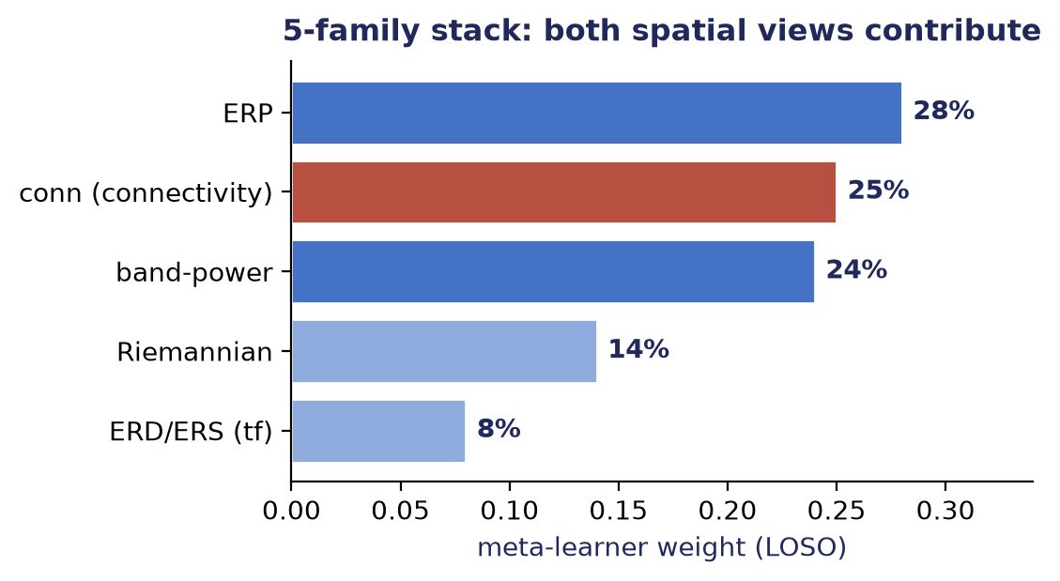
FINAL MODEL · 5-FAMILY STACK
Adding phase connectivity to the ensemble, the best decoder
The model
Five per-family LDAs fused by the meta-learner: ERP, band-power, ERD/ERS, Riemannian covariance, and phase connectivity (conn). Same leakage-safe LOSO protocol, all 60 channels.
Results
LOSO 68.1% / 64.8% balanced — the project's best. +1.8 balanced over the 4-family stacks, and ~+5 over the erp+bp baseline (chance 33%).
Why 5 helps
Connectivity and Riemannian are complementary, not redundant — the meta-learner keeps BOTH (conn 0.25, riem 0.14). Phase-locking and covariance capture partly different spatial structure.
The connectivity work yields a marginal but real gain — the 5-family stack is the new best model. conn alone also matches riem using 30x fewer, interpretable features.

