Slide 1

R Markdown
Reports - Presentations - Dashboards – Analyses - Code
From one file

Slide 2
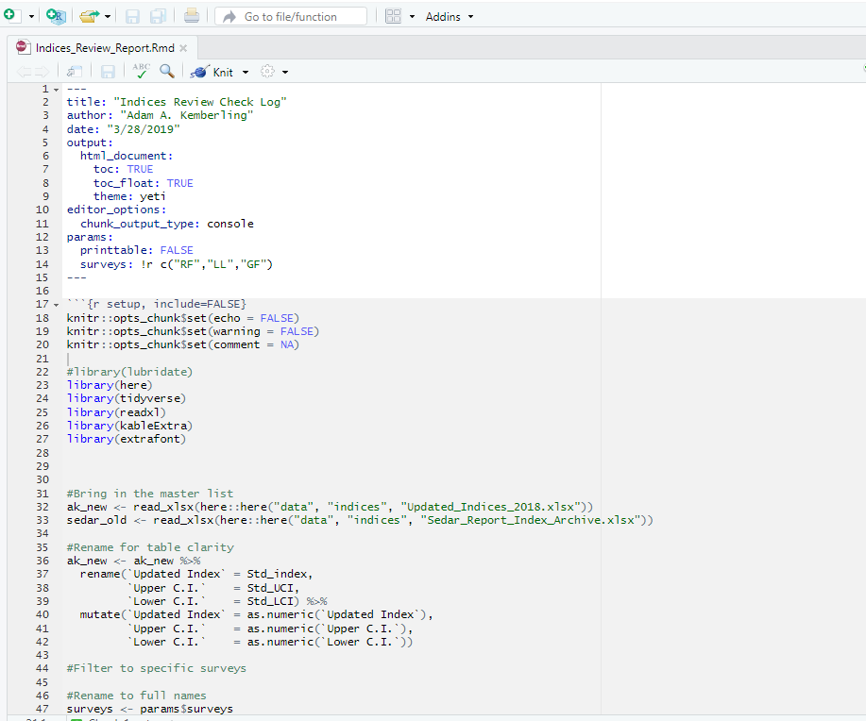
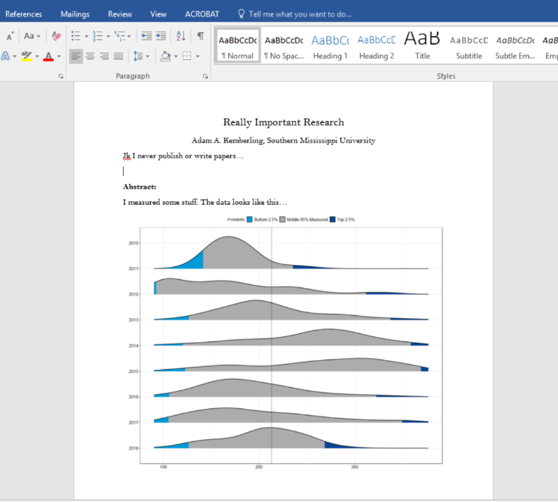
The typical analysis workflow…
Run analysis(code) and write-up (document) separately
Copy and paste between software
Hope that all changes make it to the finished project…

Slide 3
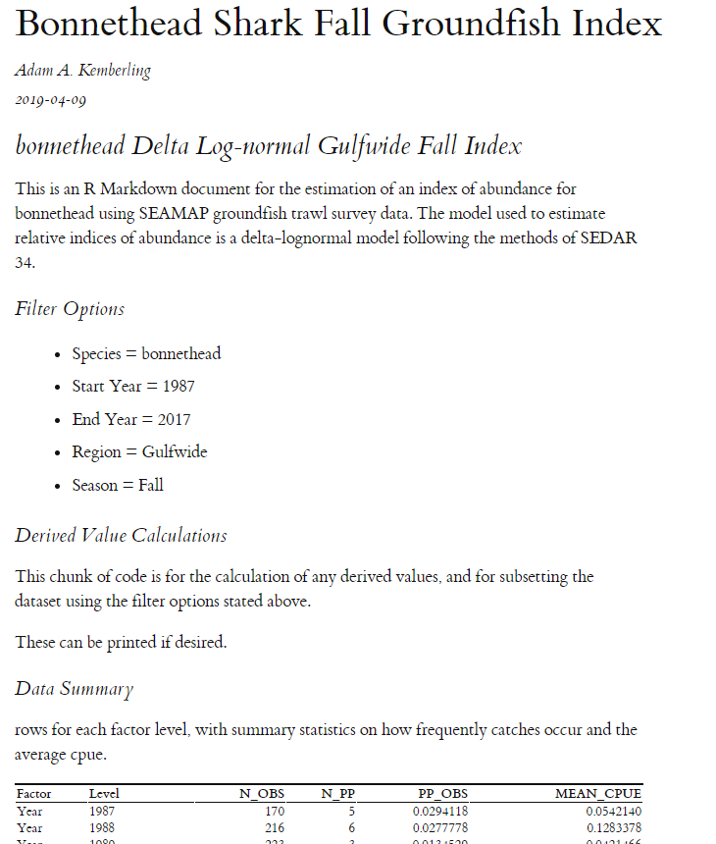
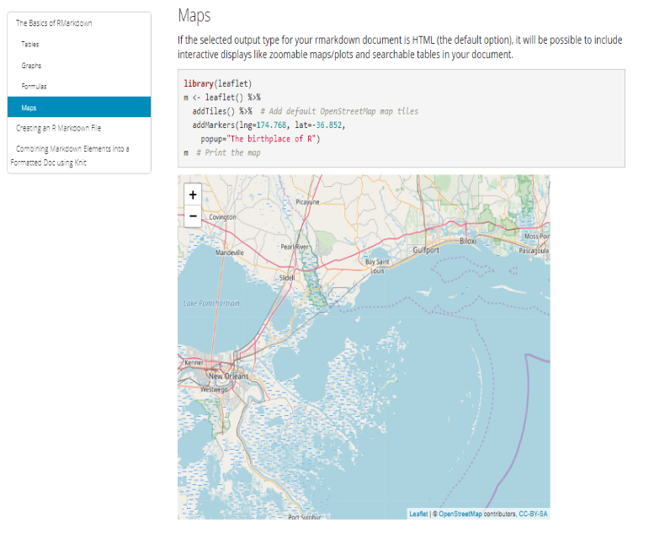
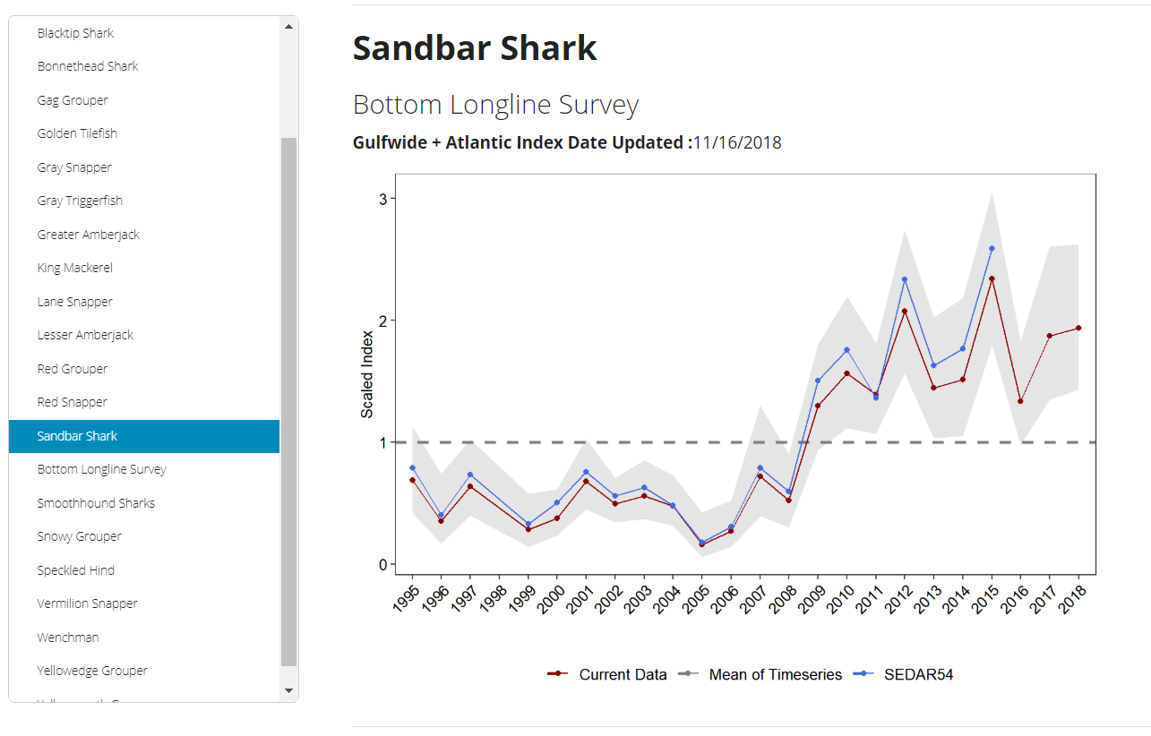
A Better Solution
Do everything in one place.
From one flexible file.
Output
Input

Slide 4
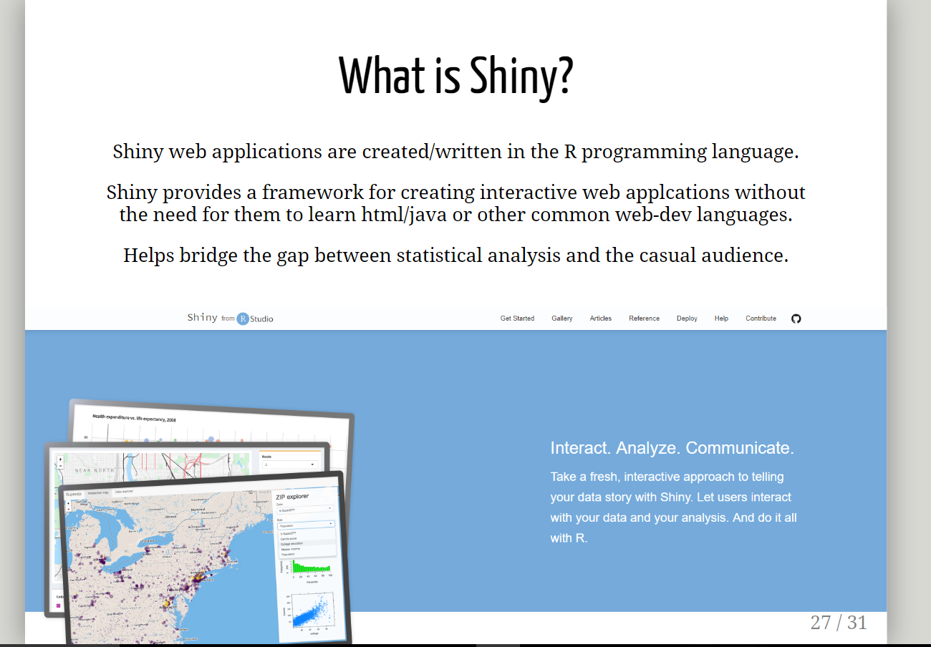
Combining Code with Finished Products
Combine the code you already write
Include any text & multimedia
All in the same file
Output as:
word
PowerPoint
pdf
html dashboards
and more…
Javascript presentation created in rmarkdown.

Slide 5

Making An Rmarkdown
Open R-Studio
Install the “rmarkdown” package
File -> New File -> R Markdown…
Add:
Title
Author

Slide 6
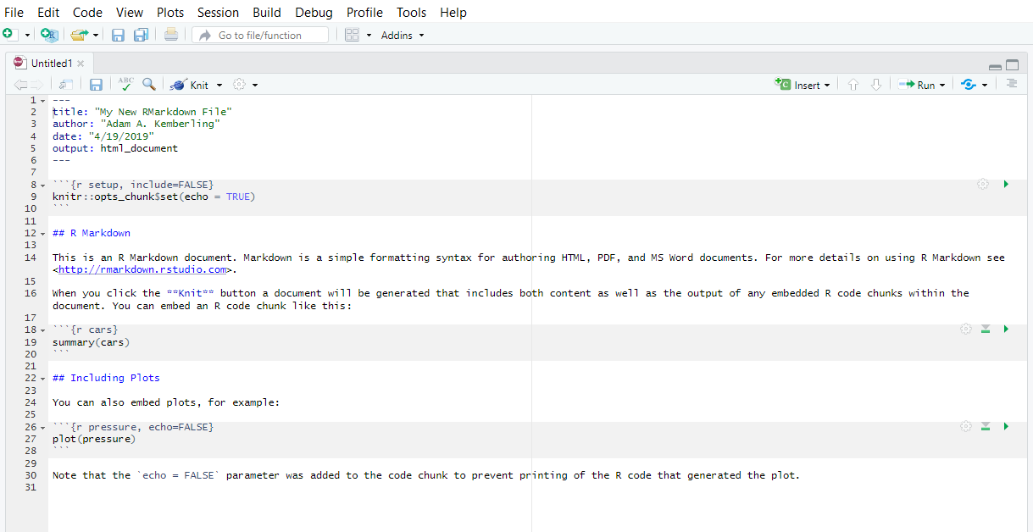
Your very first rmarkdown file.

Slide 7
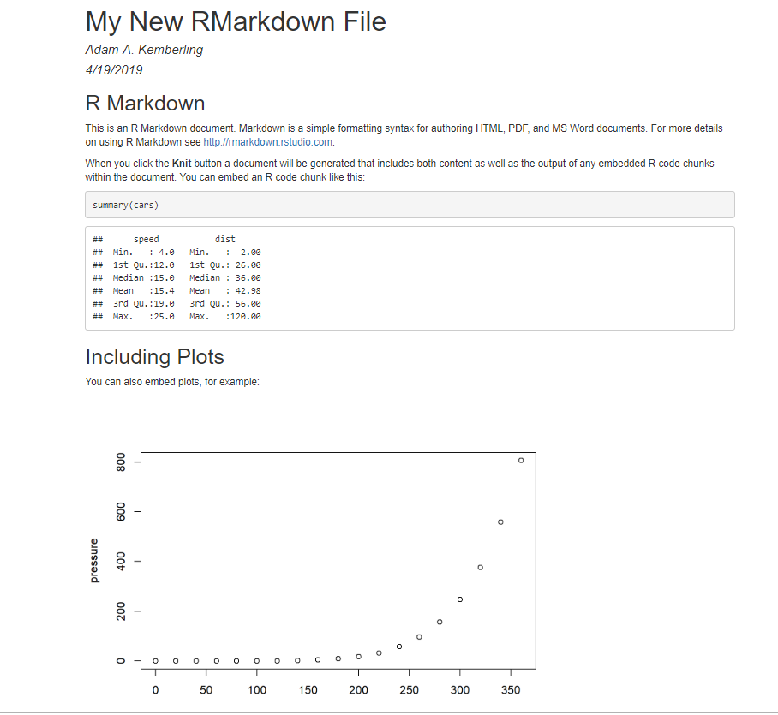
That file = This document

Slide 8
Part 1. The “YAML”

Slide 9
Part 2. The Body

Slide 10
Write Code in these

Slide 11
Set code “chunk” options here

Slide 12
Format the text with markup language
Level 2 Header
Hyperlink
Bold

Slide 13
That’s Basically it.
Pretty everything else is an extension of that!
Start a document
Add the code you need
Output to your desired format
Look up more specific stuff on:
google/stackoverflow/rstudio community
Rmarkdown cheatsheets are the best.
Or ask a friend! (R community > general public)
Because that is what programming really is…

