Slide 1
Research Software Engineering Meetups
Introduction & Tooling
2023/10/13
<number>/13

Slide 2
Overview
Schedule
Introduction
Tooling/version control
AI/LLMs
Round up
<number>/13

Slide 3
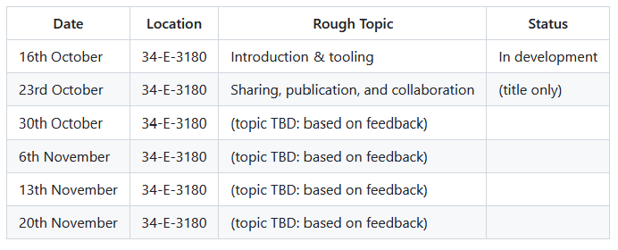
Schedule (provisional)
source: https://github.com/adamkewley/rse-meetups/
<number>/13

Slide 4
Intro: Meetup format
Roughly based on software meetups I attended in Cambridge UK (e.g. link)
Geared to be casual and typically has a low production bodgeitet ;)
  So that the content can be changed cheaply during the series
  And there isn’t as much pressure to go through all of the content/ideas (we can skip things, defer until later, etc. based on the audience)
Typically includes the organizer providing shorter present ational bits interspersed with live demos, discussions, interactive parts, etc.
<number>/13

Slide 5
Intro: You
You knew the title
You knew the rough topic schedule
You are here
Why?
<number>/13

Slide 6
My Supervisor told me (we’ve all been there ;)) | My grant agency told me (to practice “Open Science”, but I have no idea what that actually means) | You told me (that I needed to turn up to make up the numbers)
IT KEEPS SAYING `package opensim not found` EVEN THOUGH OPENSIM IS CLEARLY INSTALLED (I’m already writing software but I keep running into platform-level technical issues) | `switch (choice) { case “alg1”: return alg1(arg1); case “alg2”: return alg2(arg1, arg2); default: throw “error lol”; }` (I’m already writing software but I keep running into design-level issues) | What on earth does `get_published_result(xy)` in ${previous_code}` actually do? (I’m have to modify/use existing software)
I don’t feel like I understand what’s actually going on (I want to know how computers work) | I want to (know how to) engineer software projects | I want to write software in the future, and this seemed appropriate
<number>/13

Slide 7
Topic 1: Tooling
Topic #1?
Online platforms vs. text editors vs. IDEs
Features to value:
  Easy to install
  Easy to setup with plugins/configuration etc.
  Has a configurable button/hotkey for running your code (even if “running your code” involves things like running associated scripts first, etc.)
  Has in-built support for (e.g.) Ctrl+Clicking functions to see their implementation
  Has in-built support for debugging, and the debugger has support for conditional breakpoints and watches
  (if using an interpreted language): REPL support
<number>/13

Slide 8
Interactive: Use Tools to...
Get: https://github.com/adamkewley/rse-meetups
Open 1_IntroAndTooling/a_UsingToolingOnTrivialCodebase
(debug) setting up up environment
Run it
Debug it
Understand it
Fix it
(version control) see what we changed
<number>/13

Slide 9
Topic 1b: AI and LLMs
They’re tools.
If you’re already using them, then you probably already know where this is going
If you aren’t already using them, you should at least give it a go
Uses in software development (live demo):
  “Could you write a script that…”
  “Can you explain what this code is doing…”
  “Could you provide constructive feedback on this code…”
  “What are the benefits of $library_a over $library_b…”
<number>/13

Slide 10
Topic 1b: GitHub Copilot
It’s an LLM inside your code editor
(quick live demo)
<number>/13

Slide 11
Roundup
What was covered:
General format for the sessions
Common themes in research software engineering
General tooling considerations, how to use some features of tools
AI/LLMs/ChatGPT/GitHub Copilot
Where’d it fall short (should we cover it in a future session)?
Features X or Y of the tools presented?
Other common development tools (trello, issue tracking, profilers, etc.)?
<number>/13

Slide 12

Next Time (up for debate)
<number>/13

Slide 13
(Bonus) Interactive: Reproduce Open Science
I tried searching Dryad, but it’s mostly datasets
So I went through ~50-75 papers from PLOS Computational Biology’s September 2023 issue
  Most include some form of script or open-science
  Around half of them use something like MATLAB or R
  The other half use python
  … and deliver the python via Jupyter
  … and assume you’re using anaconda to manage libraries
  … and use many libraries
Around 5 or so “just python, not too many dependencies” codebases from that cohort
Lets try….. : https://github.com/John-king-zhou/COVID
(see https://github.com/adamkewley/rse-meetups/1_IntroAndTooling README for a more comprehensive list of the stuff I tried)
<number>/13

