Slide 1
Research Software Engineering Meetups:
Operating Systems, Subprocesses, and Command Lines
2023/11/10
<number>/21

Slide 2
Overview
Schedule
Short intro
Each subtopic with interspersed practicals
<number>/21

Slide 3
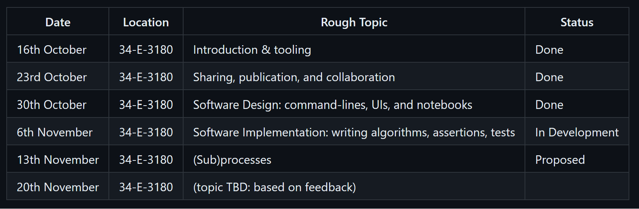
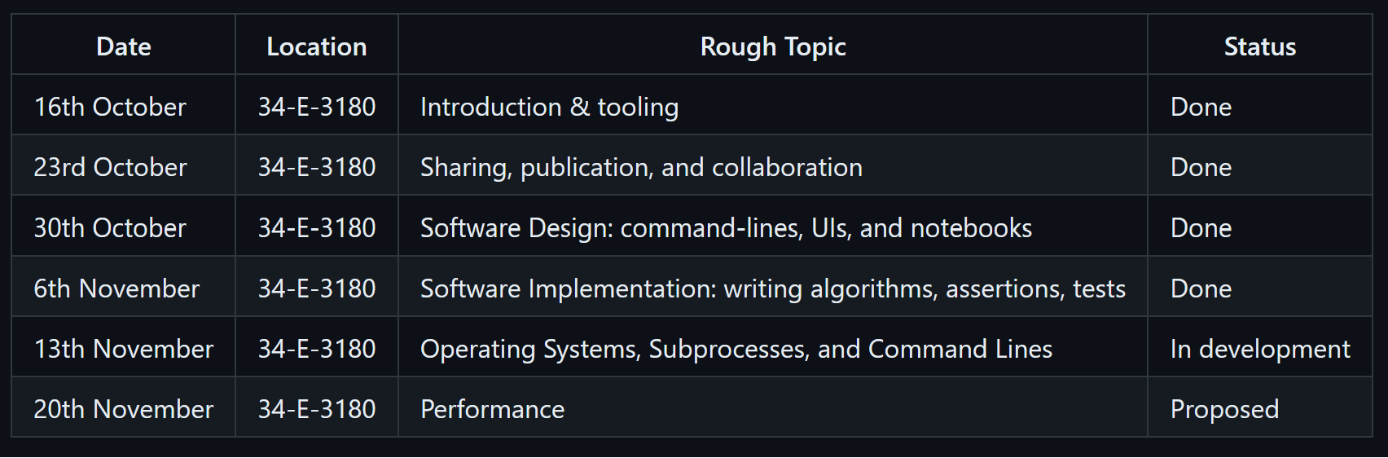
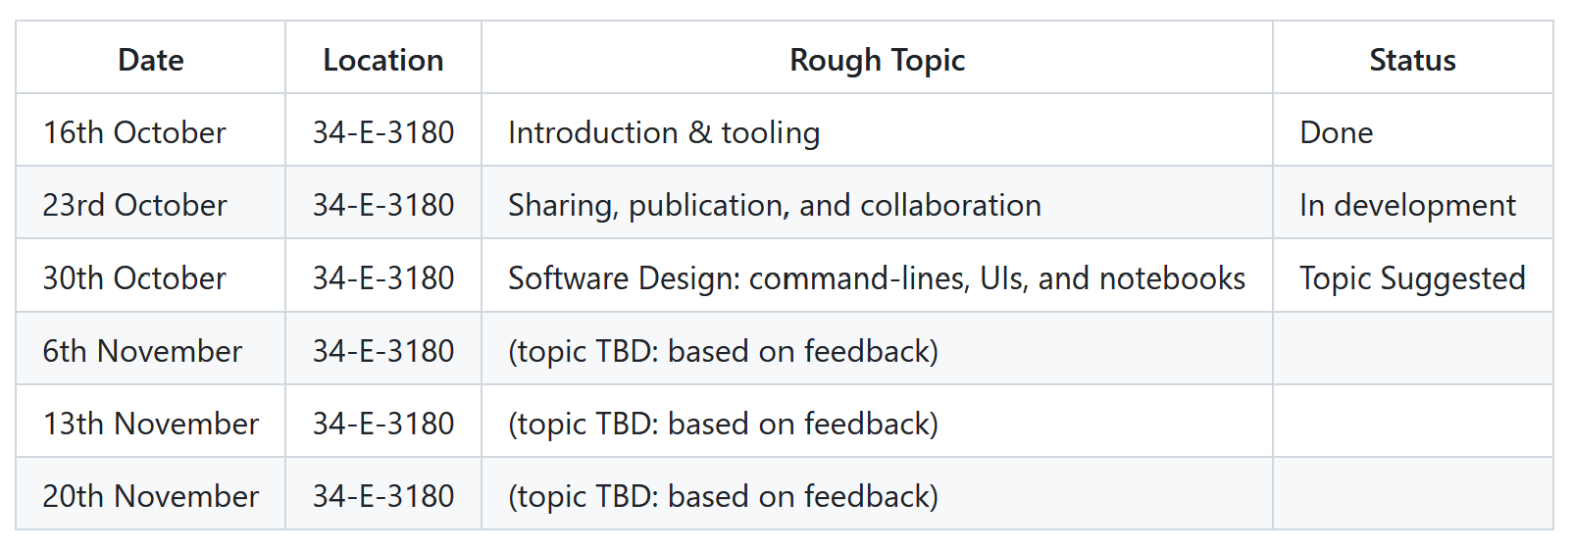
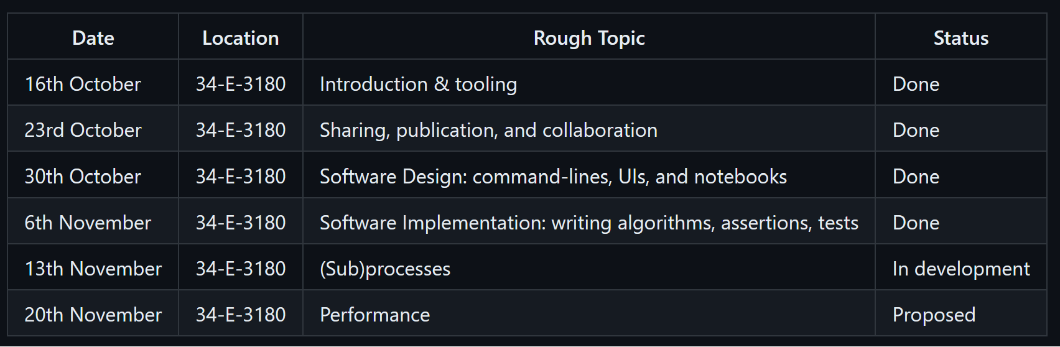
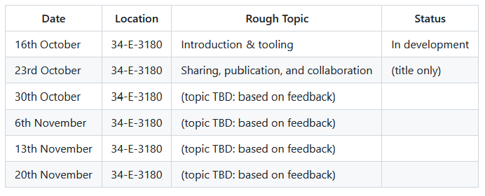
Schedule (provisional)
source: https://github.com/adamkewley/rse-meetups/
<number>/21

Slide 4
Introduction
You’ve got the tools (1. tooling)
You’ve got a platform (2. sharing, collaboration)
You have an idea of what you want to build (3. design)
And you’re in the process of making it (4. implementation)
… But you’re not quite sure how these things actually run on a typical computer
… So you’re not quite sure how to join up various scripts/programs (integration)
<number>/21

Slide 5
Operating Systems
(intro)
Name some?
Which ones are good?
What do they do?
<number>/21

Slide 6
Everything | Advertise bing | Install updates at the worst possible time
Run machine code | Sandbox stuff (e.g. users, processes, filesystems) | Schedule task execution (concurrency)
Communicate with hardware (e.g. GPUs, WiFi) | Control Access to Hardware | Provide abstractions for all of the other tiles in this grid
<number>/21

Slide 7
Operating Systems
(the bits you need to know)
OSes take an awfully long time to study – usually an entire undergraduate module
But for practical purposes, this will just be an overview of:
  Processes
  Command-Line Arguments
  Standard Input/Output/Error
  Terminals
All major OSes provide those three things. Being aware of them can sometimes make debugging/running/integrating software easier
<number>/21

Slide 8
Processes (overview)
A task that the OS is managing (simplifying)
The OS can only run machine code. It doesn’t (usually) care whether it’s running `python.exe` or `firefox.exe`
Processes may spawn sub-processes (recursive). Task managers (e.g. `top` in Linux) can show you the current process hierarchy
They’re the fundamental unit that almost all code runs inside of (ignoring hardware drivers, RTOS, etc.)
<number>/21

Slide 9
Processes (practical)
Find the native executable for your web browser of choice on your computer e.g.:
  C:\Program Files\Mozilla Firefox\firefox.exe
  C:\Program Files (x86)\Google\Chrome\Application\chrome.exe
Google “python subprocess module”
Use `subprocess.run([command, arguments])` to launch a browser subprocess
Try providing `https://google.com` as an argument to the process
<number>/21

Slide 10
Command-Line Arguments (overview)
An array of strings that are passed to a process when it is started
Command-line arguments are one of the most common ways to change the behavior of a program at runtime without having to change the source code
Examples: `input_file.csv`, `--help`, `--algorithm=mcmc`
<number>/21

Slide 11
Command-Line Arguments (practical)
Write a new script that prints `sys.argv` (import sys first – google sys.argv for more info)
Modify your script from the first practical to run `python.exe` with your second script as the first argument (e.g. `subprocess.run([“path/to/python.exe”, “path/to/your/script.py”])
Ensure it runs
Provide more arguments to your first script’s argument list
(this is one way of passing information between two processes)
<number>/21

Slide 12
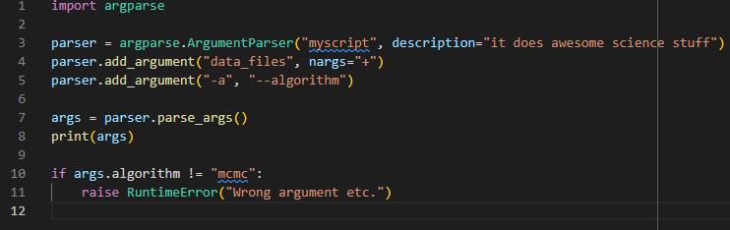
Command-Line Arguments
(practical - bonus steps)
Add a command-line parser to your sys.argv-printing script
Run your script via the command-line, as well as your `subprocess` practical
<number>/21

Slide 13
Standard Input/Output/Error
Standard data streams for inputting/outputting data to/from a process
E.g. in `python` you can read from the standard input with the `input` command:
  `name = input(“What is your name?”)`
And you can write to the standard output with the `print` command:
  `print(f”Hello, {name}!”)`
And you can write to the standard error with the `print` command:
  `print(“Error, no name entered!”, file=sys.stderr)`
---
You can also read/write entire files etc. via these streams, and you can join the output stream of one process to the input stream of another.
<number>/21

Slide 14
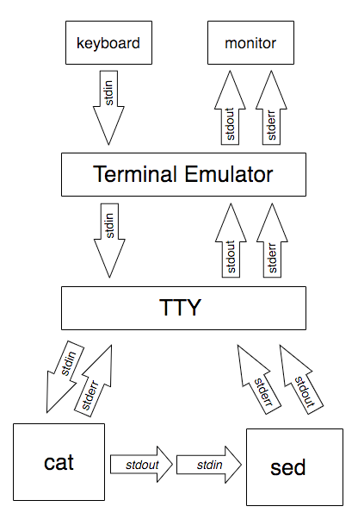
Standard Input/Output/Error
<number>/21

Slide 15
Terminal [emulator] (overview)
A program to launch/join/control processes
Most of you probably write python in an IDE and run it from there
And if you’re unfamiliar with terminals, it’s normal that they initially look very scary
But terminals are a simple, standardized, way to run almost any non-GUI application – regardless of the language it was programmed in
And because they’re standardized across multiple languages, they’re also a very good way to automate/integrate applications
They provide a convenient syntax for launching processes:
  application ARG1 ARG2
And for joining them together:
  application ARG1 ARG2 | python script_that_reads_input.py 2> errors.txt 1>output.txt
<number>/21

Slide 16
Terminal (practical)
(for this, we’ll use the `git` terminal, or your preferred bash terminal)
https://learnxinyminutes.com/docs/bash/
Use a terminal to run your script from the “Command-line arguments” practical, see if it prints Command-Line Arguments, etc.
Then augment your script read `sys.stdin` in a for loop (i.e. `for line in sys.stdin:`), exiting when given a unique word, such as “chicken”, or `print`ing something otherwise (e.g. `line.toupper()`)
Run your script in a terminal (e.g. `python yourscript.py`) and make sure it works by typing stuff in the terminal (in a terminal, you’re the input ;))
Write another python script that prints stuff, possibly including “chicken”
Use the terminal to pipe the output of your second script into the input of your first: `python outputs_stuff.py | python yourscript.py`
Now switch `python outputs_stuff.py` for non-python commands, such as `echo`, `cat`, etc.
<number>/21

Slide 17
Environment Variables (overview)
Process-wide Key→Value storage
(e.g. PATH → ~/.local/bin:/usr/local/bin:/usr/bin)
System-level environment variables are inherited by all processes on the system
User-level environment variables are inherited by all user-initiated processes
Process-level environment variables, are inherited by a given process, and all of its sub-processes
---
The above three are merged together, top-to-bottom
Overwrites are allowed (necessary, even)
<number>/21

Slide 18
Environment Variables (practical)
In your `subprocess.run` script (the first one)
  Add a section that prints `os.environ`
  Run it and have a look at what environment variables your particular computer provides
In the script your `subprocess.run` runs
  Add a section that prints `os.environ`
  (it should print the same environment variables)
Now set an environment variable in your top-level subprocess.run script with `os.environ[“MY_VAR”] = “some-var”
What does the sub-script now print?
<number>/21

Slide 19
PATH (+ PYTHONPATH)
(the important environment variable)
A list of directories that processes can search through when looking for an executable
You can use `subprocess.run` to run an executable directly:
  e.g. subprocess.run([“C:\Path\To\Exe.exe”])
Or you can be looser, and ask it to run (e.g.) “python”:
  e.g. subprocess.run([“python”], shell=True) # windows: shell=True required
When you do the latter, the implementation needs a strategy to find `python.exe` on your computer
The default strategy is to search through each directory in PATH until `python.exe` is found
You’ll find that many larger platforms (e.g. MATLAB, compilers, desktop software) will sometimes ask you to set PATH, or similar environment variables. The reason they do that is because they are inherited (so end up being propagated to all subprocesses inside MATLAB) and because it means that MATLAB can be looser about where external software is installed on your computer
<number>/21

Slide 20
Summary
Lots of information (sorry about that)
Operating systems run native executables (.exes, on Windows) as processes
Processes can run other processes as subprocesses, forming a process hierarchy
Processes almost always support
  Command-line arguments – one-off list of strings given to one process
  Standard input/out/error – IO streams that can be joined together
  Environment variables – key-value store that is inherited by all subprocesses
A terminal provides a standard way to launch a process:
  ENV_VAR=hello PATH=extra:${PATH} application ARG1 ARG2 > stdout.txt
<number>/21

Slide 21

Next Time (up for debate)
<number>/21

