Slide 1
Research Software Engineering Meetups:
Performance
2023/11/20
<number>/8

Slide 2
Overview
Schedule (there isn’t one after this ;))
Why is performance important?
Performance Overview
Code analysis, practical techniques, etc.
Practical: finding hotspots the fast way
Practical: profilers
Overall meetup conclusions
<number>/8

Slide 3
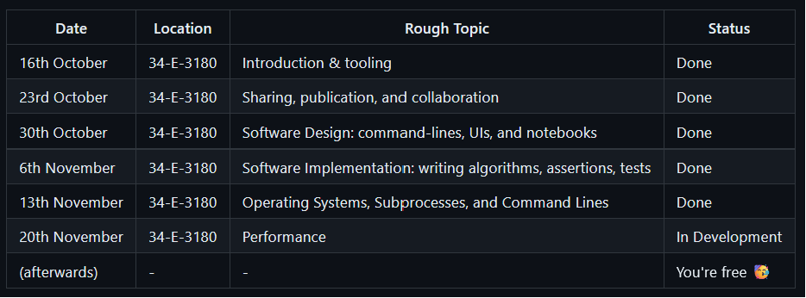
Schedule (provisional)
source: https://github.com/adamkewley/rse-meetups/
<number>/8

Slide 4
Introduction
You’ve got the tools (1. tooling)
You’ve got a platform (2. sharing, collaboration)
You have an idea of what you want to build (3. design)
Maybe you’re in the process of developing it (4. implementation)
Maybe you’ve had to integrate various other applications (5. subprocesses)
And now you’re finding that it takes forever to run… (6. performance)
<number>/8

Slide 5
Performance
(questions for the group)
(1) Why is performance important?
(2) What techniques can be used to improve performance?
<number>/8

Slide 6
(1) – Because (RACE CAR NOISES) | (1) Because it will make my code cleaner | (2) Use a faster programming language
(1) Because it will make my workflow faster | (1) Because it enables entirely new solutions | (2) Use algorithmic analysis
(2) Use a completely new software design | (2) Use a GPU | (2) Use Multithreading
<number>/8

Slide 7
Performance
(possible solutions – tl;dr, it depends on your problem)
Technique | Potential Effectiveness | Potential Cost
Redesign Software | Medium-High | Very High (depends what you’re redesigning)
Change Algorithms | Very Very High | Low, or Very Very Very High (depends on what alg. you need)
Find hotspots in existing code and fix them | Medium - High | Low – Medium (depends on the hotspot...)
Multithreading | Low-Medium | Medium – High (depends on what alg. you’re using, and available hardware)
GPUs | Low-High | Medium - Very High (depends on what alg. you’re using, and available hardware)
(specialized hardware: FPGAs, ASICs, etc.) | High-Very High (if it suits) | Insanely High (extremely specialist development and hardware required)
Use a “faster” programming language | Medium | Very High (depends on alg, and your software design+size)
<number>/8

Slide 8

Next Time (up for debate)
<number>/8

