Slide 1
Research Software Engineering Meetups:
Software Design
2023/11/30
<number>/14

Slide 2
Overview
Schedule/upcoming
A quick note about the topic order
Software Design/architecture overview
Interactive part
<number>/14

Slide 3
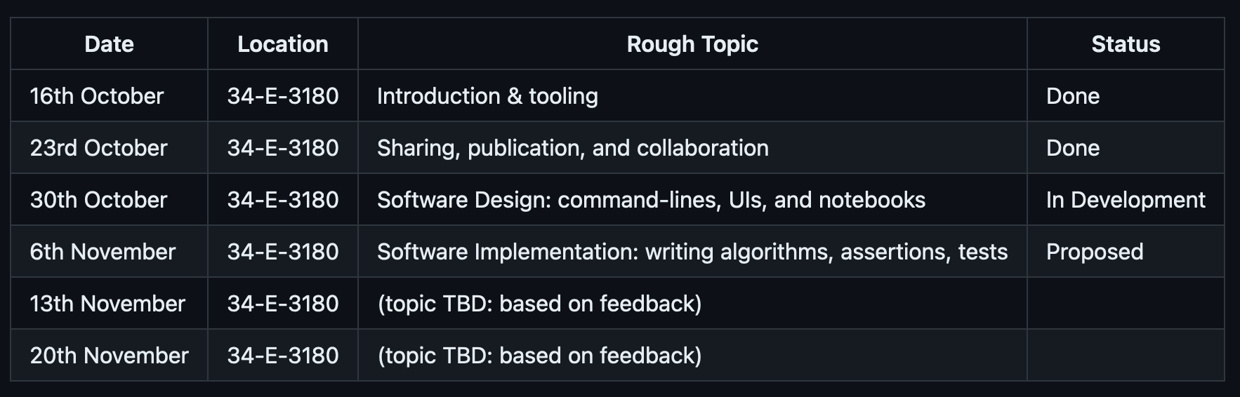
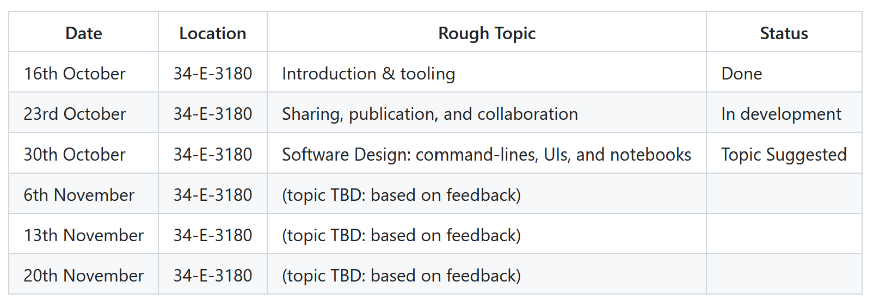
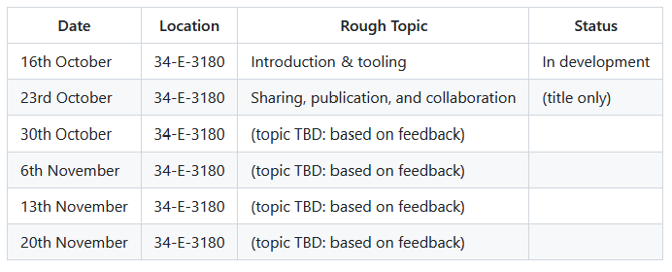
Schedule (provisional)
source: https://github.com/adamkewley/rse-meetups/
<number>/14

Slide 4
A quick note about the topic order
You might be wondering why we aren’t studying python coding...
Or algorithms...
Or high-level automation/scripting...
Or low-level hardware coding...
Or GP-GPU...
Or Julia…
Or...
It’s because, when working on software, those things aren’t the most important.
People, Processes, and Design are.
<number>/14

Slide 5
Software Design
(it’s all-encompassing)
What are you trying to build?
What’s likely to change in the future?
What processes will make it easier to handle?
What’s the desired user experience?
What’s the desired developer experience?
What’s the best way for you to get the most out of your team/collaborators (or vice versa)?
<number>/14

Slide 6
Research Software Design
(typical steps)
Figure out what you actually need
  Is it to ship your thesis/paper, where the software is purely a related side-effect?
  Is it to write a small, but perhaps heavily reused, script/app that helps work on a standalone research problem?
  Is it to write a larger application with multiple, reused, algorithms? Perhaps with multiple developers over a longer period of time?
  Is it to write a fundamental system that many other researchers will use as a key component of their research, multiple developers, and a very long lifetime?
Try to use the same/similar processes as other researchers in your field*
  E.g. programming language, libraries, applications
  Remember that people and processes are usually more important than just the code (for better or worse)
Deliver what you need, prioritizing
  Iteration speed
  Simplicity/readability
  Correctness
  Performance
*: Unless you plan on redefining your research area’s processes, e.g. by writing a whole new platform.**
**: Even then, you’ll have difficulty writing a whole new platform unless you learn the old one first.
<number>/14

Slide 7
Software Architecture
(categories that small-/medium-sized software projects typically fall into)
Libraries
  Packages
  Dlls
  That mathworks script you downloaded to fit a sphere to some datapoints. It works, but you have no idea why, and the comments are just “fit X”, “do Eigen analysis”, etc.
Applications
  Servers (uncommon in RSE, unless you’re delivering a data processing service)
  UIs (less-common in RSE)
  Notebooks (becoming increasingly common – try these out)
  Command lines (extremely common in SE and RSE)
Hybrid (i.e. both of the above)
  E.g. write your code as-if it were designed as a modular library, but then separately put command-line interfaces around it so that you can (e.g.) run it from VSCode or run it from a batch script, etc.
<number>/14

Slide 8
Software Architecture
(typical choices for python-based research projects)
Libraries – Python packages and modules
  A directory containing an __init__.py file is a package
  Individual python files (optionally, within package directories) are modules
  Modules define functions and classes that can be called from python
Applications – Command-line scripts (what you’d think of as a python script)
  Typically starts out as a top-level script that you’re running a lot (e.g. `main.py`, `run.py`)
  You can also add a `__main__.py` file into a package directory to tell python what to run when you “run a package” (e.g. `python -m pip` would run `__main__.py` in `pip/`
  Python comes with batteries-included for command-line parsing (argparse), configuration files (config), and environment variables (`os.env`)
  (not covered here, but notebooks usually means “Jupyter Notebook in an Anaconda envrionment”)
Hybrid - Usually happens naturally as your codebase grows
  Have modules/packages for the command-line bit (e.g. __main__.py) and modules/packages for the algorithmic big (e.g. fft.py, fea.py)
  E.g.
    Start out with a python script that you can run top-to-bottom (i.e. it’s a batch-oriented command-line application)
    Then break out parts of that script into modules/packages
    Then “jazz it up” with a nicer command-line interface, arguments, configuration file support, etc.
<number>/14

Slide 9
Discussion: The design of some projects
Python codebases from PLOS Computational Biology:
https://github.com/John-king-zhou/COVID
https://github.com/crossley/sensory_uncertainty_fffb
https://github.com/ZhangGroup-MITChemistry/OpenABC
https://github.com/ncbi/TranNet
https://github.com/ZhangGroup-MITChemistry/OpenABC
https://github.com/serena-aneli/recombulator-x
Jupyter codebases (PLOS Comp. Bio.):
https://github.com/RuodanL/fixation_probability
https://gitlab.gwdg.de/nsharma/self_loops_egt
<number>/14

Slide 10
Discussion: Typical Design Observations
Seems basic | I have to read/change code to run the analysis I need | Running it seems quite manual (e.g. clicking through a lab notebook) | It’s not obvious how each part of the code relates to the science
Easy to understand | Seems like there’s a lot going on | Clear feedback that is scientifically relevant | I have to run tertiary analysis on the output to do anything interesting
Seems like it would be difficult to develop further | The scientific explanation relates to the code very clearly | It’s not obvious how I’d integrate this code into my codebase | Running it is easy
<number>/14

Slide 11
Interactive: Redesign a Codebase
(overview)
(story) we have obtained a “typical” (small) research script that’s been gradually growing. The following problems have already been identified:
  It’s hard-coded. you run the script and it does what it does. It is not possible to (e.g.) provide different data to the script, or modify its behavior, without changing the code
  The only way to use it is to run the whole thing. Other people in the team can’t just import one part of the codebase. Merely importing the script tries to run the script, rather than just importing the functions for use elsewhere.
  It’s lacking organization. All of the code is is one file. There isn’t a “tidy” separation of “here’s the algorithmic bits” and “here’s the utility bits” – everything is in one place and it’s up to the (external) reader to dig through all of the code to find the part they’re interested in.
<number>/14

Slide 12
Interactive: Redesign a Codebase
Rule #1: always ensure that you can run your application/tests after each step.
Get base research script from TODO
Create project directory that contains a package directory that contains the script
  advanced: create the project directory as a GitHub repository, as in previous sessions, so that you can commit each step
Setup your development environment (e.g. VSCode) to open your project folder. “Running” the project should run the script. Ensure that actually works.
Study the script and identify what parts of it would be candidates for being broken out into separate modules/packages (discuss this)
Start breaking it out into modules/packages
Use `argparse` (google it, ask ChatGPT, etc.) to add arguments to the “main” module. Good candiates for arguments: `num_samples`, `sampling_algorithm_name` etc.
Use `config` to add configuration file support. Allow users to specify (e.g.) `sampling_algorithm` via a configuration file. Command-line arguments should take priority over anything that can be defined via the config file.
Resources (google)
“Structure of a typical python project”
How to break up code into packages/modules
Python argparse
Python config
<number>/14

Slide 13
Session Checklist
Design is about understanding a combination of the problem, the people, and the process
Typically, the easiest thing to do at the start is to study+emulate previous work in the field
Software architectures can be simplified into a few categories
There are common patterns/steps for cleaning up or redesigning a codebase to make it ready for the next phase of building
<number>/14

Slide 14

Next Time (up for debate)
<number>/14

