Slide 1
Research Software Engineering Meetups:
“ “.join([“software”.capitalize(), “implementation”.capitalize()])
2023/11/06
<number>/16

Slide 2
Overview
print_session_table(sessions)
introduce(topics.software_implementation)
await attendees.implement_stuff()
<number>/16

Slide 3
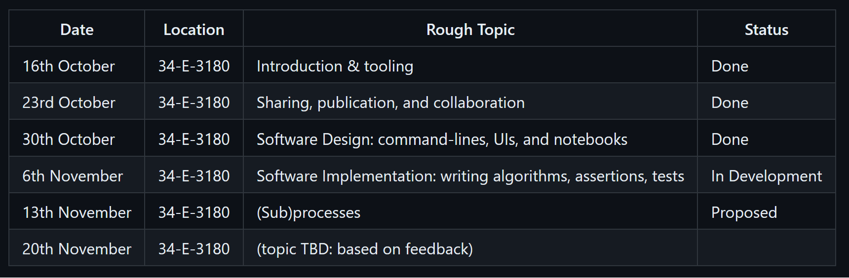
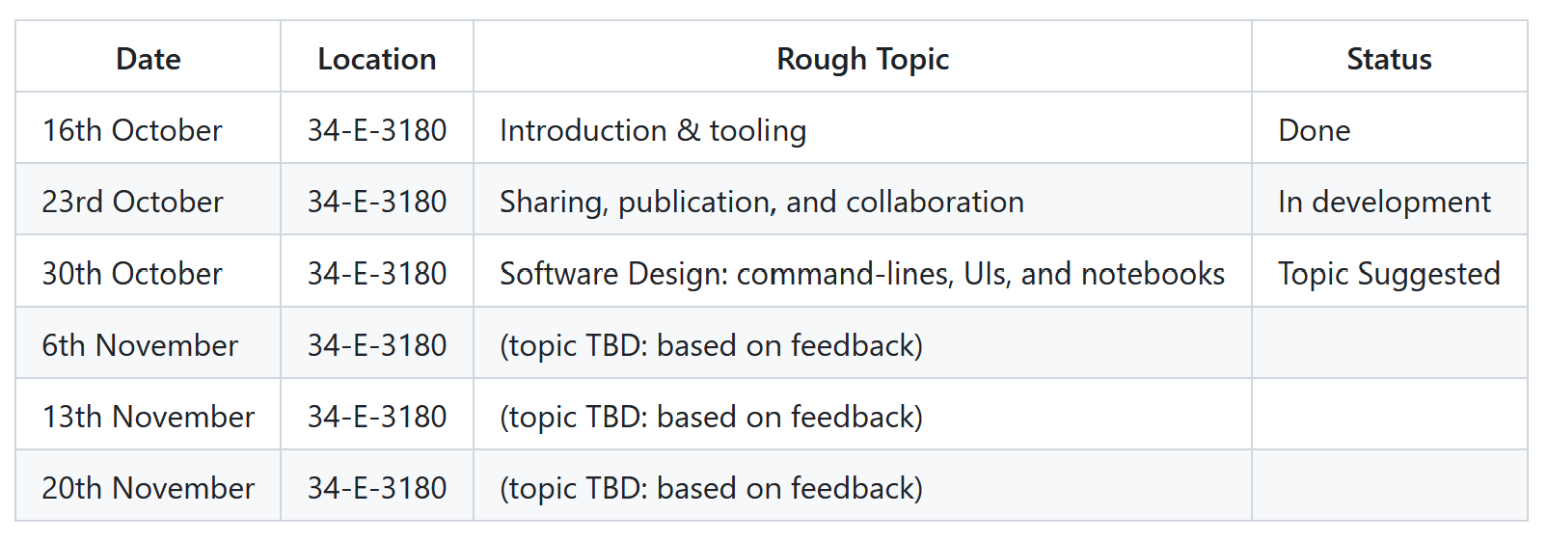
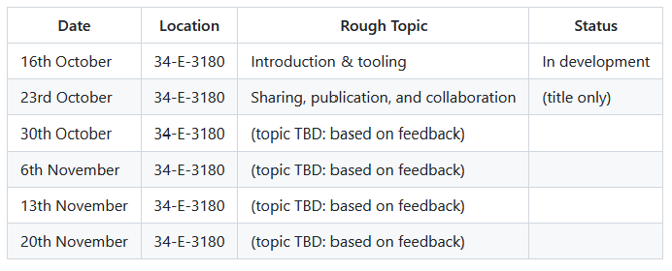
Schedule (provisional)
source: https://github.com/adamkewley/rse-meetups/
<number>/16

Slide 4
topic = “implementation”
You’ve got the tools
You’ve got a platform
You have an idea of what you want to build
… Now there’s just the small matter of actually making it
<number>/16

Slide 5
Overview
It’s hard, especially if you aren’t using the right tools, platform, or design
You will probably screw it up, many times - regardless of how long you’ve been doing it
Your colleagues might make it look easy, but that’s because they only show the 5 % that worked during their presentations
<number>/16

Slide 6
Overview #2
One of the differences between inexperienced and experienced developers is that the experienced ones tend to anticipate/handle the screw ups faster than the inexperienced ones
They also typically invest time/money into making sure their iteration loop is short. E.g. by writing automation scripts, buying better computers, etc.
  Previous session: we covered iteration speed > simplicity > correctness > performance
---
Therefore, get familiar with the edge-cases, error messages, common software issues, and gotchas of your chosen platform. Figure out which tools help spot/report problems quickly
Because, at least in software, learning how to work through problems quickly is a much better return-on-investment than trying to learn to never make mistakes
<number>/16

Slide 7
Interactive #1
Lets implement sequence reversal
Rules:
Define a function called `reverse` (i.e. `def reverse(lst):`)
It should take a single list argument
It should return a new list such that:
  new_list[i] == lst[len(lst)-1-i] for all i in [0, len(lst))
You can’t use any library functions, just the python language. And don’t you dare try and spoil it by using ChatGPT, I know you’re thinking it.
<number>/16

Slide 8
Interactive #1
Summary
Figured it out?
Did tooling help at all? What tools did you end up using?
  Debugger?
  REPL?
  Wrote a command-line thing in the script that you ran to see the input/output while you worked on it?
  It’s so simple that it’s obvious that it works? (remember: simplicity was high on our priority list)
---
Are you sure it works?
Are you really sure it works?
Like, really?
How would you convince me that you’re sure?
How would you convince yourself that you’re still sure in a few year’s time, after your code has undergone a few hundred changes?
<number>/16

Slide 9
Interactive #2 (shared)
Lets solve a HackerRank puzzle together
I’ll open one up
We’ll give it a whirl
Hopefully it provides some insights
(or, at least, it’ll show you the wonderful world of HackerRank/LeetCode/etc. for code interviews)
<number>/16

Slide 10
Interactive #2
Summary
What’s nice about this (way of approaching coding)?
What’s hard about this?
Is there something we can learn about these systems?
Is it a useful study guide/teacher?
<number>/16

Slide 11
Assertions
Assertions are runtime tests that you place in your code that explode (i.e. throw an exception) if the asserted statement is false
Python has in-built support for them:
assert len(lst) > 0
You should use them in your code – especially if you’re writing something tricky
  If your code assumes something (e.g. “the average of this numpy vector is non-negative”)
  And the performance overhead of double-checking your assumption isn’t important
  Then an assertion is MUCH better than a comment – comments aren’t checked, assertions are
  (if performance becomes a problem, then they’re easy enough to find+remove later on)
<number>/16

Slide 12
Testing
Testing can elicit feelings of intimidation and boredom at the same time ;)
But you’re probably already doing it, it’s just that you haven’t been calling it testing
-----
If you have a habit of regularly running your program and checking outputs (you should), you’re testing
The only thing you’re missing is to automate and standardize the testing process
<number>/16

Slide 13
Interactive #3
Add a few automated tests for `reverse`
Use the python `unittest` module (comes with python) to write some basic unit tests for your `reverse` function
The test should explode/fail when something doesn’t meet expectations. You can use `assert (expr)` to do this. `unittest` also provides useful assertions (`self.assertEqual`, etc.)
Initially, you can put your `unittest.TestCase` in the same file, and then call `unittest.main()` to run all of the tests
Later, you can move the test cases into separate python modules and run them separately.
<number>/16

Slide 14
Interactive #3
Summary
Is it easy enough to add some tests?
How rigorously should you test?
Should tests be committed? Or just used as a temporary implementation aid?
<number>/16

Slide 15

Next Time (up for debate)
<number>/16

Slide 16
Interactive #4 (bonus)
Lets implement a (binary) search algorithm
Rules:
Define a function called `binary_search` (i.e. `def binary_search(lst, el):`)
It should take a single list argument (`lst`) and an element to search (`el`)
Elements in `lst` will be provided sorted, and each element will be comparable (<, >, ==) to `el`
Your function should return the index of `el` in `lst`
Input size: 0 <= len(lst) < 10^8
Run time must be “fast” (i.e. <0.1 seconds, even for large inputs)
You can’t use any library functions, just the python language
<number>/16

