Slide 1
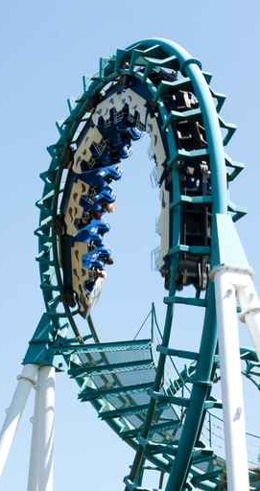
Welcome to Sensation Park
New Employee Orientation

Slide 2
Our goal is to ensure that all employees of Sensation Park Entertainment Group are aware of our mission, values, and safety practices.

Slide 3
Schedule
Day One
Maya Ruiz
Human Resources Director
Day Two
David Jensen
Park Operations Director
Day Three
Ken Lee
Safety Director

Slide 4
Schedule Details
Day One
Day Two
Human Resources overview
Overview of company history
Employee benefits and payroll overview
Park tour including ride safety
Training seminars specific to employee job classification
Supervisor meetings

Slide 5

Day Three—Park Safety
First aid training
Emergency response
CPR
Fire alarms and evacuations
Lost children procedures
Notification process
This Photo by Unknown Author is licensed under CC BY-SA-NC
All employees will be tested on park safety procedures!

Slide 6
Sensation Park Entertainment Group Welcomes You!

