Slide 1
NORFOLK SPECIALTY PARKS
Unique Outdoor Fun
Notes:
This file created specifically for Adam Kistler

Slide 2
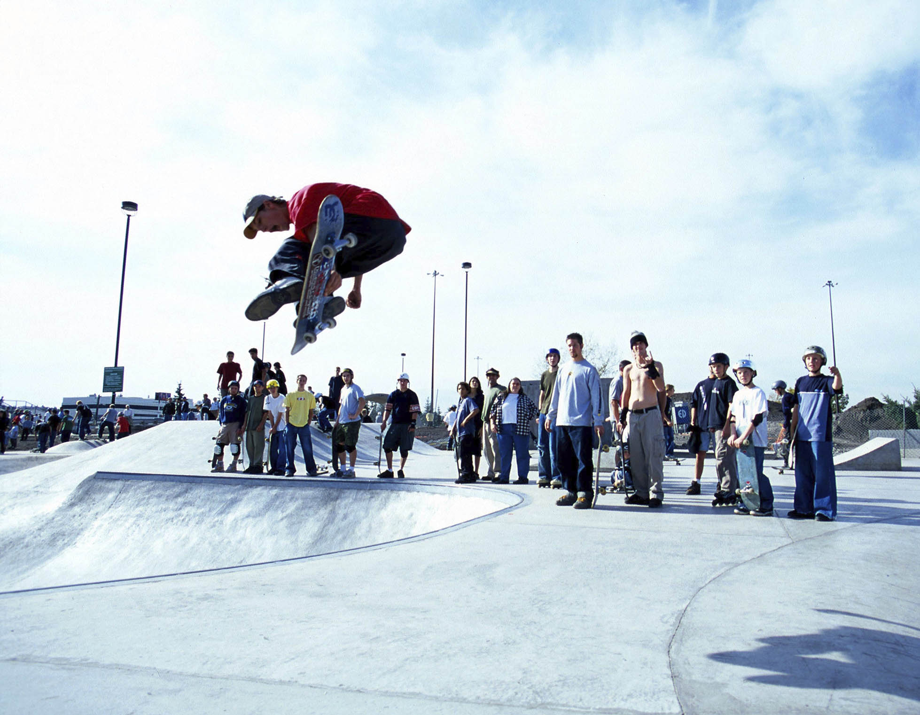
Successful Parks
Great Attendance

Slide 3
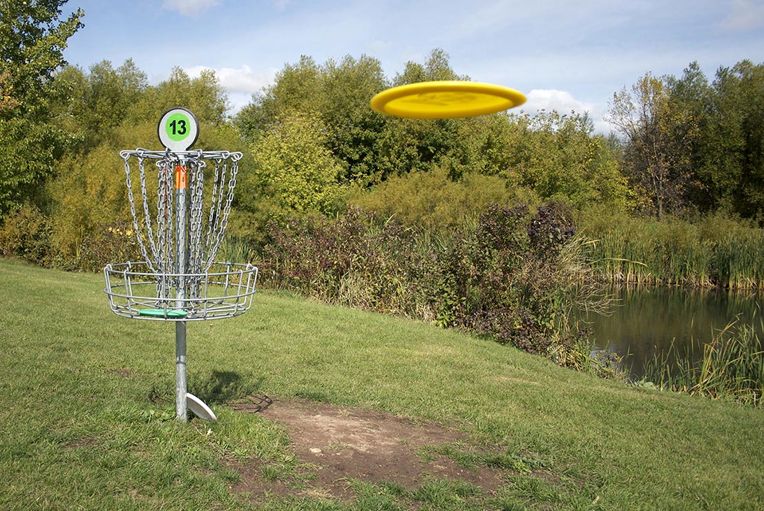
Frisbee Golf!

Slide 4
Our Other Parks
Arboretum
Community Gardens
Dog
Water Spray & Play
Soft trails
Organic
On-leash
Family

Slide 5
Day and Night Use
Grants for lighting
Arboretum (limited)
Bike/blade/roll paths
Sports complexes
Skate
Dawn to dusk
Arboretum
Community garden
Frisbee golf
Water spray

Slide 6
How the Parks Are Funded
Grants
City general fund
Participant fees
Business
Easements
Only one-quarter to one-third of parks budget

Slide 7
Why Parks Matter
Bring people together
Social
Economic
Cultural
Green space linked to better health
Help increase social connections

Slide 8
Parks and Programs
Adopt a Grandparent
Watch a game
Learn history
Salad
Flowers
Herbs

Slide 9
Support the Frisbee Golf Grand Opening
Buy an official Frisbee
Form a Frisbee team
Donate league t-shirts
Sponsor a team
Notes:
Great publicity.

Slide 10
Your Norfolk Specialty Parks Team
Stacy Rollins, Supervisor
757-100-1111
Leon Barajas, Sports
757-100-1113
Becca Jenson, Green Spaces
757-100-1130
Parks-Rec@norfolkparks.gov

