Slide 1
Avid Vintage
Vintage Furniture and Design Services
Notes:
This file created specifically for Adam Kistler

Slide 2
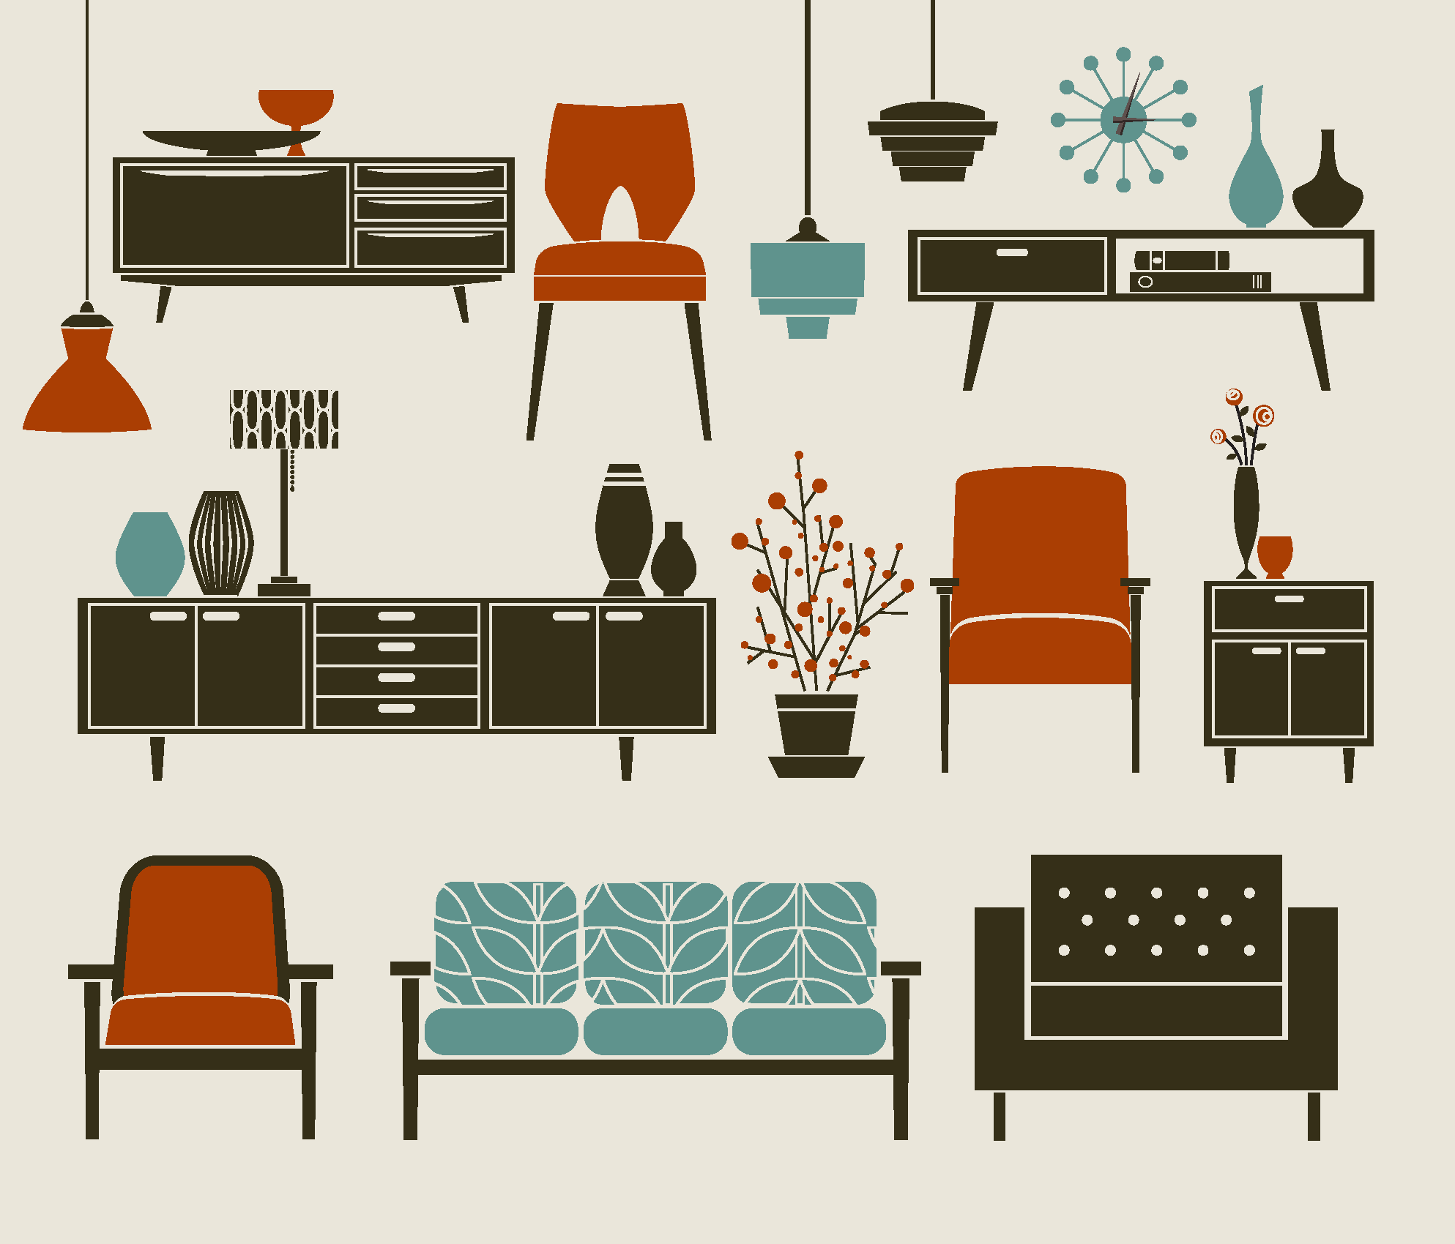
All About Avid Vintage
Retail store and website
Used and vintage furniture
Curators around North America
Design and repair services
Consignment services

Slide 3

Competitive Advantages
Wide variety of periods and styles
One-of-a-kind items
Free return shipping for online orders
Online bargaining with “Make us an offer” feature
In-home consulting for local customers

Slide 4
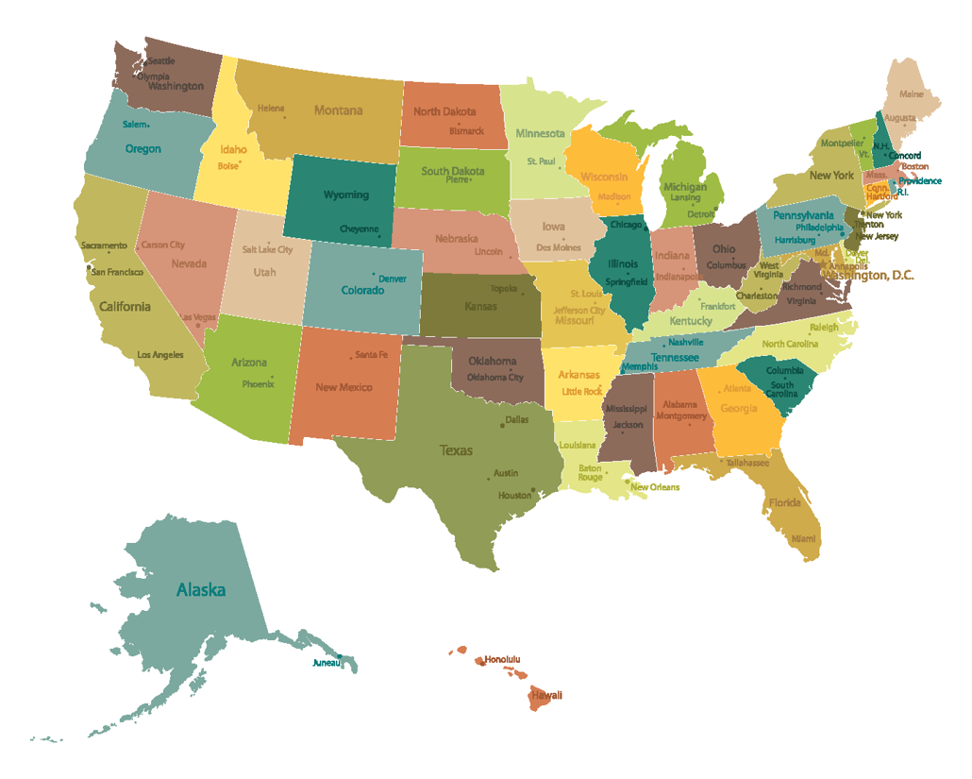
Curators
New England
New York City
Chicago, IL
Avid Vintage has curators looking for unique furnishings around the country.
We are here
Palm Springs, CA

Slide 5
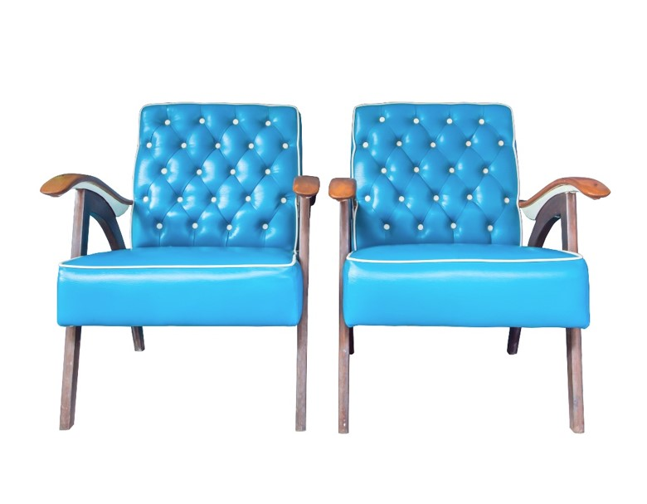
Featured Furnishings
Jarvi™ chairs
Contemporary ottomans
Mid-century accent tables
Milan runners
Modern lighting
Palm Springs patio sets

Slide 6

Specialty Items
We have a delightful collection of wind-up toys to invite customers into our retail store.

Slide 7
Marketing Successes
Activity | Result
Sales events | +15%
Design classes | +2%
Refinishing classes | +4%

Slide 8
Sales Forecast
Sales Type | Year 1 | Year 5
Direct retail sales | $325,000 | $436,000
Consignment sales | $13,000 | $27,500
Online sales | $102,000 | $270,500
Total sales | $440,000 | $734,000

Slide 9

Interested in a Franchise?
Avid Vintage
(415) 555-4600
info@avintage.cengage.com

