Slide 1
THE NOISE COMMUNITY FOUNDATION
Our Mission Is Musical
Notes:
This file created specifically for Adam Kistler

Slide 2

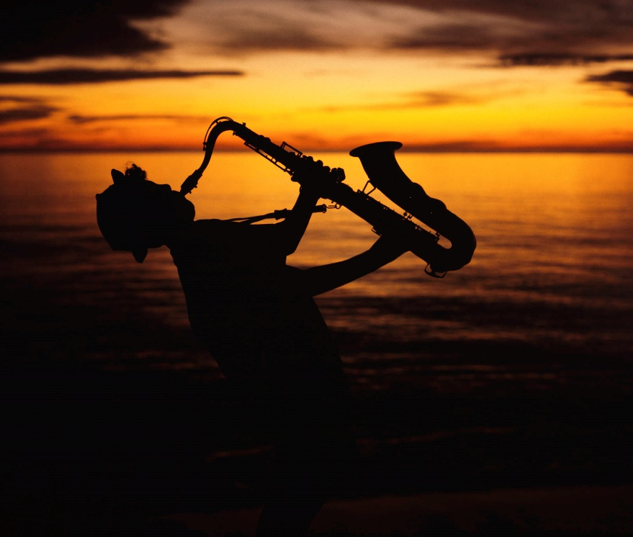
Our History
Founded by Anita Lopez in 2011
Band member ages: 16–86
Performs throughout greater San Diego
Over 5,000 free concerts
Produces annual Arts on the Beach© video

Slide 3
Our Donation tempo
Sources
Costs
Boy & Girl Scouts
Musical Organizations
City’s Parking Ticket Payment
Bar/Bat Mitzvah Programs
Pickup
Delivery
Ship
Repair

Slide 4
The Instrument Drive
A guitar gathering dust?
An oboe in your attic?
A clarinet in your closet?
A banjo in your basement?
Call to arrange a pickup

Slide 5
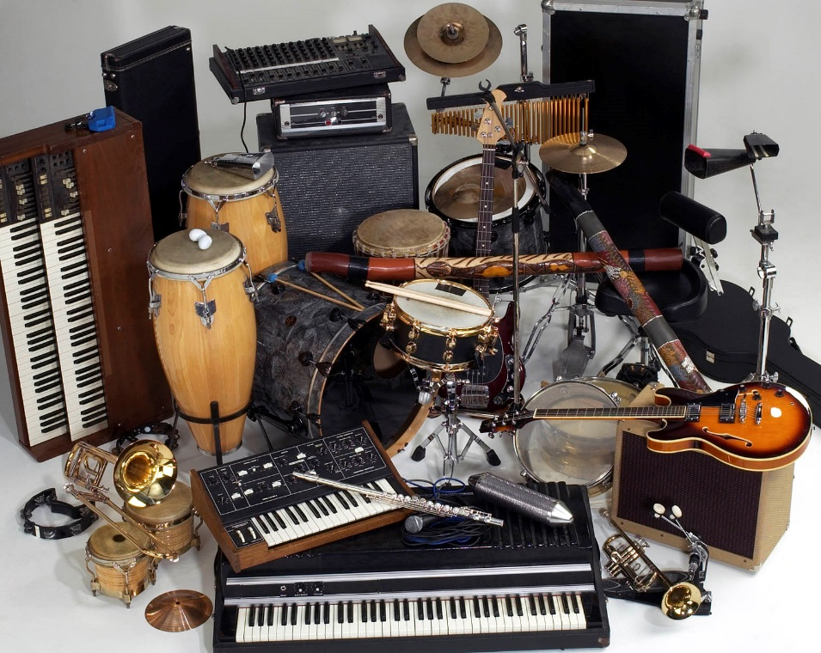
The Instrument Petting zoo
Identify and explore instrument families
Wind
Percussion
String
Brass

Slide 6
Etude in fundraising
Item | 2020 | 2021
Concert profits | $20,000 | $23,000
Grants | $5,000 | $18,000
Sponsorships | $30,000 | $36,500
T-shirt sales | $800 | $1,500

Slide 7
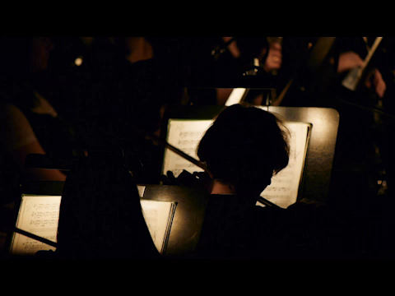
Prelude to harmony

Slide 8
Popular Riffs
Instrument | No. of Musicians
Upright Bass | 8
Electric Guitar | 12
Keyboards | 16

Slide 9
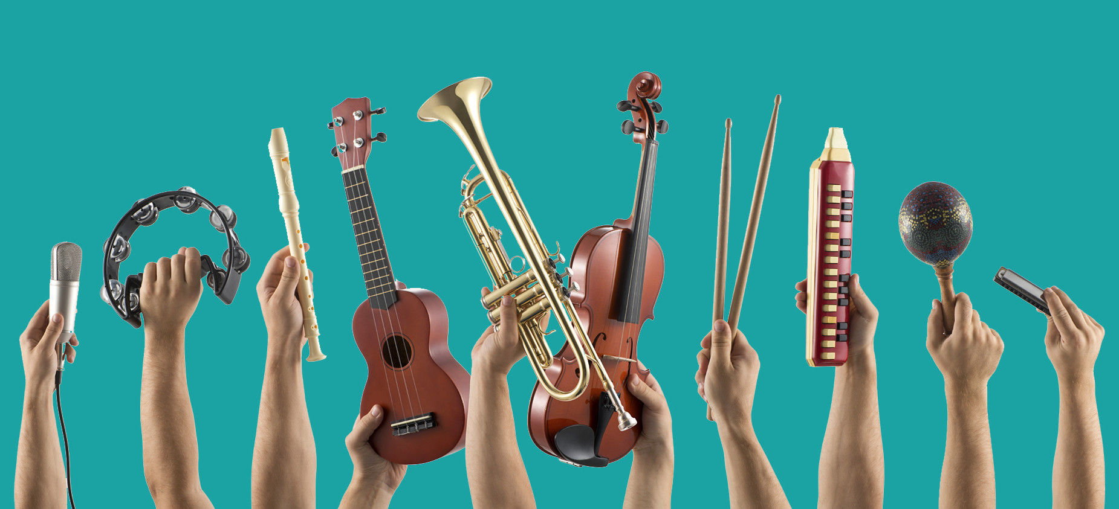
Music CHANGES LIVES

Slide 10
Keeping the beat
Come to our concerts!
Challenge five friends to donate an instrument
Volunteer
Become a rehearsal buddy
Like us on social media
Questions? Info@Noise.org
Notes:
Remember, music can change lives

