Slide 1
Copper Harbor Land Trust
Preserving natural resources
Notes:
This file created specifically for Adam Kistler

Slide 2
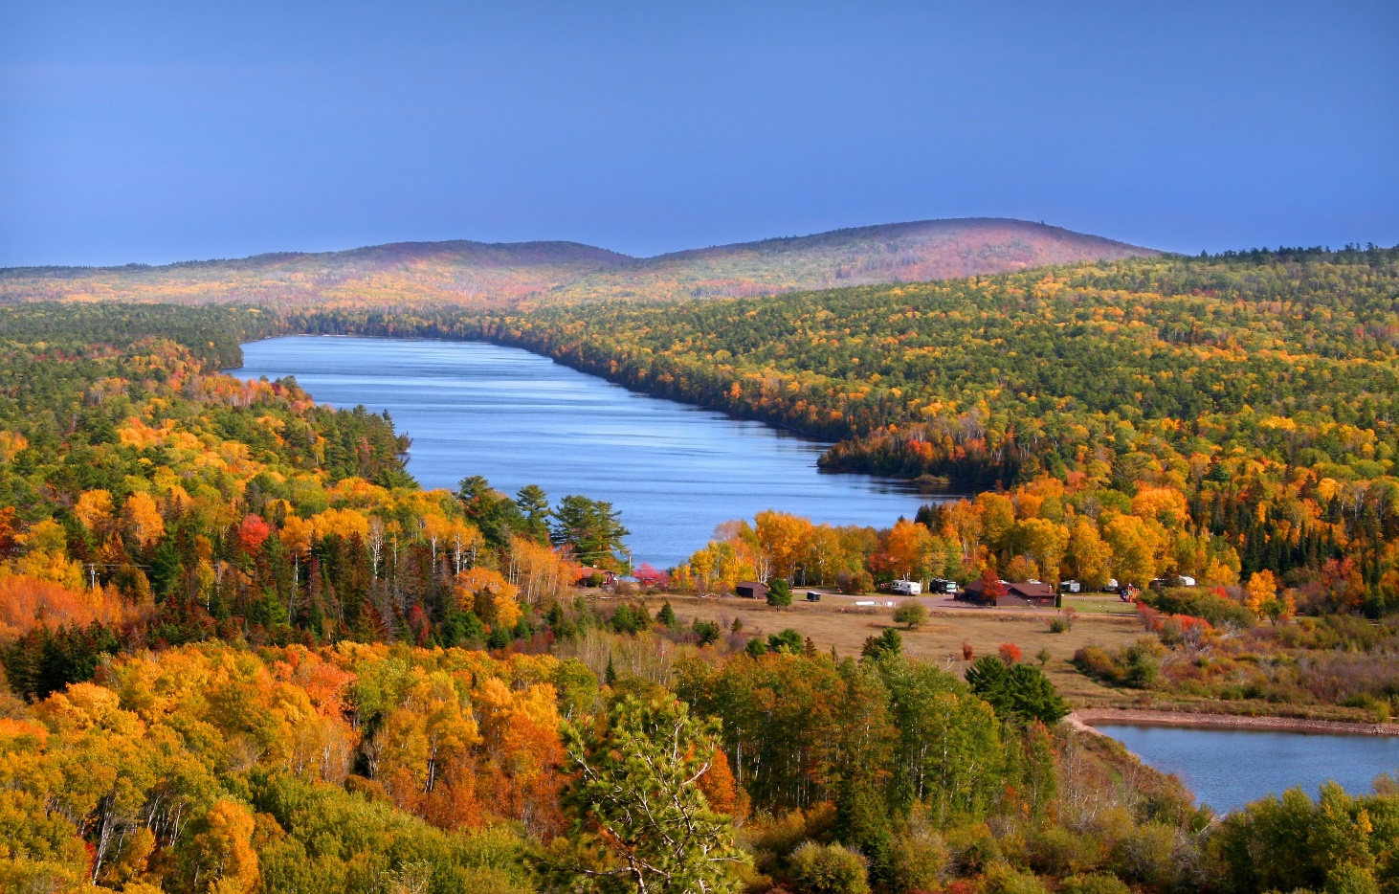
Welcome to Copper Harbor

Slide 3
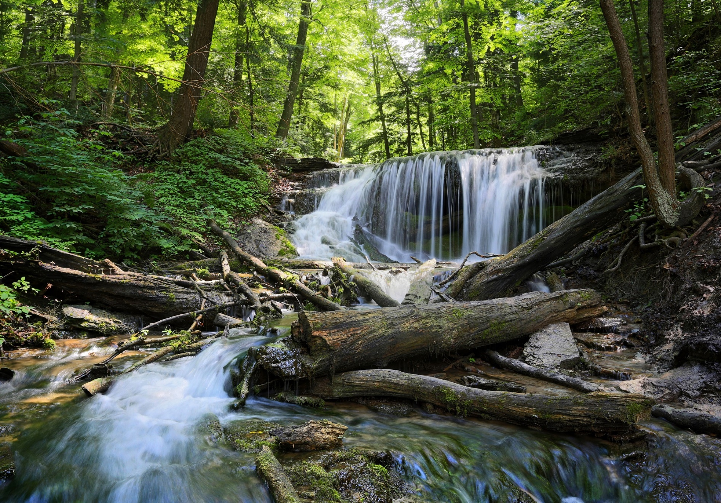
Copper Harbor Watershed

Slide 4
What We Protect
Habitat
Resources
Beauty
Waterways
Forests
Historic sites

Slide 5
Conservation Areas
Land stewardship
Farmland
Forests
Open spaces
Porcupine Mountains
Water preservation
Rivers
Streams
Lakes
Copper Harbor
Notes:
Copper Harbor Land Trust works in two areas: land stewardship and waterway preservation.

Slide 6
How We Protect
Land
Water
Conservation easements
Private donations
Ownership
Preservation rights
Easements
Clean-up projects
Use restrictions
Notes:
Conservation easements and land trust donations are the primary tools we use to preserve the undeveloped areas of Copper Harbor.

Slide 7
Where We Protect
Porcupine Mountains
Lily Lake
Horseshoe Harbor
Notes:
We are now focusing on four general areas: the Porcupine Mountains, Lily Lake, Horseshoe Harbor, and Copper Harbor itself.

Slide 8
Connect with Others
Volunteer
Outreach
Events
Annual meeting
Family picnic
Notes:
The Copper Harbor Land Trust welcomes volunteers to help us build our community and preserve the land.

Slide 9
Ways to Give
Donate online: www.copperharbor.cengage.com
Create a charitable bequest
Conserve your land
Become a supporter
All donations are tax-deductible
Notes:
We depend on your contributions

Slide 10
Contact the Copper Harbor Land Trust
Marty Spinelli, Executive Director
(906) 555-2016
Lindsey Brownell, Conservation Director
(906) 555-2017
info@copperharbor.cengage.com

