Slide 1

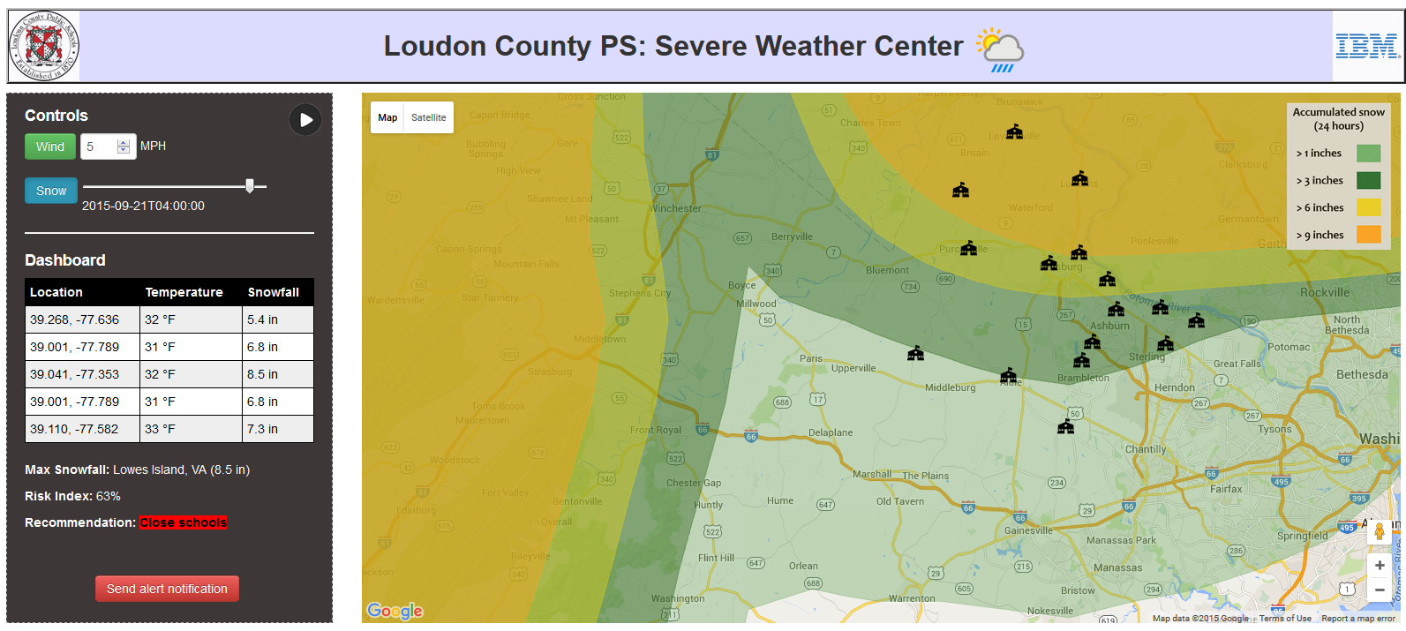

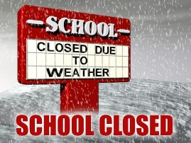

Visualize key weather conditions over time
Tracking of key indicators
Deliver recommendations for school closures
and delays
Simple user interface with adjustable map and weather overlays
Send automatic alerts to school officials and families

Slide 2
Accumulated snow
(24 hours)
> 1 inches
> 3 inches
> 6 inches
> 9 inches

