Slide 1
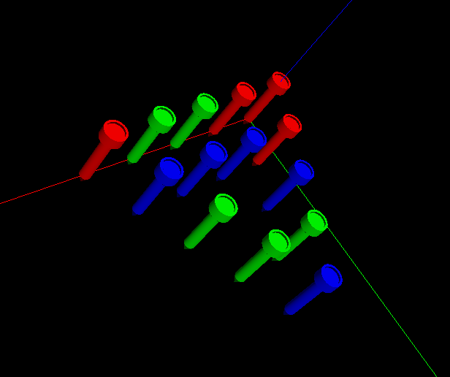
Triangle Peg Game Modeling
Adam. K., Jiazhong. Z., Fei. X.
2015.12

Slide 2

Objectives

Slide 3
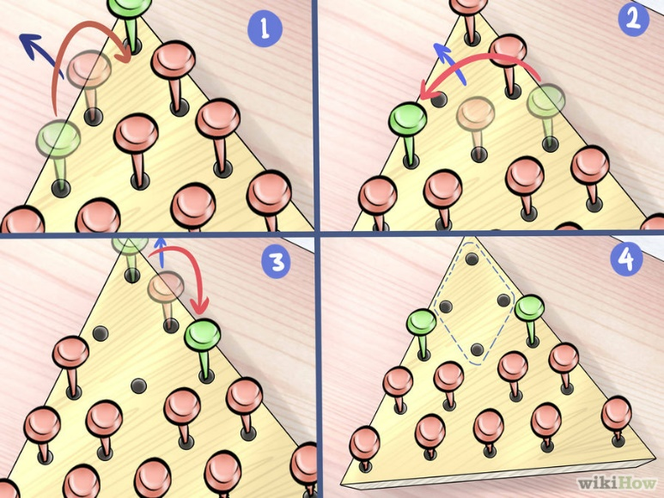
Objectives: Modeling Triangle Peg Game
You must jump each peg over another peg, but only if there is an open space
Each peg you jump over must be removed
You win if only one peg is left at the end of the game

Slide 4
Modeling Procedures

Slide 5
Modeling Procedures:
Modeling the surface of the triangular pad with holes, and all the tees
Simulating a combined colored light on surface
Mapping a texture to the triangular pad with Displacement Mapping
Navigation with mouse by clicking
A triggered animation and each object (tee) will have multiple paths.

Slide 6
Object Descriptions

Slide 7
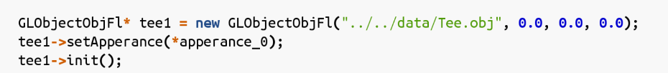
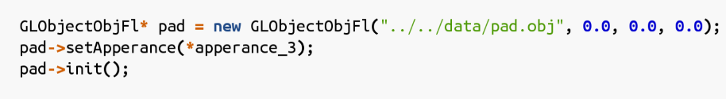
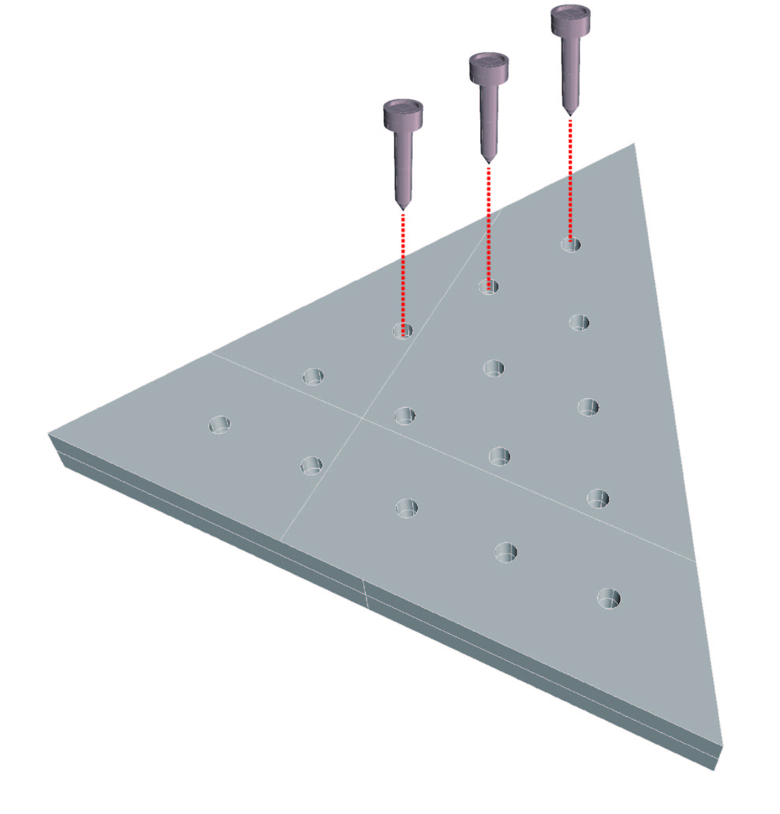
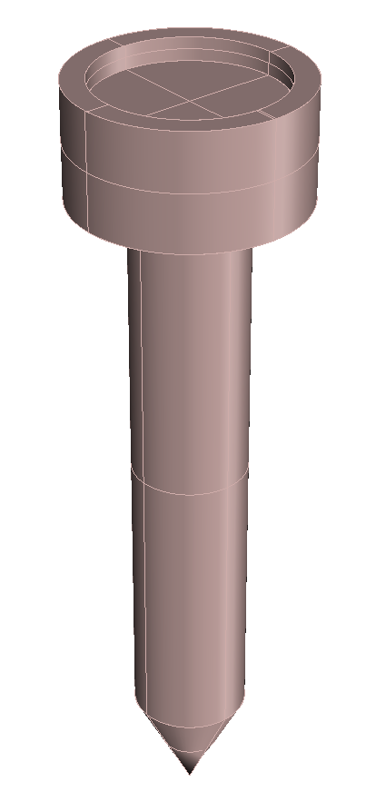
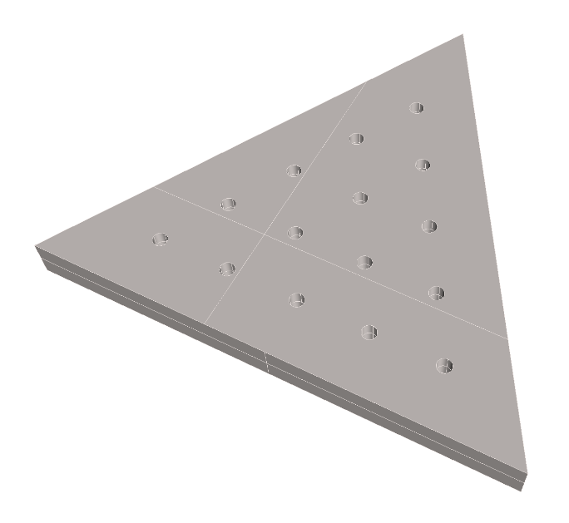
Object Modeling:

Slide 8
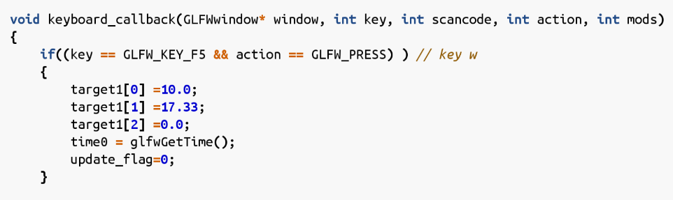
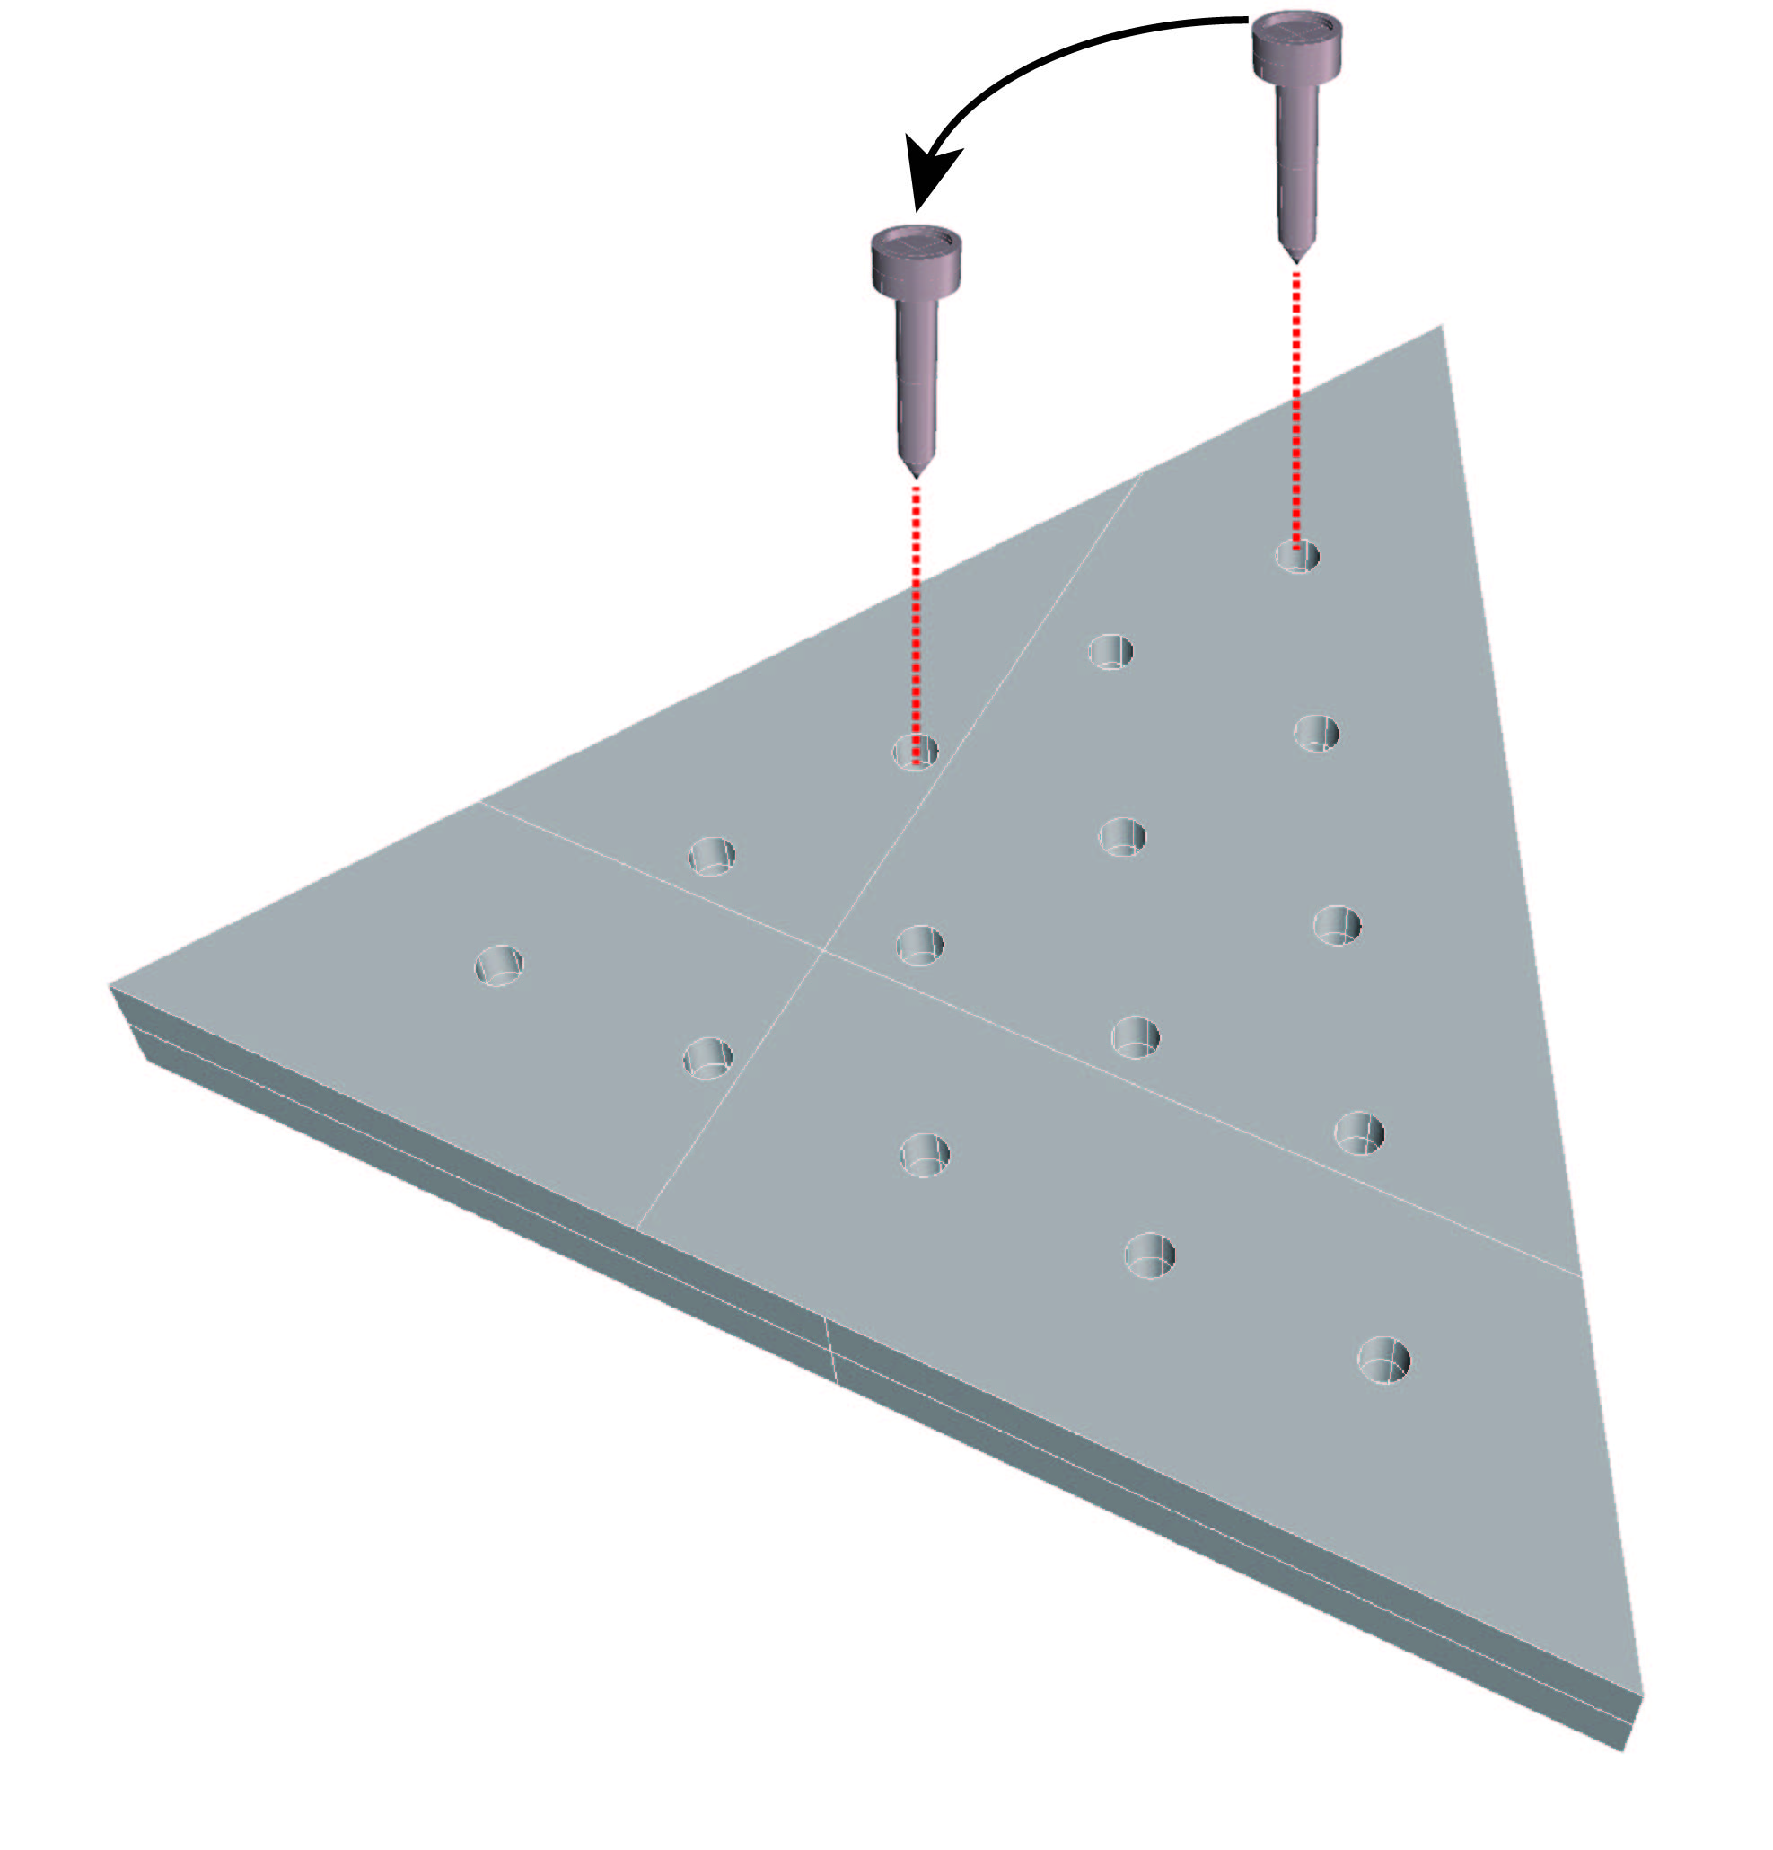
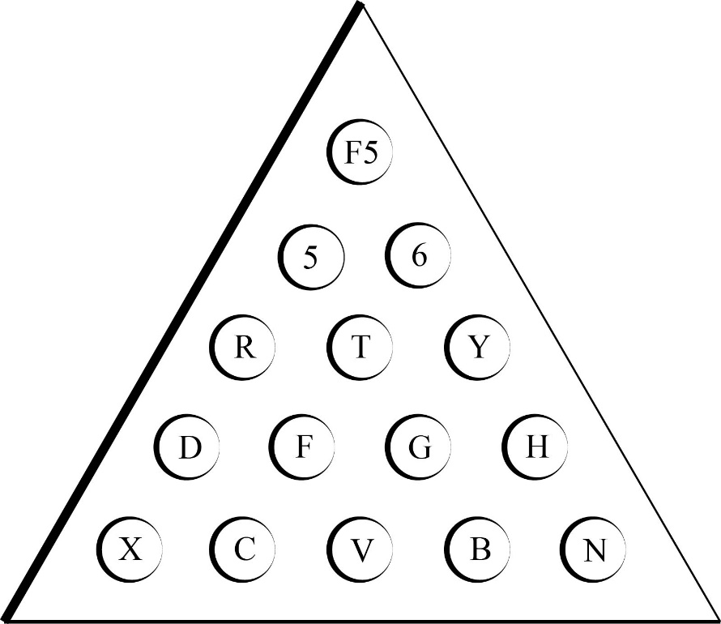
Object User Interaction:
R

Slide 9


Object Triggered Animations:
1
2
3
4
5
6

Slide 10
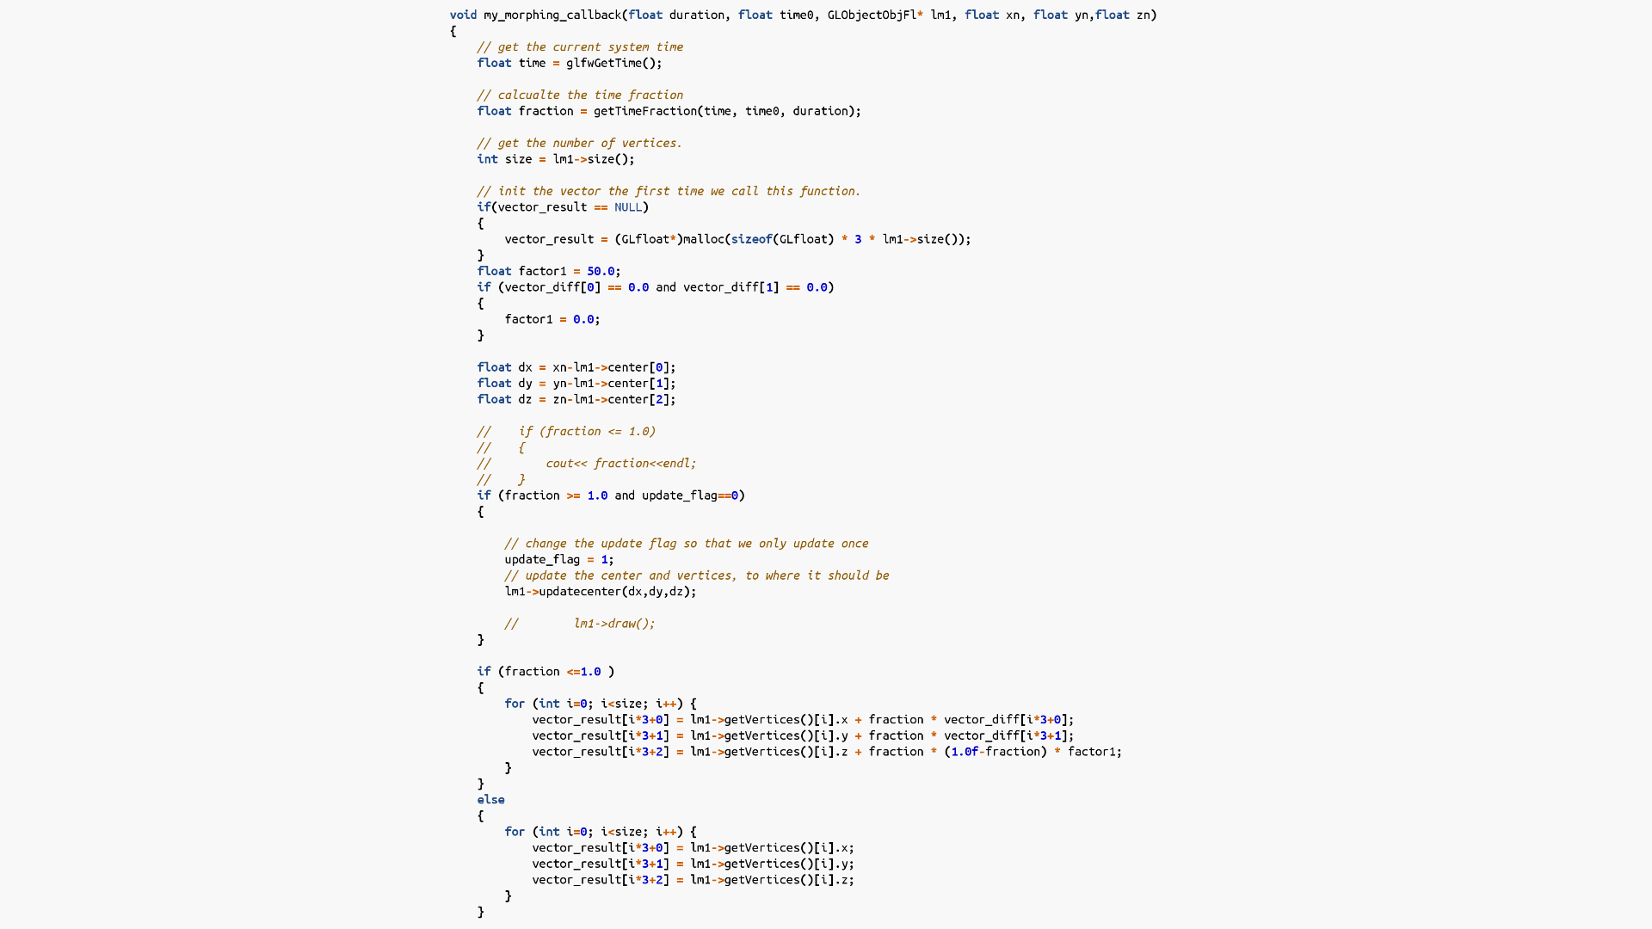
Object Animation Codes:

