Slide 1

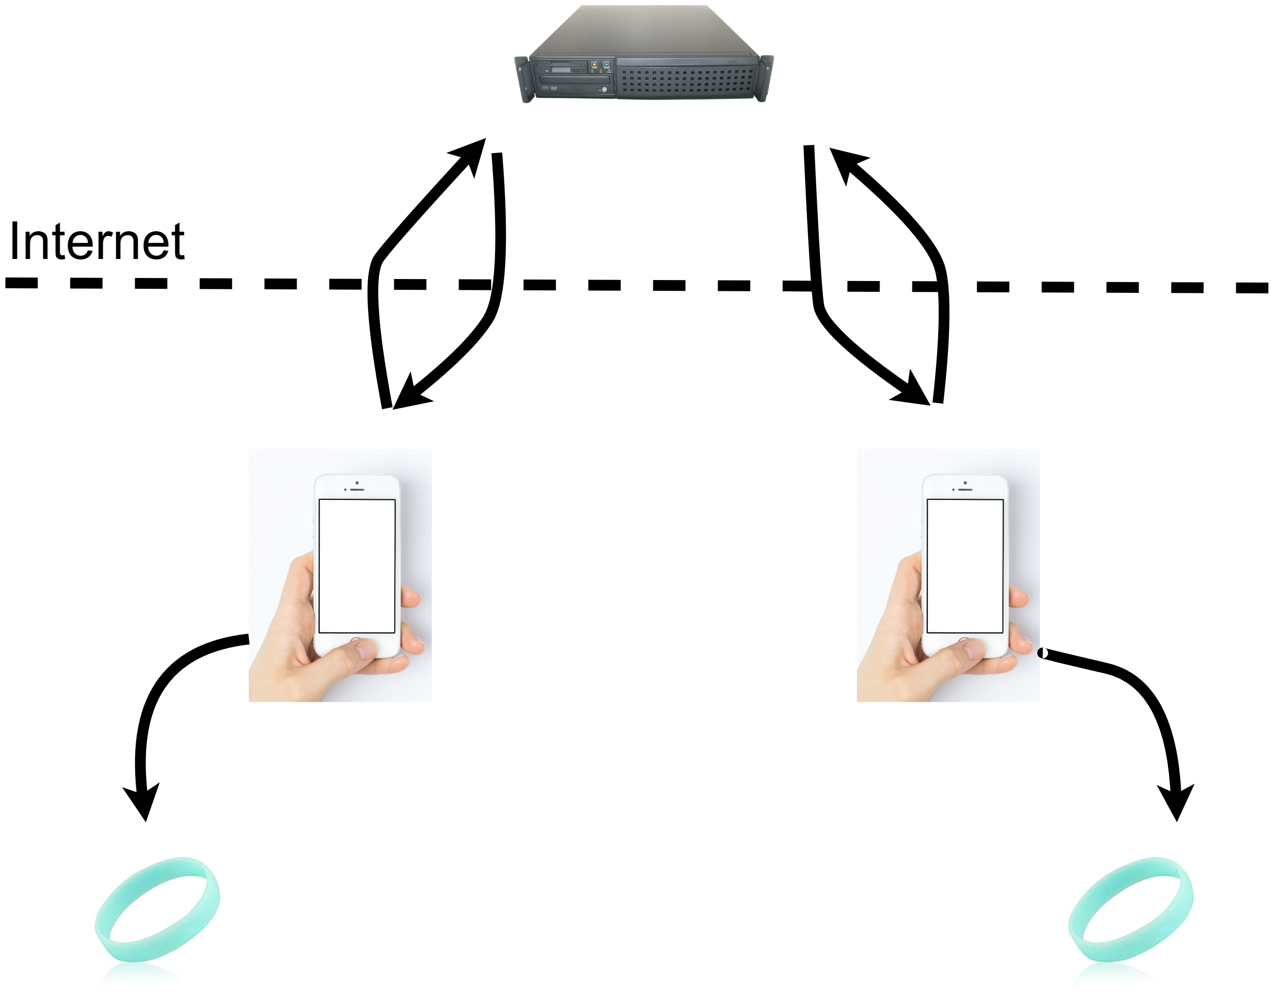
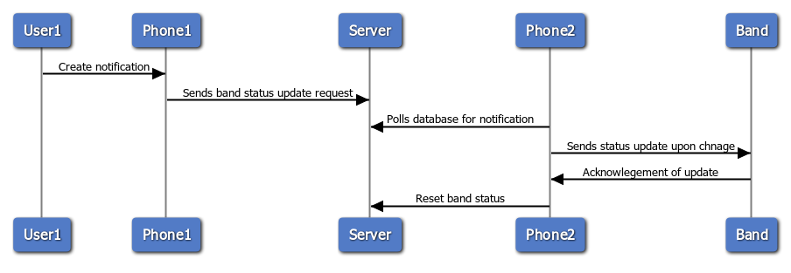
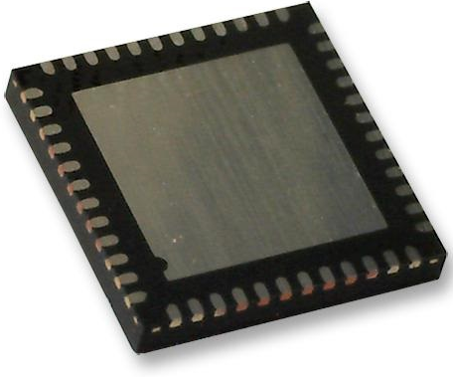
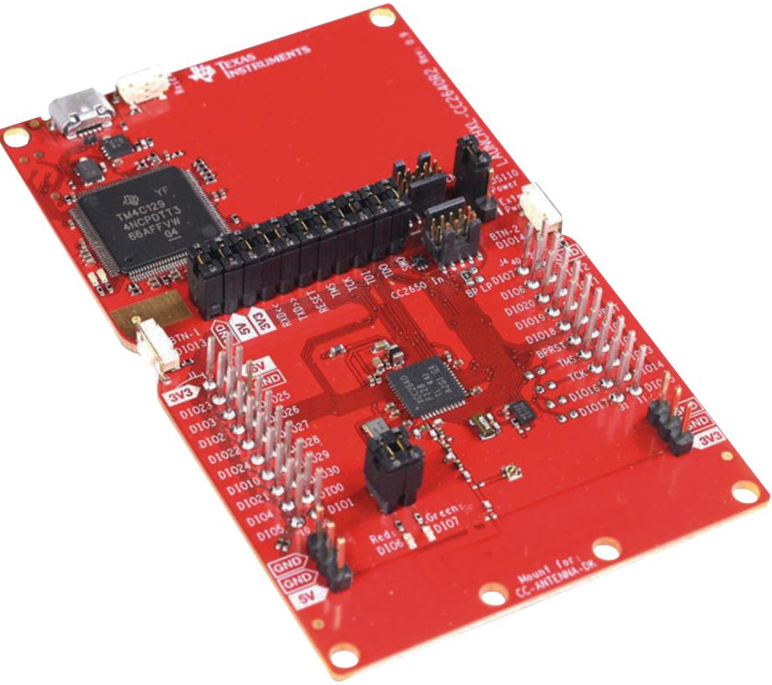
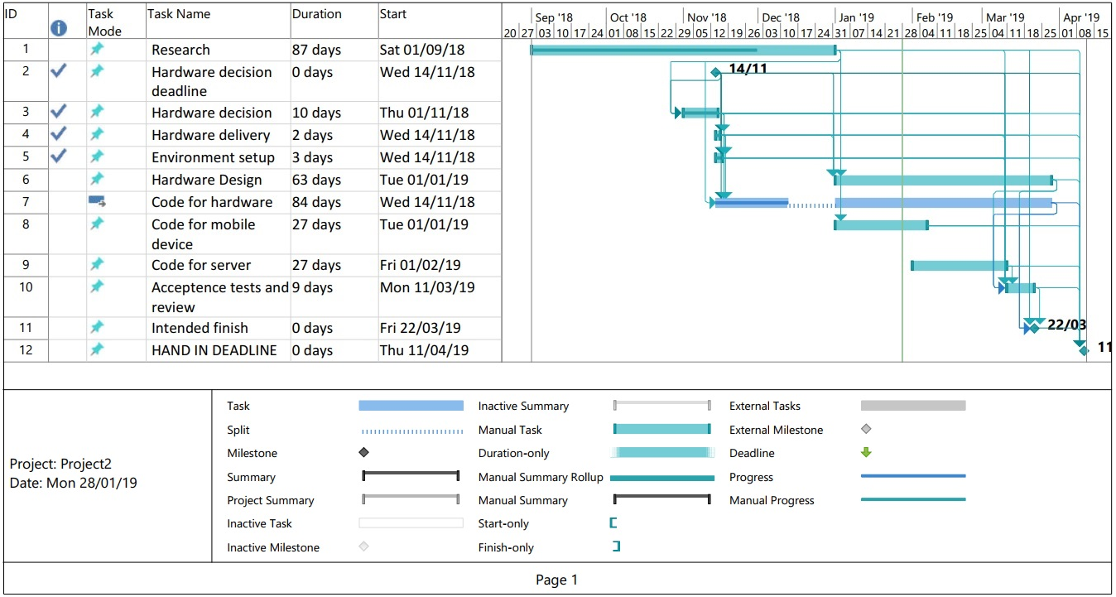
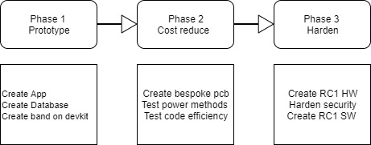
Research: In support of this project some background research has been performed – Does this already exist ? No! many companies make devices that could do this as a secondary function but none fully meet our objectives. Is this feasible ? Yes! based on background research microcontrollers capable of performing inside power and financial limits are readily available (NXP products, 2019), There are multiple options to power a device of this size from what is used in a high end mechanical watch (Richard Watkins, 2016) to those already implemented in remote sensor networks (Shaikh and Zeadally, 2016)
UFCFXK-30-3: Digital Systems Project
Student name: Adam Stock
Project Title: Discrete internet Communicator -
An ultra-low power, low cost network connected haptic
feedback wearable device.
Abstract:
A wearable notification device, near instant basic discreate communication from a remote user with a focus on low cost and low maintenance. The device will link to a companion app on a smart phone. This will enable the wide area communications by communicating with the band locally and a central database via the internet.
Design and implementation
Implementation Concept
Aims and objectives:
The aims for this project are the following :
Create hardware design for a wrist band notification device with suitable controls and communications
Create a companion app for a smartphone to offload processing from the wristband (to lower power usage) and provide wan communication
Create a server for notification passing between users/apps
Keep productions costs low (rrp of less than £10)
Notifications sequence
Implementation Hardware
After initial research the microcontroller chosen is the CC2640R2FRHBT – an ARM Cortex-M3 equipped Quad Flat Package with integrated Bluetooth LE and 5 features integrated. All while having a low power usage (> 6mA) while in use and even lower ( ~100µA) while using its various sleep/shutdown modes
Key requirements:
Functional
Non-Functional
Requirement # | Requirement description | Category
1.1 | System powers on | Must have
1.2 | System pairs with Bluetooth device | Must have
1.3 | System retries previous Bluetooth connection upon disconnection | Must have
1.4 | App should boot in android | Must have
1.5 | App should transmit notification to device | Must have
1.6 | Device should receive notification from app | Must have
1.7 | Device should vibrate if notification dictates | Must have
1.8 | App should initiate notification message manually | Should have
1.9 | App should initiate notification message from local source (e.g. alarm) | Should have
1.11 | App should initiate notification from remote source (database lookup) | Must have
1.12 | App should be able to send notification to a remote user (database insertion) | Must have
1.13 | The product should provide differentiation between sources of notification (intensity and/or duration of pulse) | Should have
1.14 | Device should have a way to silence notification locally (button/motion) | Could have
1.15 | Device should be able to display reason for message visually (RGB or display) | could have
Requirement # | Requirement description | Category
2.1 | Device must provide notification only to the user (discretion)
2.1 | Device must provide long service life without user input
2.3 | Device must have physical attributes to enable comfortable wearing/use
2.4 | Device should provide usage without power input (charging)
2.5 | The product must provide notifications in a timely manor (>10s)
2.6 | The product should be of near disposable cost (>£10)
2.7 | The device must work over a reasonable range between it and internet enabled device
2.8 | The device should provide a widespread method to connect to an internet enabled device (Bluetooth)
This microcontroller has conveniently already been integrated into the LAUNCHXL-CC2640R2 - Development Kit. Enabling easy development of the project using Ti’s own ‘Code Composer’ IDE based on Eclipse.
Planning and Management: .
References: House of Haptics (2018) SAY HEY Stay in Touch. Available from: https://heybracelet.com/about [Accessed 11/10/2018].
NXP products (2019) QN902X: Ultra Low Power Bluetooth LE System-on-Chip Solution Follow . Available from: https://www.nxp.com/products/wireless/bluetooth-low-energy/ultra-low-power-bluetooth-le-system-on-chip-solution:QN902X [Accessed 27.01.2019].
Shaikh, F.K. and Zeadally, S. (2016) Energy harvesting in wireless sensor networks: A comprehensive review. Renewable and Sustainable Energy Reviews,. 55 pp.1041.

