Slide 1

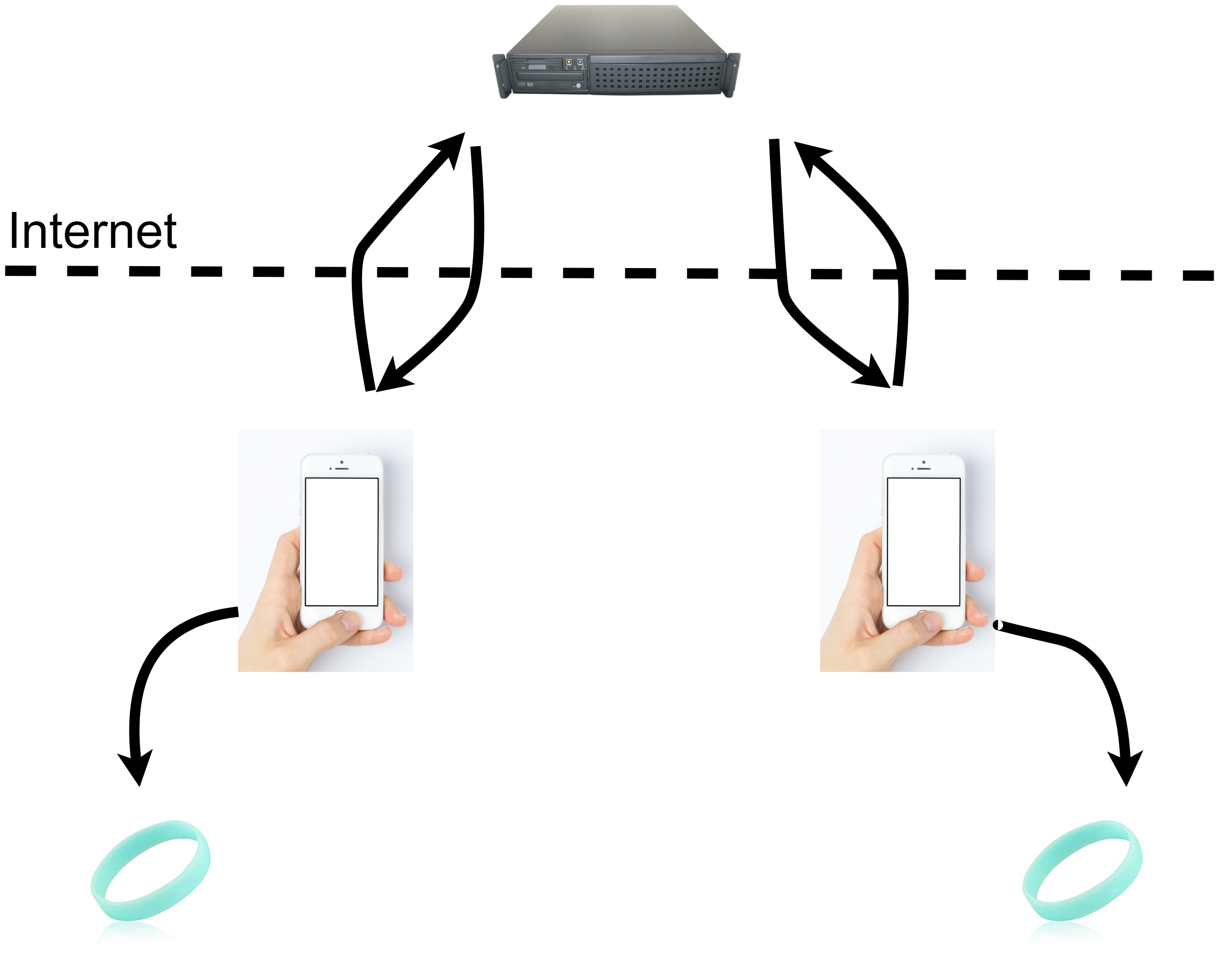
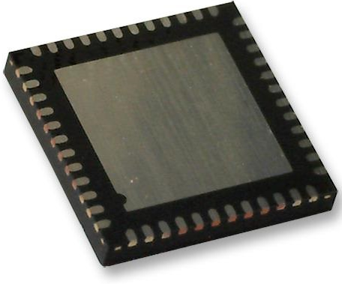
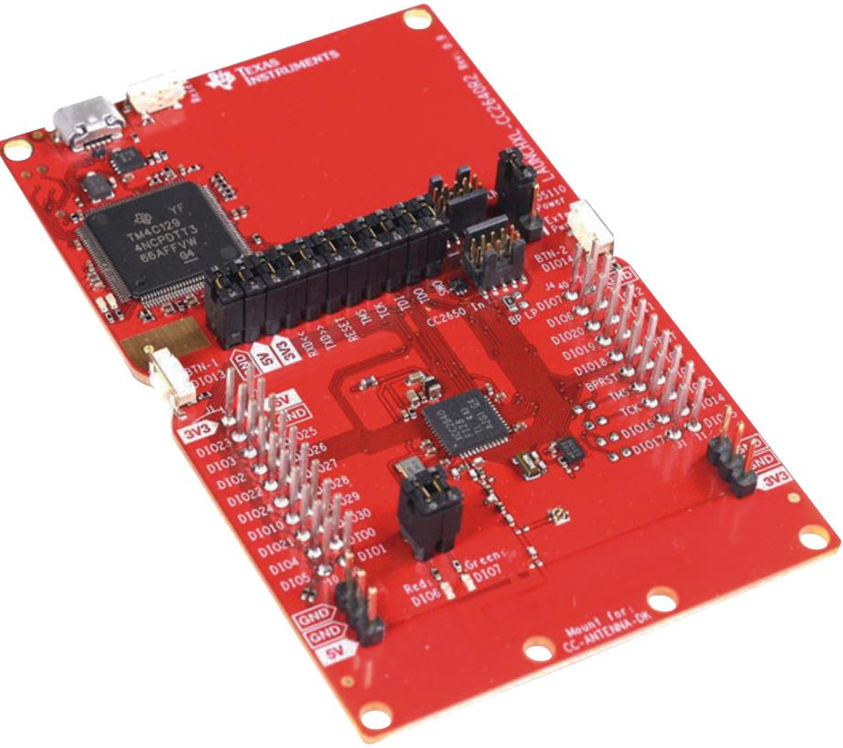
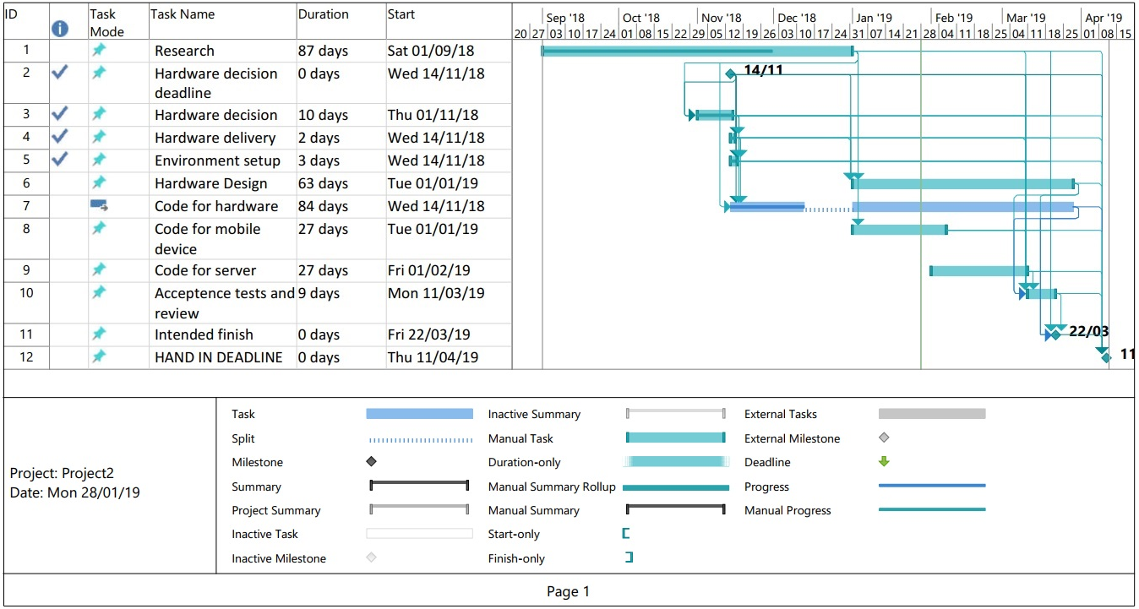
Research: In support of this project some background research has been performed – Does this already exist ? Yes and no , a vague answer yes but accurate. Companies such as ‘House of Haptics’ have bought products to market such as the ‘Hey bracelet’ (House of Haptics, 2018) however these have been bulky and required frequent charging and maintenance. Also available are items such as the plethora of affordable smartwatches coming to market, but again these don’t fulfil our requirements. Can this exist / is this feasible ? In short yes, based on background research microcontrollers capable of performing these functions inside the available power and financial limits are readily available (NXP products, 2019), as well as batteries there are multiple options to power a device of this scale ranging from those similar to what is used in a high end mechanical watch (Richard Watkins, 2016) to those already implemented in remote sensor networks (Shaikh and Zeadally, 2016)
UFCFXK-30-3: Digital Systems Project
Student name: Adam Stock
Project Title: Discrete internet Communicator -
An ultra-low power, low cost network connected haptic
feedback wearable device.
Abstract:
A wearable notification device, near instant basic discreate communication from a remote user with a focus on low cost and low maintenance. This device should use a companion app on a smartphone to enable long range communication and contain an embedded power source with enough capacity to prevent the need for frequent charging.
Design and implementation
Implementation Concept
Aims and objectives:
The aims for this project are the following :
Create hardware for a wrist band notification device with suitable controls and communications
Create a companion app for a smartphone to offload processing from the wristband (to lower power usage) and provide wan communication
Integrate haptic feedback with a secondary potential use as an energy harvesting device
Create a server for notification passing between users/apps
Keep productions costs low (ideally with an rrp of less than £10)
Implementation Hardware
After initial research the microcontroller chosen is the CC2640R2FRHBT – an ARM Cortex-M3 equipped Quad Flat Package with integrated Bluetooth LE and 5 features integrated. All while having a low power usage (> 6mA) while in use and even lower ( ~100µA) while using its various sleep/shutdown modes
This microcontroller has conveniently already been integrated into the LAUNCHXL-CC2640R2 - Development Kit. Enabling easy development of the project using Ti’s own ‘Code Composer’ IDE based on Eclipse.
Key requirements:
The key requirements for this project are as follows-
Functional
The product must provide simple near silent notification (vibration)
The product must enable communication with other band users via a wan enabled device (smartphone)
The product must provide differentiation between sources of notification (pulse and duration of vibration)
Non-functional
The device must provide long service life without servicing
The device must provide usage without the need for charging
The device must have physical attributes that enable comfortable wearing
The product must provide notification in a timely manor (> 10s)
The product should be of near disposable cost ( > £10)
The product must work over a reasonable range between device an companion and between users
Planning and Management: .
References: House of Haptics (2018) SAY HEY Stay in Touch. Available from: https://heybracelet.com/about [Accessed 11/10/2018].
NXP products (2019) QN902X: Ultra Low Power Bluetooth LE System-on-Chip Solution Follow . Available from: https://www.nxp.com/products/wireless/bluetooth-low-energy/ultra-low-power-bluetooth-le-system-on-chip-solution:QN902X [Accessed 27.01.2019].
Shaikh, F.K. and Zeadally, S. (2016) Energy harvesting in wireless sensor networks: A comprehensive review. Renewable and Sustainable Energy Reviews,. 55 pp.1041.

