Slide 1
Chapitre 3
Configuration du matériel sur un ordinateur exécutant Windows 7 Professionnel
Module S41

Slide 2
Plan du cours
Vue d'ensemble des pilotes de périphériques dans Windows 7
Installation des périphériques et des pilotes
Utilisation des pilotes
Résolution des problèmes liés aux périphériques matériels

Slide 3



Vue d'ensemble des pilotes de périphériques dans Windows 7
Un pilote est un petit logiciel qui permet à un périphérique matériel de communiquer avec un ordinateur.
Les pilotes développés pour les versions 32 bits ne fonctionnent pas avec les versions 64 bits et vice versa.
Les pilotes de périphériques qui sont fournis avec Windows 7 ont une signature numérique Microsoft.
Le magasin de pilotes est le référentiel de pilote.
Les packages des périphériques contiennent:
    Les propriétés du périphérique
    Les fonctions du périphérique
    Les applications et les services qui prennent en charge le périphérique.
Notes:
Key message: A driver is software that allows the computer to communicate with hardware or devices.
To build this slide:
Click to display each of the bullet points.
Use the following information as you talk about each point.
Describe each of the following so that students have the background information they need for the remainder of this lesson. For more information about each item, refer to the Course Companion CD.
Device drivers – specialized, hardware-dependent software that is also specific to an operating system.
32-bit and 64-bit drivers - drivers developed for the 32-bit versions do not work with the 64-bit versions, and vice versa. You must ensure that you obtain the appropriate device drivers before installing Windows 7.
Driver signing - device drivers that Windows 7 includes have a Microsoft digital signature that indicates whether a particular driver or file has met a certain level of testing, is stable and reliable, and has not been altered since it was digitally signed.
Driver store - the driver repository that can be preloaded with drivers for commonly used peripheral devices. The driver store is located in systemroot\System32\DriverStore. Use the Pnputil.exe tool to add a driver to the Windows 7 driver store manually.
Device metadata packages
The Device Metadata System provides an end-to-end process for defining and distributing device metadata packages. These packages contain device experience XML documents that represent the properties of the device and its functions, together with applications and services that support the device. Through these XML documents, the Devices and Printers folder and Device Stage present users with an interface that is specific to the device as defined by the device maker.

Slide 4
2. Installation et configuration de périphériques matériels
Installation de périphériques Plug-and-Play
Installation de périphériques non-Plug-and-Play
Les nouveautés
Processus de détection des pilotes
Outils de gestion de pilotes de périphériques

Slide 5
Installation de périphériques plug and play
1
Connectez le périphérique à votre ordinateur
2
Windows installe automatiquement le périphérique
3
Vous pouvez commencer à utiliser le périphérique

Slide 6
Installation de périphériques non plug and play
1
Connectez le périphérique à votre ordinateur
2
Chargez les pilotes de périphérique appropriés
3
Configurez les propriétés et les paramètres du périphérique, si nécessaire

Slide 7
Les nouveautés
Les packages de pilotes sont stockés dans le magasin de pilotes protégé
Utilisation de l’outil en ligne de commande (Pnputil.exe).
Les utilisateurs standard peuvent uniquement installer des packages de pilotes que vous autorisez.
Notes:
Key message: When you install a new device, typically Windows 7 recognizes and configures it by using Plug and Play. The success of driver installation depends on whether the device is supported by a driver package included with Windows or available on Windows Update and when the user has media with the driver package provided by the vendor.
At a high level, discuss how the following actions helps improve the user experience and reduce help desk support costs by allowing standard users to install approved driver packages without requiring additional permissions or the assistance of an administrator:
Staging driver packages
Configuring client computers to automatically search a specified list of folders when a new device is attached to the computer
Restarting the system is rarely necessary when installing Plug and Play devices or software applications
These features also help increase computer security by ensuring that standard users can only install driver packages that you authorize and trust.
Discuss the device configuration and driver information requirements that must be met.
Walk through the driver detection process including digital signature validation and how Plug and Play queries the device for identification strings and searches the driver store for a driver package that matches the identification strings and what happens if a matching package is not found in the driver store.
Describe the Pnputil.exe tool. Mention that it must be run from an elevated command prompt. Two common parameters are “-a” to add a driver, and “-e” to enumerate through the list of drivers in the driver store. Also mention that drivers are renamed to “oem*.inf” when they are added, provide an example. Discuss the difference between disconnecting a device, disabling the driver, and deleting a driver.
Non-Plug and Play Devices
Talk briefly about Non-Plug and Play devices including the following (optionally you can demonstrate where to view Non-Plug and Play devices in Device Manager):
The devices are becoming increasingly rare
The devices are installed and configured in Device Manager
Users need to carefully research changes to the startup type and resource settings
Implementers must use the informational materials that accompanied the device and the Device Manager Help
Question: What are the steps to install a driver in the driver store by using the Pnputil.exe tool?
Answer: The steps are as follows:
Identify the name of the device driver.
Start the Pnputil.exe tool from an elevated command prompt.
Use the –a parameter along with the path to the driver and name of the driver to perform the addition to the driver store.
Make note of the newly assigned driver name, including the number.

Slide 8
Processus de détection des pilotes
1
Lorsqu'un utilisateur insère un périphérique, Windows le détecte
2
Le service PnP récupère les chaînes d'identification du périphérique et recherche un package de pilotes qui lui correspond
Si le package est trouvé:
3
Copie des fichiers de pilotes de périphériques à partir du magasin de pilotes vers leurs emplacements opérationnels
4
Démarrage du pilote de périphérique installé
Si le package est non trouvé:
3
Windows lance une recherche: dossiers spécifiés par Registre;
site Web Windows Update ; média.
Notes:
Key message: When you install a new device, typically Windows 7 recognizes and configures it by using Plug and Play. The success of driver installation depends on whether the device is supported by a driver package included with Windows or available on Windows Update and when the user has media with the driver package provided by the vendor.
At a high level, discuss how the following actions helps improve the user experience and reduce help desk support costs by allowing standard users to install approved driver packages without requiring additional permissions or the assistance of an administrator:
Staging driver packages
Configuring client computers to automatically search a specified list of folders when a new device is attached to the computer
Restarting the system is rarely necessary when installing Plug and Play devices or software applications
These features also help increase computer security by ensuring that standard users can only install driver packages that you authorize and trust.
Discuss the device configuration and driver information requirements that must be met.
Walk through the driver detection process including digital signature validation and how Plug and Play queries the device for identification strings and searches the driver store for a driver package that matches the identification strings and what happens if a matching package is not found in the driver store.
Describe the Pnputil.exe tool. Mention that it must be run from an elevated command prompt. Two common parameters are “-a” to add a driver, and “-e” to enumerate through the list of drivers in the driver store. Also mention that drivers are renamed to “oem*.inf” when they are added, provide an example. Discuss the difference between disconnecting a device, disabling the driver, and deleting a driver.
Non-Plug and Play Devices
Talk briefly about Non-Plug and Play devices including the following (optionally you can demonstrate where to view Non-Plug and Play devices in Device Manager):
The devices are becoming increasingly rare
The devices are installed and configured in Device Manager
Users need to carefully research changes to the startup type and resource settings
Implementers must use the informational materials that accompanied the device and the Device Manager Help
Question: What are the steps to install a driver in the driver store by using the Pnputil.exe tool?
Answer: The steps are as follows:
Identify the name of the device driver.
Start the Pnputil.exe tool from an elevated command prompt.
Use the –a parameter along with the path to the driver and name of the driver to perform the addition to the driver store.
Make note of the newly assigned driver name, including the number.

Slide 9
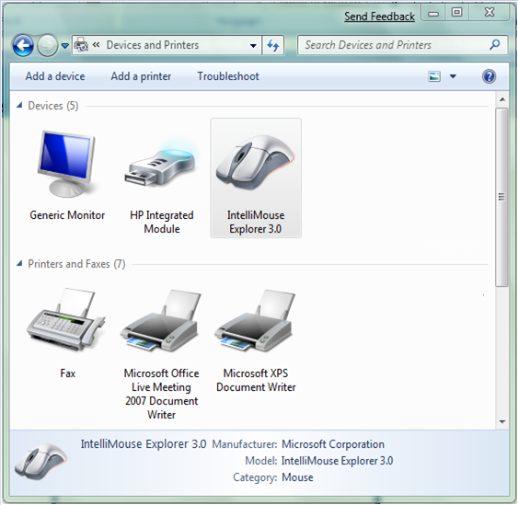
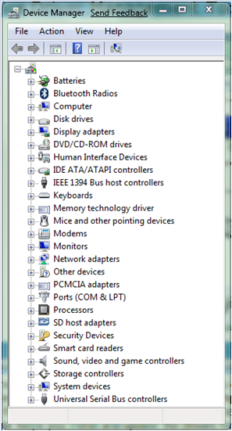
Outils de gestion de pilotes de périphériques
Gestionnaire de périphériques
Périphériques et imprimantes
Périphériques et imprimantes
fournit un endroit supplémentaire pour gérer des périphériques.
Les périphériques qui s’affichent dans cet emplacement sont en général des périphériques externes que vous connectez ou déconnectez de l'ordinateur via un port ou une connexion réseau
Gestionnaire de périphériques
Afficher la liste des périphériques installés
Désinstaller un périphérique
Activer ou désactiver des périphériques
Résoudre les problèmes liés aux périphériques
Mettre à jour les pilotes de périphériques
Restaurer des pilotes
Notes:
Key message: There are several areas in Windows 7 where you can manage devices and their related drivers including Device Manager, Devices and Printers, Device Stage, and the Pnputil tool run from an elevated command prompt.
To build this slide:
Click to show Device Manager
Click to show Devices and Printers
Click to show a photo realistic image in Device Stage™
Click to show all images at one time
Talk about each of these areas in turn, describe the tasks that can be performed in each area or tool:
Device Manager helps you install and update the drivers for hardware devices, change the hardware settings for those devices, and troubleshoot problems by updating a driver or rolling it back. You can use Device Manager to manage devices only on a local computer. On a remote computer, Device Manager works in read-only mode, allowing you to view, but not change, the hardware configuration of that computer. Device Manager is accessible in the All Items category in Control Panel.
The Devices and Printers category in Control Panel provides a single place to access and interact with connected and wireless devices. Wizards guide you through the setup process which reduces complex configuration tasks. Windows 7 recognizes new devices and attempts to automatically download and install any drivers required for that device. Have the students discuss common devices that they see in this location. Also contrast how a multifunction device displays differently in Device Manager and Devices and Printers.
Device Stage provides users with a new way to access devices and advanced options for managing them. Devices in use are shown on the taskbar with a photo-realistic icon. This taskbar icon can include quick access to common device tasks; status indicators that let users quickly discern battery status, device synchronization status, remaining storage capacity, and so on.
Pnputil tool is run from an elevated command prompt and was discussed previously. Review as needed.
If you have an internet connection, show the list of the Device Stage experiences found at the following location: http://go.microsoft.com/fwlink/?LinkID=144630&clcid=0x409.

Slide 10
2. Utilisation des pilotes
Options de mise à jour de pilotes
Gestion des pilotes signés

Slide 11
Options de mise à jour de pilotes
Mise à jour dynamique
Mise à jour de Windows
Médias ou le site Web du fabricant
Gestionnaire de périphériques
Fonctionne avec Windows Update pour télécharger les correctifs critiques et pilotes de périphériques requis pour le processus d’installation
Fournit des mises à jour de logicielles et des pilotes et fournit des options de mise à jour automatiques
Utiliser les médias ou accédez au site Web du fabricant de l’appareil pour obtenir un pilote mis à jour
Met à jour manuellement le logiciel du pilote pour le périphérique
Notes:
Key message: Dynamic Update is a feature that works with Windows Update™ to download any critical fixes and device drivers that are required for the setup process. When updated device drivers are required, Microsoft is working to ensure that you can get them directly from Windows Update or through links to driver downloads on device manufacturer Web sites.
Mention that students can use Device Manager to manually update drivers. Also talk about the “load driver” feature that is provided so that, if an upgrade is blocked due to incompatible or missing drivers that are required for the system to start, you can load a new or updated driver from the Compatibility Report and continue with the upgrade.
Use the information on the slide to describe ways to update drivers.

Slide 12
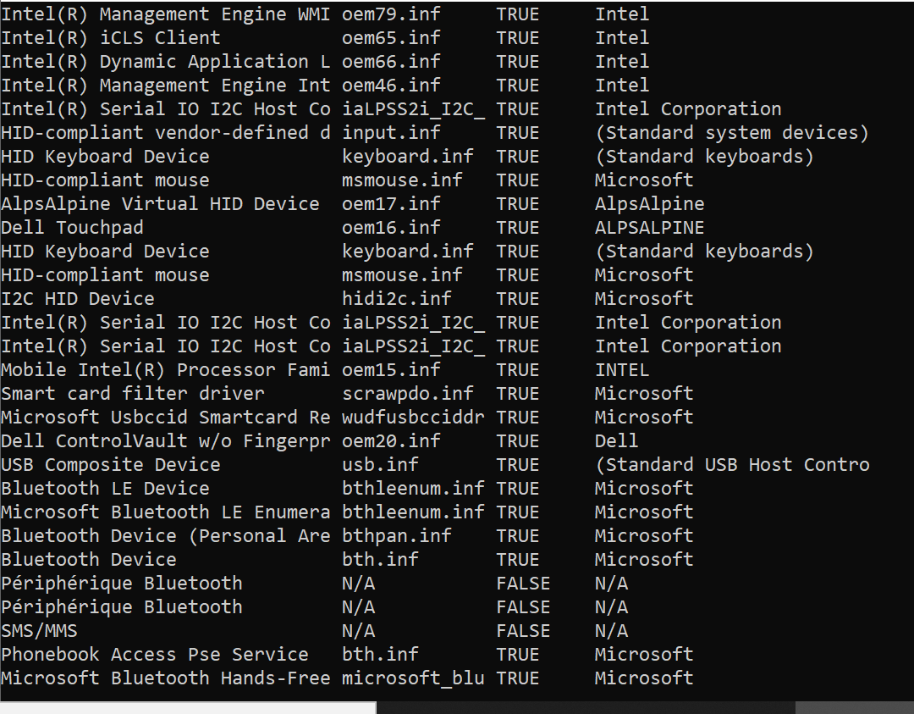
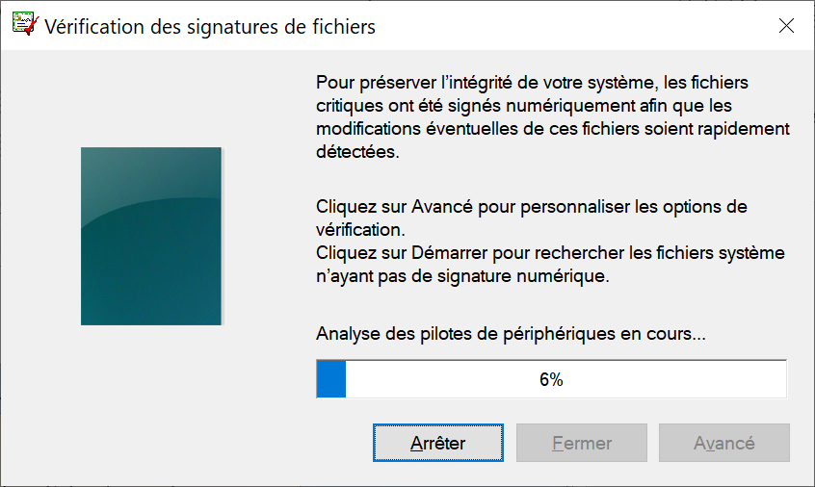
Gestion des pilotes signés
Avantages de la signature de pilotes
Amélioration de la sécurité
Réduction du coût de la prise en charge
Gestion des pilotes signés
Utiliser Sigverif.exe pour rechercher les pilotes de périphériques non signés
Utilisez la commande driverquery avec le commutateur /si pour obtenir une liste de base des pilotes signés et non signés
Notes:
Key message: Because device drivers run with system-level privileges and can access anything on the computer, it is critical to trust device drivers that are installed. Digital signatures allow administrators and end users who are installing Windows-based software to know that a legitimate publisher has provided the software package. A device driver that includes an electronic security mark indicating the publisher of the software and that the original contents of the driver package are unchanged.
Discuss the two main principles of trust where authenticity conveys a guarantee that the package came from its claimed source and integrity conveys an assurance that the package is completely intact and has not been modified after its release.
Describe a signed driver and talk about each of the benefits of signing and staging driver packages, improved security, reduced support costs, and better user experience. Talk about the store for digital certifications and that Group Policy allows you to have the certificate automatically installed to all managed computers in a domain, organizational unit, or site.
Make sure students know what the Sigverf.exe tool is used for. Show them the results of the driverquery command if there is interest.

Slide 13
3. Résolution des problèmes liés aux périphériques matériels
Options de récupération suite à un problème du pilote
Suppression de périphériques

Slide 14


Options de récupération suite à un problème du pilote
Quelles sont les différentes façons de procéder à une récupération suite à un problème du pilote?
Notes:
Key message: If you have a hardware problem, it can be caused by hardware or a device driver. Fortunately, the process to update device drivers to a newer version is straightforward. Alternatively, device drivers can be rolled back to an older version or reinstalled. Troubleshooting hardware problems often starts by troubleshooting device drivers.
To identify a device driver problem, answer the following questions:
Did you recently upgrade the device driver or other software related to the hardware? If so, roll back the device driver to the previous version.
Are you experiencing occasional problems, or is the hardware not compatible with the current version of Windows? If so, upgrade the device driver.
Did the hardware suddenly stop working? If so, upgrade the device driver. If that does not solve the problem, reinstall the device. If the problem continues, try troubleshooting the hardware problem.
Ask students the following questions:
How many times have new devices and their associated drivers introduced reliability problems on computers that you manage?
What are possible ways of recovering from a driver problem? Describe a situation in which you might use each recovery method to resolve a driver problem. Possible answers are to roll back the driver and perform a System Restore.
Tell the students that keeping drivers current is critical to efficient performance. A newer version of a device driver often adds functionality and fixes problems that were discovered in earlier versions; many hardware problems can be resolved by installing updated device drivers. Also, device driver updates often help resolve security problems and improve performance. If the updated device driver is not available through Windows Update, find the latest version of the device driver by visiting the computer manufacturer’s Web site for an updated driver, visiting the hardware manufacturer’s Web site, or searching the Web using the device name.
Talk about driver maintenance that can be performed in Device Manager, such as updating driver software, rolling back drivers, viewing driver status. Point out that rolling back a driver can cause the loss of new functionality and can reintroduce problems that were addressed with the newer version. Also mention that in certain circumstances the Roll Back Driver button is not available. It is only present if a previous version of the driver was installed. If the current driver for the device is the only one that was ever installed on this computer, then the Roll Back Driver button is not enabled.
Inform the students that after a device or driver is updated, it is rare that the computer may not start. This problem may occur in the following situations:
The new device or the driver causes conflicts with other drivers that are installed on the computer.
A hardware-specific issue occurs.
The driver that is installed is damaged.
In these types of situations, System Restore or the Last Known Good Configuration can be used to resolve the problem.

Slide 15
Options de récupération suite à un problème du pilote
Vous pouvez utiliser la fonction de restauration de la version précédente du pilote pour effectuer une récupération à la suite d'un problème lié au périphérique.
Si la restauration du pilote n'est pas suffisante, vous pouvez utiliser l'outil Restauration du système.
Utilisez l'option Dernière bonne configuration connue comme moyen de restauration du système à une configuration précédente
Notes:
Key message: If you have a hardware problem, it can be caused by hardware or a device driver. Fortunately, the process to update device drivers to a newer version is straightforward. Alternatively, device drivers can be rolled back to an older version or reinstalled. Troubleshooting hardware problems often starts by troubleshooting device drivers.
To identify a device driver problem, answer the following questions:
Did you recently upgrade the device driver or other software related to the hardware? If so, roll back the device driver to the previous version.
Are you experiencing occasional problems, or is the hardware not compatible with the current version of Windows? If so, upgrade the device driver.
Did the hardware suddenly stop working? If so, upgrade the device driver. If that does not solve the problem, reinstall the device. If the problem continues, try troubleshooting the hardware problem.
Ask students the following questions:
How many times have new devices and their associated drivers introduced reliability problems on computers that you manage?
What are possible ways of recovering from a driver problem? Describe a situation in which you might use each recovery method to resolve a driver problem. Possible answers are to roll back the driver and perform a System Restore.
Tell the students that keeping drivers current is critical to efficient performance. A newer version of a device driver often adds functionality and fixes problems that were discovered in earlier versions; many hardware problems can be resolved by installing updated device drivers. Also, device driver updates often help resolve security problems and improve performance. If the updated device driver is not available through Windows Update, find the latest version of the device driver by visiting the computer manufacturer’s Web site for an updated driver, visiting the hardware manufacturer’s Web site, or searching the Web using the device name.
Talk about driver maintenance that can be performed in Device Manager, such as updating driver software, rolling back drivers, viewing driver status. Point out that rolling back a driver can cause the loss of new functionality and can reintroduce problems that were addressed with the newer version. Also mention that in certain circumstances the Roll Back Driver button is not available. It is only present if a previous version of the driver was installed. If the current driver for the device is the only one that was ever installed on this computer, then the Roll Back Driver button is not enabled.
Inform the students that after a device or driver is updated, it is rare that the computer may not start. This problem may occur in the following situations:
The new device or the driver causes conflicts with other drivers that are installed on the computer.
A hardware-specific issue occurs.
The driver that is installed is damaged.
In these types of situations, System Restore or the Last Known Good Configuration can be used to resolve the problem.

Slide 16
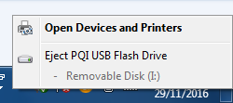
Suppression de périphériques

Slide 17
Exercices
Vous venez d'installer un nouveau périphérique sur un ordinateur exécutant Windows 7. Vous téléchargez et installez la version 2.2 du pilote de périphérique sur l'ordinateur, mais découvrez que le périphérique se comporte de manière erratique. Après avoir vérifié les forums de support technique, vous découvrez que vous pouvez résoudre le problème en utilisant la version 2.1 du pilote de périphérique, que vous pouvez également télécharger sur le site Web du fournisseur. Quelles mesures devez-vous prendre pour vous assurer que la version 2.1 de ce pilote de périphérique est utilisée à la place de la version 2.2?
Vous devez désinstaller la version 2.2 du pilote et le supprimer du magasin de pilotes. Vous pouvez ensuite installer la version 2.1 du pilote de périphérique. Vous ne pouvez pas revenir à la version 2.1 car il n'a pas été installé sur l'ordinateur en premier lieu.

Slide 18
Exercices
Vous êtes l'administrateur de 100 ordinateurs exécutant Windows 7 Professionnel. Un utilisateur annonce que son lecteur de DVD-ROM ne fonctionne plus. Après lui avoir demandé plus d'informations, vous découvrez que l'utilisateur a récemment mis à jour le pilote de son lecteur de DVD-ROM. Comment résoudrez-vous le problème de la manière la plus simple ?
La meilleure méthode serait d'utiliser la fonctionnalité de restauration de pilote pour rétablir le pilote initial.

Slide 19
Exercices
Un utilisateur de votre service graphique essaye d'utiliser sa caméra numérique USB, mais il ne peut pas la visualiser. Quel est l'utilitaire le plus approprié pour vérifier que la caméra est présente et que les pilotes appropriés sont installés sur cet ordinateur ?
Vous pouvez utiliser le Gestionnaire de périphériques, vous pouvez voir si le périphérique fonctionne correctement et que les pilotes appropriés sont installés.
Vous pouvez aussi utilisez la fonctionnalité Device Stage

Slide 20
Exercices
Un utilisateur se sert d'une caméra PC USB pour de la vidéoconférence et doit déplacer chaque jour la caméra entre deux ordinateurs. Il craint que le redémarrage de chaque ordinateur lui prenne trop de temps lorsque la caméra est déplacée d'un ordinateur à un autre. Que pouvez-vous répondre à cet utilisateur ?
La plupart des périphériques USB sont dotés de la fonctionnalité Plug-and-Play. Cet utilisateur n'a donc pas besoin de redémarrer l'ordinateur lorsqu'il connecte et déconnecte son périphérique USB

