Slide 1
Chapitre 4
Gestion des disques
Module S41

Slide 2
Plan du cours
Le partitionnement des disques sous Windows 7
Utilisation des disques dynamiques
Gestion des disques
Défragmentation des volumes

Slide 3
1- Le partitionnement des disques sous Windows 7
Qu’est-ce qu’un disque MBR ?
Qu’est-ce qu’un disque GPT ?
Les outils de gestion disque
Notes:
Key message: This lesson focuses on the two different types of partitions that can be selected when you are adding a new disk and the tools used to manage them.
After completing this lesson, students will be able to:
Describe MBR-based partitions
Describe GPT-based partitions
Describe the disk management tools in Windows 7
Convert an MBR partition to a GPT partition

Slide 4
Qu’est-ce qu’un disque MBR ?
    L'enregistrement de démarrage principal (Master Boot Record)
    Il contient:
    La table de partition du disque
    +
    Un extrait du code exécutable appelé le code de démarrage principal.
Il est créé lorsque le disque est partitionné
    Contient une table d’écriture de quatre partition
Il est sur le premier secteur du disque dur
Limite le nombre & taille de partitions
C:
C:
D:
3 partitions principales au plus et une partition étendue avec volumes logiques
D:
Partitions supportées:
4 partitions/disque
E:
E:
Taille de partition supportée:
Taille de 2 Téraoctets (To)
4 partitions
principales
au plus
F:
F:
Aucune redondance fournie : si le MBR est endommagé, le système d'exploitation peut ne plus être amorçable.
G:
- OU -
H:
Notes:
Key message: Disk partitioning is the process of dividing a physical disk’s storage into manageable pieces to support the requirements of a computer operating system. The MBR is stored at a consistent location on a physical disk, enabling the computer BIOS to reference it. During the startup process, the computer examines the MBR to determine which partition on the installed disks is marked as active. The active partition contains the operating system startup files.
Discussion prompt: Ask students if they are familiar with MBR and GPT.
Explain the characteristics and limitations presented on the slide.
Whiteboard: As you explain the characteristics and limitations of MBR, on the whiteboard, start a table to contrast MBR and GPT partition styles. For MBR, add these items:
Partition style has been around for a long time
Four partitions for each disk
2 TB maximum partition size
No redundancy provided
Question: What are three restrictions of an MBR partitioned disk? Have you encountered these limitations in your organization, and if so, what did you do to work around them?
Answer: The restrictions are that MBR partitioned disks are limited to four partitions, a 2 TB maximum partition size, and there is no data redundancy provided.

Slide 5
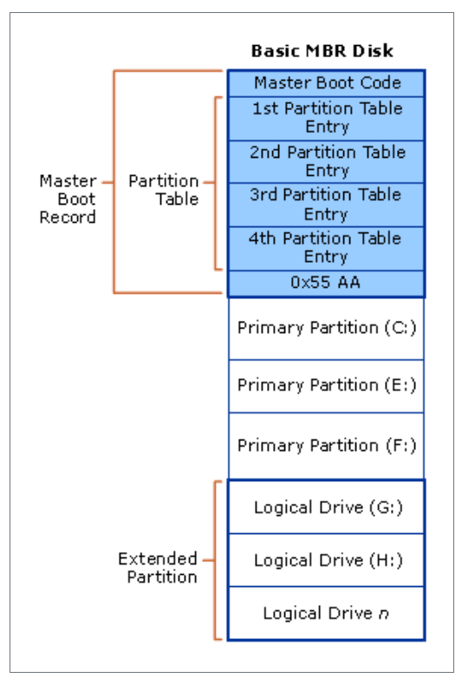
Qu’est-ce qu’un disque MBR ?
Notes:
Key message: Disk partitioning is the process of dividing a physical disk’s storage into manageable pieces to support the requirements of a computer operating system. The MBR is stored at a consistent location on a physical disk, enabling the computer BIOS to reference it. During the startup process, the computer examines the MBR to determine which partition on the installed disks is marked as active. The active partition contains the operating system startup files.
Discussion prompt: Ask students if they are familiar with MBR and GPT.
Explain the characteristics and limitations presented on the slide.
Whiteboard: As you explain the characteristics and limitations of MBR, on the whiteboard, start a table to contrast MBR and GPT partition styles. For MBR, add these items:
Partition style has been around for a long time
Four partitions for each disk
2 TB maximum partition size
No redundancy provided
Question: What are three restrictions of an MBR partitioned disk? Have you encountered these limitations in your organization, and if so, what did you do to work around them?
Answer: The restrictions are that MBR partitioned disks are limited to four partitions, a 2 TB maximum partition size, and there is no data redundancy provided.

Slide 6
Qu’est-ce qu’un disque GPT ?
Table de Partition GUID (GPT)
Elle contient un ensemble d'entrées de partition qui décrivent les références LBA (Logical Block Address) de début et de fin de chaque partition du disque
Support plus de partitions:
128 partitions/disque
Support des partitions de taille plus grand:
Taille de volume de 256 To
Il est dupliqué et protégé par les contrôles de redondance cycliques
Notes:
Key message: GPT partitioned disks address the limitations of MBR-partitioned disks. GPT contains an array of partition entries describing the start and end LBA of each partition on disk. The GPT format is specified by the Unified Extensible Firmware Interface (UEFI), but is not exclusive to UEFI systems. Both 32-bit and 64-bit Windows operating systems support GPT for data disks on BIOS systems, but they cannot boot from them. The 64-bit Windows operating systems support GPT for boot disks on UEFI systems.
Whiteboard: As you discuss the features of GPT disks from the slides, add them to the table that you created on the whiteboard to contrast MBR and GPT partitioned disks:
128 partitions per disk (this item correlates to the first bullet)
18 Exabyte (EB) partition size (this item correlates to the second bullet)
Redundancy
Ensure that the students know that GPT-based disks can be implemented on Windows Server® 2008, Windows Vista®, and Windows 7, but not on removable media.
Talk about the sectors on a GPT partitioned disk. Describe the protective MBR, the partition table header, the ESP, MSR, and operating system partition. Spend time reviewing the differences between the partition styles that you have documented on the whiteboard. For more information about GPT architecture, refer to the Companion Content CD.
Question: How does a GPT partitioned disk on a 64-bit Windows 7 operating system use an MBR?
Answer: On a GPT partitioned disk, Sector 0 contains a legacy protective MBR. The protective MBR contains one primary partition covering the entire disk. The protective MBR protects GPT disks from previously released MBR disk tools such as Microsoft MS-DOS FDISK or Microsoft Windows NT Disk Administrator. These tools view a GPT disk as having a single encompassing (possibly unrecognized) partition by interpreting the protected MBR, rather than mistaking the disk for one that is unpartitioned. Legacy software that does not know about GPT interprets only the protected MBR when it accesses a GPT disk.

Slide 7
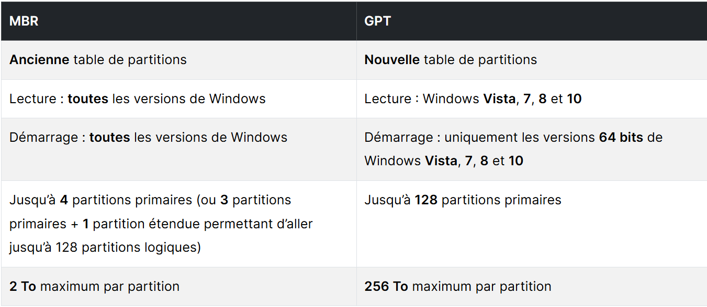
Différence entre MBR et GPT

Slide 8
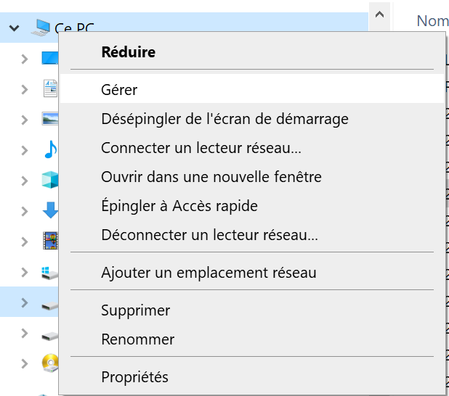
Les outils de Gestion des disques
L’outil Gestion de disque
C’est un outil graphique
Notes:
Key message: Two tools used to manage disks and the volumes or partitions that they contain on Windows 7 are Disk Management and diskpart.exe. With either tool, you can initialize disks, create volumes, and format the volume file system. Additional common tasks include moving disks between computers, changing disks between basic and dynamic types, and changing the partition style of disks. Most disk-related tasks can be performed without restarting the system or interrupting users, and most configuration changes take effect immediately.
To build this slide:
Click to have the Disk Management Snap-in features fly in from the bottom.
Click to have the screenshot of Disk Management fly in from the bottom.
Click to have the diskpart.exe features fly in from the bottom.
Click to have the partition image fly in from the bottom.
Describe each tool for the students.
Discussion prompt: Ask if any of the students are familiar with either of the tools and if they are have them talk about scenarios in which they use the tools. Have they used Disk Management remotely?
Describe each of the following new features as they relate to Disk Management in Windows 7: simpler partition creation, disk conversion options, and extend and shrink partitions.
Show how to open Disk Management, how to start diskpart, explain the DISKPART> command prompt , and how to view a list of diskpart commands by typing “commands” at DISKPART>. Talk about how to create a diskpart script, log results of a diskpart session, and discuss common actions.
You do not need to demonstrate these actions in this topic, you will do so in the next demonstration.
Discuss what happens when a new hard disk is added and Disk Management is started. Explain that you can switch between GPT and MBR partition styles, but there are ramifications.
Make sure that students understand the following before switching partition styles:
Membership in the Backup Operators or Administrators group is required
Back up the entire contents of the hard disk before making changes
Disks must be online before initializing them or creating new partitions or volumes
You can only convert from GPT to MBR if the disk does not contain any volumes or partitions
Use Event Viewer to check the system log for disk-related messages
Point out that students must not use disk editing tools such as DiskProbe to make changes to GPT disks. Any change made renders the checksums invalid, which might cause the disk to become inaccessible. To make changes to GPT disks, use diskpart or Disk Management.
Question: What is the effect on existing data when you convert a basic disk to a dynamic disk and vice versa?
Answer: Basic disks can be converted to dynamic disks without data loss. However, converting a dynamic disk to basic is not possible without deleting all the volumes first.

Slide 9
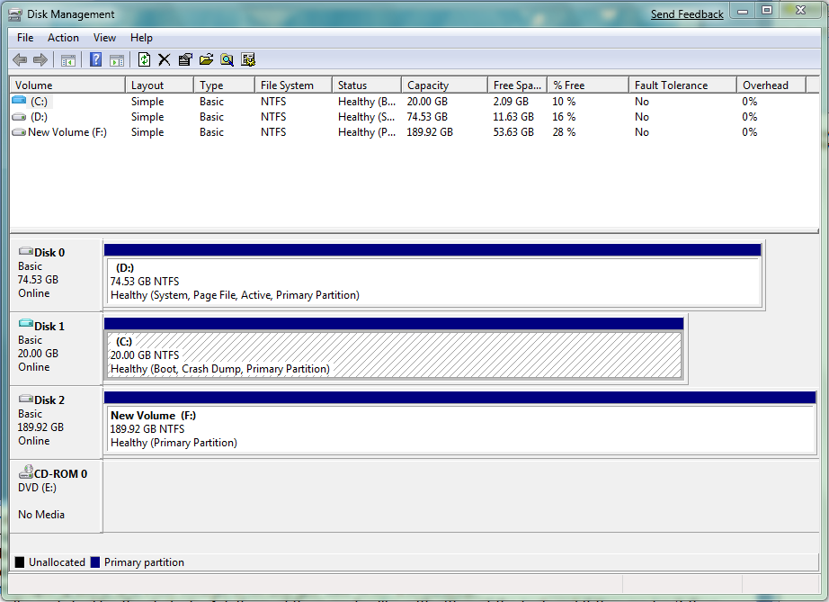
Les outils de Gestion des disques
L’outil Gestion de disque
C’est un outil graphique
Notes:
Key message: Two tools used to manage disks and the volumes or partitions that they contain on Windows 7 are Disk Management and diskpart.exe. With either tool, you can initialize disks, create volumes, and format the volume file system. Additional common tasks include moving disks between computers, changing disks between basic and dynamic types, and changing the partition style of disks. Most disk-related tasks can be performed without restarting the system or interrupting users, and most configuration changes take effect immediately.
To build this slide:
Click to have the Disk Management Snap-in features fly in from the bottom.
Click to have the screenshot of Disk Management fly in from the bottom.
Click to have the diskpart.exe features fly in from the bottom.
Click to have the partition image fly in from the bottom.
Describe each tool for the students.
Discussion prompt: Ask if any of the students are familiar with either of the tools and if they are have them talk about scenarios in which they use the tools. Have they used Disk Management remotely?
Describe each of the following new features as they relate to Disk Management in Windows 7: simpler partition creation, disk conversion options, and extend and shrink partitions.
Show how to open Disk Management, how to start diskpart, explain the DISKPART> command prompt , and how to view a list of diskpart commands by typing “commands” at DISKPART>. Talk about how to create a diskpart script, log results of a diskpart session, and discuss common actions.
You do not need to demonstrate these actions in this topic, you will do so in the next demonstration.
Discuss what happens when a new hard disk is added and Disk Management is started. Explain that you can switch between GPT and MBR partition styles, but there are ramifications.
Make sure that students understand the following before switching partition styles:
Membership in the Backup Operators or Administrators group is required
Back up the entire contents of the hard disk before making changes
Disks must be online before initializing them or creating new partitions or volumes
You can only convert from GPT to MBR if the disk does not contain any volumes or partitions
Use Event Viewer to check the system log for disk-related messages
Point out that students must not use disk editing tools such as DiskProbe to make changes to GPT disks. Any change made renders the checksums invalid, which might cause the disk to become inaccessible. To make changes to GPT disks, use diskpart or Disk Management.
Question: What is the effect on existing data when you convert a basic disk to a dynamic disk and vice versa?
Answer: Basic disks can be converted to dynamic disks without data loss. However, converting a dynamic disk to basic is not possible without deleting all the volumes first.

Slide 10
Les outils de Gestion des disques
L’outil Gestion de disque
    Permet de gérer les disques et les volumes (de base et dynamiques)
    Gère les disques localement ou des ordinateurs distants
    Exemples de gestion:
Convertir des types de disques
Formater des disques
Ajouter des disques
Afficher l'état et les propriétés des disques
Résoudre les problèmes de disque
Notes:
Key message: Two tools used to manage disks and the volumes or partitions that they contain on Windows 7 are Disk Management and diskpart.exe. With either tool, you can initialize disks, create volumes, and format the volume file system. Additional common tasks include moving disks between computers, changing disks between basic and dynamic types, and changing the partition style of disks. Most disk-related tasks can be performed without restarting the system or interrupting users, and most configuration changes take effect immediately.
To build this slide:
Click to have the Disk Management Snap-in features fly in from the bottom.
Click to have the screenshot of Disk Management fly in from the bottom.
Click to have the diskpart.exe features fly in from the bottom.
Click to have the partition image fly in from the bottom.
Describe each tool for the students.
Discussion prompt: Ask if any of the students are familiar with either of the tools and if they are have them talk about scenarios in which they use the tools. Have they used Disk Management remotely?
Describe each of the following new features as they relate to Disk Management in Windows 7: simpler partition creation, disk conversion options, and extend and shrink partitions.
Show how to open Disk Management, how to start diskpart, explain the DISKPART> command prompt , and how to view a list of diskpart commands by typing “commands” at DISKPART>. Talk about how to create a diskpart script, log results of a diskpart session, and discuss common actions.
You do not need to demonstrate these actions in this topic, you will do so in the next demonstration.
Discuss what happens when a new hard disk is added and Disk Management is started. Explain that you can switch between GPT and MBR partition styles, but there are ramifications.
Make sure that students understand the following before switching partition styles:
Membership in the Backup Operators or Administrators group is required
Back up the entire contents of the hard disk before making changes
Disks must be online before initializing them or creating new partitions or volumes
You can only convert from GPT to MBR if the disk does not contain any volumes or partitions
Use Event Viewer to check the system log for disk-related messages
Point out that students must not use disk editing tools such as DiskProbe to make changes to GPT disks. Any change made renders the checksums invalid, which might cause the disk to become inaccessible. To make changes to GPT disks, use diskpart or Disk Management.
Question: What is the effect on existing data when you convert a basic disk to a dynamic disk and vice versa?
Answer: Basic disks can be converted to dynamic disks without data loss. However, converting a dynamic disk to basic is not possible without deleting all the volumes first.

Slide 11
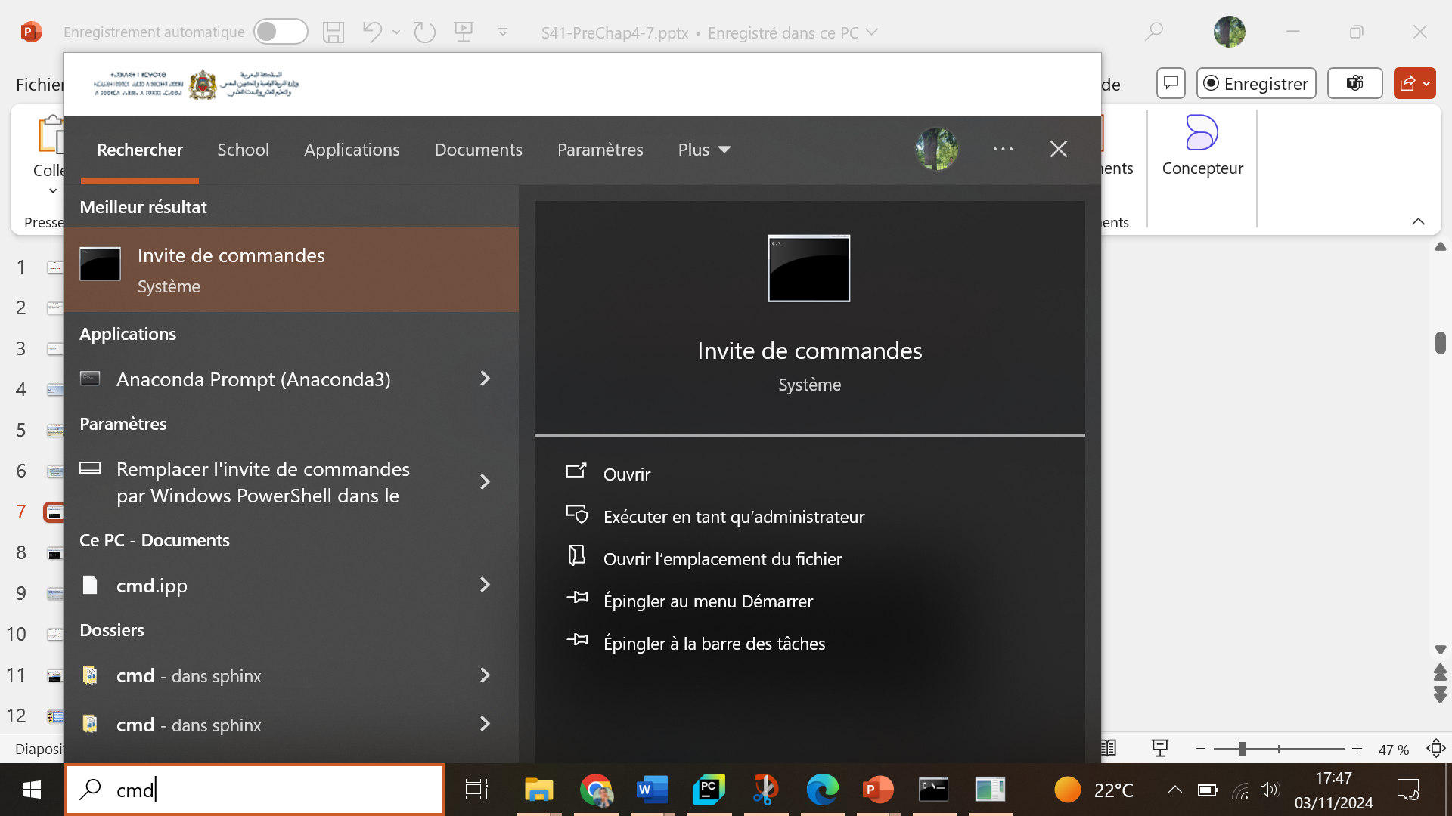
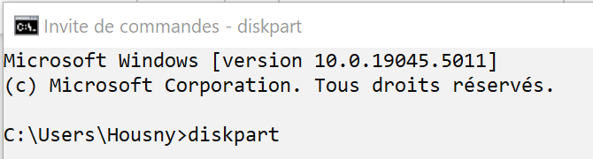
Les outils de Gestion des disques
L’outil en ligne de commande Diskpart.exe
Outil de ligne de commande scriptable

Slide 12
Les outils de Gestion des disques
L’outil en ligne de commande Diskpart.exe
S’exécute toujours localement
Permet de créer des scripts pour automatiser des tâches liées à la gestion des disques
Commande | Description
list disk | Affiche la liste des disques et les informations les concernant (taille, la quantité d'espace libre disponible, …)
select disk <numéro_disque> | Sélectionne le disque spécifié
convert gpt | Convertit un disque de base MBR en un disque de base GPT.

Slide 13
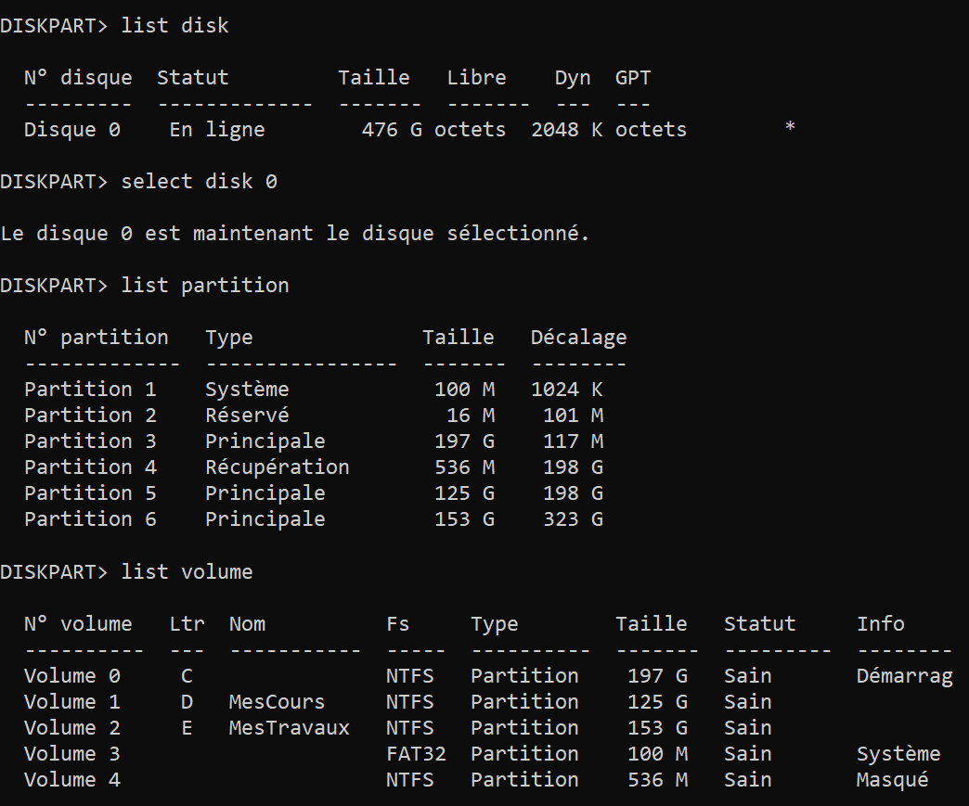
Les outils de Gestion des disques
L’outil en ligne de commande Diskpart.exe
S’exécute toujours localement
Permet de créer des scripts pour automatiser des tâches liées à la gestion des disques
Exemples de tâches

Slide 14
Les outils de Gestion des disques
L’outil en ligne de commande Diskpart.exe
S’exécute toujours localement
Permet de créer des scripts pour automatiser des tâches liées à la gestion des disques
Exemples de tâches

Slide 15
Les outils de Gestion des disques
L’outil en ligne de commande Diskpart.exe
S’exécute toujours localement
Permet de créer des scripts pour automatiser des tâches liées à la gestion des disques
Exemples de tâches

Slide 16
2.Utilisation des disques dynamiques
Conversion d'un disque de base en disque dynamique
Organisation d'un disque dynamique
Qu’es-ce qu’un volume simple?
Que sont les volumes fractionnés et les volumes agrégés par bandes?

Slide 17
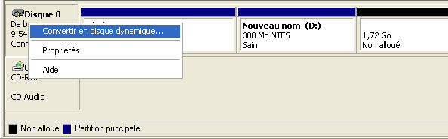

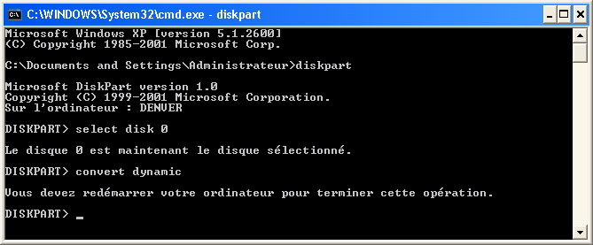
Conversion d'un disque de base en disque dynamique
Gestion des disques
DiskPart

Slide 18

Organisation d'un disque dynamique
Volume simple
Contient l'espace d'un seul disque
Volume agrégé
par bande
Données écrites alternativement et équitablement sur deux disques
ou plus
Volume fractionné
Inclut l'espace disque de deux disques physiques ou plus, en remplissant le premier disque, puis le deuxième, etc.

Slide 19
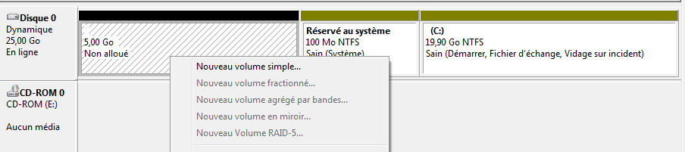
Qu’es-ce qu’un volume simple?
Le volume simple
Il englobe l'espace libre disponible d'un seul disque.
Il peut comporter une zone unique ou plusieurs zones liées les unes aux autres sur le même disque.
Il ne tolère pas les pannes

Slide 20
Que sont les volumes fractionnés et les volumes agrégés par bandes?
Fractionné
Agrégé par bande
Un volume Fractionné
Il joint des zones d'espace non alloué sur au moins 2 disques, et au plus 32, dans un disque logique unique
Nécessite des disques dynamiques
Nécessite plusieurs disques dynamiques
Espace alloué provenant de plusieurs disques dynamiques
L’espace alloué dans chaque disque doit être identique
Jusqu'à 32 disques peuvent être combinés en un seul volume fractionné
Jusqu'à 32 disques peuvent être combinés en seul volume agrégé par bandes
Un volume Agrégé par bande
requiert au moins deux disques et mappe cycliquement les bandes de données sur les disques.
Pas de tolérence de panne
Pas de tolérence de panne
Peut être réduit ou étendu
Prévoit un débit de lecture/écriture plus rapide
Notes:
Key message: Create a spanned volume when you want to encompass several areas of unallocated space on two or more disks. The benefits of using spanned volumes include fault isolation, uncomplicated capacity planning, and straightforward performance analysis. Striped volumes map stripes of data cyclically across the disks. Create a striped volume when you want to improve the I/O performance of the computer. Striped volumes provide for higher throughput by distributing I/O across all disks configured as part of the set.
Whiteboard: Add spanned and striped performance information to the whiteboard and discuss.
To build this slide:
Click to have the definitions fly out.
Click to have the spanned characteristics appear.
Click to have the striped characteristics appear.
Discuss the definitions of each type of volume. Contrast the characteristics of spanned and striped volumes using the information on the slide. This helps students identify when to use either type of volume.
Mention that when creating spanned volumes on dynamic disks, it is necessary to define how much space to allocate to the spanned volume from each physical disk. Also, when talking about the shrink process, note that no data loss occurs; however, the number of disks involved may decrease. If the spanned volume resides on a single disk, the spanned volume is converted into a simple volume. If there is an empty dynamic disk(s) that results from shrinking a spanned volume, the empty dynamic disk is implicitly converted to a basic disk.
Talk about how striped volumes are well suited for isolating the paging file. Explain that by creating a volume where PAGEFILE.SYS is the only file on the entire volume, the paging file is less likely to become fragmented, which helps improve performance. Redundancy is not normally required for the paging file.
Point out the following differences:
When allocating space for a striped disk, the allocated space from each disk must be identical.
It is possible to delete a striped volume, but it is not possible to extend or to shrink the volume.
Discussion prompt: Ask students if there have been times when they have wanted to upgrade or in some way alter the configuration of computer hardware or software. Some examples are as follows:
When the addition of functionality adds value to your organization
When a fault in software, hardware, or the combined architecture results in an application failing
When a change in the functionality or role of a server or workstation occurs
Make sure that even though other forms of volume management, with different types of fault tolerance and recovery, are not covered in this module, they must be considered during times of change, for example, using RAID-1 or RAID-5 volumes, hardware mirroring, and disk duplexing.
Question: Describe scenarios when you create a spanned volume and when you create a striped volume.
Answer: Create a spanned volume when you want to encompass several areas of unallocated space on two or more disks. Create a striped volume when you want to improve the I/O performance of the computer.

Slide 21
3. Gestion des disques
Affichage de l'état et des propriétés de disque
Extension d'un volume ou d'une partition
Réduction d'un volume ou d'une partition
Suppression d'un volume ou d'une partition
Changement d'une lettre de lecteur
Création d'un point de montage

Slide 22
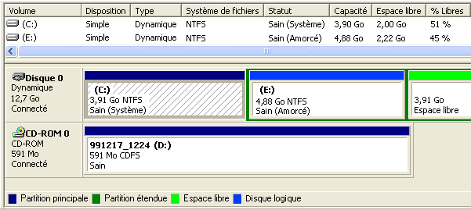
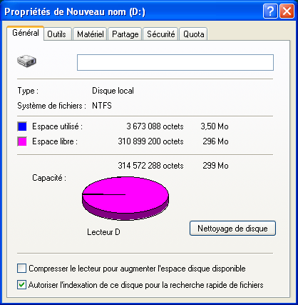
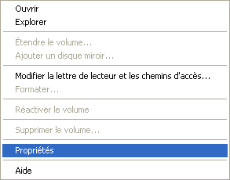
Affichage de l'état et des propriétés de disque
État des disques
Propriétés du disque

Slide 23
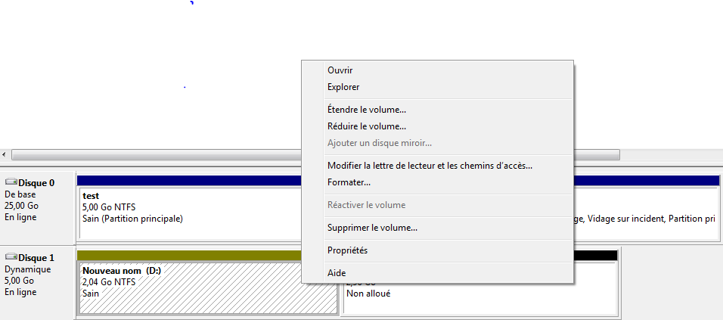
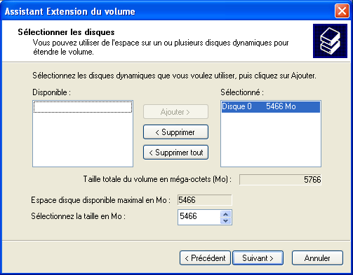
Extension d'un volume ou d'une partition
Vous pouvez étendre des volumes simples et des partitions au format NTFS
Vous ne pouvez pas étendre un volume ou une partition qui contient un volume système ou d'amorçage

Slide 24
Réduction d'un volume ou d'une partition
Vous pouvez réduire les volumes existants pour créer un espace supplémentaire non alloué à utiliser pour les données ou les programmes.
Avant la réduction, défragmentez le disque

Slide 25
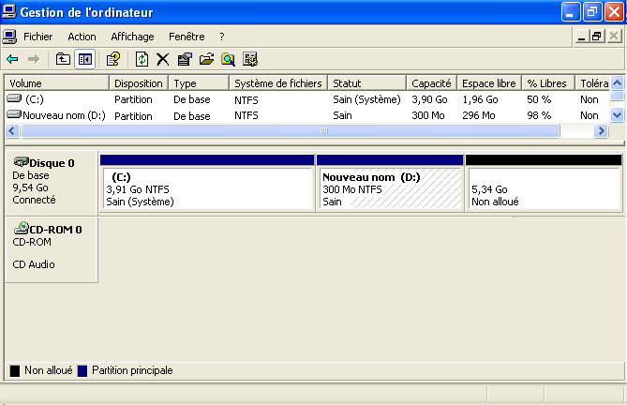
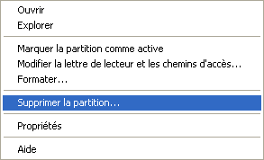
Suppression d'un volume ou d'une partition

Slide 26
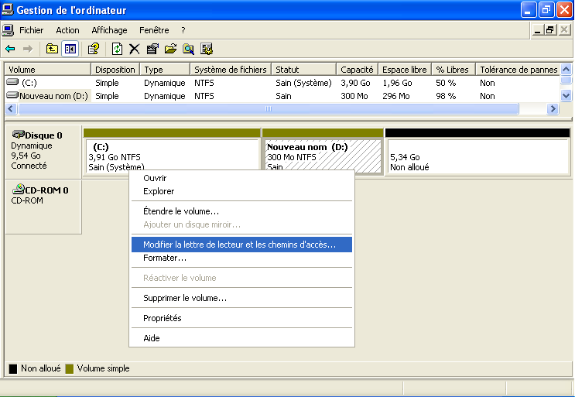
Changement d'une lettre de lecteur

Slide 27

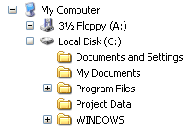
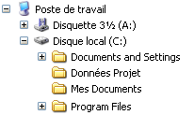
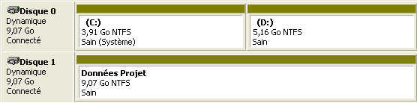
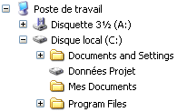
Création d'un point de montage
Avant l'ajout d'un point de montage
Après l'ajout d'un point de montage

Slide 28
4. Défragmentation des disques
Qu'est-ce que la fragmentation du disque ?
La défragmentation d’un disque
Utilisation de l'outil Defrag.exe
Défragmentation

Slide 29
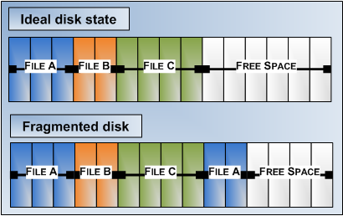
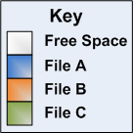
Qu'est-ce que la fragmentation du disque ?
Fragmentation du disque est le stockage non contigus de données sur un volume
La fragmentation du disque:
Se composent de fichiers fragmentés et d’espace libre fragmenté
Entraîne des performances médiocres du disque
Notes:
Key message: Fragmentation of the file system occurs over time as you save, change, and delete files. Initially, the Windows I/O manager saves files in contiguous areas on a given volume. As the volume fills up with data and other files, contiguous areas of free-space are harder to find. In addition, when a file is extended, there may not be contiguous free-space following the existing file blocks; this forces the I/O manager to save the remainder of the file in a non-contiguous area.
Use the slide to show the process of disk fragmentation and then explain how disk fragmentation affects performance. Each color represents one file and white is free space. The first diagram represents the ideal state of a disk: the three files are stored in contiguous areas and there is no fragmentation. In the second illustration, fragmentation has occurred when file A grew. A portion of data is now located in a non-contiguous location. On the next slide is a diagram that shows how the file data looks after the disk is defragmented.
To build this slide:
This slide starts with the definition of disk fragmentation visible. To build the remainder of the slide:
Click to show what disk fragmentation can consist of and lead to.
Click to show a visual representation of an ideal disk and a fragmented disk. Tell students how contiguous areas of free-space are reduced with saving, updating, and deleting files.
Discussion prompt: Have students discuss situations in which they have encountered fragmentation and how it affected the end-users. What were the symptoms that were reported?

Slide 30


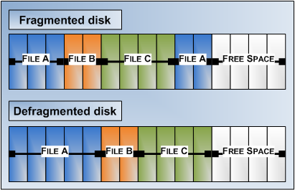

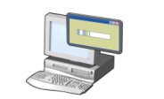

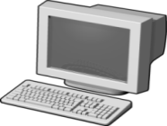
La défragmentation d’un disque
Réorganiser les données et réunir les fichiers fragmentés
Planifiée pour être exécuter automatiquement par défaut
Peut être exécuté à partir de la ligne de commande
C:>
Notes:
Key message: A fragmented disk will negatively impact computer performance. To help reduce the impact of disk fragmentation on disk volumes, including USB drives, Windows 7 continues to make Disk Defragmenter available. Disk Defragmenter rearranges fragmented data so that disks and drives can work more efficiently. Ask students if they have ever needed to place restrictions on users’ disk-space consumption.
To build this slide:
Click to show the graphical representation of a defragmented slide. Contrast the fragmented disk and defragmented disk so the students can see the difference.
Click to show the remaining bullet points and discuss each.
Open Disk Defragmenter. Right-click a volume in Windows Explorer, click Properties, click the Tools tab, and then click Defragment Now. Show the students the following tasks and explain each:
Disable automatic defragmentation
Modify the defragmentation schedule
Select which volumes you want to defragment
Analyze the disk to determine whether it requires defragmentation
Launch a manual defragmentation
Ensure that students know that Disk Defragmenter might take from several minutes to a few hours to finish depending on the size and degree of fragmentation of the disk or USB device and that the computer can be used during the defragmentation process.
If students are interested in running disk defragmentation from an elevated Command Prompt, refer them to the Companion Content CD for more information.
Mention additional ways to help prevent disk fragmentation:
Partition the disk in such a way that static files are isolated from those that are created and deleted frequently (such as some user profile and temporary internet files).
Per-user preferences for console files are saved in your profile. As these changes accumulate, they consume disk space. To free that disk space, use the Disk Cleanup feature.
Also, mention that in addition to regularly defragmenting a disk, regular backups of data must be made to prevent data loss. Also, administrators must monitor logs in Event Viewer, use Performance Monitor, and Reliability Monitor to help predict and identify the sources of system problems.

Slide 31
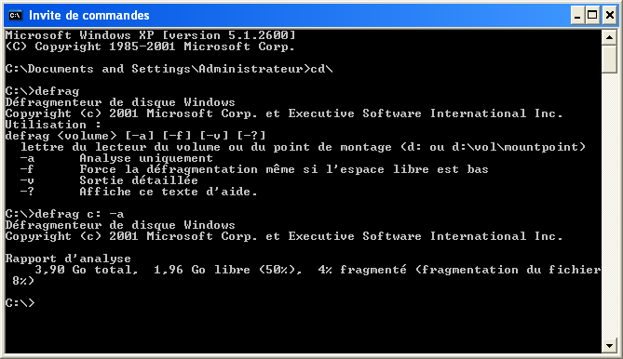
Utilisation de l'outil Defrag.exe

Slide 32
Exercices
Quels sont les outils de gestion des disques?
Quels sont les types de disques?
Est-il possible de convertir un disque de base en disque dynamique? Si oui, comment?
Comment peut-on organiser un disque dynamique?
Quels sont les avantages des volumes agrégés par bandes et fractionné par rapport au volume simple?

Slide 33
Exercices
Expliquez le principe d'un point de montage
C'est quoi la défragmentation de disque?
Comment peut-on faire une défragmentation?
Vous implémentez Windows 7 64 bits et vous devez partitionner le disque pour qu'il prenne en charge 25 volumes, dont certains dépasseront 2 To. Pouvez-vous implémenter cette configuration à l'aide d'un seul disque dur ?

Slide 34
Exercices
Vous êtes chargé d'assurer le support technique d'un certain nombre d'ordinateurs Windows 7 Professionnel. Un utilisateur appelle pour vous dire qu'il manque d'espace disque sur son lecteur de données. Cet utilisateur doit stocker une grande quantité de données sur son ordinateur local dont la quantité d'espace disponible est très faible. L'ordinateur est configuré avec un seul disque dur divisé en deux partitions sur un disque de base. Toutes les données de l'utilisateur sont stockées sur la seconde partition. Comment allez-vous résoudre ce problème tout en affectant aussi peu que possible l'environnement de l'utilisateur ?
La solution consiste à créer un volume fractionné.
Convertir le disque de base en disque dynamique.
Installez un disque dur supplémentaire
Convertir ce nouveau disque en disque dynamique
étendre le volume de données de l'utilisateur pour inclure l'espace disponible de ce nouveau disque dynamique.

Slide 35
Exercices
Utilisez le même scénario de la première question, mais en gardant à l'esprit que le système de l'utilisateur est à présent configuré ainsi :
• Un disque de base
• Une partition
• Système de fichiers NTFS
Comment allez-vous résoudre le problème décrit dans la première question tout en affectant aussi peu que possible l'environnement de l'utilisateur ?
Créez un point de montage de volume sur un nouveau disque:
Commencez par installer un disque dur supplémentaire.
Créez un dossier sur le lecteur C et montez cette nouvelle partition sur ce dossier.

Slide 36
Exercices
Un utilisateur est à cours d'espace disque sur son lecteur C. Vous devez lui fournir un espace de stockage supplémentaire sans modifier ses méthodes de travail. Comment pouvez-vous procéder ?
Vous pouvez créer un point de montage pour le lecteur C sur l'ordinateur de cet utilisateur.

