Slide 1
Facebook

Slide 2
Basic Information
Company name: Facebook
Ticker: FB
Price: $113.05
52-week range: $72.00-$117.59
Market Cap: $321.85B
Recommendation: Buy

Slide 3
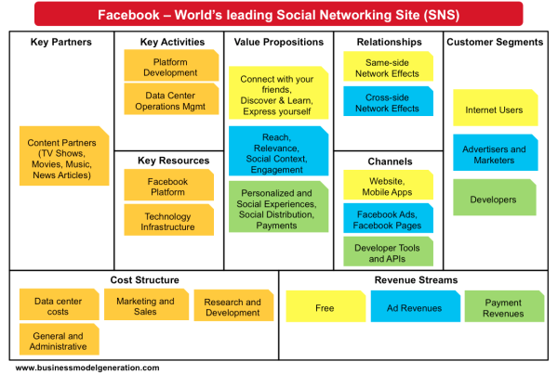
Story
Business Model:
Notes:
Facebook is a social conglomerate. It launched in Feb 2004 and by December 2004, it had 1 million users. This type of growth has continued for nearly 12 years. December 2005, FB reaches 6 million users (as it had expanded into college and high school networks). It eventually expands into work networks and become an application program interface (otherwise known as an API) for people to retrieve different types of information.
Facebook has up to 1.3 billion total active monthly users with more than 50% of users now visiting the site six days a week. The industry is currently churning out one start up after the next, so many believe that Facebook runs the risk of losing its stardom. However, FB has proved to be made of steel.
FB is laying the groundwork for a platform that can make FB a part of just about every social interaction that takes place around the world.
The fact that FB is customized but also standardized has made it a premiere company and a platform that many rely on.

Slide 4
Competitive Advantage
Company is led by an owner-operator who founded the company and owns nearly 30% of the company
FB is exploring new markets (Asia)
Penetration and population
Notes:
Revenue from Asia have been rising @ a rate of 25% as organizations and businesses learn the value of advertising over the FB platform.
FB welcomes all people, all ages, from all places. It’s a social hub that invites everyone and neglects no one. Users come a from a wide range of income brackets and education levels. The most interesting stat on Facebook according to an article on Global MAC IT.com, however, is the fact that 69 percent of Internet users who have an income of $75,000 or more are on Facebook. This is an attractive statistic for any business looking to grow as individuals in this bracket often have the most disposable income to spend on new goods and services.
In addition, FB is building the next generation of services. With Instagram, they’re targeting a new way to engage with visual content (users given more options to create and share diff. types of content). They just launched a Layout app and also Boomerang, which allows users to make looping videos. With Messenger and WhatsApp platforms, FB is focused on increasing engagement. They’ve introduced new ways to communicate between users (video calling, and new customizations options for conversations)
FB is also creating breakthrough tech. Launching Express Wi-FI, a product designed to help entrepreneurs bring their communities online. Using solar power aircrafts to beam internet into communities from the sky.

Slide 5
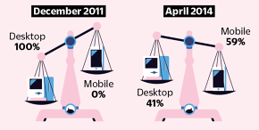
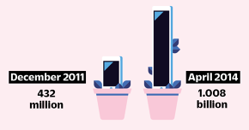
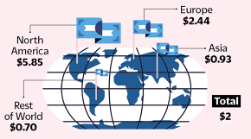
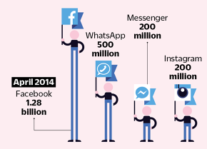
Growth Opportunity
Ad Revenue
Monthly Active Users
Revenue per User Location
Portfolio of Brands
Notes:
1) Ad revenue (Desktop):
December 2011: 100%
April 2014: 41%
Ad revenue (Mobile):
December 2011: 0%
April 2014: 59%

Slide 6
Brief Look Into 2015 Key Metrics
Facebook had YoY revenue growth of 51.7% in 2015-Q4
Revenue has grown at a compounded annual rate of 55.5% over the last 5 years.
Facebook reported a Net profit margin of 26.6% in 2015-Q4
FB stock reported an average net profit margin of 20.70% over the last 3 years.
Operating margin (or operating profit margin) of 43.8% has improved by 14.4% over 2014’s Q4 .
Notes:
Q4 ad revenue grew 57%, or 66% on a constant currency basis. Mobile ad revenue reached $4.5 billion, up 81% year-over-year, and is now 80% of total ad revenue.
Full year 2015 revenue was $17.9 billion up 44% year-over-year, or 53% on a constant currency basis. In 2015, we generated over $6 billion in free cash flow including $2.1 billion in Q4, while continuing to fund important investments for the future growth of the business.
Pros: Recent Revenue Growth, Strong Operating Cash Flows, Strong Growth Track Record
Cons: Risky PE
5 Year Revenue Growth is estimated at 55.5% CAGR.

Slide 7
Relative Valuation
FB: PE= 88.3
FB Price to Sales Multiple: 17.8
Industry: PE= 50.4
Industry Price to Sales Multiple: 7.7
Compared to industry averages, FB stock is expensive. However, the growth outlook and market expansion of FB’s operations make this stock a buy and a long-term hold.

