Slide 1
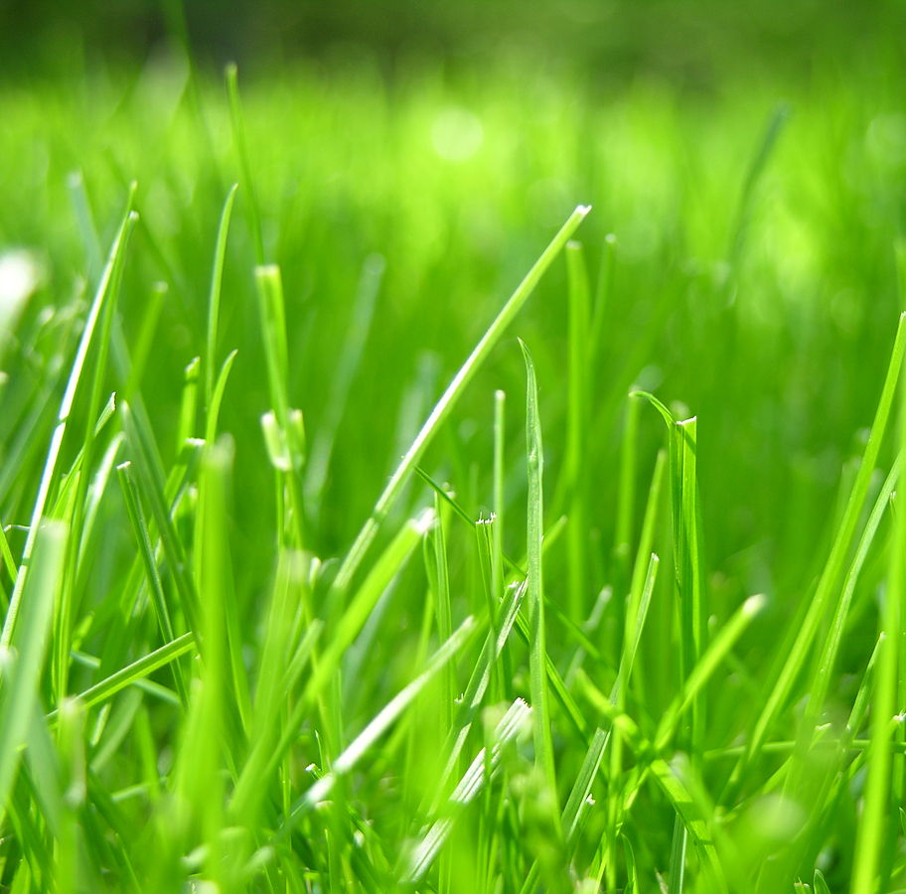
fasterRaster
with GRASS GIS

