Slide 1
Swarm Intelligence
From Natural to Artificial Systems
Ukradnuté kde sa dalo, a adaptované

Slide 2
Swarming – The Definition
aggregation of similar animals, generally cruising in the same direction
Termites swarm to build colonies
Birds swarm to find food
Bees swarm to reproduce

Slide 3
Why do animals swarm?
To forage better
To migrate
As a defense against predators
Social Insects have survived for millions of years.

Slide 4
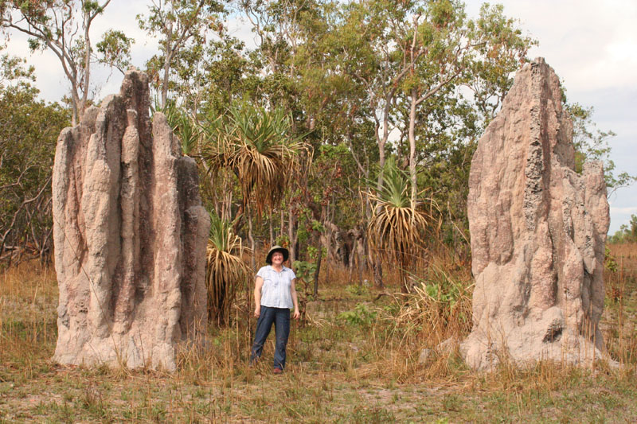
Swarming is Powerful
Swarms can achieve things that an individual cannot

Slide 5
Swarming – Example
Bird Flocking
“Boids” model was proposed by Reynolds
  Boids = Bird-oids (bird like)
Only three simple rules

Slide 6
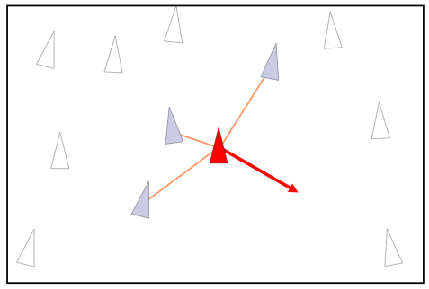
Collision Avoidance
Rule 1: Avoid Collision with neighboring birds

Slide 7
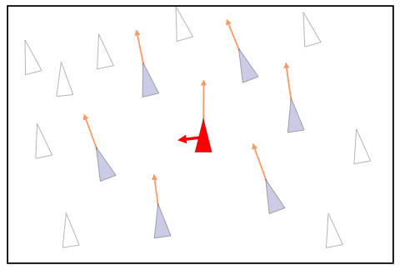
Velocity Matching
Rule 2: Match the velocity of neighboring birds

Slide 8
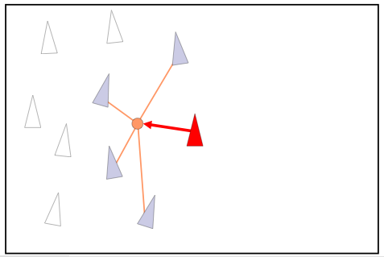
Flock Centering
Rule 3: Stay near neighboring birds

Slide 9
Swarming - Characteristics
Simple rules for each individual
No central control
  Decentralized and hence robust
Emergent
  Performs complex functions

Slide 10
Learn from insects
Computer Systems are getting complicated
Hard to have a master control
Swarm intelligence systems are:
  Robust
  Relatively simple

Slide 11
Swarm Intelligence - Definition
“any attempt to design algorithms or distributed problem-solving devices inspired by the collective behavior of social insect colonies and other animal societies” [Bonabeau, Dorigo, Theraulaz: Swarm Intelligence]
Solves optimization problems

Slide 12
Applications
Movie effects
  Lord of the Rings
Network Routing
  ACO Routing
Swarm Robotics
  Swarm bots

Slide 13
Roadmap
Particle Swarm Optimization
  Applications
  Algorithm
Ant Colony Optimization
  Biological Inspiration
  Generic ACO and variations
  Application in Routing
Limitations of SI
Conclusion

Slide 14
Particle Swarm Optimization

Slide 15
Particle Swarm Optimization
Particle swarm optimization imitates human or insects social behavior.
Individuals interact with one another while learning from their own experience, and gradually move towards the goal.
It is easily implemented and has proven both very effective and quick when applied to a diverse set of optimization problems.

Slide 16
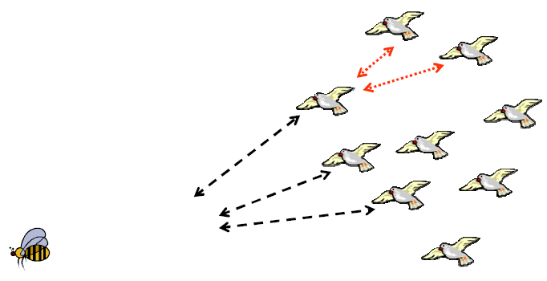
Bird flocking is one of the best example of PSO in nature.
One motive of the development of PSO was to model human social behavior.

Slide 17
Applications of PSO
Neural networks like Human tumor analysis, Computer numerically controlled milling optimization;
Ingredient mix optimization;
Pressure vessel (design a container of compressed air, with many constraints).
Basically all the above applications fall in a category of finding the global maxima of a continuous, discrete, or mixed search space, with multiple local maxima.

Slide 18
Algorithm of PSO
Each particle (or agent) evaluates the function to maximize at each point it visits in spaces.
Each agent remembers the best value of the function found so far by it (pbest) and its co-ordinates.
Secondly, each agent know the globally best position that one member of the flock had found, and its value (gbest).

Slide 19
Algorithm – Phase 1 (1D)
Using the co-ordinates of pbest and gbest, each agent calculates its new velocity as:
v_{i} = v_{i} + c₁ x rand() x (pbestx_{i} – presentx_{i})
+ c₂ x rand() x (gbestx – presentx_{i})
where 0 < rand() <1
presentx_{i} = presentx_{i} + (v_{i} x Δt)

Slide 20
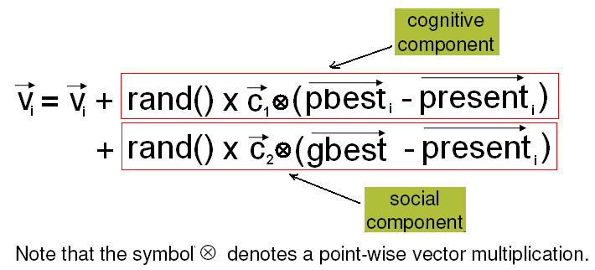
Algorithm – Phase 2 (n-dimensions)
In n-dimensional space :

Slide 21
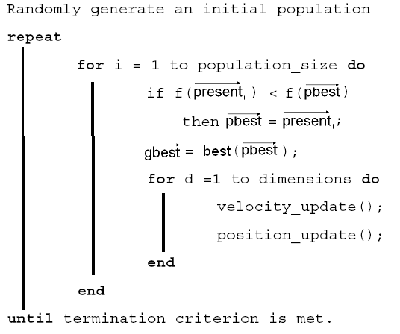

Slide 22
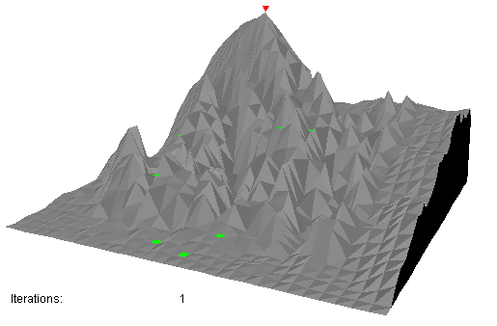

Slide 23
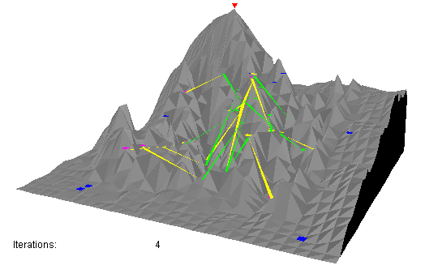

Slide 24
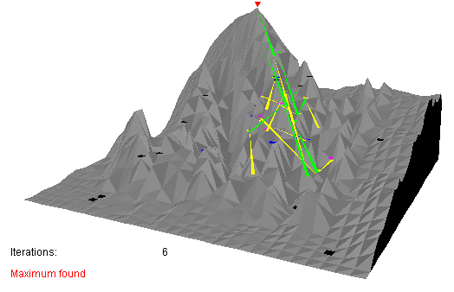

Slide 25
Ant Colony Optimization

Slide 26
Ant Colony Optimization - Biological Inspiration
Inspired by foraging behavior of ants.
Ants find shortest path to food source from nest.
Ants deposit pheromone along traveled path which is used by other ants to follow the trail.
This kind of indirect communication via the local environment is called stigmergy.
Has adaptability, robustness and redundancy.

Slide 27
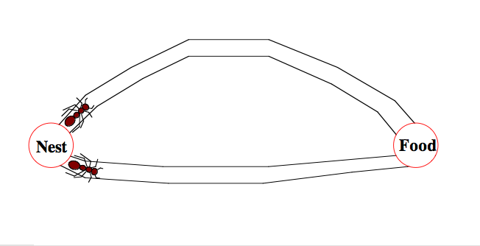
Foraging behavior of Ants
2 ants start with equal probability of going on either path.

Slide 28
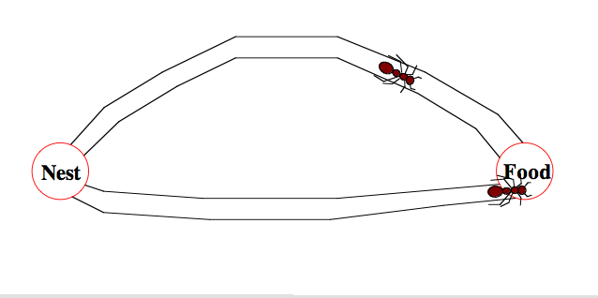
Foraging behavior of Ants
The ant on shorter path has a shorter to-and-fro time from it’s nest to the food.

Slide 29
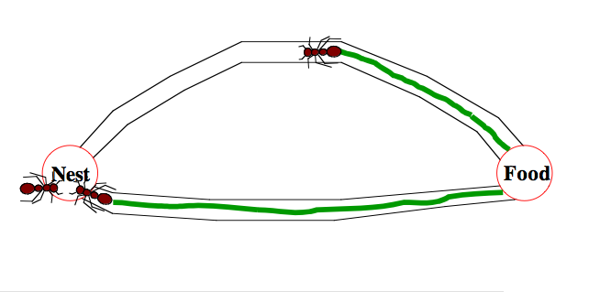
Foraging behavior of Ants
The density of pheromone on the shorter path is higher because of 2 passes by the ant (as compared to 1 by the other).

Slide 30
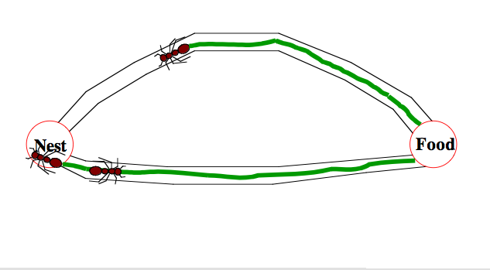
Foraging behavior of Ants
The next ant takes the shorter route.

Slide 31
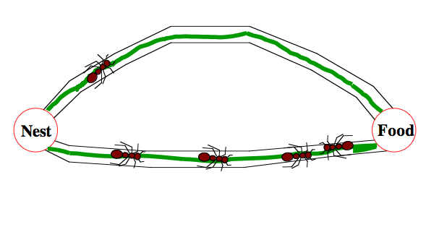
Foraging behavior of Ants
Over many iterations, more ants begin using the path with higher pheromone, thereby further reinforcing it.

Slide 32
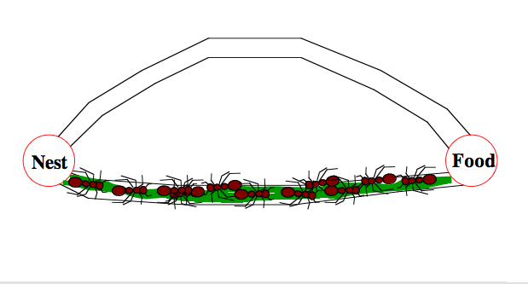
Foraging behavior of Ants
After some time, the shorter path is almost exclusively used.

Slide 33
Generic ACO
Formalized into a metaheuristic.
Artificial ants build solutions to an optimization problem and exchange info on their quality vis-à-vis real ants.
A combinatorial optimization problem reduced to a construction graph.
Ants build partial solutions in each iteration and deposit pheromone on each vertex.

Slide 34
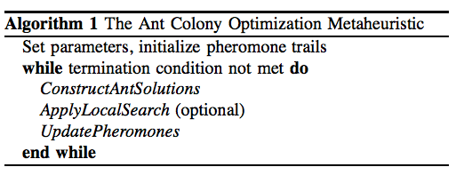
Ant Colony Metaheuristic
ConstructAntSolutions: Partial solution extended by adding an edge based on stochastic and pheromone considerations.
ApplyLocalSearch: problem-specific, used in state-of-art ACO algorithms.
UpdatePheromones: increase pheromone of good solutions, decrease that of bad solutions (pheromone evaporation).

Slide 35



Various Algorithms
First in early 90’s.
Ant System (AS):
  First ACO algorithm.
  Pheromone updated by all ants in the iteration.
  Ants select next vertex by a stochastic function which depends on both pheromone and problem-specific heuristic n_{ij} =

Slide 36
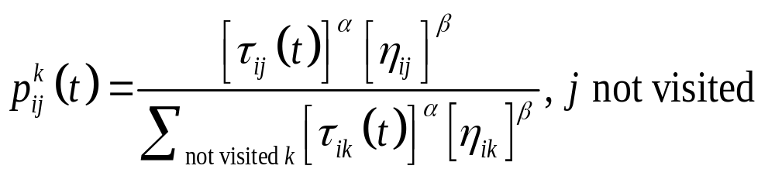
Probability of ant k going from city i to j at iteration t
α=1, β=5, počet mravcov m=počet miest, Q=100, počiatočné množstvo feromónu τ₀=10⁻⁶

Slide 37
Alpha = 0 : represents a greedy approach
Beta = 0 : represents rapid selection of tours that may not be optimal.
Thus, a tradeoff is necessary.

Slide 38


Various Algorithms - 2
MAX-MIN Ant System (MMAS):
  Improves over AS.
  Only best ant updates pheromone.
  Value of pheromone is bound.
  L_{best} is length of tour of best ant.
  Bounds on pheromone are problem specific.

Slide 39
Theoretical Details
Convergence to optimal solutions has been proved.
Can’t predict how quickly optimal results will be found.
Suffer from stagnation and selection bias.

Slide 40
Scope
List of applications using SI growing fast
  Routing
  Controlling unmanned vehicles.
  Satellite Image Classification
  Movie effects

Slide 41
Conclusion
Provide heuristic to solve difficult problems
Has been applied to wide variety of applications
Can be used in dynamic applications

Slide 42
References
Reynolds, C. W. (1987) Flocks, Herds, and Schools: A Distributed Behavioral Model, in Computer Graphics, 21(4) (SIGGRAPH '87 Conference Proceedings) pages 25-34.
James Kennedy, Russell Eberhart. Particle Swarm Optimization, IEEE Conf. on Neural networks – 1995
www.adaptiveview.com/articles/ ipsop1
M.Dorigo, M.Birattari, T.Stutzle, Ant colony optimization – Artificial Ants as a computational intelligence technique, IEEE Computational Intelligence Magazine 2006
Ruud Schoonderwoerd, Owen Holland, Janet Bruten - 1996. Ant like agents for load balancing in telecommunication networks, Adaptive behavior, 5(2).

