Slide 1
Introduction to Deep Generative Models-Part II
Yadong Lu
Mar 8. 2019

Slide 2
Content
Introduction to divergence metric
- Kullback–Leibler divergence
- Jensen–Shannon divergence
Generative Adversarial Network (GAN)
- Idea
- Optimization perspective
Current research in GANs
Mini-project: GAN in tensorflow

Slide 3
Introduction to divergence metric
Question: How do we measure the distance between two points?
- Euclidean distance
How do we measure the distance between two probability distribution?
- Divergence metric

Slide 4
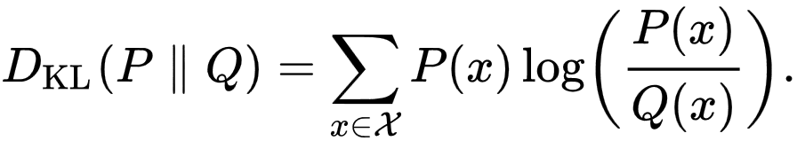
Introduction to divergence metric
Kullback–Leibler divergence:
Several properties:
Equal to zero when P(x)=Q(x)
Greater than 0
Forward KL and reverse KL not equal

Slide 5
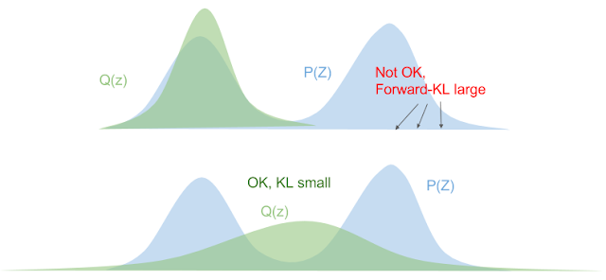
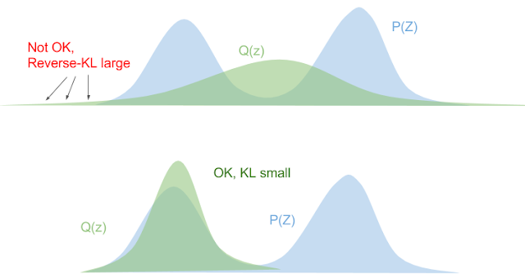
Introduction to divergence metric
Eric Jiang’s blog: https://blog.evjang.com/2016/08/variational-bayes.html

Slide 6

Introduction to divergence metric
Jensen–Shannon divergence
Properties
symmetric
Bounded by [0, ln2]

Slide 7
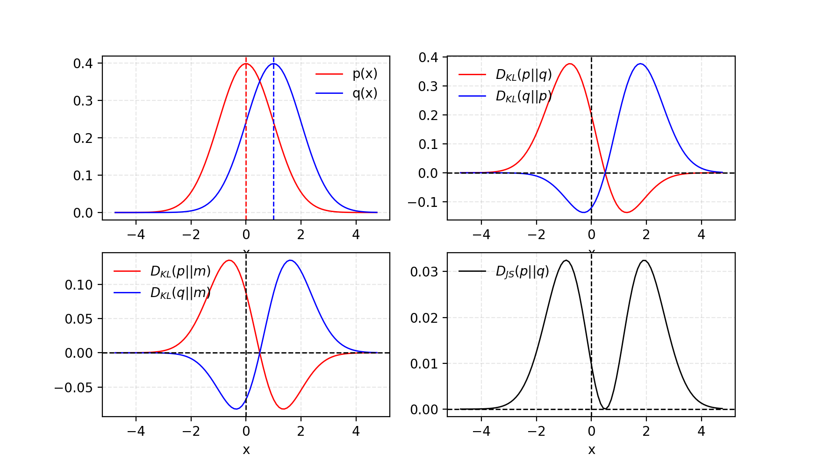
Introduction to divergence metric
Comparison of KL divergence and JS divergence:
https://lilianweng.github.io/lil-log/2017/08/20/from-GAN-to-WGAN.html

Slide 8
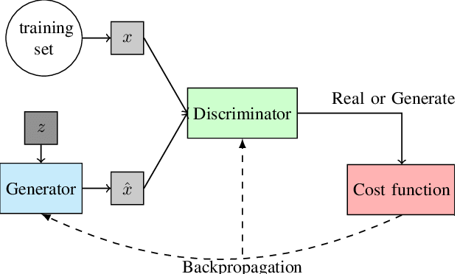
Generative Adversarial Network (GAN) - Idea
GAN consists of two components:
Discriminator (D): optimized to tell the fake samples from the real ones
Generator (G): trained to capture the real data distribution so that its generative samples can be as real as possible

Slide 9
Generative Adversarial Network (GAN) - Idea
A different perspective:
Learning a map (parameterized by neural networks) from random noise to true data distribution.
The discrepancy (divergence) between real images and generated images serves as the source of signal gradient descent update the parameters in the generator overall discrepancy becomes smaller.
After training, the learned map can be used to generate new realistic looking images

Slide 10
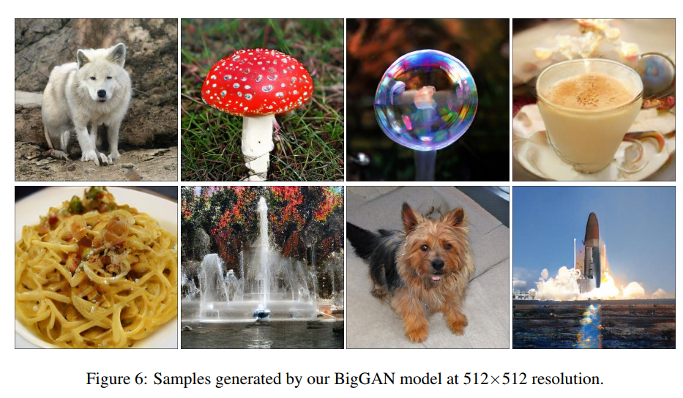
Generative Adversarial Network (GAN) - Idea
Realistic looking images from state of the art BigGAN (Brock et al. 2018)

Slide 11
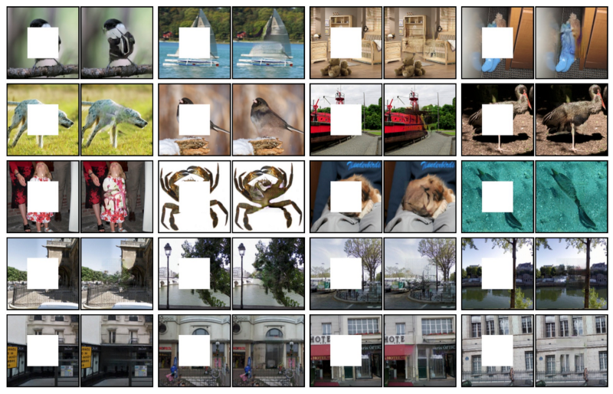
Applications
Video generation. Vondrick et al, 2016
Image inpainting. Pathak et al, 2016

Slide 12
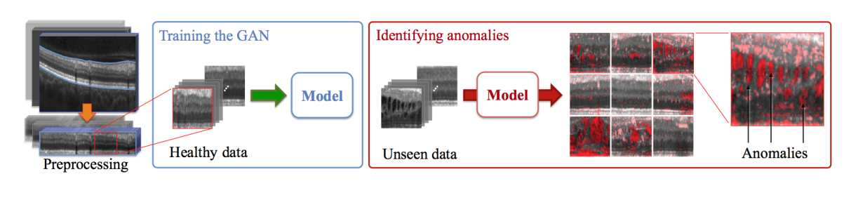
Applications
Anomaly detection. Schlegl et al. 2017

Slide 13
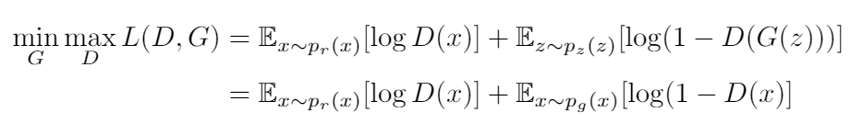
Generative Adversarial Network (GAN) - Optimization perspective
Optimization Perspective:
How is it related to JS divergence?

Slide 14
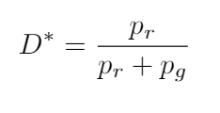
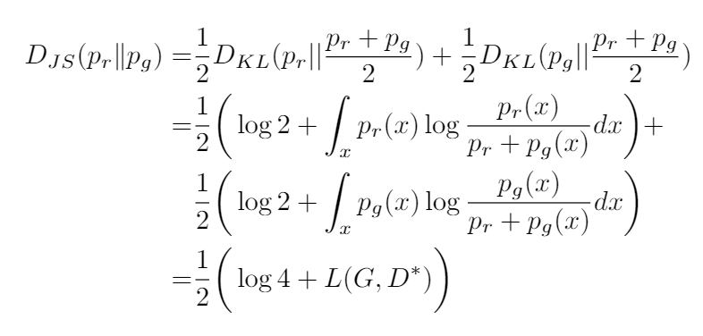
Generative Adversarial Network (GAN) - Optimization perspective
Optimal discriminator:
Connection:

