Slide 1
Introduction to Deep Generative Models-Part III
Yadong Lu
Mar 8. 2019

Slide 2
Content
Change of Variables
Normalizing Flows
Models with Normalizing Flows
NICE
RealNVP
Limitations

Slide 3
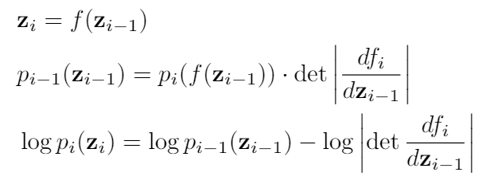
Change of Variables
Suppose f is an invertible transformation:

Slide 4
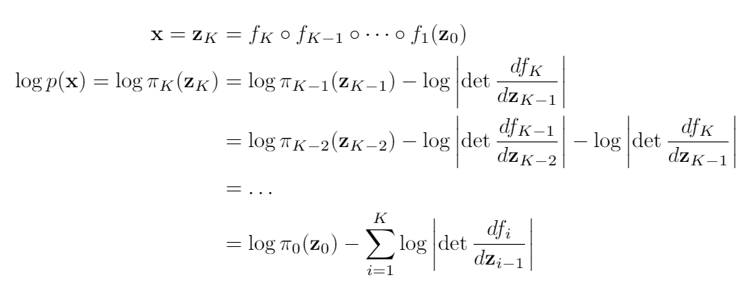
Normalizing Flows
A normalizing flow is a series of invertible transformation of a random variable

Slide 5
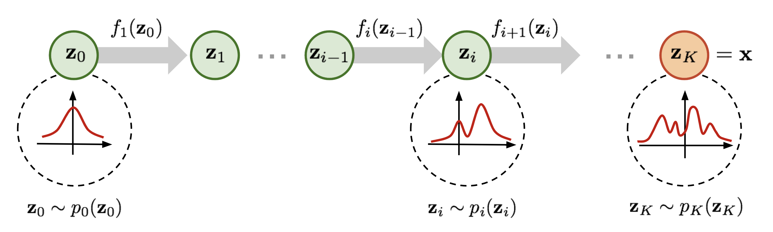
Normalizing Flows
A normalizing flow is a series of invertible transformations of a random variable
https://lilianweng.github.io/lil-log/2018/10/13/flow-based-deep-generative-models.html

Slide 6
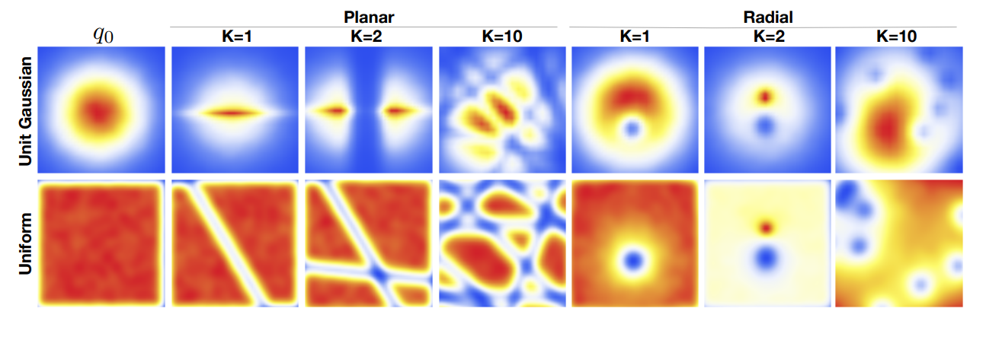
Normalizing Flows
Effect of normalizing flow on two distributions
Rezende and Mohamed, 2015

Slide 7
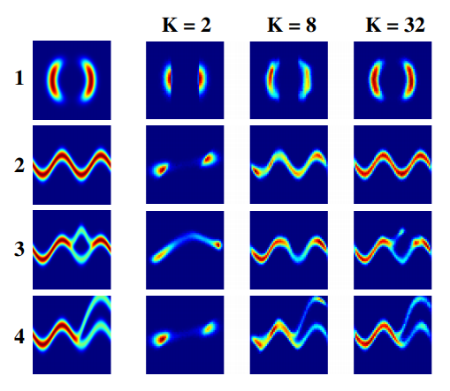
Normalizing Flows
More examples

Slide 8
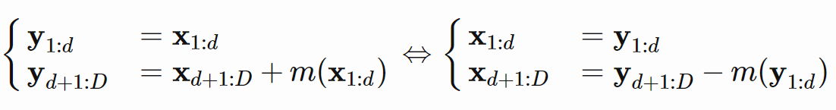
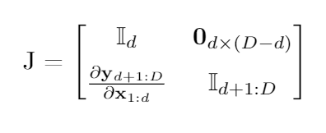
Models with Normalizing Flows
NICE: Non-linear Independent Component Estimation. Dinh, 2015
easy determinant of the Jacobian (diagonal 1)
easy inverse
Volume Preserving
Transformation
Jacobian

Slide 9
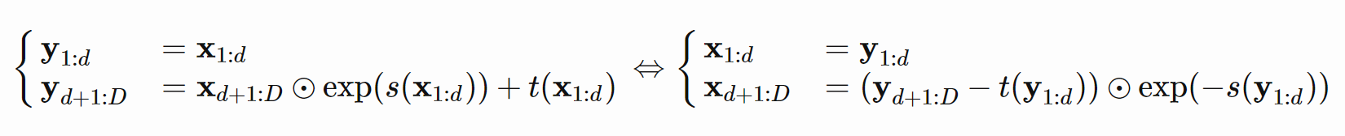
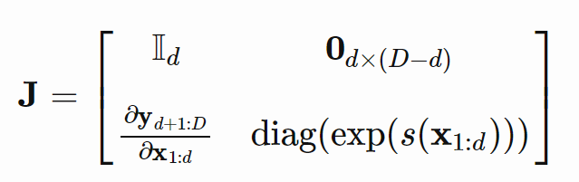
Models with Normalizing Flows
RealNVP: Real-valued Non-Volume Preserving. Dinh et 2017
scale and translation
reverse the order of input in each layer so that no component is left unchanged.
Transformation
Jacobian

Slide 10
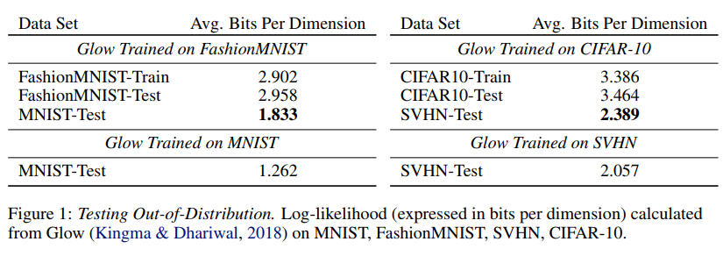
Limitations
Memory intensive (input output size has be equal)
Not suitable for testing out of sample distribution
Nalisnick et al. 2019

