Slide 1

Introduction to TensorFlow Low Level API
Yadong Lu

Slide 2
Content
General Intro to TensorFlow
  Comparison with other framework
  Resources
  High level API
Low Level API
  Tensors/variables
  Graph
  Sessions
Walk-through of An Example

Slide 3
General Intro to TensorFlow
TensorFlow: an open-source software library for dataflow and differentiable programming.
The name derives from the operations that such neural networks perform on multidimensional data arrays, which are referred to as tensors.
Competing deep learning frameworks – why tensorflow?

Slide 4
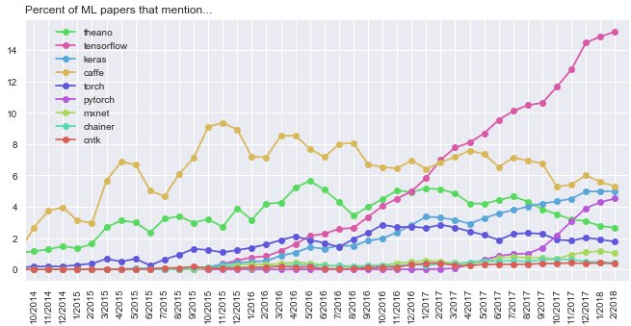
General Intro to TensorFlow
Several comparing metrics:
Over 43K ML papers TF mentioned in 14.3% of all papers, PyTorch 4.7%, Keras 4.0%,
https://twitter.com/karpathy/status/972295865187512320/photo/1

Slide 5
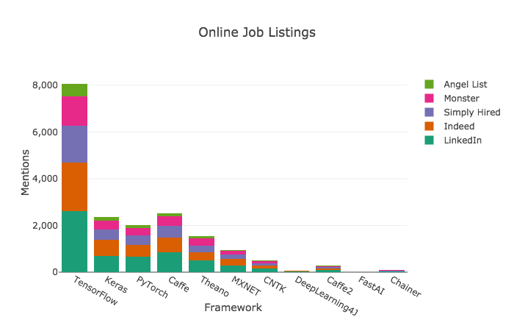
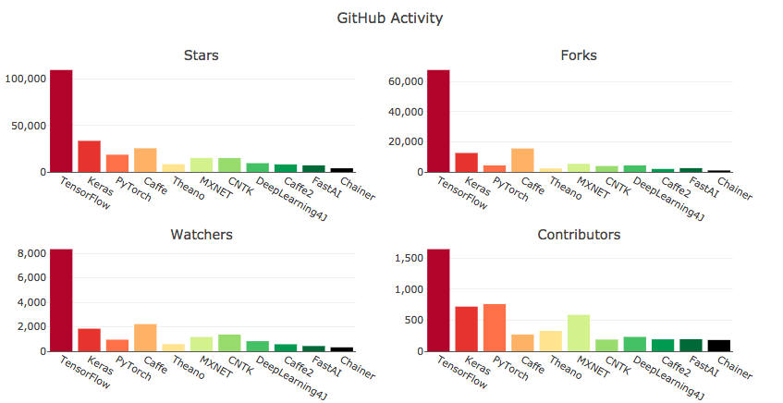
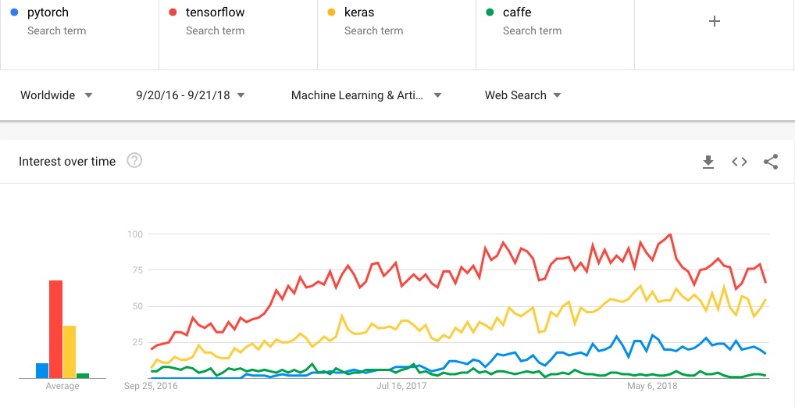
Results updated on 09/20, 2018: https://towardsdatascience.com/deep-learning-framework-power-scores-2018-23607ddf297a

Slide 6

High level API
High level API:
  Keras
  tf.keras
  Estimators
Pros
  User friendly
  Modular/Quick prototyping
Cons:
  Debugging is less straightforward
  Customizable but restricted.
import tensorflow as tf
mnist = tf.keras.datasets.mnist
(x_train, y_train),(x_test, y_test) = mnist.load_data()
x_train, x_test = x_train / 255.0, x_test / 255.0
model = tf.keras.models.Sequential([
tf.keras.layers.Flatten(input_shape=(28, 28)),
tf.keras.layers.Dense(512, activation=tf.nn.relu),
tf.keras.layers.Dropout(0.2),
tf.keras.layers.Dense(10, activation=tf.nn.softmax)
])
model.compile(optimizer='adam',
loss='sparse_categorical_crossentropy',
metrics=['accuracy'])
model. x_train, y_train, epochs=5)
model.evaluatefit( (x_test, y_test)

Slide 7
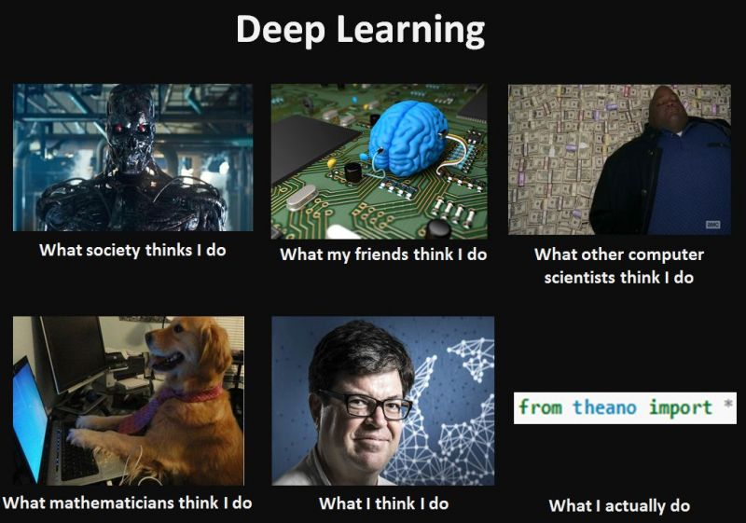

Slide 8
Low Level API
TensorFlow programs:
  Building computation graph (tf.Graph)
    Create placeholders for tensors
    Build a series of tensorflow operations.
  Running computation graph in a Session (tf.Session)
    Initialization
    Feed data into placeholders
    Training

Slide 9
Walk-through of An Example
Google Colab

