Slide 1
Bayesian Compression for Deep Learning
Christos Louizos, Karen Ullrich, Max Welling

Slide 2
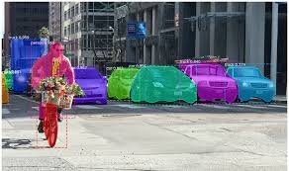
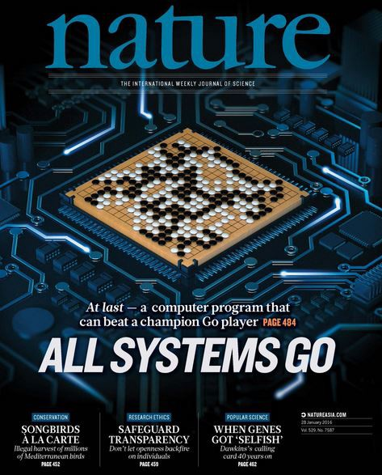
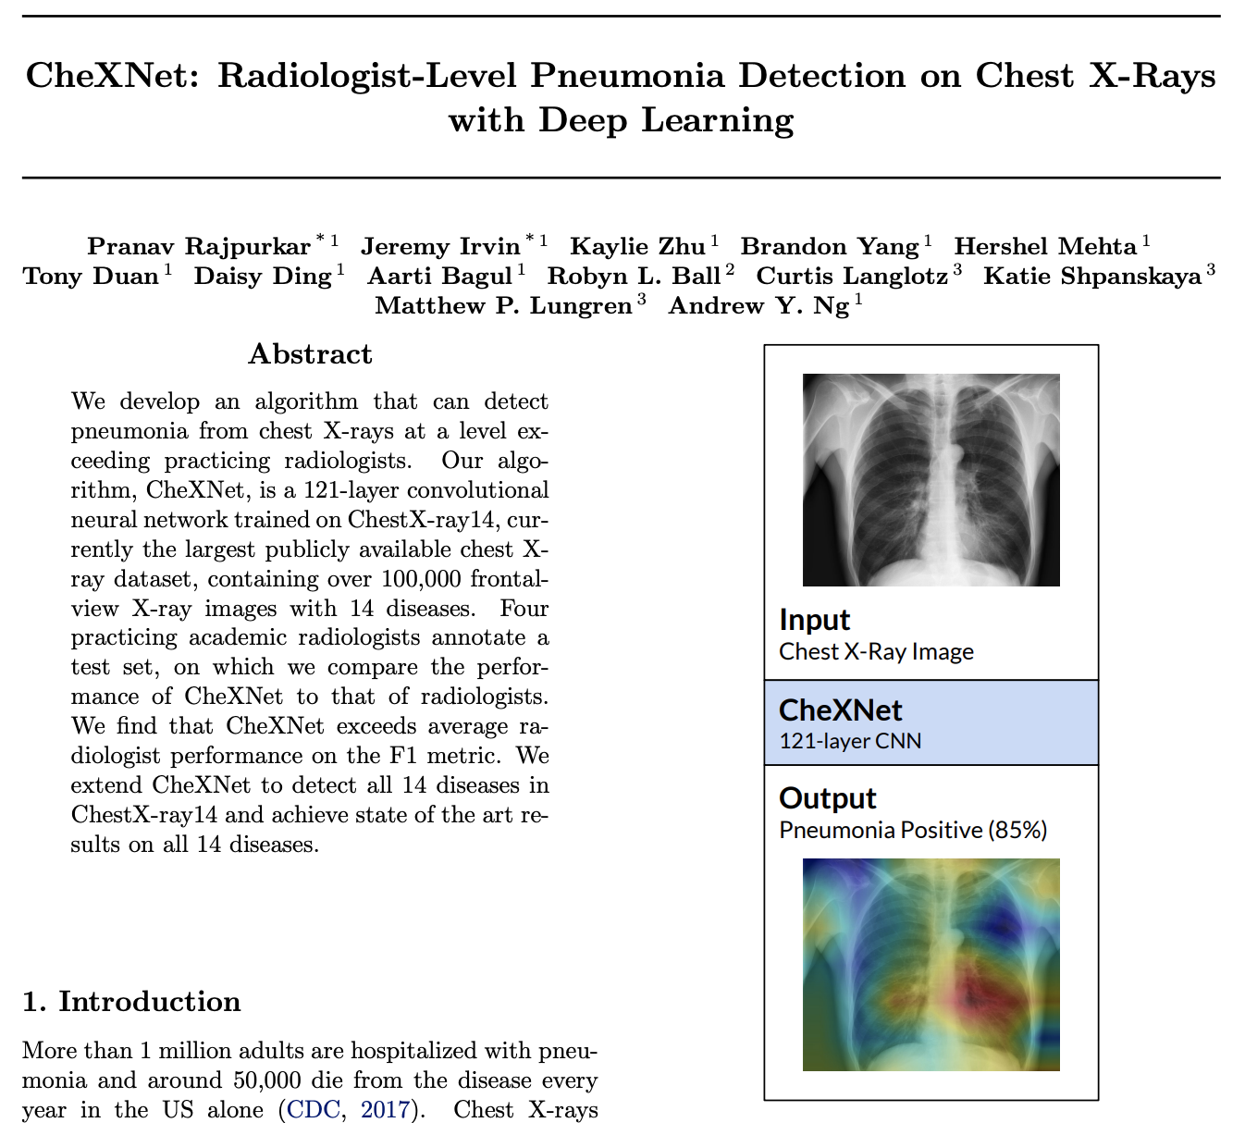
Deep Learning
Success in application
Reinforcement Learning: Alpha Go
Object detection: self driving, medical image diagnosis
Natural language processing: Siri, Alexa, news generation

Slide 4
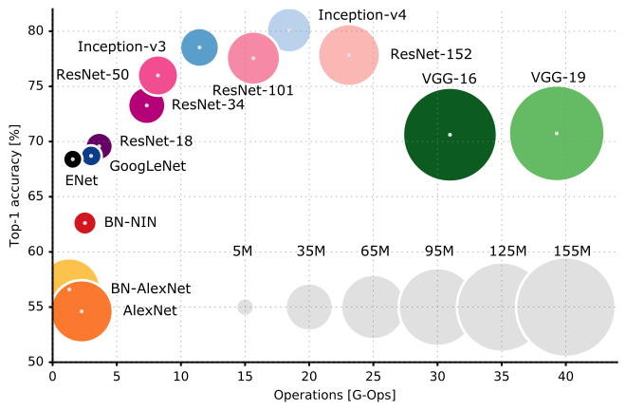
Computation Challenge in Deep Neural Network

Slide 5
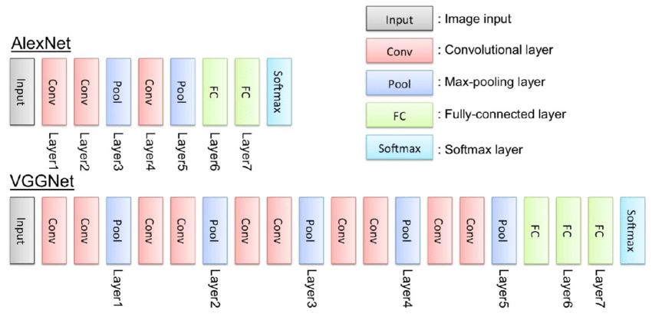
Architecture Evolvement

Slide 6
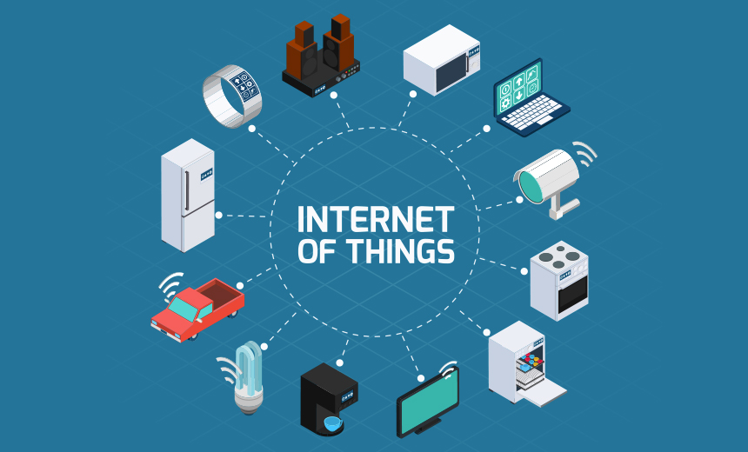
Neural Network Compression

Slide 7
Current Approaches in Neural Network Compression
Pruning (structured/unstructured)
L0, L1, L2 regularization.
Eigen Pruning.
Quantization
32 bit floating point → 2/4/8 bit integer.
Distillation: student-teacher learning

Slide 8
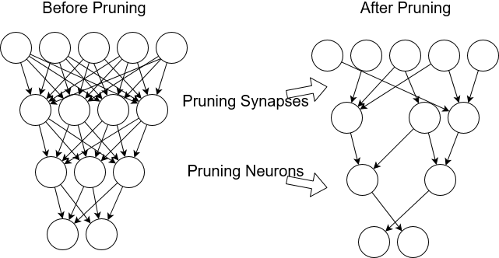
Neural Network Pruning

Slide 9
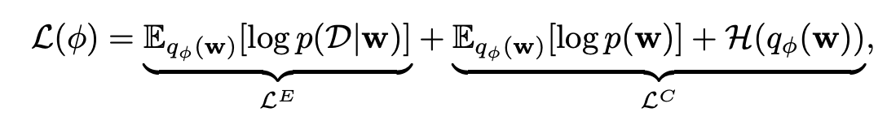
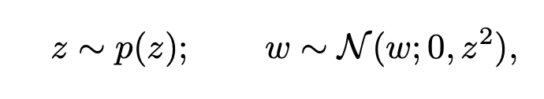
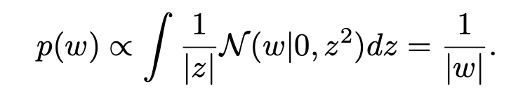
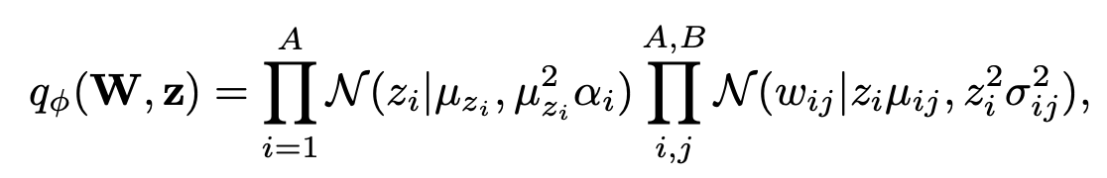
Variation Bayes
Bayesian compression with scale mixtures of normals
Choice 1: Log uniform prior

Slide 10
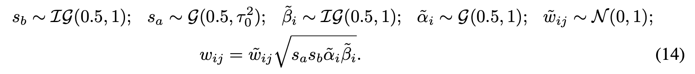
Choice 2: Group horseshoe with half-Cauchy scale prior
Reparameterization of half Cauchy prior:

Slide 11
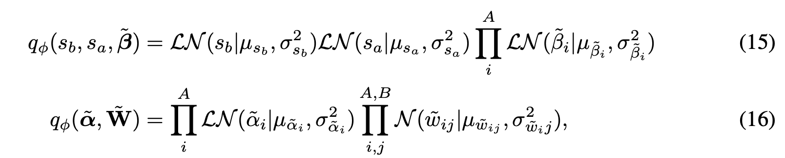
Variational distributions after reparameterization

Slide 12
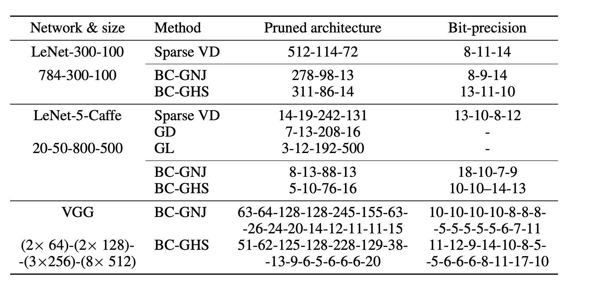
Results

