Slide 1
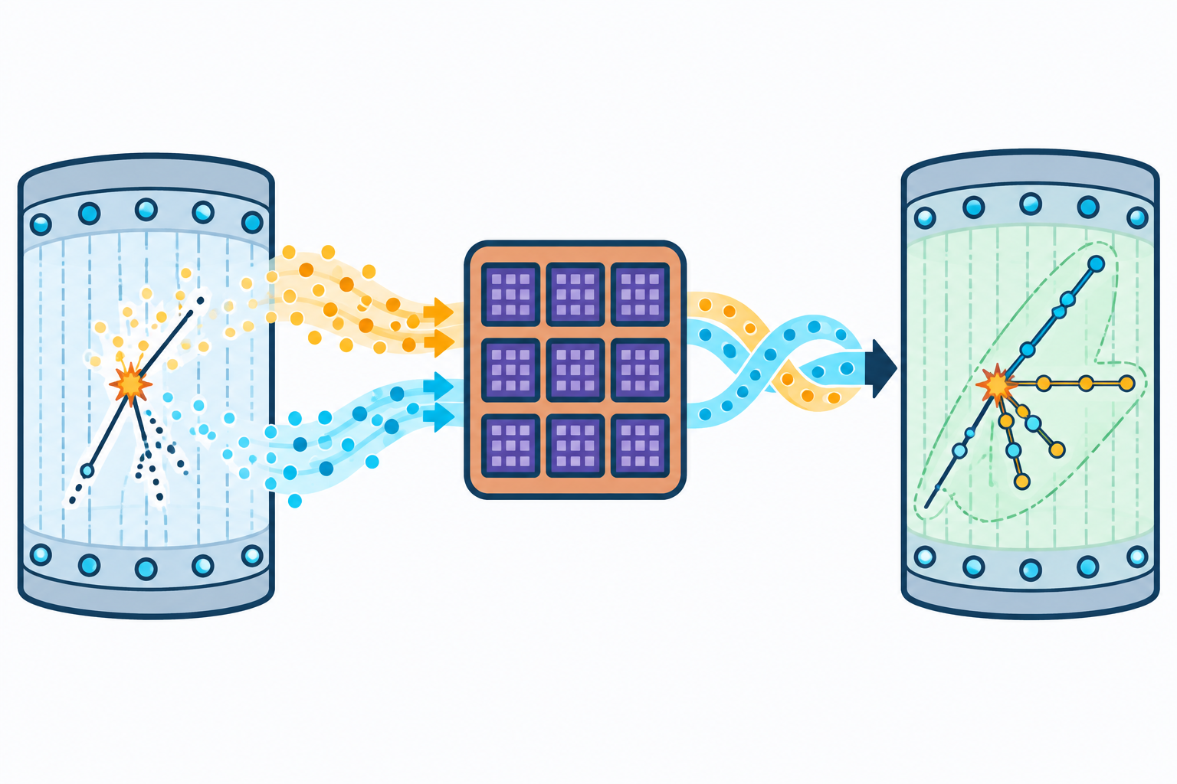
DOE PROPOSAL FIGURE 1
Turn a dense proposal into a reviewable visual hypothesis
How the beta.5 plugin works, why to use it before professional design, and where it fits in the proposal process
SOURCE-GROUNDED | LABEL-FREE | ONE DRAFT
Unedited beta.5 qualification output | collaboration draft, not final art
SEPTEMBER 2026
Notes:
Open by framing the plugin as a collaboration step. The displayed image is an unedited beta.5 output and still requires science and design review.
[Sources]
- Team App Library resource page, accessed 2026-09-11: https://adammalin.github.io/Team-App-Library/resources/ercp-proposal-figures/
- ERCP beta.5 qualification report: /Users/ia2/Documents/ERCP Proposal & Roadmap Figure GPT/agent-plugin/qualification/2026-09-10-beta4-beta5-ab-consistency/QUALIFICATION-REPORT.md
- Displayed image: /Users/ia2/Documents/Coding Projects/team-app-library/public/assets/screenshots/ercp-proposal-figures-1.2.0-beta.5-preview.png
[/Sources]

Slide 2
WHY USE IT
DRAFT FOR REVIEW
A visual hypothesis keeps the team and designer from solving different problems.
The plugin makes the first design conversation concrete without pretending the draft is finished.
Jumping straight from prose
Arriving with a reviewed concept
1 The visual claim is still implicit
2 Science emphasis must be discovered during design
3 Early feedback stays abstract and hard to compare
1 The source-backed funding story is visible
2 Scientists can correct the mechanism and payoff first
3 The designer starts from an agreed visual thesis
Result: design time can focus on final communication decisions instead of first-pass story discovery.
Notes:
The value claim is qualitative: the tool creates a concrete hypothesis for review. It does not claim measured time or cost savings.
[Sources]
- Team App Library review and handoff guidance: https://adammalin.github.io/Team-App-Library/resources/ercp-proposal-figures/
- ERCP beta.5 skill product boundary and workflow: /Users/ia2/Documents/ERCP Proposal & Roadmap Figure GPT/agent-plugin/version-history/ercp-proposal-figures/1.2.0-beta.5/plugin-source/skills/create-ercp-proposal-figures/SKILL.md
[/Sources]

Slide 3
GETTING STARTED
DRAFT FOR REVIEW
Plugin installation and first use
The directory is the recommended route. The verified ZIP remains available when directory access is blocked.
01
02
03
Open the listing
Select + Install
Begin a new task
Use the direct ChatGPT Plugins link shown below.
Confirm DOE Proposal Figure 1 and version 1.2.0-beta.5, then install it.
Attach the proposal. Type @ if needed, then paste the Figure 1 use prompt.
RECOMMENDED PLUGIN LINK
https://chatgpt.com/plugins/Plugin_a3d052654ad88191873ab54059f268a4?open_in_app
Manual fallback: use the checked ZIP and SHA-256 installation prompt in the Team Apps guide.
Notes:
The directory route reduces setup friction. Keep the verified package available for users whose account, workspace, or network cannot use the directory listing.
[Sources]
- DOE Proposal Figure 1 plugin listing: https://chatgpt.com/plugins/Plugin_a3d052654ad88191873ab54059f268a4?open_in_app
- Official OpenAI plugin installation and invocation guidance: https://learn.chatgpt.com/docs/plugins
- Verified manual fallback and Figure 1 use prompt: https://adammalin.github.io/Team-App-Library/resources/ercp-proposal-figures/
[/Sources]

Slide 4
HOW IT WORKS
DRAFT FOR REVIEW
The plugin freezes the funding logic before it asks the image model to draw.
Every stage keeps the proposal as the authority and leaves a local evidence trail.
01
02
03
04
05
Read the proposal
Lock the science
Plan the visual
Generate and inspect
Return one draft
Open the source itself and verify exact supporting passages.
Freeze the before state, action, changed after state, payoff, and topology.
Choose three to five proposal-specific forms and two credible candidate structures.
Create two label-free PNGs, inspect the actual rasters, and allow at most one focused repair.
Deliver the strongest collaboration PNG with color-role and remaining-review notes.
The model sees a bounded visual brief, not an unstructured copy of the whole proposal.
Notes:
Walk left to right. The critical control is that the funding logic is frozen and verified before image generation.
[Sources]
- ERCP beta.5 skill workflow, sections 3-12: /Users/ia2/Documents/ERCP Proposal & Roadmap Figure GPT/agent-plugin/version-history/ercp-proposal-figures/1.2.0-beta.5/plugin-source/skills/create-ercp-proposal-figures/SKILL.md
- Team App Library workflow summary: https://adammalin.github.io/Team-App-Library/resources/ercp-proposal-figures/
[/Sources]

Slide 5
WHERE IT FITS
DRAFT FOR REVIEW
It fits between scientific story development and professional visual design.
The plugin narrows ambiguity; responsibility stays with the proposal team and designer.
Develop the scientific story
Create a visual hypothesis
Review the concept
Design the final figure
Approve and submit
Substantive narrative, claims, and source support
Source lock, two candidates, one label-free PNG
Correct science, emphasis, topology, and payoff
Redraw, hierarchy, labels, accessibility, and brand
Science, content, classification, accessibility, and brand
PROPOSAL AUTHOR + SCIENTISTS
PLUGIN
PROPOSAL TEAM
GRAPHIC DESIGNER
PROJECT REVIEWS
Plugin boundary
The workflow ends at a collaboration PNG. Professional design and formal approval continue.
Notes:
Emphasize ownership. The plugin owns a controlled concept-generation workflow; it does not own final scientific approval or design production.
[Sources]
- ERCP beta.5 skill product boundary and finalization: /Users/ia2/Documents/ERCP Proposal & Roadmap Figure GPT/agent-plugin/version-history/ercp-proposal-figures/1.2.0-beta.5/plugin-source/skills/create-ercp-proposal-figures/SKILL.md
- Team App Library review and handoff guidance: https://adammalin.github.io/Team-App-Library/resources/ercp-proposal-figures/
[/Sources]

Slide 6
THE HANDOFF
DRAFT FOR REVIEW
The plugin improves the handoff; the designer still owns the final figure.
The plugin brings
The designer owns
• A source-backed visual thesis
• One unedited label-free collaboration PNG
• Color roles, caveats, and an evidence archive
• Final visual hierarchy and composition
• Labels, legend, accessibility, and brand
• Editable redraw, production quality, and placement
Use it to agree on the story before investing in final art. Do not use it to approve the science or bypass design review.
https://adammalin.github.io/Team-App-Library/resources/ercp-proposal-figures/
Notes:
Close on the division of labor: the plugin accelerates alignment, while the designer and proposal review process remain responsible for the final figure.
[Sources]
- Team App Library review, limits, and handoff guidance: https://adammalin.github.io/Team-App-Library/resources/ercp-proposal-figures/
- ERCP beta.5 skill final-delivery boundary: /Users/ia2/Documents/ERCP Proposal & Roadmap Figure GPT/agent-plugin/version-history/ercp-proposal-figures/1.2.0-beta.5/plugin-source/skills/create-ercp-proposal-figures/SKILL.md
[/Sources]

