Slide 1
hunger & thirst for data: A review of food & Beverage establishments in Asheville & Raleigh
19 January 2019

Slide 2


The Incredibles
Steve Allison
Linda Asiabaka
Michelle Bigham
Amy Vargas-Tonsi
Ed Zamorski
Photo by Andrew Wulf on Unsplash

Slide 3


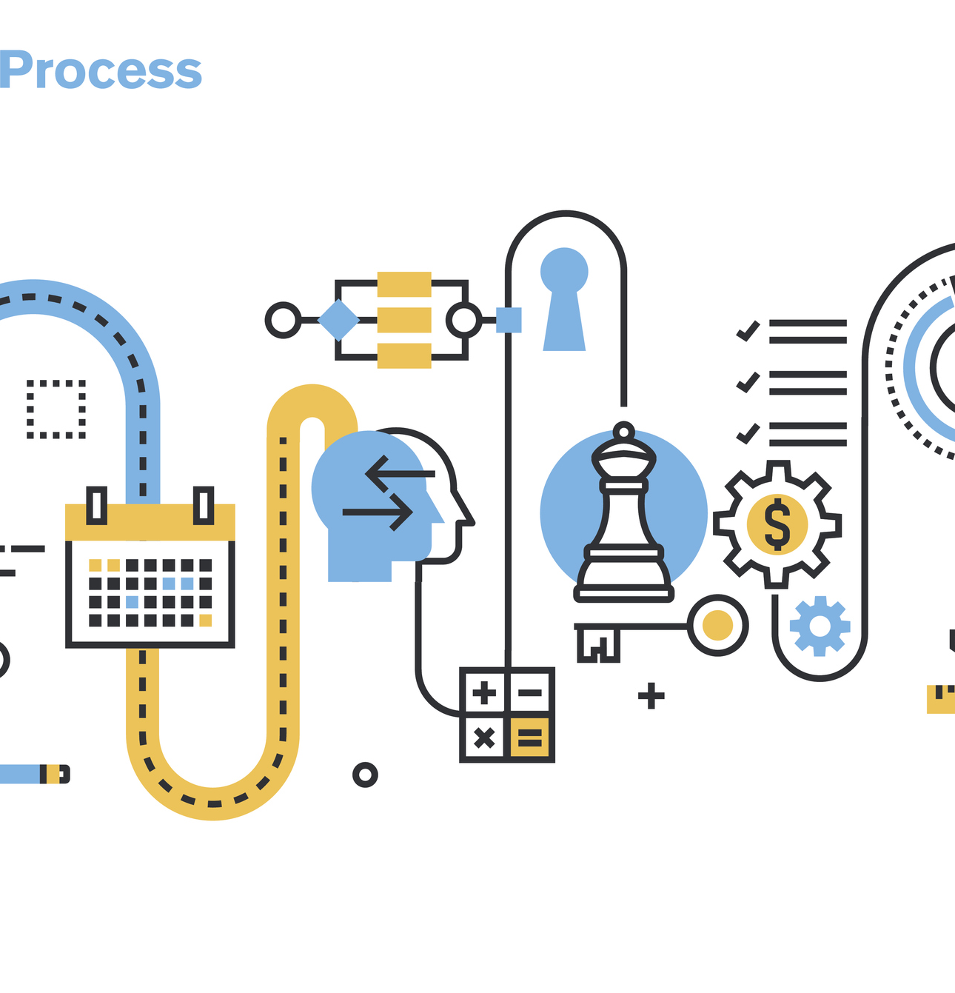
Process & challenges
Notes:
Started out looking at sports scholarship information from CollegeAI API.
Documentation looked good, but when we made our calls, we noticed the JSON responses did not include the variables referenced in the documentation.
We later realized that the JSON section was still under construction.
We pivoted and focused on food and beer by using the Yelp API and the Beer Mapping API
Again, we reviewed the API documentation
A key difference between the two was that Yelp had a record limit (950), while Beer Mapping was constantly pulling in fresh information with each call.
In the case of Yelp, the category tags were broadly and generously applied to different venues, likely so that it increases the chance of a business showing up during a search. The lack of integrity of this datapoint led us to focus, instead on the ratings and review counts. In the case of Beer Mapping, it was unclear how the various categories (“brewpub, brewery, etc.) were defined.
Further investigation is required for deeper analysis of the data.
While we encountered various error types, we relied on our debugging skills to successfully address the errors.
(Debugging errors: Null data; Indentation Error; Syntax Error; Type Error)

Slide 4
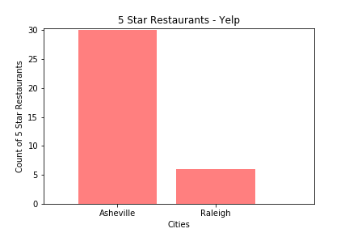

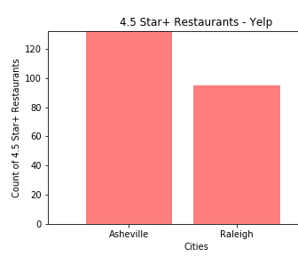
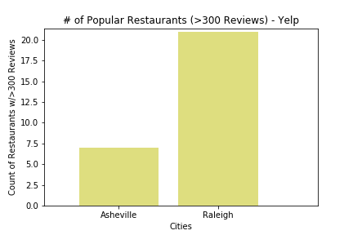
Restaurant ratings and reviews
Restaurants with 5-star ratings by city
Best rated compared to most popular
Raleigh has more restaurants than Asheville but less 5-star rated restaurants
Raleigh restaurants have more reviews, but not as many restaurants that have 5-star ratings

Slide 5
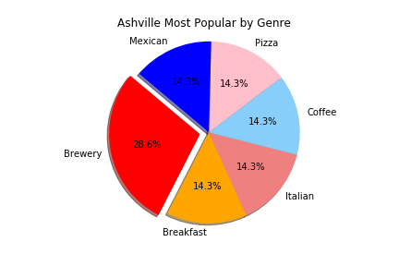
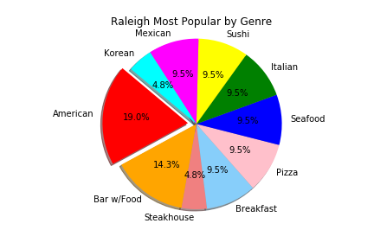
Most popular Restaurants by genre
Asheville Most Popular by Genre
Source: Yelp Fusion API
Notes:
Each city: restaurants with 5-star rating
Best rated (5-star ratings): review counts (most popular)
Raleigh has more restaurants than Asheville but less 5-star ratings;
Anything with 300+ reviews : most popular
Raleigh many popular ratings, but not 5-star ratings
Each city’s most popular restaurants pie chart of food genres
Location map of most popular and top-rated restaurants (Linda)

Slide 6
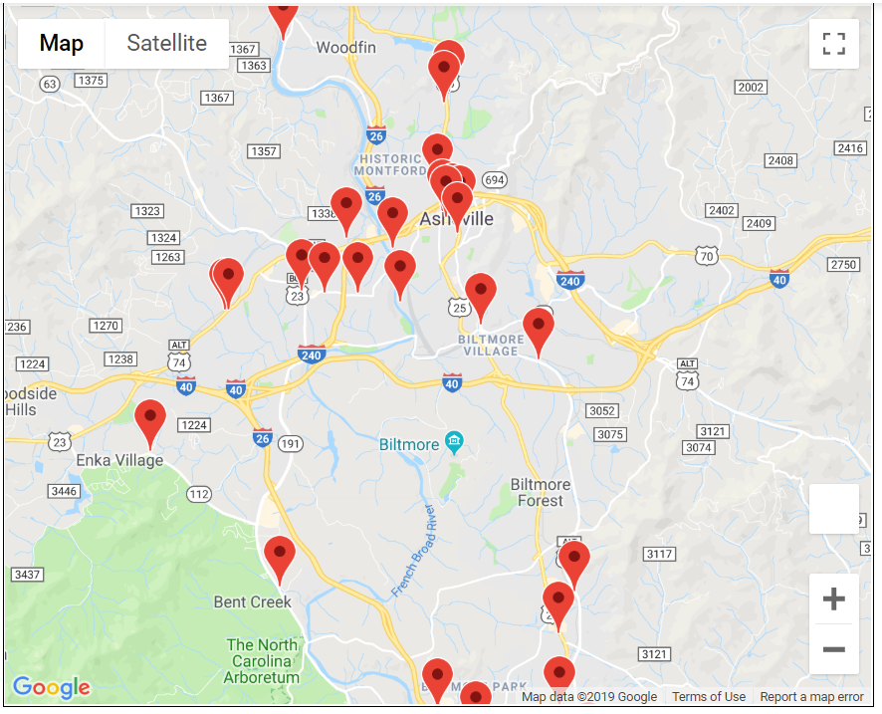
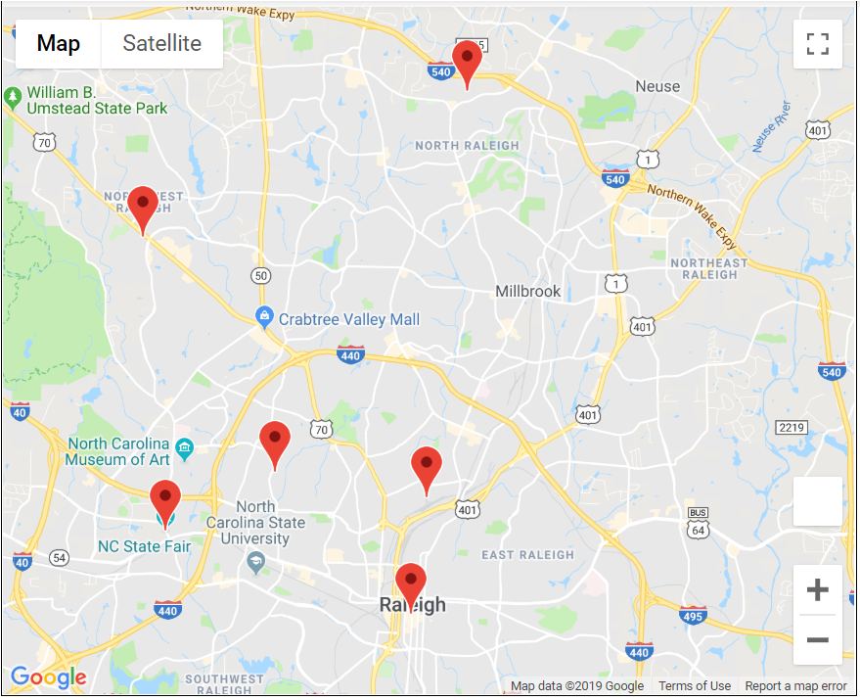
Highly-rated Restaurant density
Asheville
Raleigh
Source: Yelp Fusion API & GMAPS
Notes:
Asheville: greater density of restaurants in closer proximity
Raleigh:

Slide 7
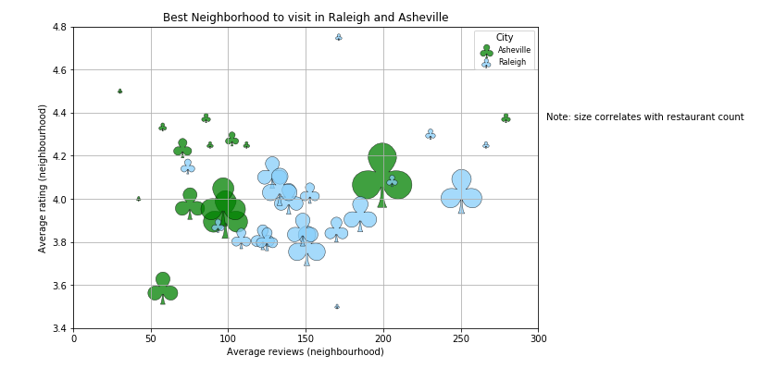
Best neighborhoods to find highly-rated and popular restaurants
Two zip codes – one in each city – have a small number of restaurants and more popular
More of the highly-rated restaurants have a lower average of reviews.
One zip code in Raleigh has restaurants with an average of 250 reviews and is rate
The highest average number of reviewed restaurants in Asheville are concentrated in one code.
Source: Yelp Fusion API
Notes:
Markers: size of the count of the restaurants per zip code
Circle the two upper right

Slide 8
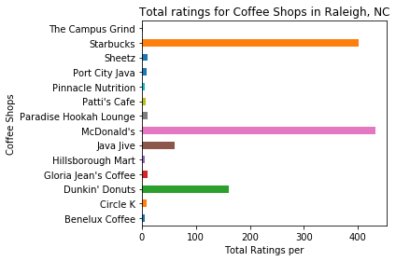
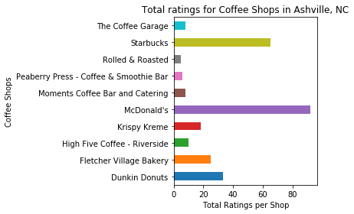
Coffee shop ratings
There are fewer review counts for coffee shops in Asheville than in Raleigh
McDonald’s is the most frequently rated coffee shop in Asheville
Total coffee establishments to population:
43 : 91,902* in Asheville
89 : 464,758* in Raleigh
* 2017 population estimates, U.S. Census Bureau
Source: Yelp Fusion API

Slide 9
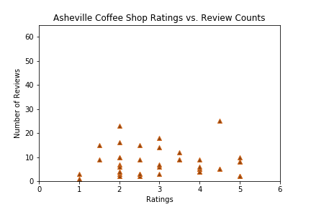
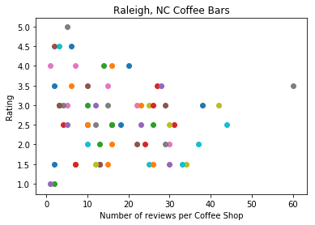
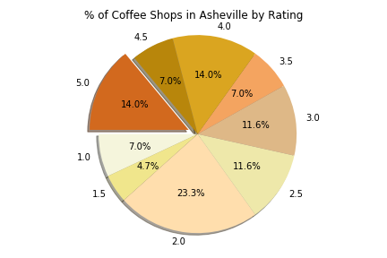
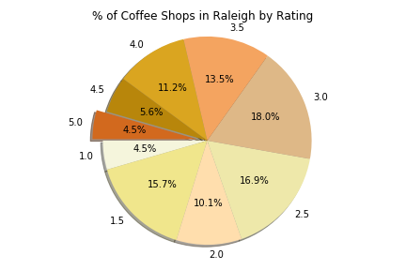
Coffee shop ratings & Reviews
Notes:
35% of coffee shops in Asheville have a 4-star or higher rating compared to 21.3% in Raleigh
35% of coffee shops in Asheville have 2-star or less rating compared to 30.3% in Raleigh

Slide 10
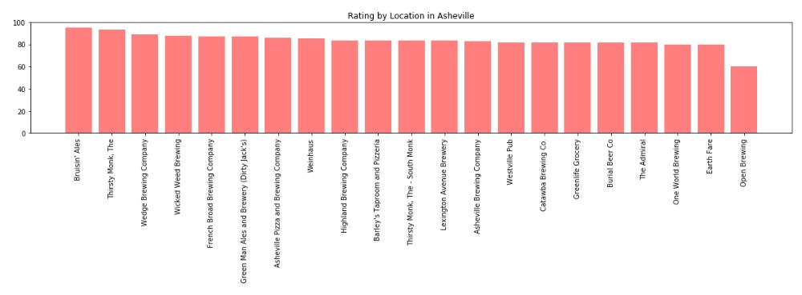
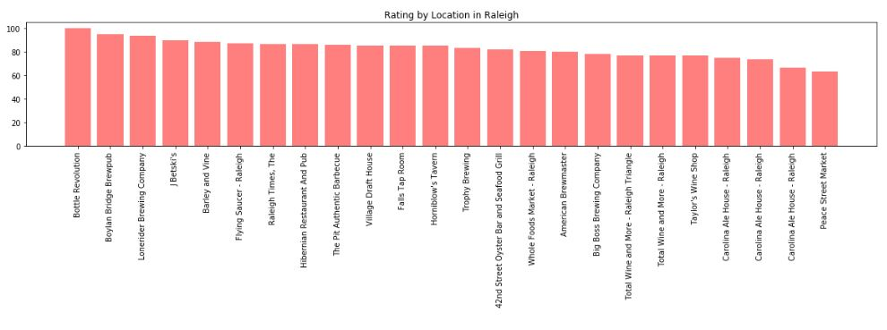
Beer establishments and ratings
Asheville: 40 establishments
Raleigh: 59 establishments
Highest overall rated beer establishments in Asheville: Bruisin’ Ales and Thirsty Monk
Highest overall rated beer establishment in Raleigh: Bottle Revolution and Boylan Bridge Brewpub
Data limitation: unclear how many reviews comprise ratings

Slide 11
QUESTIONS

