Slide 1
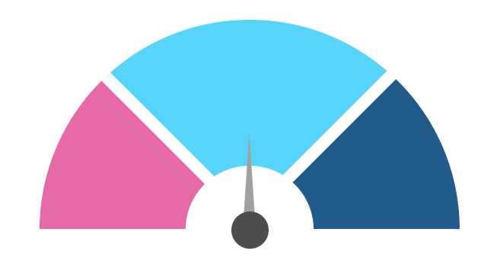




Project report:
Where2Test
Project timeframe:
10.05. – 15.05.2021
Status:
Forecast :
Target at risk
Time delay
On schedule
Description of forecast 1
Description of forecast 2
Description of the forecast 3
Degree of completion (%)
Objective
Results to date
Next steps
Text zu Box bearbeiten
Text zu Box bearbeiten
Text zu Box bearbeiten
| 1

Slide 2



Content slide with schedule for projects
Activity | May |  |  |  | Juni |  |  |  | July |  |  |  | August |  |  |  | September |  |  |  | December |  |  |  | Status/Remarks
 | 1 | 2 | 3 | 4 | 1 | 2 | 3 | 4 | 1 | 2 | 3 | 4 | 1 | 2 | 3 | 4 | 1 | 2 | 3 | 4 | 1 | 2 | 3 | 4
Task 1
Task 2
Task 3
Task 4
Task 5
Task 6
Task 7
Task 8
Total running time

Slide 3





