Slide 1
Simplified

Slide 2
Simplified
31mm
354mm
66mm

Slide 3
Simplified
Use J COM1
SPUR GEAR ARM: Steel
Thickness = 20mm
OD = 61mm
ID = 10mm

Slide 4
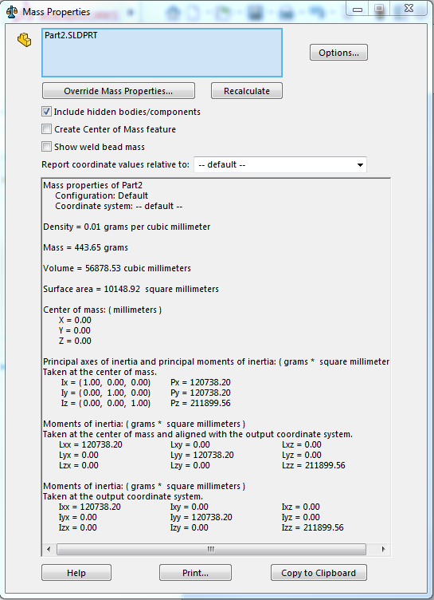
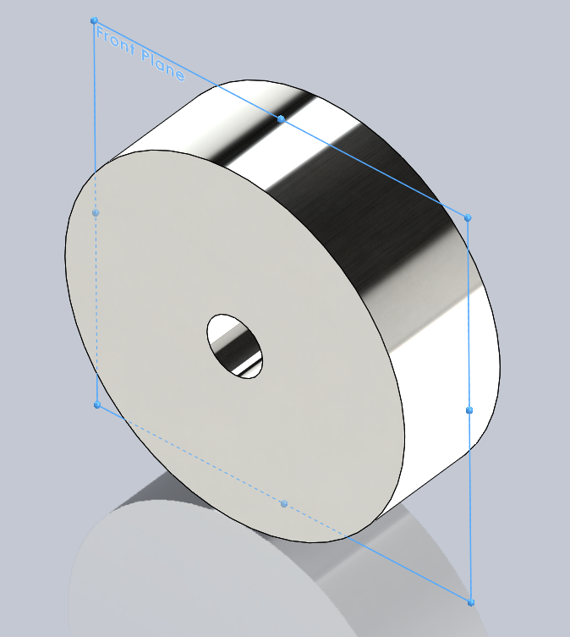

SPUR GEAR ARM: Steel
Mass matrix M_x1

Slide 5
Simplified
Use J COM1
Length = 138.25mm
OD = 15mm
WAIST GEARBOX SHAFT: Steel

Slide 6
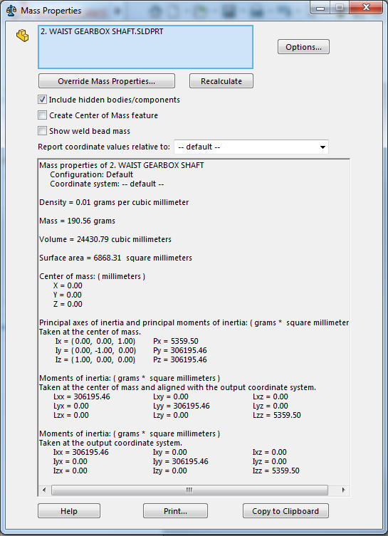
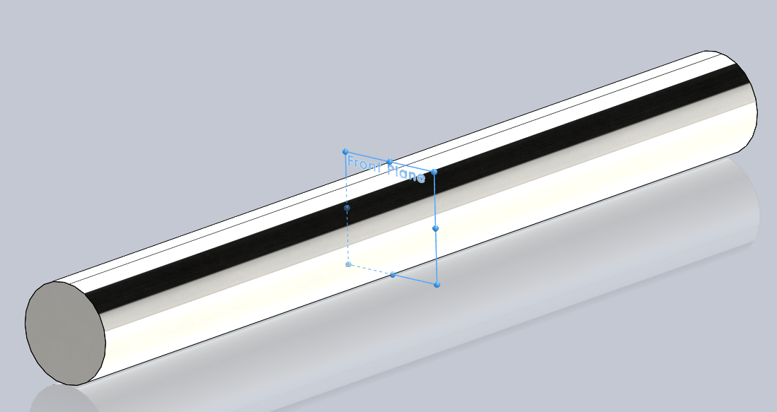

WAIST GEARBOX SHAFT: Steel
Mass matrix M_x2

Slide 7
Simplified
Use J COM1
Thickness = 26mm
Diameter = 63.5mm
L6 Waist End Plate: Aluminium

Slide 8
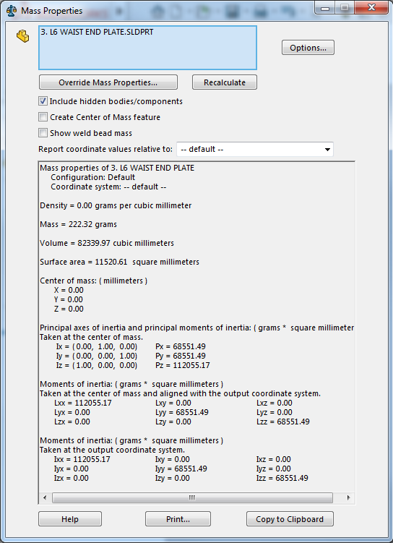
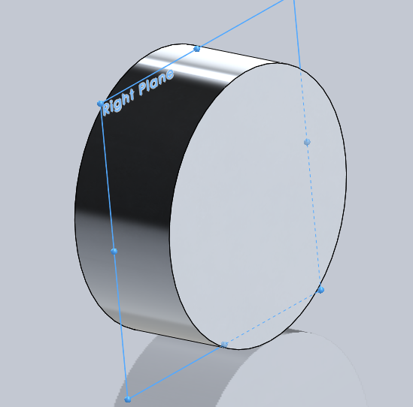

L6 Waist End Plate: Aluminium
Mass matrix M_x3

Slide 9
Simplified
Use J COM2a
Length = 424mm
Diameter = 4mm
LINK RODS: Steel

Slide 10
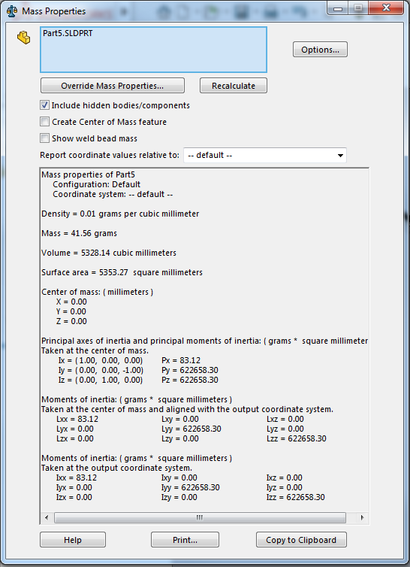
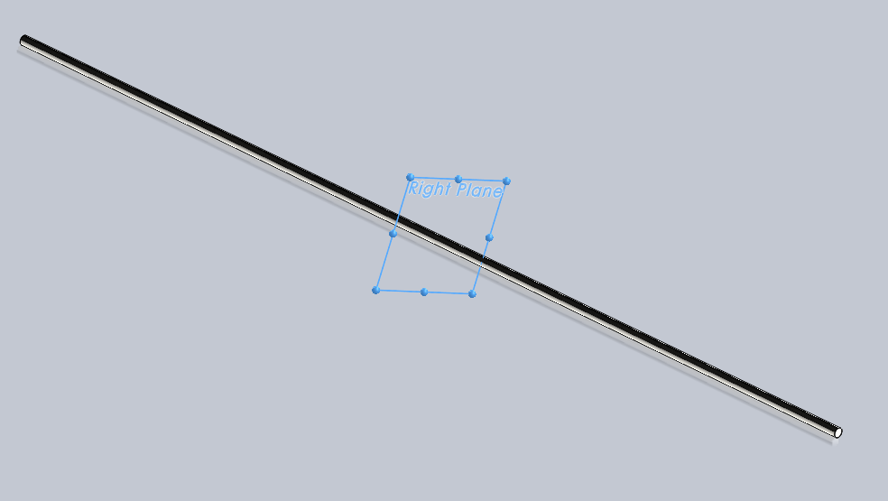

LINK RODS: Steel
Mass matrix M_4

Slide 11
Simplified
Use J COM2b
Length = 447mm
OD = 63.4 mm
ID = 60 mm
L8 Aluminium Tube Cover: Aluminium

Slide 12
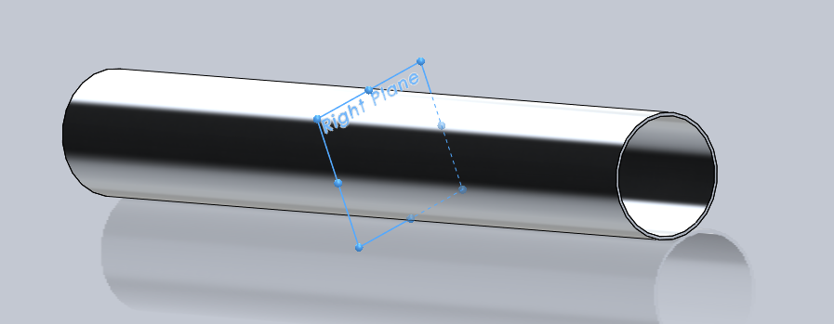
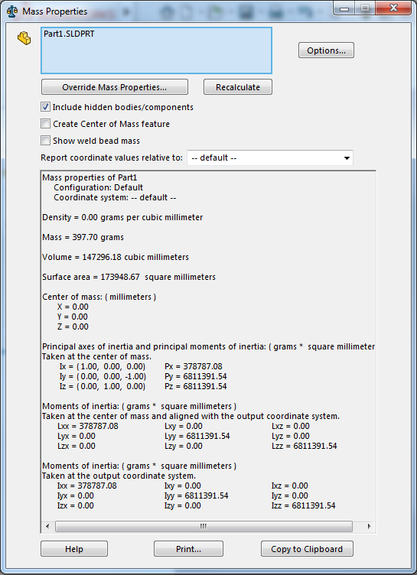

L8 Aluminium Tube Cover: Aluminium
Mass matrix M_x5

Slide 13
Simplified
Use J COM2c
Length: 108 mm
OD = 32mm
MAXON MOTOR

Slide 14
MAXON MOTOR

Slide 15
Simplified
Use J COM-neg1
Use J COM2d
OD = 63.5mm
Thickness = 4mm
L9 Link Cover: Aluminium

Slide 16
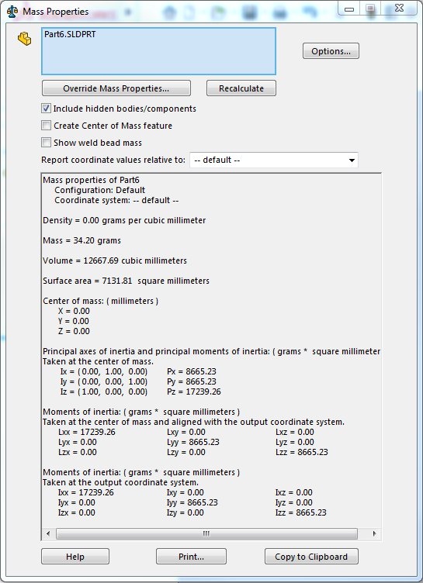

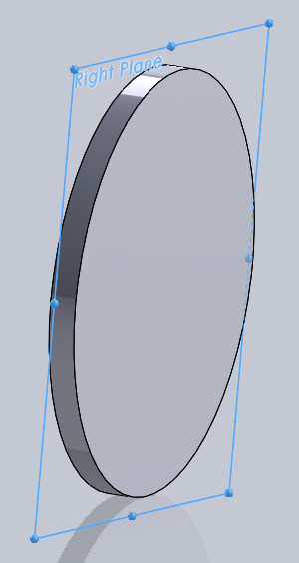
L9 Link Cover: Aluminium

Slide 17
Simplified
Use J COM2f
Use J COM2e
Thickness = 12.81mm
OD = 16.99mm
ID = 7.94mm
STRAIGHT BEVEL GEAR: Steel

Slide 18
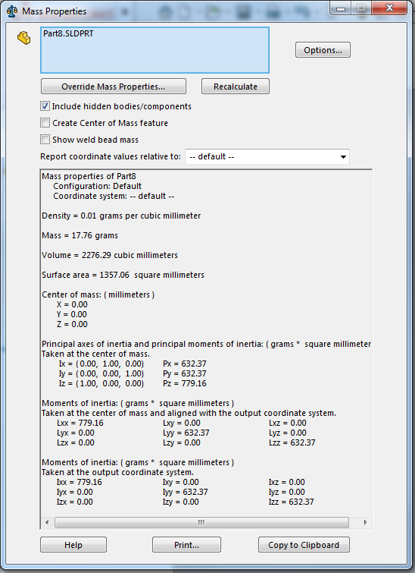
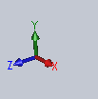
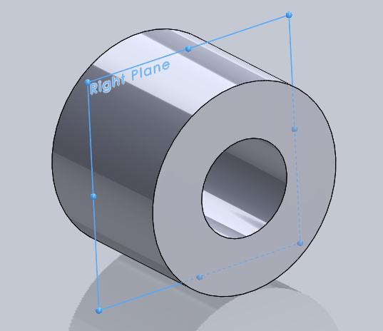
STRAIGHT BEVEL GEAR: Steel

Slide 19
Simplified
Use JCOM 3a
Thickness = 4.76 mm
OD = 28.5 mm
ID = 9.53mm
BEVEL PINION: Steel

Slide 20
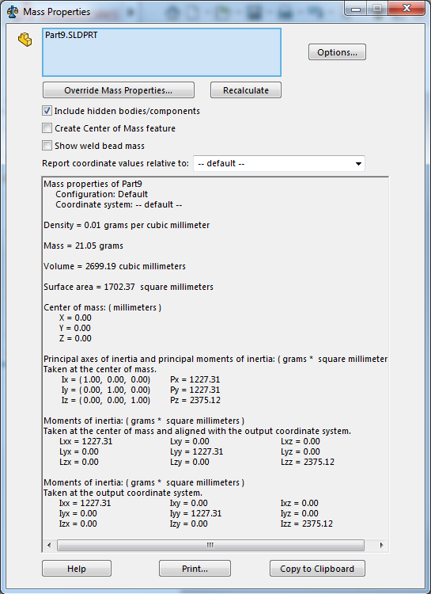
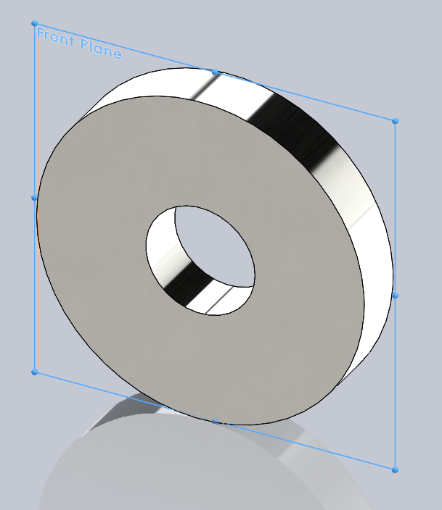

BEVEL PINION: Steel

Slide 21
Simplified
Use JCOM 3a
L = 103mm
D = 11mm
ELBOW GEARBOX SHAFT: Aluminium

Slide 22
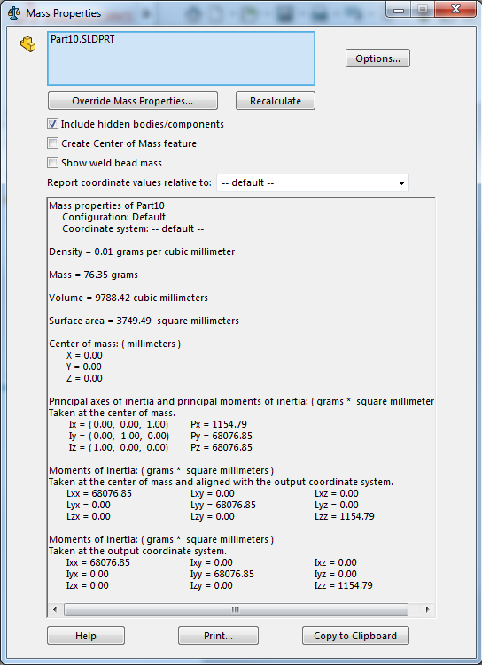
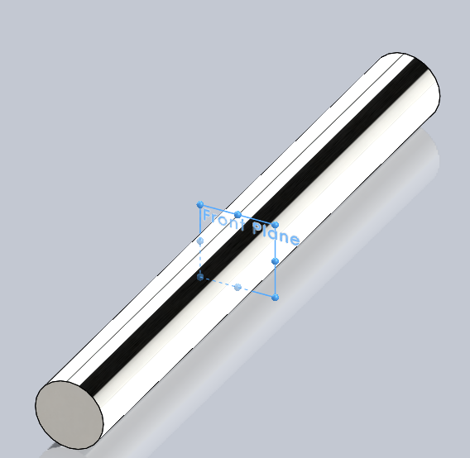

ELBOW GEARBOX SHAFT: Aluminium

Slide 23
Simplified
Use JCOM 3b
16mm
6.01mm
214 mm
OD = 22.2mm
ID = 15.8 mm
Thickness = 6.4 mm
HANDLEBAR: Aluminium

Slide 24
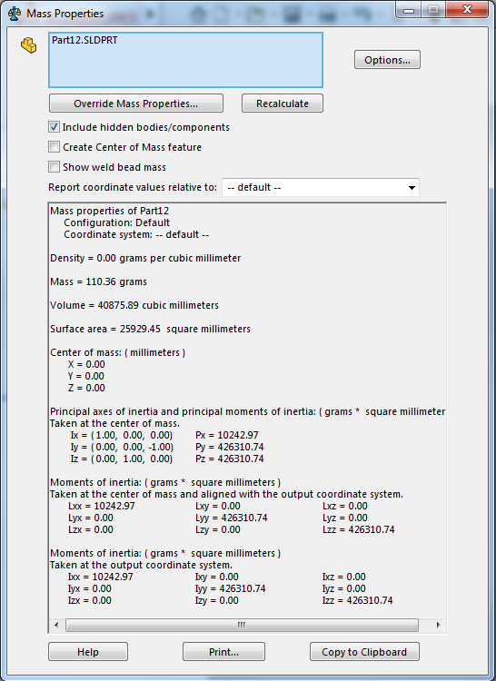
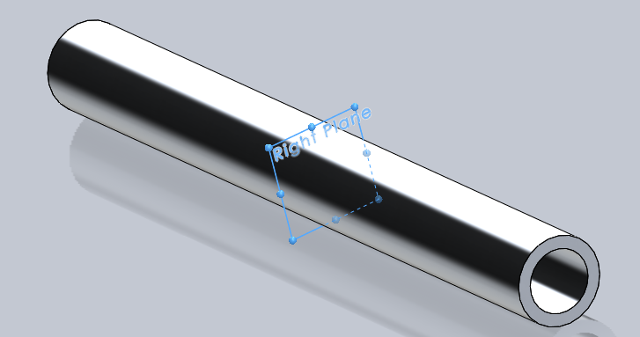

HANDLEBAR: Aluminium

