Slide 1
DirtPros
Alejandro Fernandez
Christian Gonzalez
Alexis Guerra
Adamm Hockman

Slide 2
Project Overview
DirtPros is a company responsible for the collection, sorting, and processing of recycled material
Currently information regarded the collection materials is done using paper forms
The information from these forms is then manually inserted into an Excel spreadsheet
This does not scale very well as the company grows
Our goal is to convert this process to a more modern information gathering procedure

Slide 3
Proposed Solution
Field employees will be provided with an Android application to replace the paper forms used at the work site
The Excel spreadsheet will be replaced with an internal SQL Database.
A web application will be created so that managers and administrators can monitor collection logs that have been submitted by field employees
The web application will also provide administrators with the ability to create data reports for clients

Slide 4
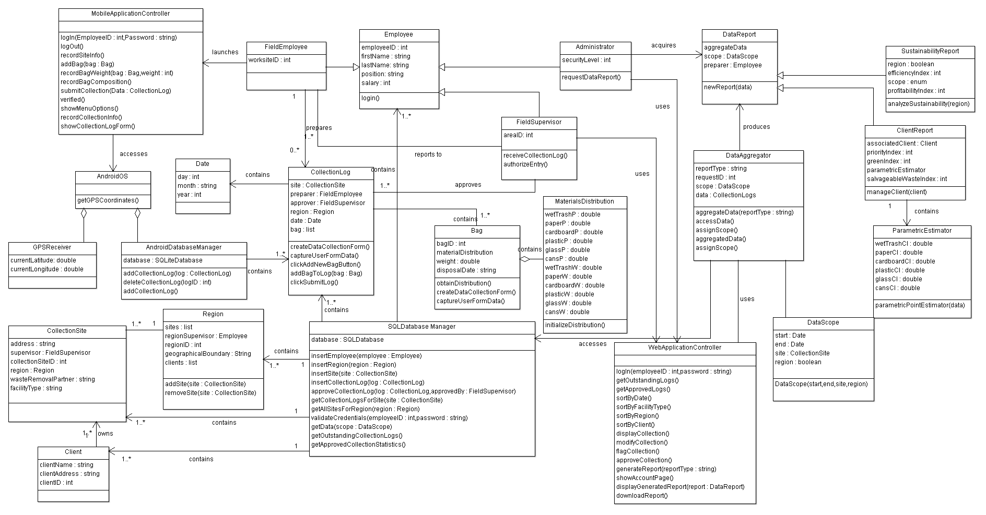
Class Diagram

Slide 5
Key Scenario
Employee arrives at collection location.
Employee launches Android application to insert collection data.
The application launches and prompts the employee for his/her login information.
The employee enters his/her login credentials and waits for the application’s confirmation.
The application evaluates the entered information, checking it with the employee’s stored information in the company database, and provides the employee with a set of options as buttons on the screen (Record Collection Information, Logout).
The employee selects the Record Collection Information option and waits for the application’s response.
The application prompts the user for the region, facility type, and solid waste removal partner associated with the collection location.
The employee enters the required information and waits for the application’s response.
The application records the information and then provides the employee with a set of options as buttons on the screen (Add Bag, Submit Data for Approval).
The employee selects the Add Bag option and waits for the application’s response.
The application prompts the user for the weight of the bag in pounds and provides a button labeled Record Weight.
The employee enters the weight of the bag, presses the Record Weight button, and waits for the application’s response.
The application then asks the employee to enter the composition of the bag (wet trash, paper, cardboard, plastic, glass, cans) in percentages, presenting a number of text fields to enter the information as well as a button labeled Record Bag Composition.
The employee enters the bag composition, presses the Record Bag Composition button, and waits for the application’s response.
The application records the data and returns to the screen presenting the options (Add Bag, Submit Data for Approval).
The employee selects the Submit Data for Approval option and waits for the application’s response.
The application asks the employee to confirm the submission of the data presenting a set of options as buttons (Confirm Submission, Cancel Submission).
The employee selects the Confirm Submission option and waits for the application’s response.
The application uses the device’s GPS capabilities to record the device’s current location together with the time and date of submission. It then attempts to connect to the company database.
The application proceeds to calculate the composition of the bag (wet trash, paper, cardboard, plastic, glass, cans) in pounds and transmit all of the necessary information associated with the collected materials before returning to the screen presenting the set of options (Record Collection Information, Logout), thus ending the transaction.

Slide 6
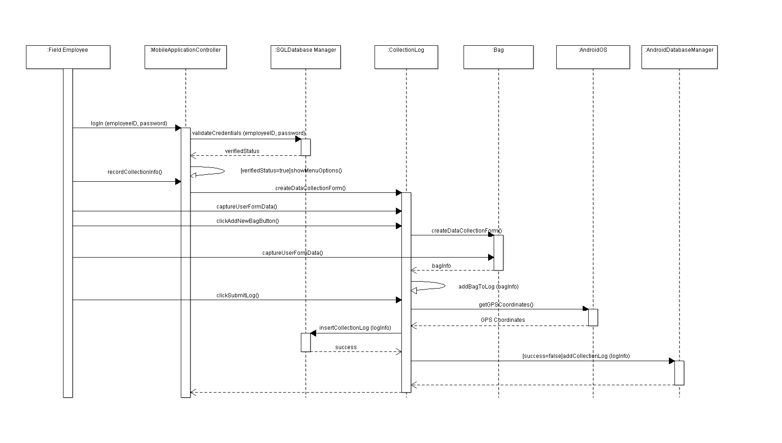
Sequence Diagram

Slide 7
Prototype Demo
Demonstrate prototype Android application
Demonstrate prototype web application

