Slide 1
DirtPros
Alejandro Fernandez
Christian Gonzalez
Alexis Guerra
Adamm Hockman

Slide 2
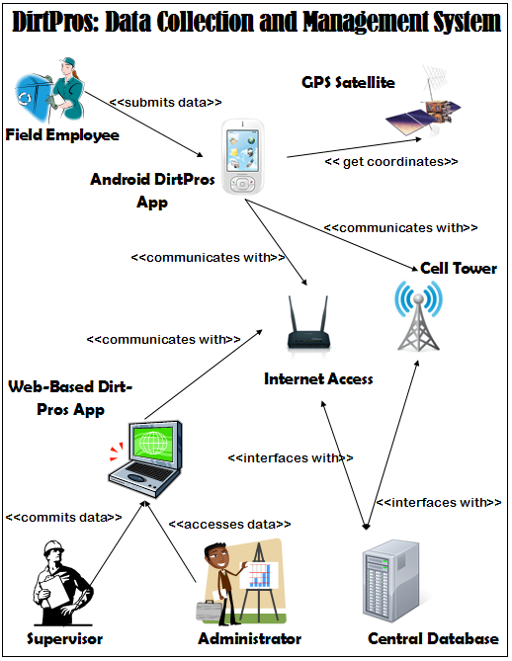
System Diagram

Slide 3
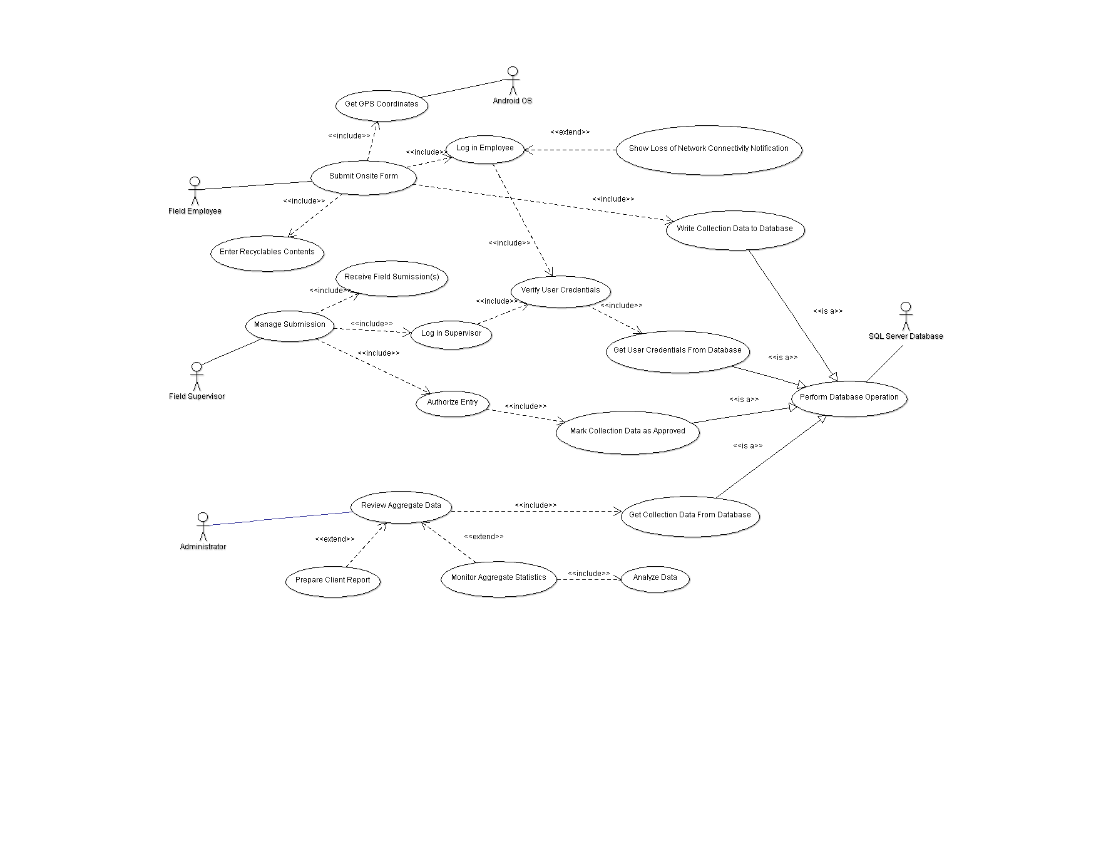
Use Case Diagram

Slide 4
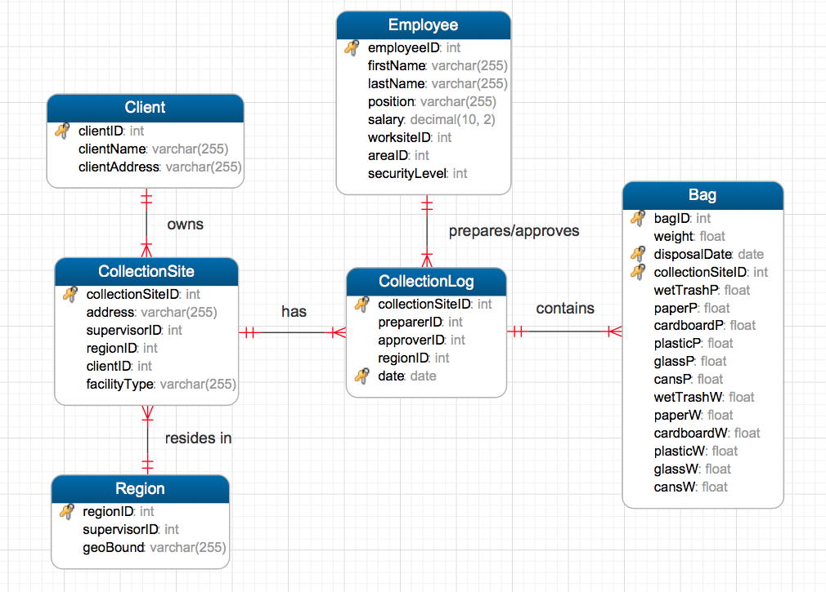
Database Schema

Slide 5
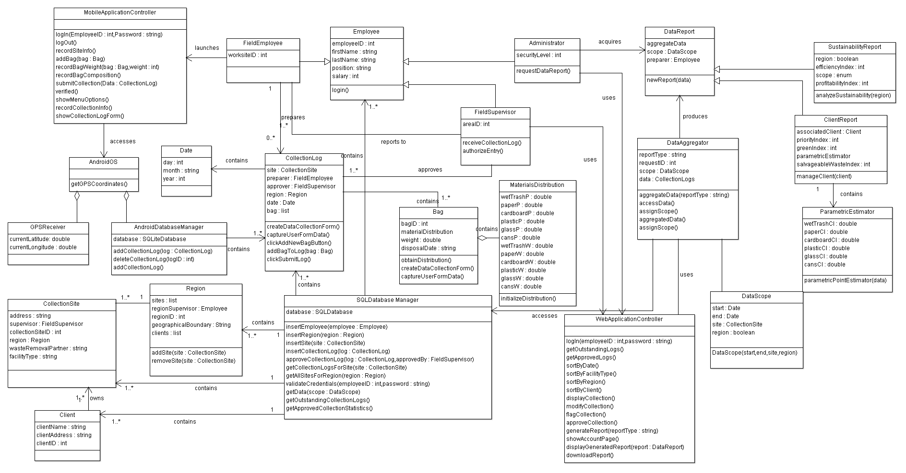
Class Diagram

Slide 6
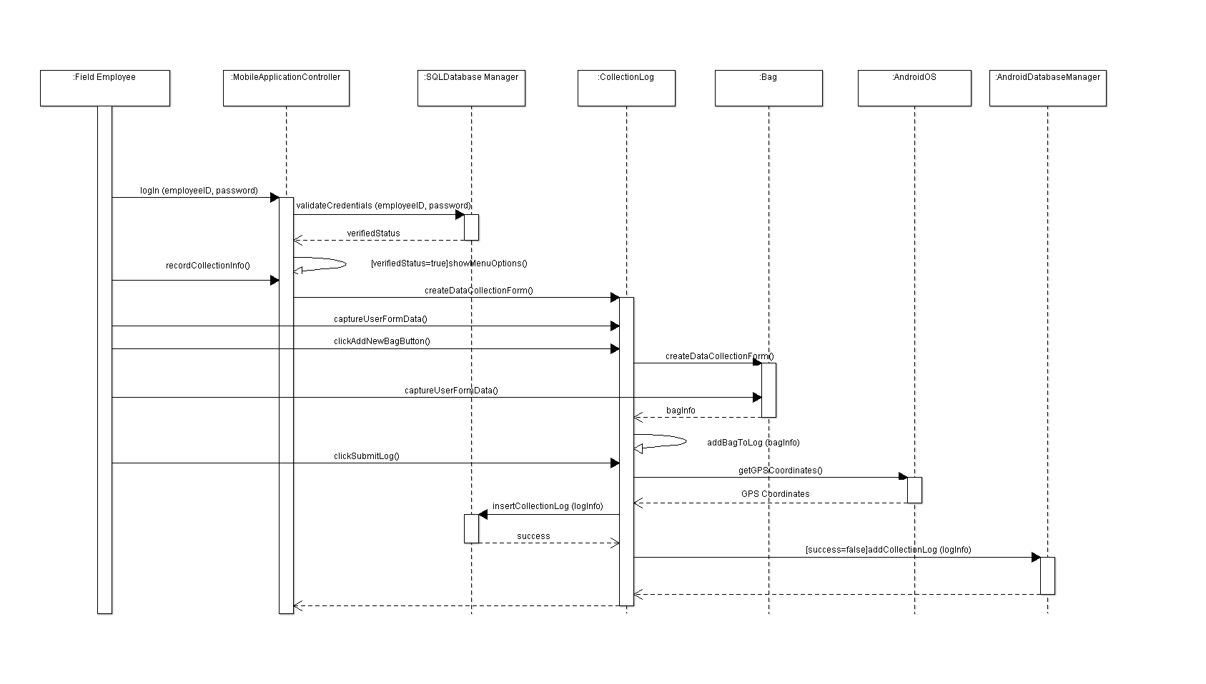
Sequence Diagram: Input Collection Log

Slide 7
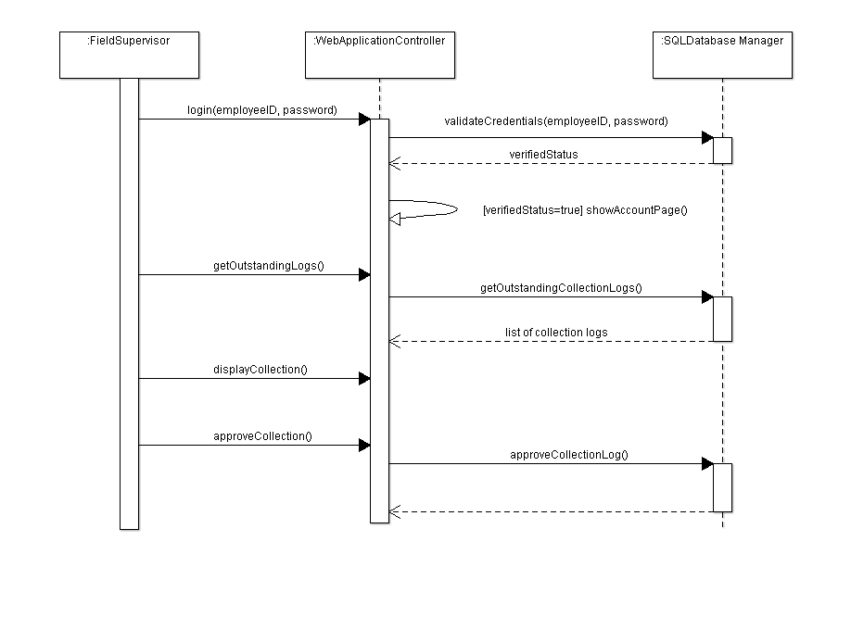
Sequence Diagram: Approve Log

Slide 8
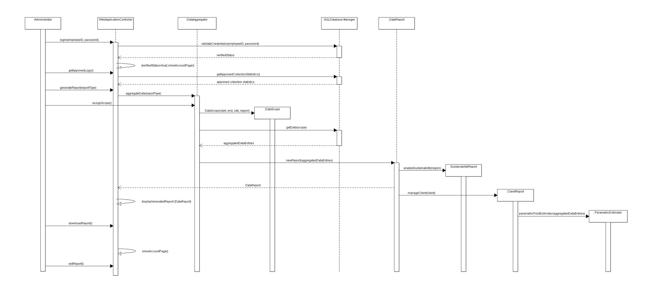
Sequence Diagram: Generate Report

