Slide 1
Stage 1
1
2
3
4
Transition
Probabilities
p = .2
Stage 2
b
r
g
p = .8
p = 1
Reward
$R1
$R2
$R3

Slide 2
Stage 0
1
2
3
4
Stage 1
A
B
C
D

Slide 3
Trial Type
COLOR
vs.
SHAPE
Transition
Probabilities
Stage 1
1
2
3
4
p = .2
p = .8
p = 1
Stage 2
Color Reward
$R1
$R2
$R5
Shape Reward
$R3
$R4
$R6

Slide 5

(A)
(B)
Stage 1
1
2
3
4
Transition
Probabilities
1
2
0s
p = .2
Stage 2
+ <4s
You earn
+3
points.
p = .8
Reward
$Rb
$Rr
$Rg
p = 1
+ <4s
Trial N-1:
Trial N:
1
2
3
4
0s
0s
+ <4s
You earn
+3
points.
+ <4s

Slide 6
(A)
(B)
Stage 0
A
B
C
D
A
B
0s
1
Stage 1
1
2
3
4
+ <4s
+ <4s
You earn
+3
points.
+ <4s

Slide 7
(A)
(B)
Trial Type
COLOR
vs.
SHAPE
SHAPE
Stage 1
1
2
3
4
0s
1
3
+ 2s
Stage 2
+ <4s
You earn
-2
points.
+ <4s
Shape Reward
$Rs
$Rc
$Rt
Color Reward
$Rb
$Rr
$Rg

Slide 8
(A)
Trial N-1:
Trial N:
SHAPE
SHAPE
0s
1
3
0s
2
3
+ 2s
+ 2s
+ <4s
You earn
-2
points.
+ <4s
(B)
Trial N-1:
Trial N:
SHAPE
COLOR
0s
1
3
0s
2
3
+ 2s
+ 2s
+ <4s
You earn
-2
points.
+ <4s

Slide 9
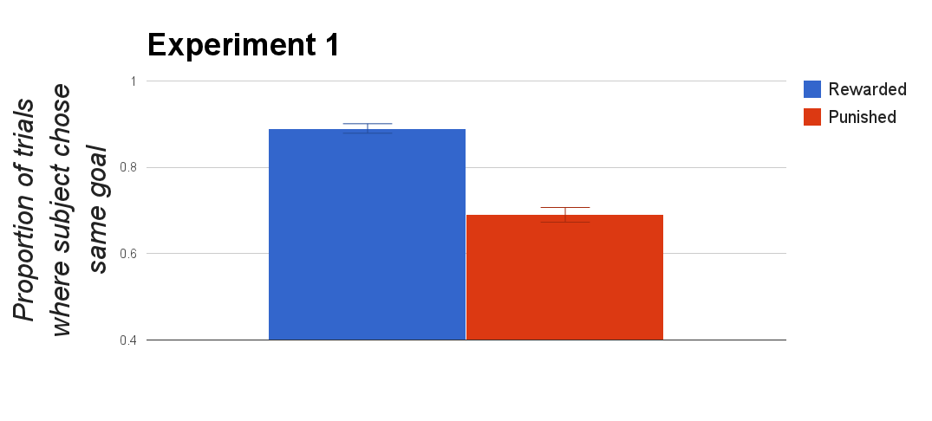
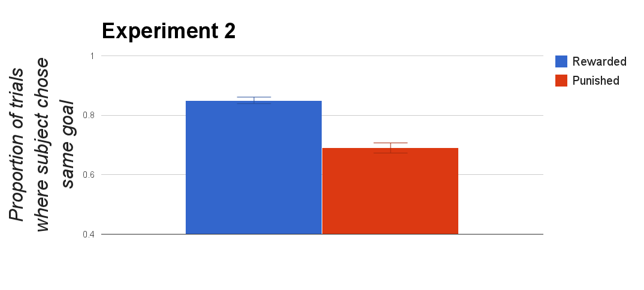
a
b

Slide 10
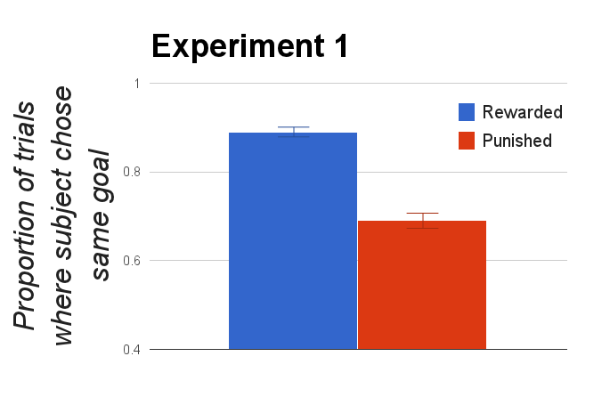
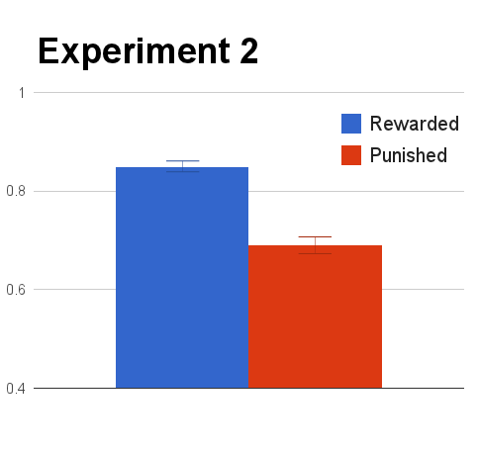

Slide 11
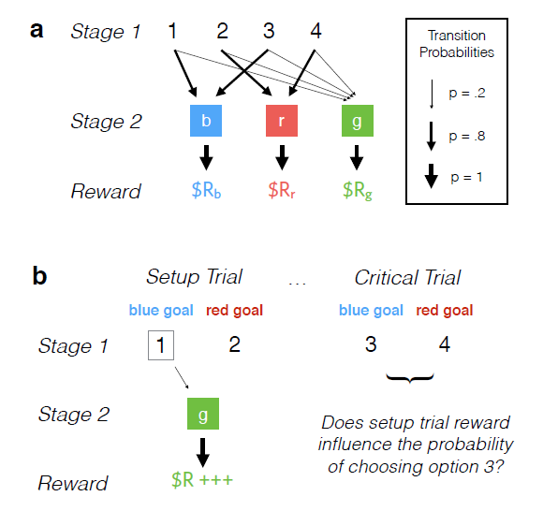

Slide 12
Stage 1
12
4
17
Transition
Probabilities
p = .2
Stage 2
16
21
0
p = .8
p = 1
Reward
$R1
$R2
$R3

Slide 13
Stage 1
1
2
3
4
Transition
Probabilities
p = .2
p = .8
Stage 2
b
r
g
p = 1
Reward
$R1
$R2
$R3
$R4
$R5
$R6

