Slide 1
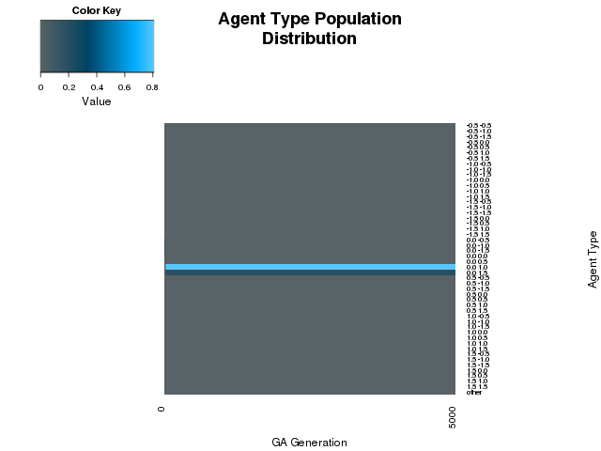
Share-Reciprocate (-1.5 to 1.5)
No stealth or mutation

Slide 2
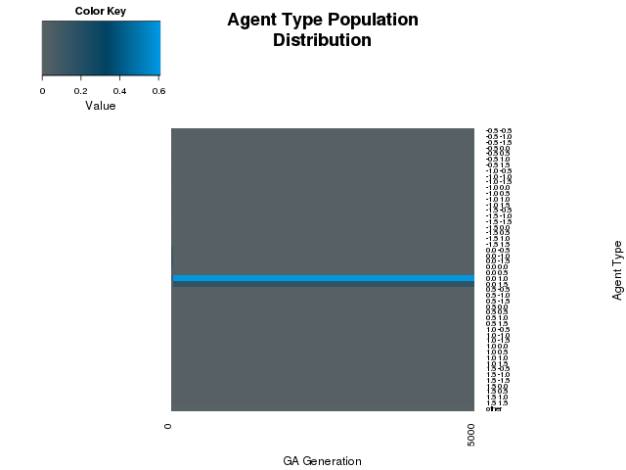
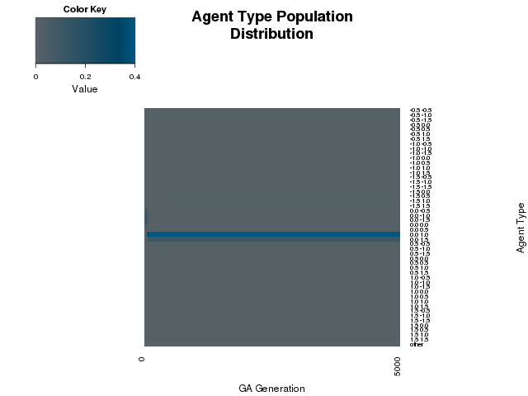
Mutation
.25
.5

Slide 3
Stealth
.25
.5

