Slide 1
AIDE Provenance Badge & Schemas
FAIR Research Consultancy and Management

Slide 2

AIDE Provenance Badge Visual signal of AI Disclosure provenance.

Slide 3
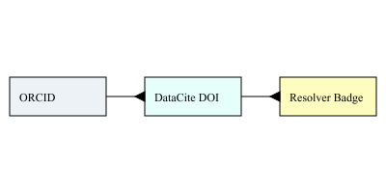
Badge Data Flow (ORCID → DataCite DOI → Resolver → Badge)

